Slide 1
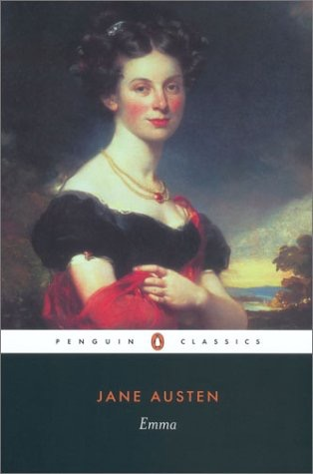
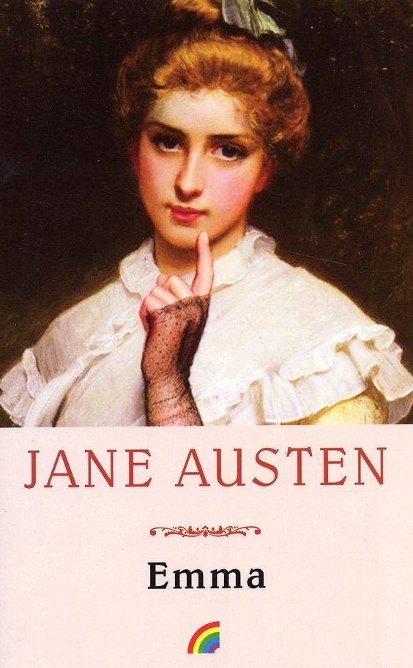
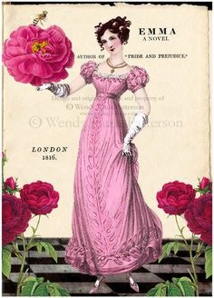
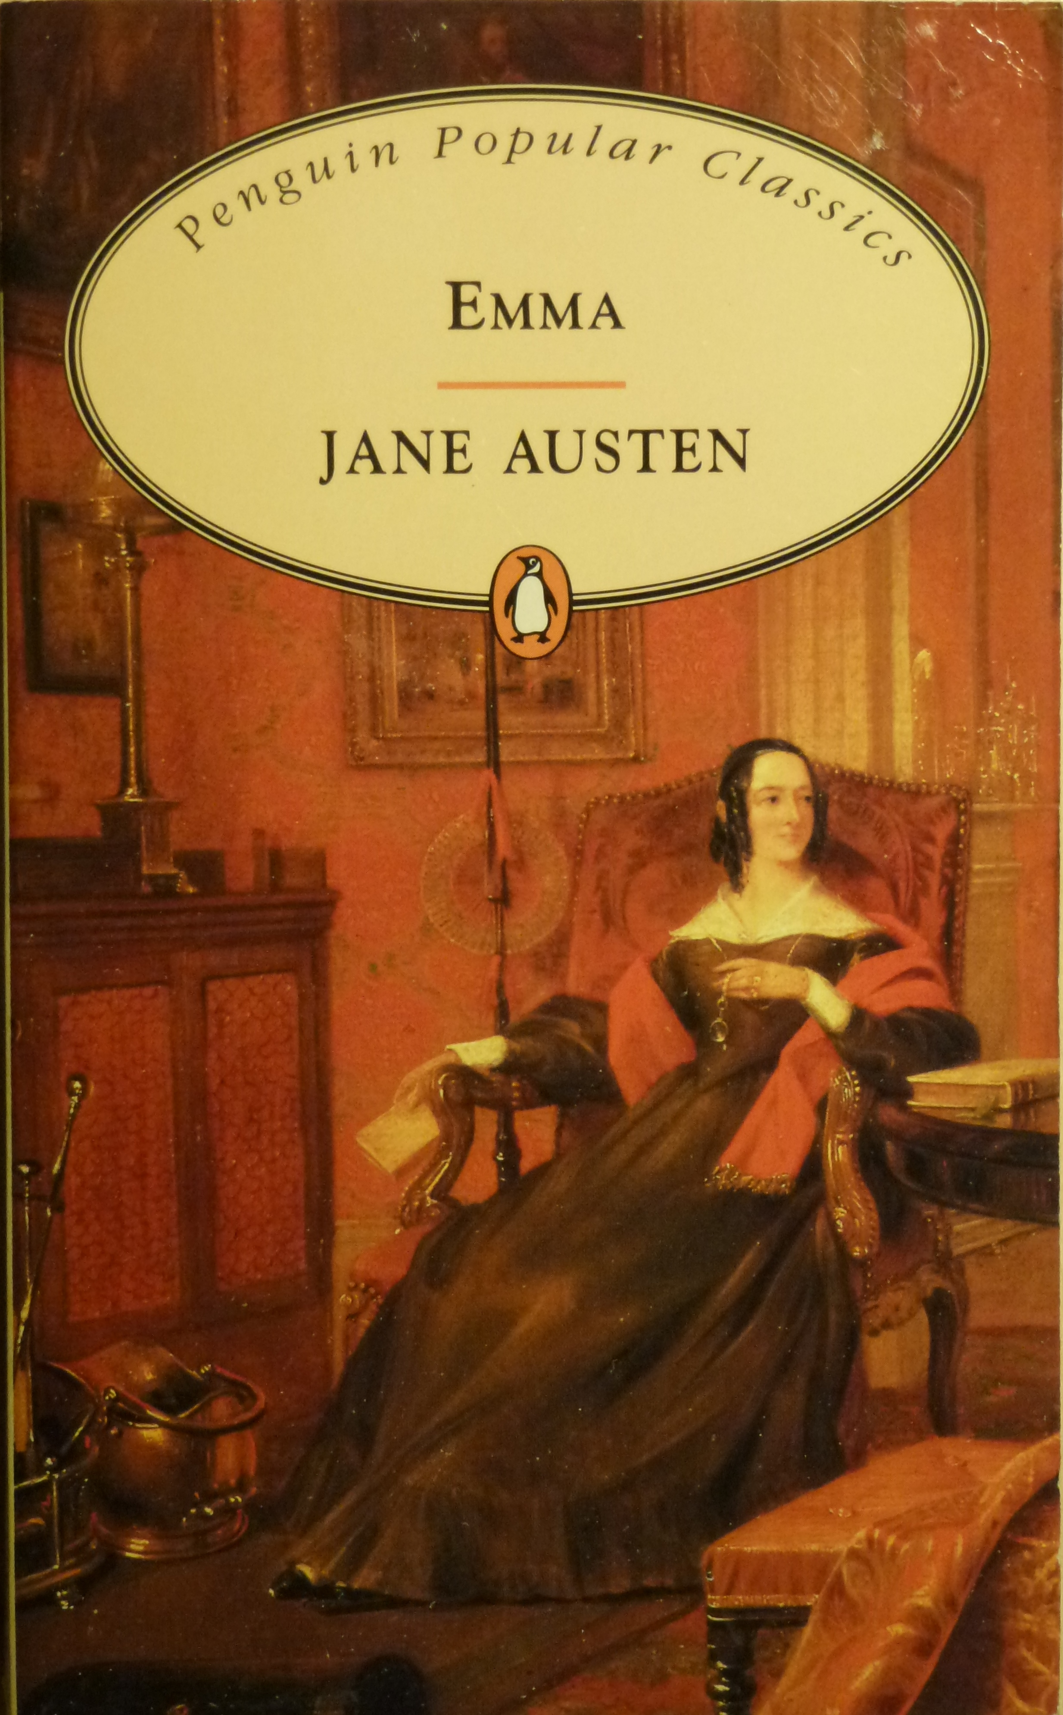
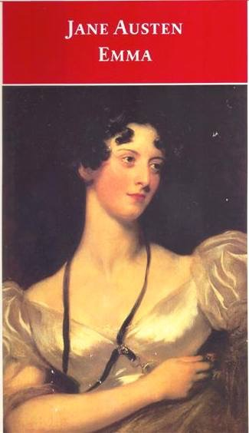
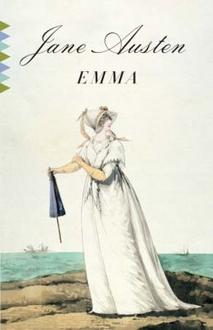
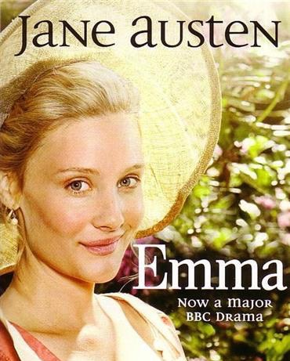
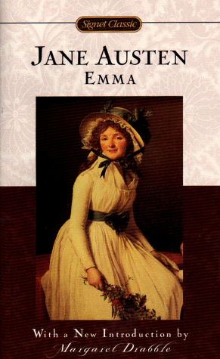
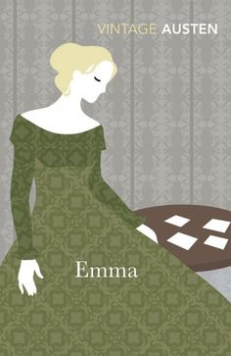
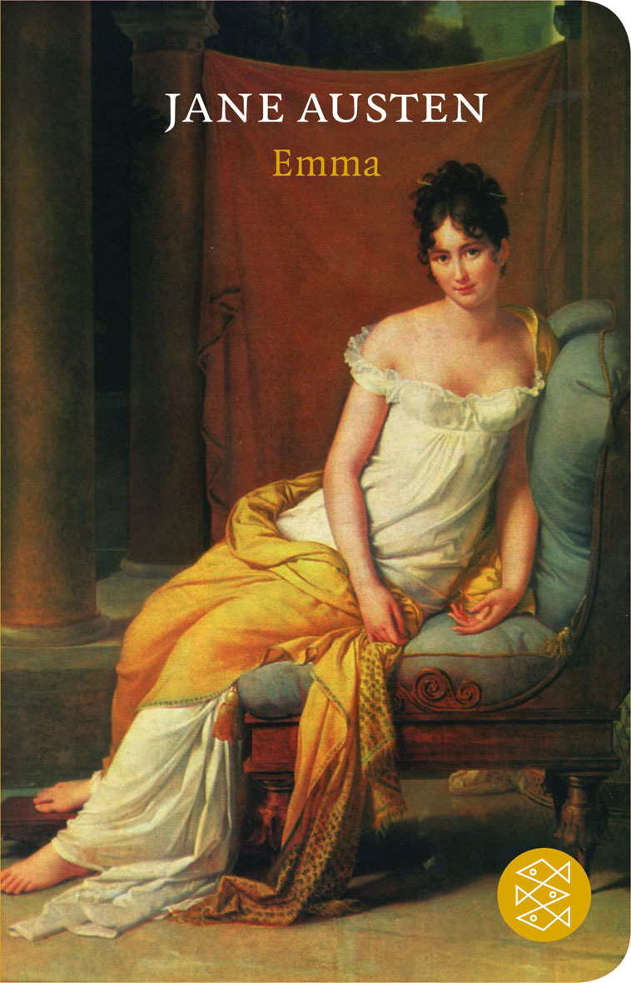

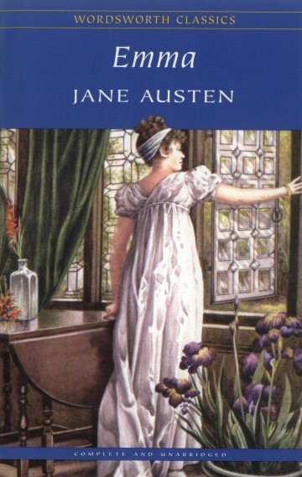
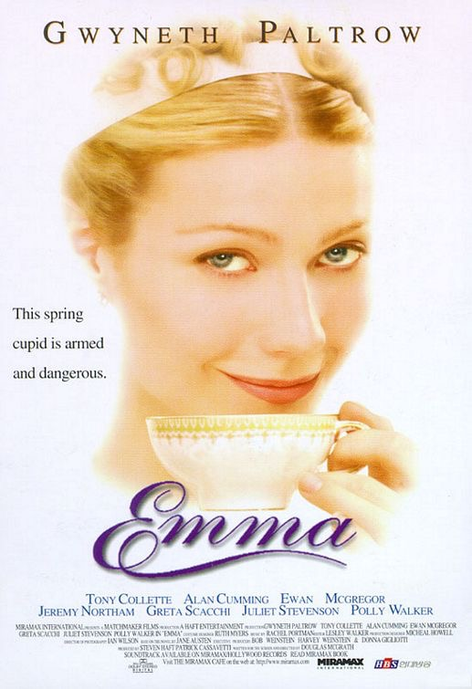

Slide 2
Context
The heroine
The location
Personal development
Blunders
Marriage and the end of the novel
200 years later

Slide 3
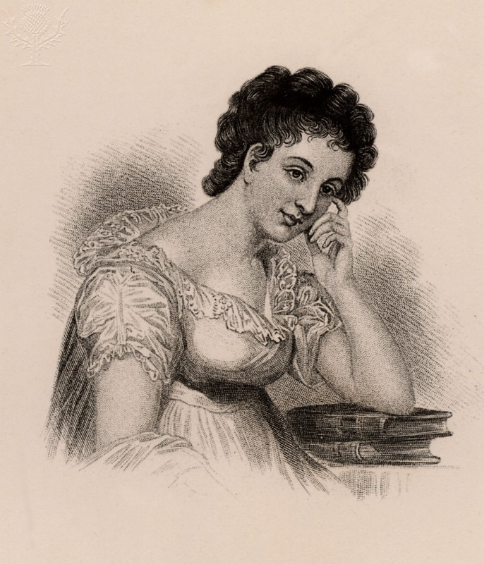
1. Context
“There was no story in it, except that Miss Emma found that the man whom she designed for Harriet’s lover was an admirer of her own - & he was affronted at being refused by Emma & Harriet wore the willow - and smooth, thin-water gruel is according to Emma’s father’s opinion a very good thing…”
Butler, Marilyn. Maria Edgeworth: A literary biography. Oxford: Clarendon Press, 1972. Print.
Maria Edgeworth

Slide 4
1. Context
1799 - French Revolution ends. Napoleon seizes power
1803 - War breaks out between France and England
1811 - Prince George is appointed regent to his father King George III
January 1814 - Jane Austen starts writing Emma
March 1815 - Jane Austen finishes Emma
November 1815 - War between France and England ends

Slide 5
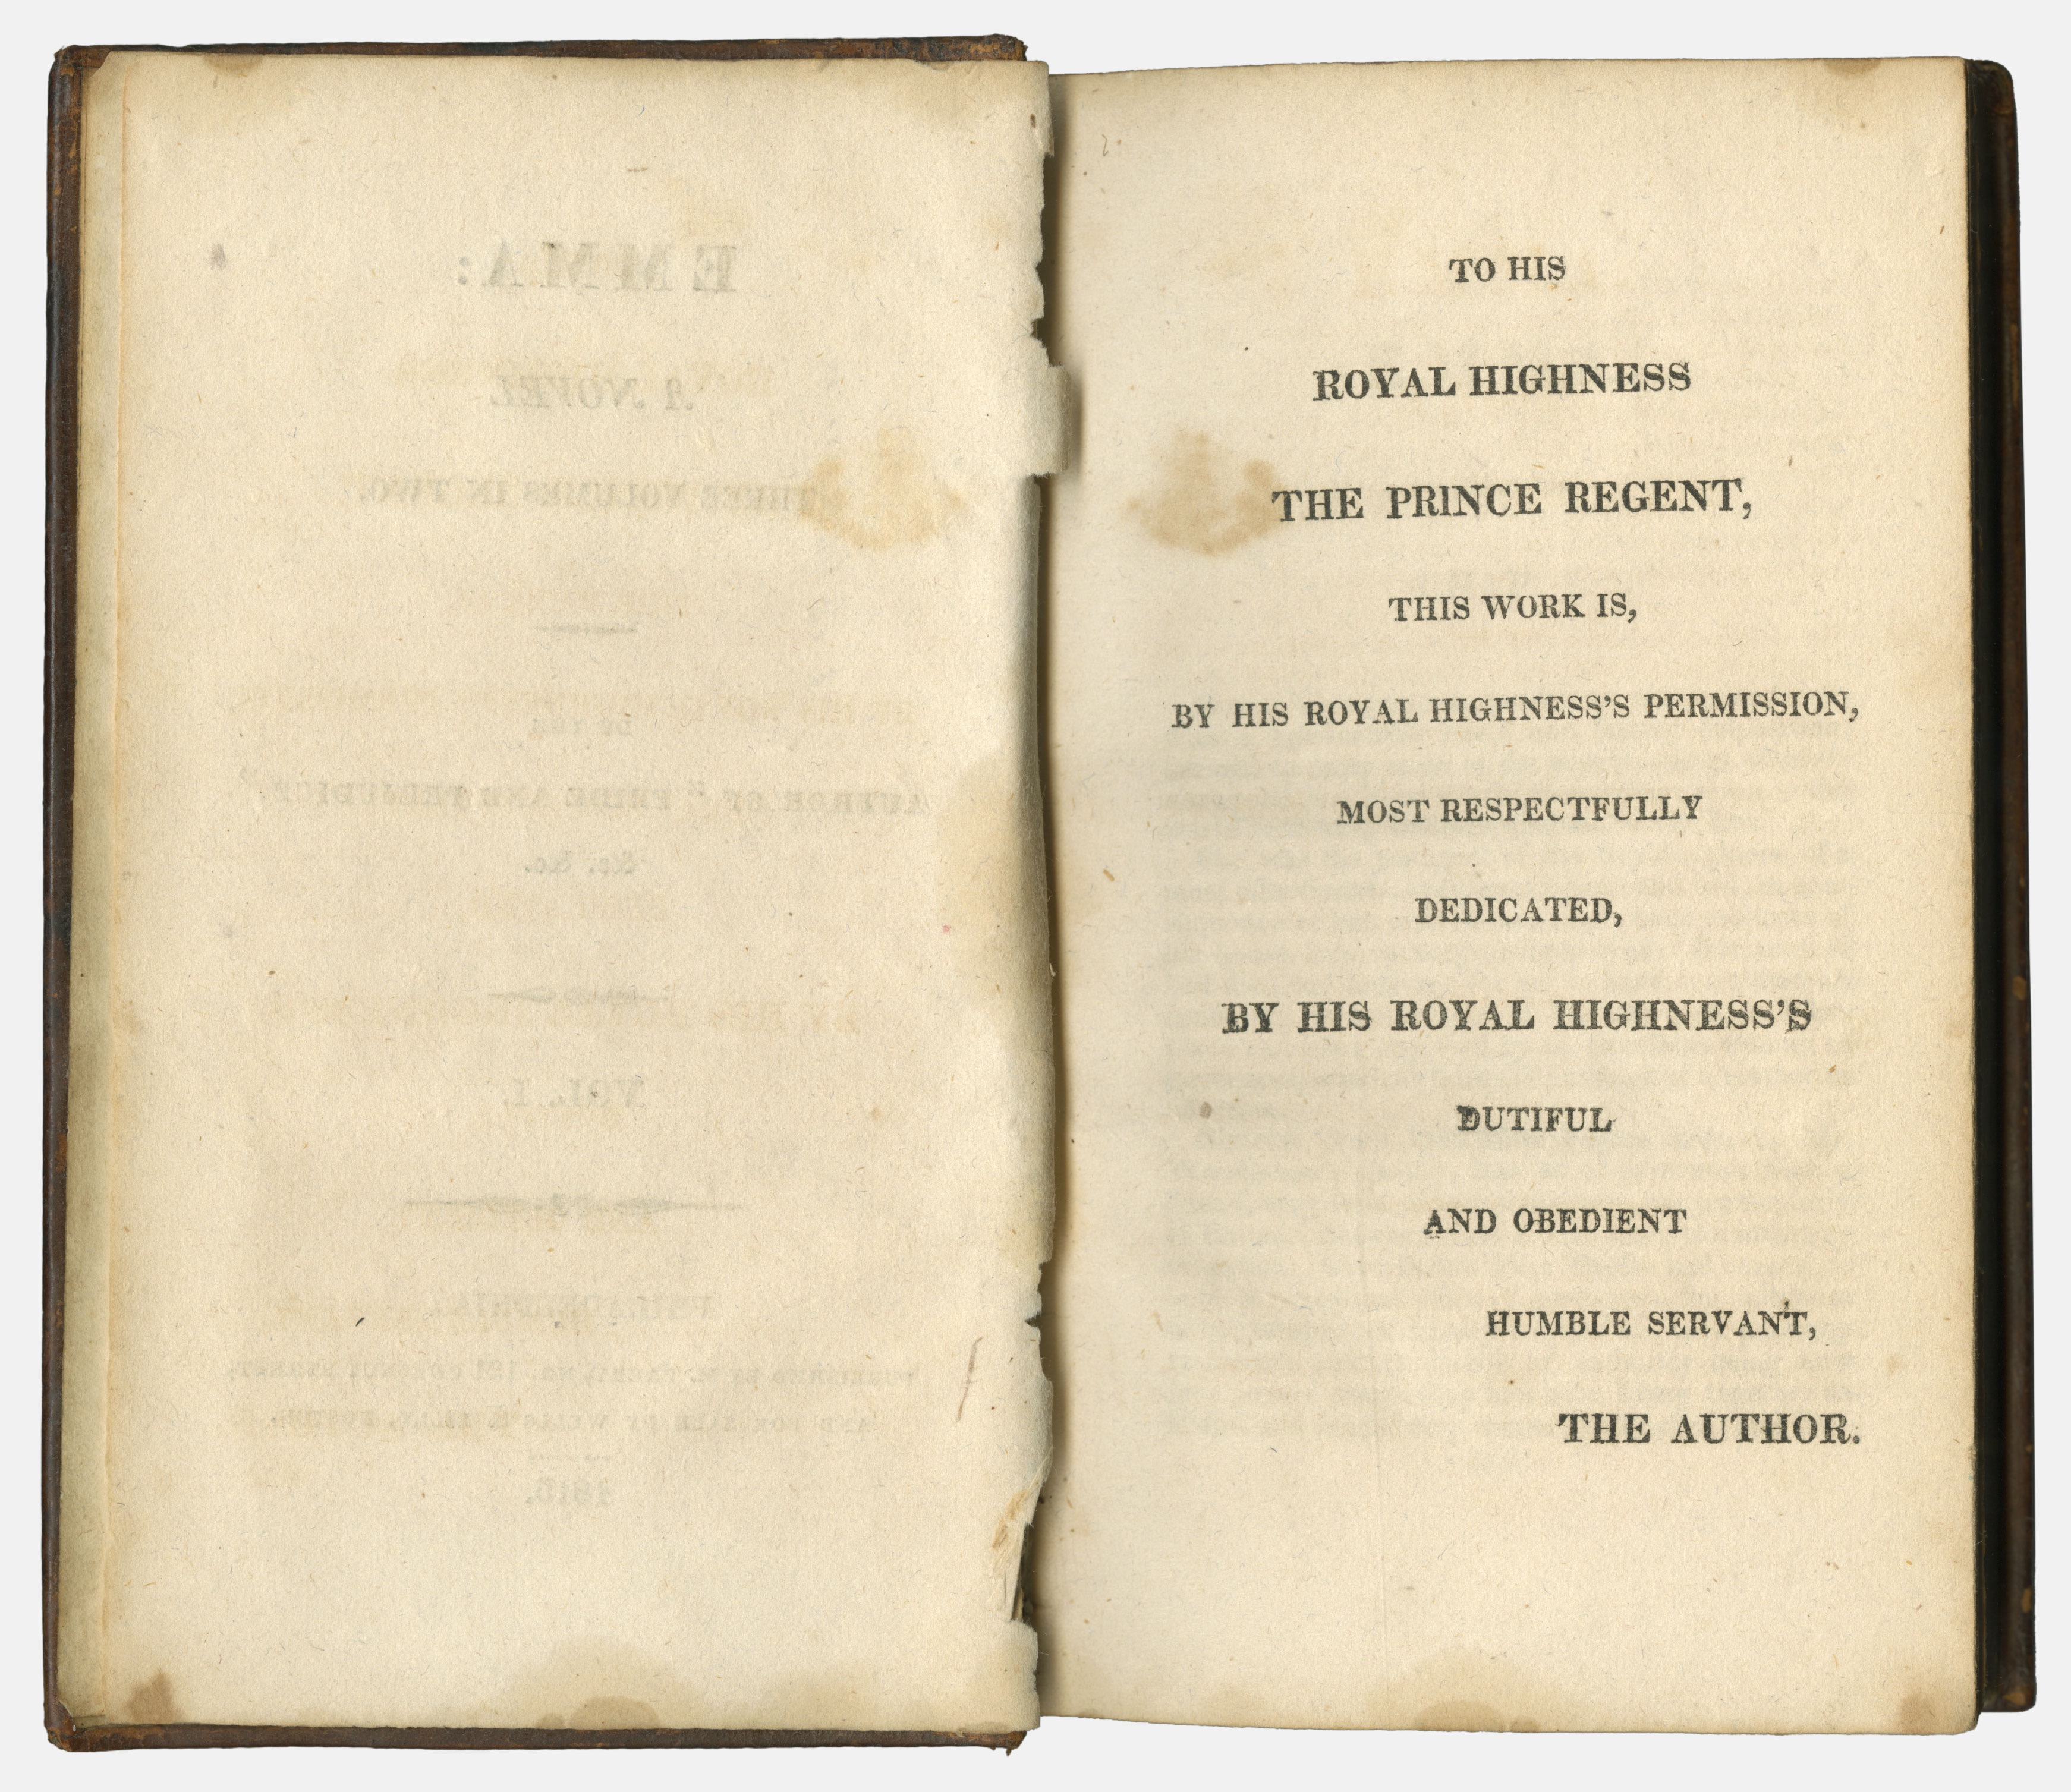
1. Context
Dedication to the Prince Regent

Slide 6
1. Context
“Scene to be in the Country, Heroine the Daughter of a Clergyman, one who after having lived much in the World had retired from it and settled in a Curacy, with a very small fortune of his own. -- He, the most excellent Man that can be imagined, perfect in Character, Temper, and Manners -- without the smallest drawback or peculiarity to prevent his being the most delightful companion to his Daughter from one year's end to the other. -- Heroine a faultless Character herself, -- perfectly good, with much tenderness and sentiment, and not the least Wit -- very highly accomplished, understanding modern Languages and (generally speaking) everything that the most accomplished young Women learn, but particularly excelling in Music -- her favourite pursuit -- and playing equally well on the PianoForte and Harp -- and singing in the first stile. ( . . . ) The name of the work not to be Emma, but of the same sort as S. & S. and P. & P.”
http://www.pemberley.com/janeinfo/plannovl.html

Slide 7
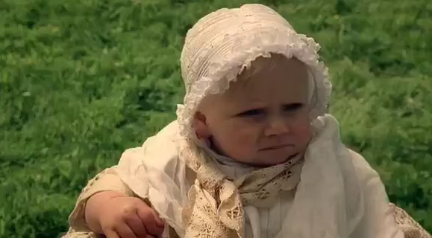
2. The heroine

Slide 8
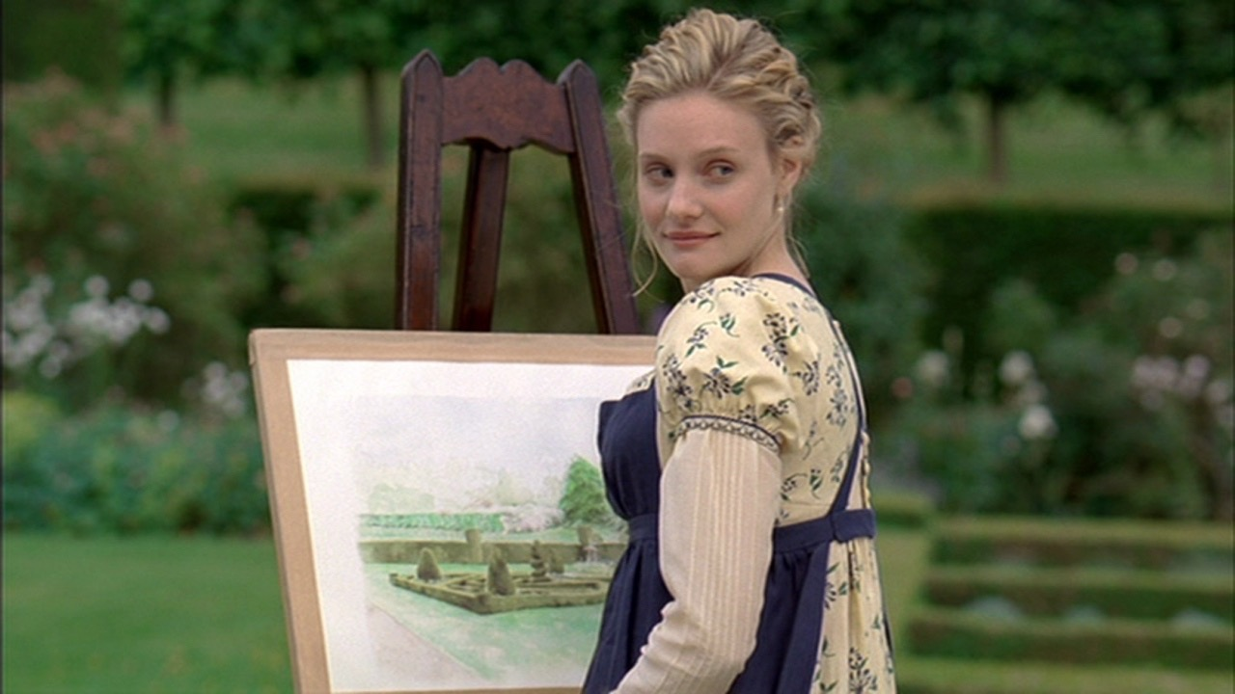
2. The heroine
“Emma Woodhouse, handsome, clever, and rich, with a comfortable home and happy disposition, seemed to unite some of the best blessings of existence; and had lived nearly twenty-one years in the world with very little to distress or vex her.”
Austen, Jane. Emma. Oxford: Oxford University Press, 2008. pp. 6. Print.

Slide 9
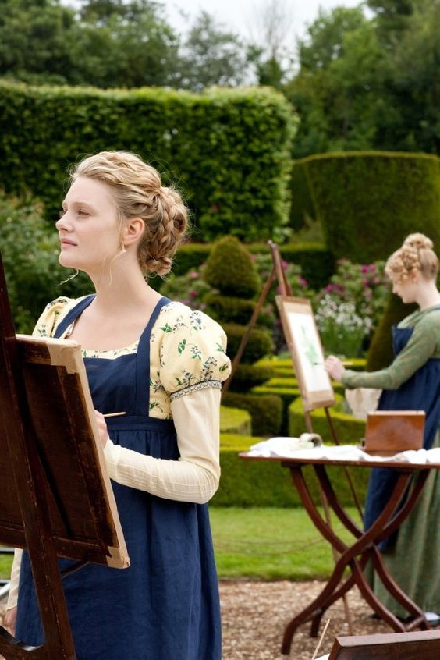
2. The heroine
“The real evils indeed of Emma’s situation were the power of having rather too much her own way, and a disposition to think a little to well of herself; these were the disadvantages which threatened alloy to her many enjoyments.”
Austen, Jane. Emma. Oxford: Oxford University Press, 2008. pp. 6. Print.

Slide 10
2. The heroine
“She [Austen] continues to see that the heroine has derived from the people and conditions around her, but she now keeps clearly in mind the objectionable features of those people; and she faces the far bolder conclusion that even a heroine is likely to have assimilated many of the more unpleasant possibilities of the human being in society. And it is not that society has spoilt an originally perfect girl who now has to recover her pristine good sense, as it was with Catherine Morland [in Northanger Abbey], but that the heroine has not yet achieved anything like perfection and is actually going to learn a number of serious lessons from some of the people she lives with…the story no longer progresses towards her vindication or consolation; it consists in her gradual, humbling self-enlightenment.”
D. W. Harding, “Regulated Hatred: An Aspect of the Work of Jane Austen.” Scrutiny. March 1940. pp. 359. Online

Slide 11
2. The heroine
“Austen…shows that there are real dangers in the situation of a highly intelligent and energetic young woman, wholly protected from the need to make her way in the world and with nothing much to do in life but pamper her silly father and meddle in the lives of those she thinks she is assisting…Emma’s misdeeds are the result of her staying at home in an environment which makes it difficult for her to grow up; her errors of judgement about social relationships in general are the direct outcome of the infantile role which she plays as perfect daughter.”
Kirkham, Margaret. Jane Austen, Feminism and Fiction. Brighton: Harvester Press, 1983. pp. 136. Print.

Slide 12
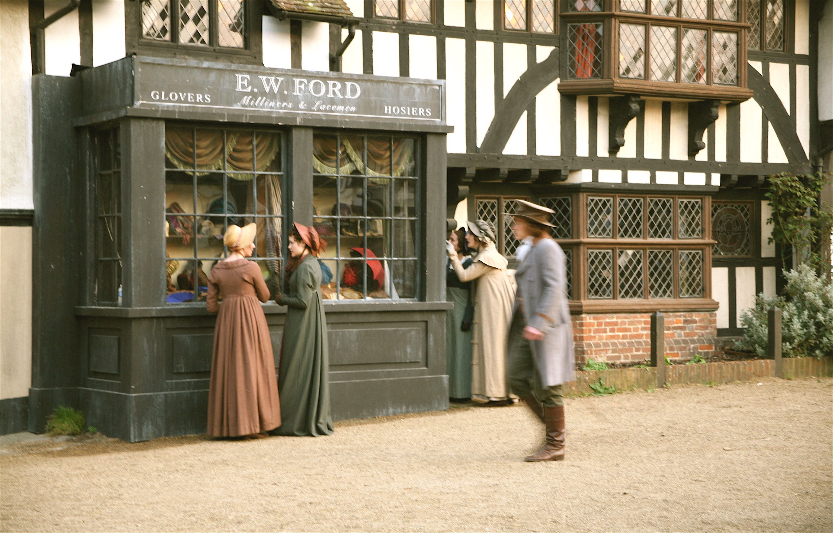
3. Location

Slide 13
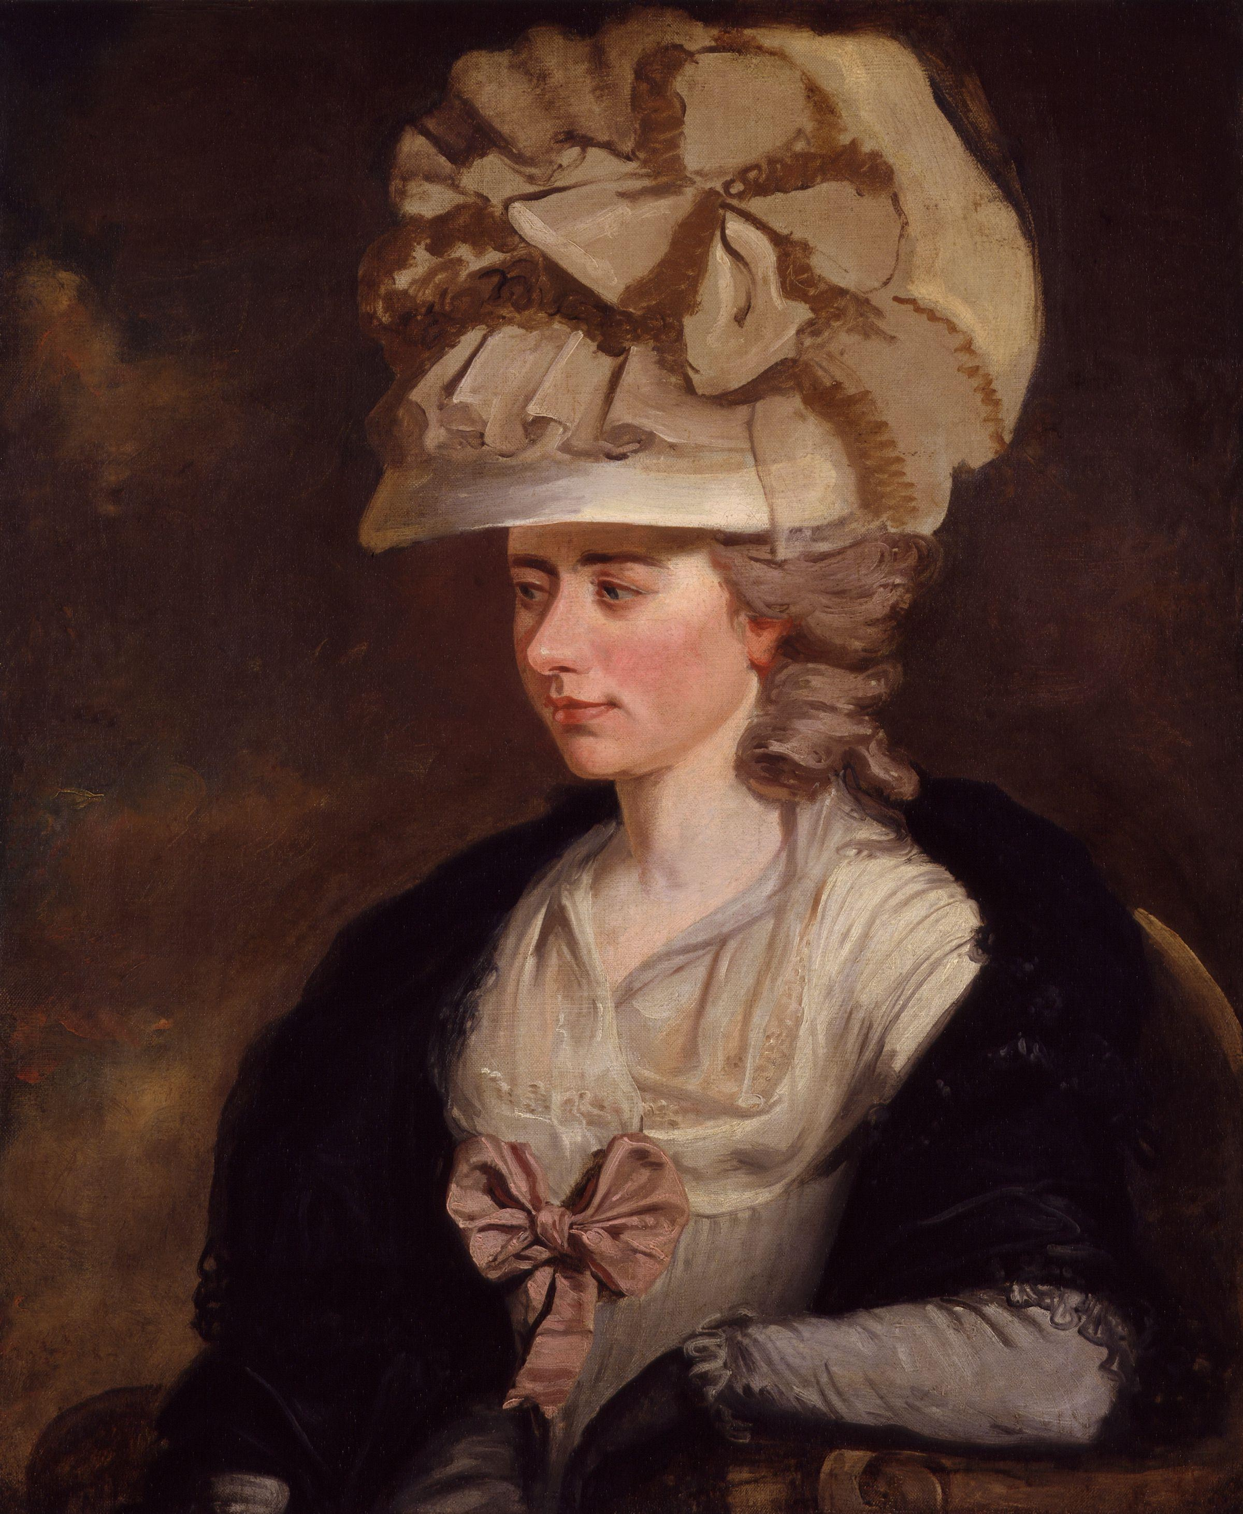
4. ^{Personal development}
“She had repeatedly refused to borrow anything more of Mrs Arlbery, always hoping every call for money would be the last; but she was too inexperienced to know, that in gay circles, and public places, the demands for wealth are endless and countless; and that oeconomy itself, which is always local, is there lavish and extravagant, compared with its character in private scenes and retired life.”
Burney, Fanny. Camilla. Oxford: Oxford University Press, 2009. pp. 518 Print.
Fanny Burney

Slide 14
4. ^{Personal development}
“She had had many a hint from Mr. Knightley and some from her own heart, as to her deficiency -- but none were equal to counteract the persuasion of its being very disagreeable, -- a waste of time -- tiresome women -- and all the horror of being in danger of falling in with the second rate and third rate of Highbury, who were calling on them for ever, and therefore she seldom went near them.”
Austen, Jane. Emma. Oxford: Oxford University Press, 2008. pp. 121. Print.

Slide 15
4. ^{Personal development}
“Essentially, a young protagonist is poised at the outset of life, with two missions to perform: to survey society, distinguishing the true values from the false; and in the light of this new knowledge of ‘reality’ to school what is selfish, immature, or fallible in herself.”
Butler, Marilyn. Jane Austen and the War of Ideas. Oxford: Oxford University Press. 1975. pp. 250. Print.

Slide 16
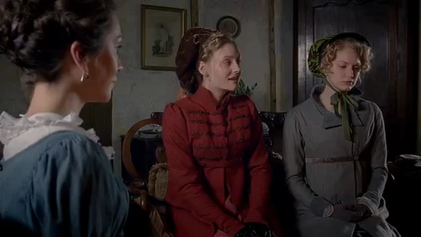
5. ^{Blunders}

Slide 17
5. ^{Blunders}
“At this moment, an ingenious and animating suspicion entering Emma’s brain with regard to Jane Fairfax, this charming Mr Dixon, and the not going to Ireland.”
Austen, Jane. Emma. Oxford: Oxford University Press, 2008. pp. 125. Print.
“With regard to her not accompanying them to Ireland, her account to her aunt contained nothing but truth, though there might be some truths not told. It was her own choice to give the time of their absence to Highbury; to spend, perhaps, her last months of perfect liberty with those kind relations to whom she was so very dear: and the Campbells, whatever might be their motive or motives, whether single, or double, or treble, gave the arrangement their ready sanction.”
Austen, Jane. Emma. Oxford: Oxford University Press, 2008. pp. 130. Print.

Slide 18
5. ^{Blunders}
“Her caution was thrown away. Emma saw its artifice, and returned to her first surmises. There probably was something more to conceal than her own preference; Mr. Dixon, perhaps, had been very near changing one friend for the other, or been fixed only to Miss Campbell, for the sake of the future twelve thousand pounds.”
Austen, Jane. Emma. Oxford: Oxford University Press, 2008. pp. 132-133. Print.

Slide 19
5. ^{Blunders}
“Such an adventure as this, -- a fine young man and a lovely young woman thrown together in such a way, could hardly fail of suggesting certain ideas to the coldest heart and the steadiest brain. So Emma thought, at least. Could a linguist, could a grammarian, could even a mathematician have seen what she did, have witnessed their appearance together, and heard their history of it, without feeling that circumstances had been at work to make them peculiarly interesting to each other? ( . . . ) It seemed as if every thing united to promise the most interesting consequences. It was not possible that the occurrence should not be strongly recommending each to the other.”
Austen, Jane. Emma. Oxford: Oxford University Press, 2008. pp. 263. Print.

Slide 20
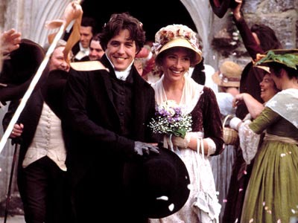
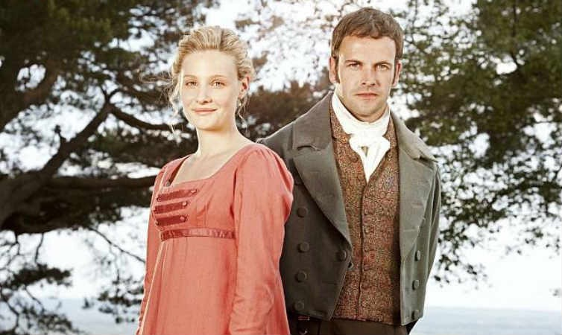
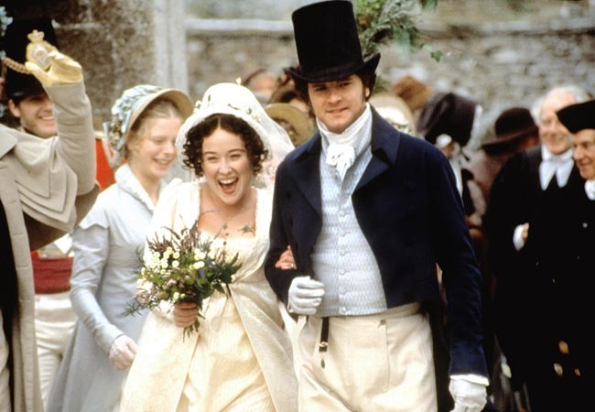
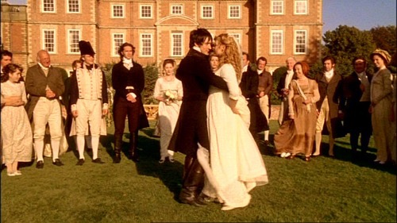
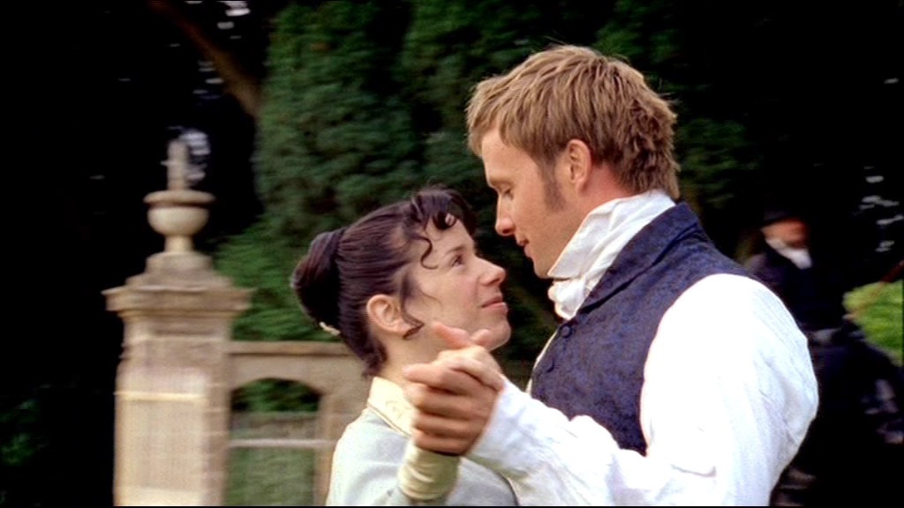
6. Marriage and the end of the novel

Slide 21
6. Marriage and the end of the novel
“On the brink of growing up, the necessity of marriage revealed to her, Emma is rescued, as it were, of Mr. Woodhouse’s inevitable resistance to her ever leaving his hearth and jurisdiction. In what could be construed as a regressive move for Emma, the new couple decide they will remain at Hartfield with her father. ( . . . ) Mr. Woodhouse’s authority will protect Emma, one feels, from the worst excesses of Knightley’s exasperating correctness. Her father will weigh in on her side, and help her maintain a proper balance of power.”
Perry, Ruth. Novel Relations: The Transformation of Kinship in English Literature and Culture, 1748-1818. Cambridge: Cambridge University Press. 2004. pp. 90. Print.

Slide 22
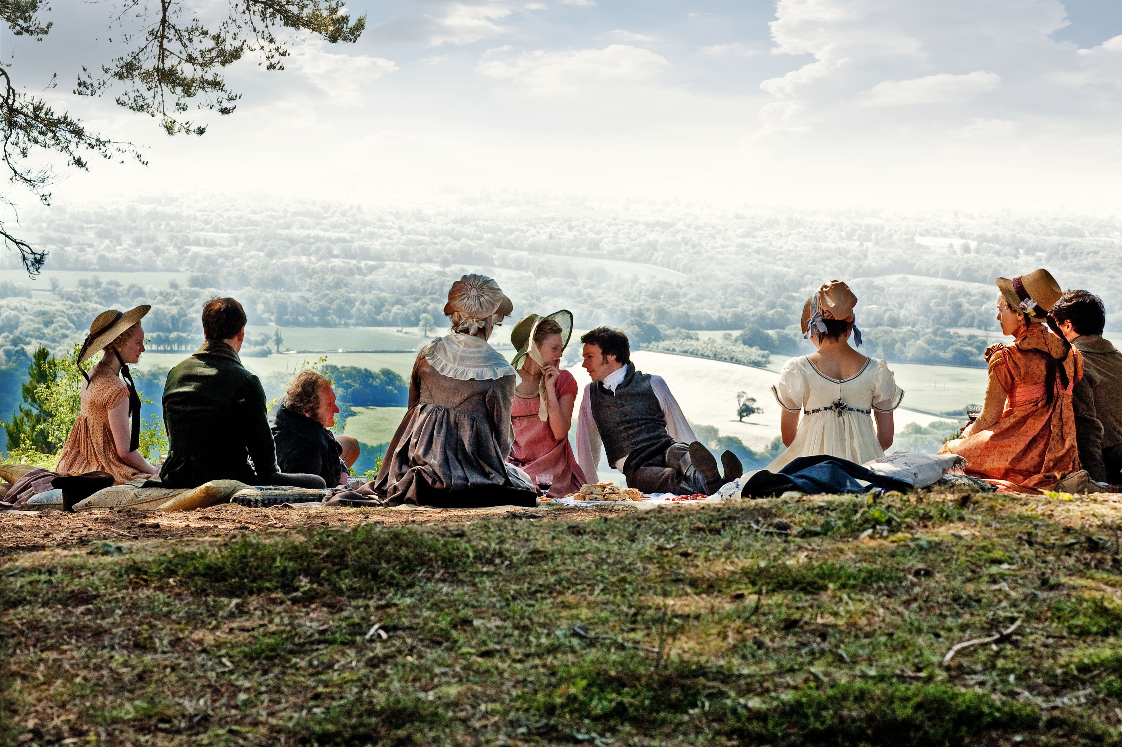
7. 200 Years Later

