Slide 1
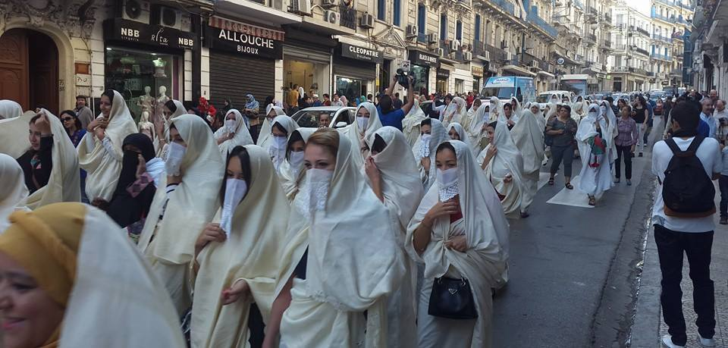
Algerian
WHITE
Assia Djebar
April 2013 – Women march in Alger for the commemoration of the country’s traditional white Haik , endangered by Islamic conservatism

Slide 2
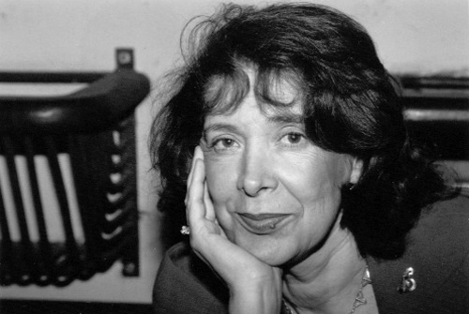
Assia
DJEBAR
Born Fatima-Zohra Imalayen
Assia ‘consolation’ and Djebar ‘intransigence’
Was Muslim, educated in French, Arabic, speaker of ‘Algerian’ and of Berber
Literary work is in French
Married twice
Taught Algerian history at the University of Algiers
Taught in the French Studies department at NYU
Member of L’Academie Française (2006)
Ceases to reside in Algeria in 1966
1936 Cherchel – 2015 Paris

Slide 3
Assia
DJEBAR
Works
Novels
La Soif, 1957 (English: The Mischief)
Les impatients, 1958
Les Enfants du Nouveau Monde, 1962 (English: Children of the New World)
Les Alouettes naïves, 1967
L'Amour, la fantasia, 1985 (English: Fantasia: An Algerian Cavalcade)
Ombre sultane 1987 (English: A Sister to Scheherazade)
Loin de Médine, (English: Far from Medina)
Vaste est la prison, 1995 (English: So Vast the Prison)
Le blanc de l'Algérie, 1996 (English: Algerian White)
Les Nuits de Strasbourg, 1997
La femme sans sépulture, 2002
La disparition de la langue française, 2003
Nulle part dans la maison de mon père, 2008
Poetry
Poème pour une algérie heureuse, 1969
Short Stories
Femmes d'Alger dans leur appartement, 1980 (English: Women of Algiers in Their Apartment)
Oran, langue morte, 1997 (English: The Tongue's Blood Does Not Run Dry: Algerian Stories)
Theatre
Rouge l'aube, 1969 Theatre
Main themes:
Female condition - Algeria – Identity – Language

Slide 4

Assia
DJEBAR
Themes
Female condition - Algeria – Identity – Language
“As for the original language of this text being French, I don’t apologize. It is a matter of contingence . I am an Arab woman and my writing is [in] French”.
(00.52 – 01.07min )
March 1990

Slide 5

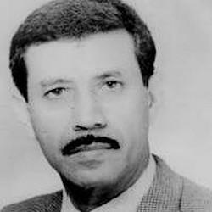
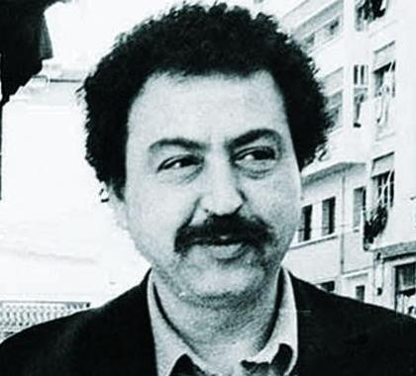
Algerian
WHITE
Themes
Mourning of the death of three Algerian intellectuals, assassinated by Islamist Guerrilla Groups during the Algerian Civil War (1991-2002)
Mahfoud Boucebci
Psychiatrist
15 June 1993
M’Hamed Boukhobza
Sociologist
27 June 1993
Abdelkader Alloula
Playwright
15 March 1994

Slide 6
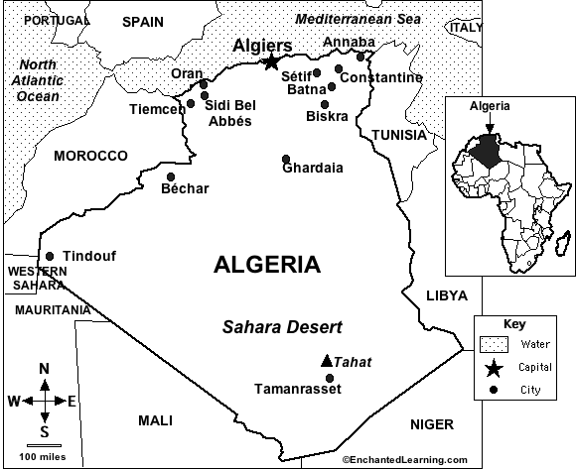
Algerian
WHITE
Historical Context
Formed around the city of Algiers
Indigenous population: Berber (Arab-Berber) Muslim
Invaders: Spanish, Ottoman, French
French colonialism 1830-1962
Algerian War of Independence 1954 – 1962
FNL: Nationalism, socialism and Islam
After independence, single-party non-aligned socialist State and power struggle
1991 political opening, Islamist party about to win
FLN cancels election
Civil war (1991-2002) Islamist groups x FLN
Current president in office since 1999
Economy reliant on oil

Slide 7
Algerian
WHITE
Form and Content
“I settled into a constant coming-and-going, resigned myself to this between-two-worlds, between-two-lives, between-two-freedoms, one deeply diving backward, the other of rushing forward and, each time, glimpse a new horizon!...” Assia Djebar
Juxtaposition of the subjective experience and history
Memory and history are intertwined, in relation
Colonial and postcolonial time are in relation
Colonial and postcolonial political violence is put in relation
No clear cut
A time and a state in-between
“The silence of that hyphen does not pacify or appease anything, not a single torment, not a single torture”
Jacques Derrida
The monolingualism of the other

Slide 8
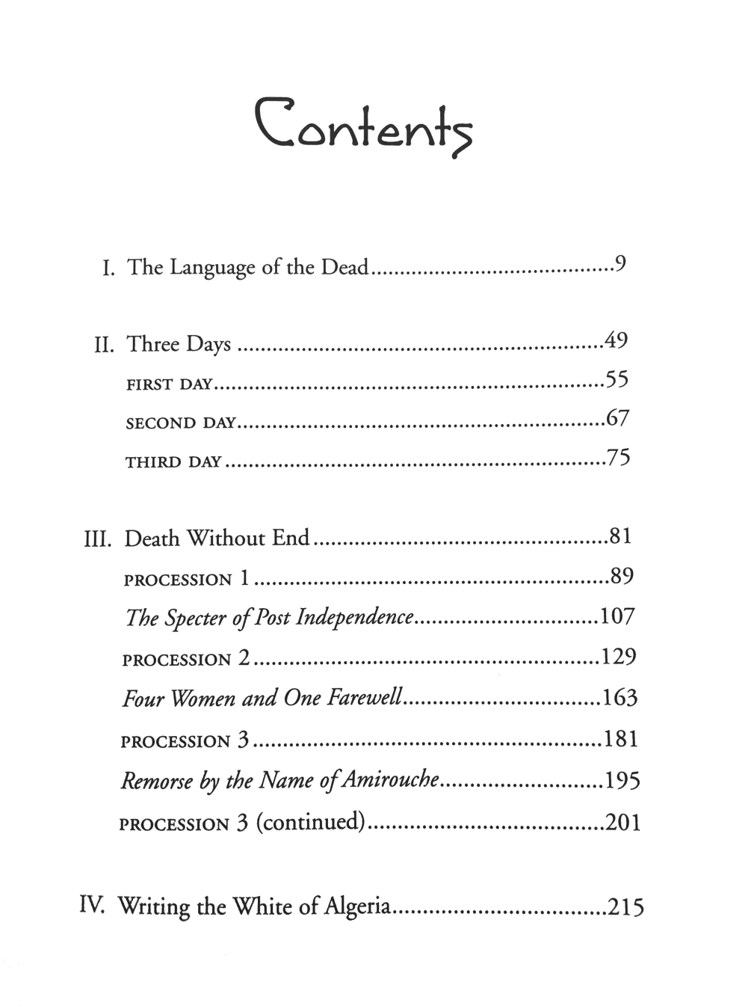
Algerian
WHITE
Form and Content
Narrative Structure
Time disruption
Interruptions in the chronological order of events
Narration of past as present
Time of memory and spectral presence
Refusal to temporal progression
Stream of consciousness
Performatic role of language

Slide 9
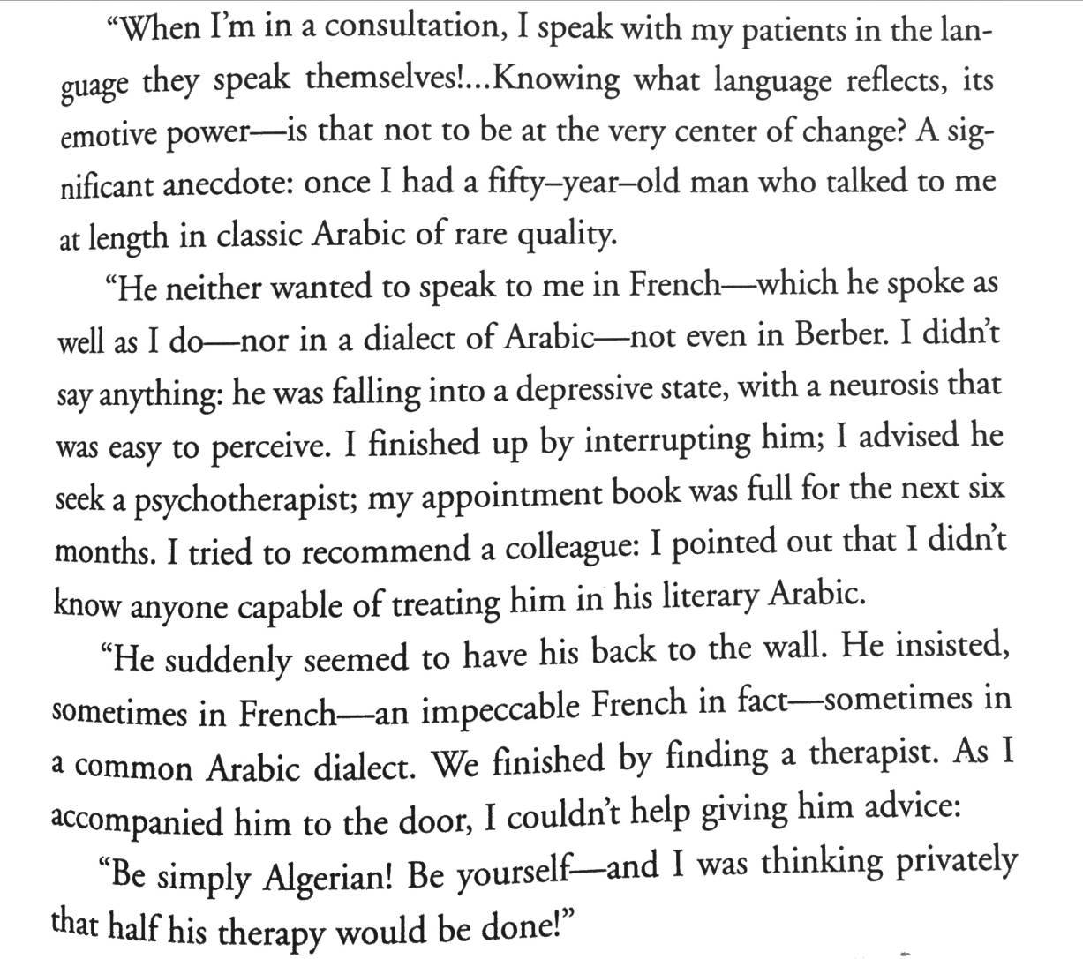
Algerian
WHITE
The performative role of language

Slide 10
Algerian
WHITE
An “European” “Novel”?
Considering the tradition of the European novel form, can we call Algerian White a novel?
Given that the narrative is written by an Algerian woman, has Algeria as a main setting and considers a experiences grounded in Algerian history, how do you see this book fitting this module?

