Slide 1
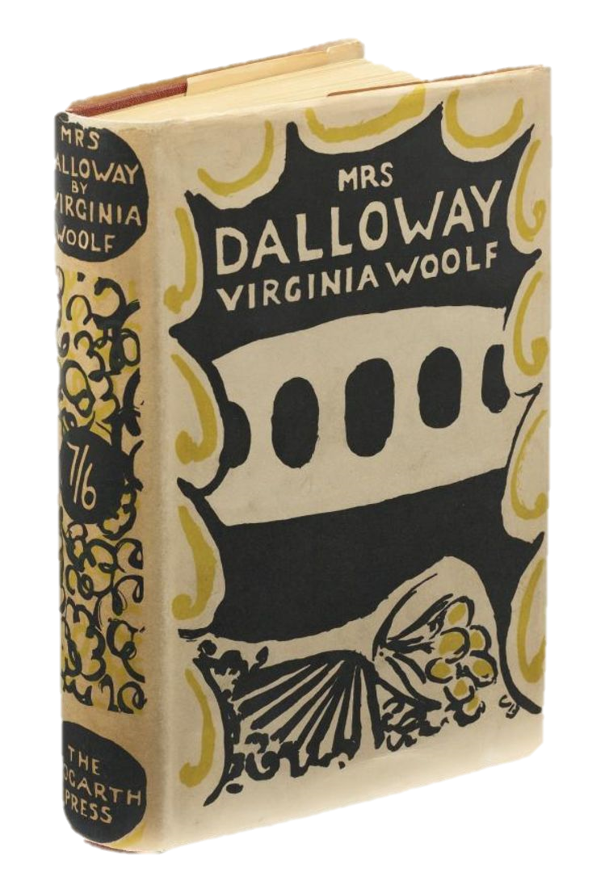
Mrs. Dalloway (1925) Virginia Woolf
Photo of the novel’s first edition
by The Hogarth Press
Cover designed by Vanessa Bell

Slide 2
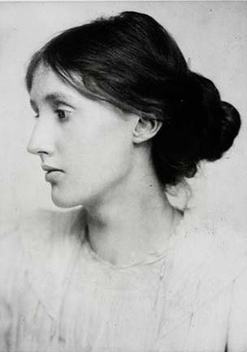
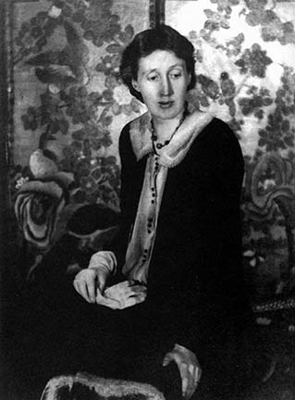
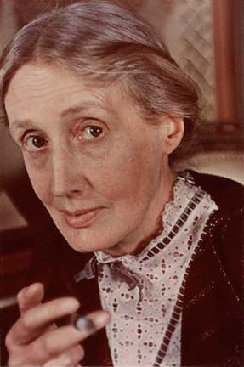
Virginia Woolf (1882-1941)
Portrait of 1902
(photo by George Beresford)
Portrait of 1925
(photo by Beck & MacGregor)
Portrait of 1939
(photo by Gisele Freund)
Source of images : http://kaykeys.net/passions/virginiawoolf/index.html

Slide 3
Virginia Woolf’s Works
Novels
The Voyage Out (1915)
Night and Day (1919)
Jacob's Room (1922)
Mrs Dalloway (1925)
To the Lighthouse (1927)
Orlando (1928)
The Waves (1931)
The Years (1937)
Between the Acts (1941)
Short story collections
Kew Gardens (short story) (1919)
Monday or Tuesday (1921)
Non-fiction
Modern Fiction (1919)
The Common Reader (1925)
A Room of One's Own (1929)
On Being Ill (1930)
The London Scene (1931)
The Common Reader: Second Series (1932)
Three Guineas (1938)

Slide 4
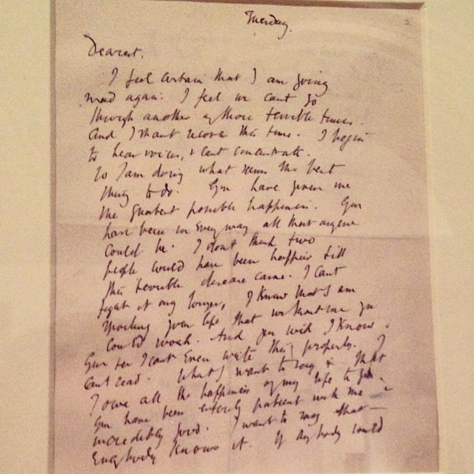
Virginia Woolf’s Suicide Note
Tuesday.
Dearest,
I feel certain I am going mad again. I feel we can’t go through another of those terrible times. And I shan’t recover this time. I begin to hear voices, and I can’t concentrate. So I am doing what seems the best thing to do. You have given me the greatest possible happiness. You have been in every way all that anyone could be. I don’t think two people could have been happier till this terrible disease came. I can’t fight any longer. I know that I am spoiling your life, that without me you could work. And you will I know. You see I can’t even write this properly. I can’t read. What I want to say is I owe all the happiness of my life to you. You have been entirely patient with me and incredibly good. I want to say that – everybody knows it. If anybody could have saved me it would have been you. Everything has gone from me but the certainty of your goodness. I can’t go on spoiling your life any longer.
I don’t think two people could have been happier than we have been.

Slide 5
Mrs. Dalloway
When: one Wednesday in June of 1923;
What: Mrs. Clarissa Dalloway’s organization of a party. Septimus suicides;
Where: at the heart of London;
How: narrated through the stream of consciousness technique;

Slide 6
Mrs. Dalloway
Themes:
Mental illness;
(Life)Time;
The city/ the metropole – London;
Empire;
Class;
Love;
Marriage;
ALL THESE THEMES ARE
IN INTERSECTION!!
Wealth;
Gender;
Sexuality;
War;
Inequality;
REMEMBER!

Slide 7
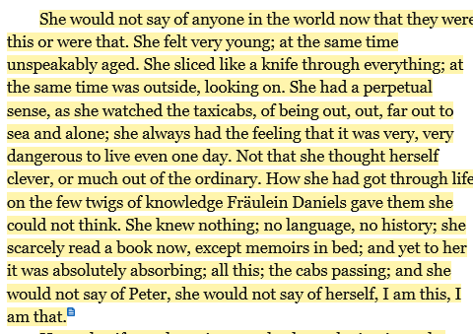
Simultaneity

Slide 8
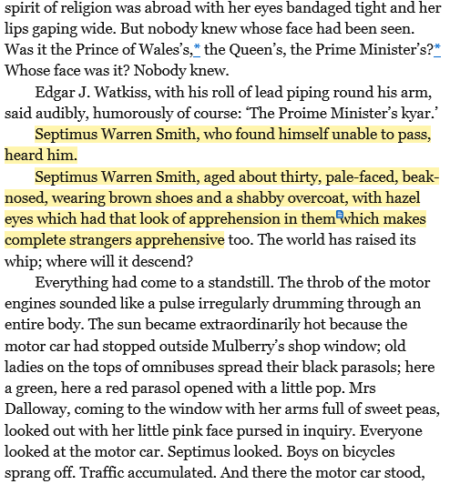
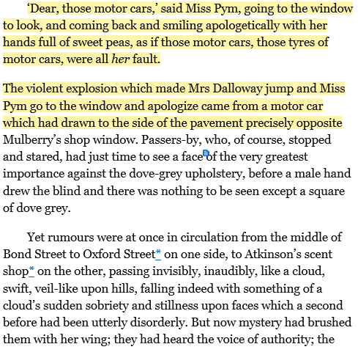
Parallels, Doubles, Intersections

Slide 9
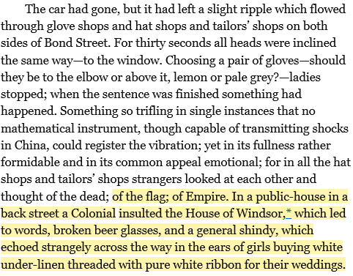
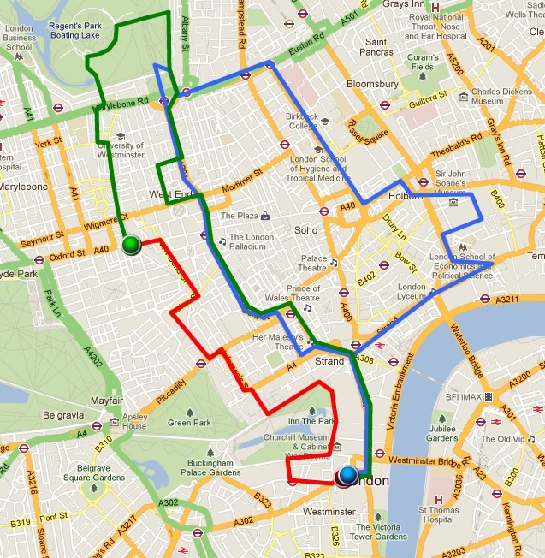
London and the Empire
Mrs. Dalloway ‘s route is represented with red, Peter’s with blue, and Septimus and Rezia’s with green.
Mrs. Dalloway Mapping Project | Georgia Institute of Technology
by Adam Erwood, London Lamb, Jasmine Perrett, Anjaly Poruthoor, Manoj Vangala http://mrsdallowaymappingproject.weebly.com/index.html

Slide 10
Stream of Consciousness and the Novel
Moretti The Novel Vol.2 (3-4)
the novel portrays the dissociation between hero and society, and establishes the journey of the hero against society which gives way to a sense of individuality;
18thC. novel “asked whether humans are the source of moral law and masters of their own actions”; (individual reclaims moral authority)
19thC. novel “concluded that human beings are shaped less by moral norms than by their social and historical milieu”; (individual reclaims political and economic power)
Early-20th C. novel “modernists rebelled against both the attempt to imprison human beings in their social milieu and the method of observation and empathy. This rebellion created an unprecedented rupture between, on one side, the individual, liberated from moral concerns and conceived as the site of uncontrollable sensorial and linguistic activity; and, on the other, reality, which came to be seen as mysterious and profoundly disquieting. Modernism gave the novel a new formal dynamism, without however altering its old focus on the individuals and their relation to the surrounding world“ (individual questions the very postulates upon which it is legitimized)

Slide 11
Stream of Consciousness
A continuous flow of sense-data (perceptions, thoughts, memories, and sensations) produced in the mind without either self-censorship or self-reflection. The concept was conceived by the American psychologist William James (brother of the writers Henry and Alice James), but is widely used in literary studies to describe a style of writing that tries to emulate this particular state of mind. The key examples are James Joyce's Ulysses (1922) and Virginia Woolf's To the Lighthouse (1927). Ideally, writing of this type should give the reader the impression they are witnessing thoughts as they are born, as though they were somehow able to jack directly into another consciousness. (Oxford Dictionary of Critical Theory)
It allows the layering of different, simultaneous, states of mind;
It is necessary to conciliate contradictive situations such as a World War and/or situations of deep social inequality;

Slide 12
Stream of consciousness
In Mrs. Dalloway, the stream of consciousness permits the constant layering of multifaceted categories:
Present Time
Past
Future
Imperial Space London
Metropole
Colony
Relations between/within
Self ⬄ Other
Superficial
Deep

Slide 13
In Film – The Hours
https://www.youtube.com/watch?v=gbc7jtmuOJM

