Slide 1


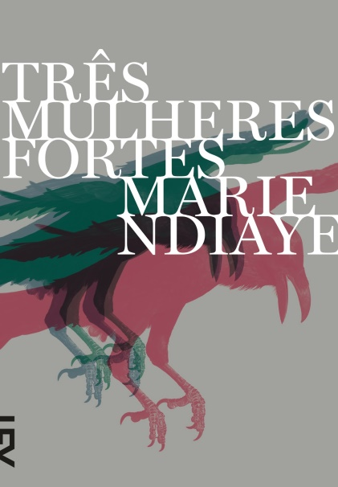

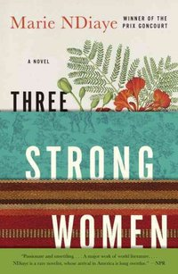
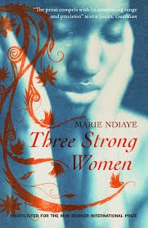
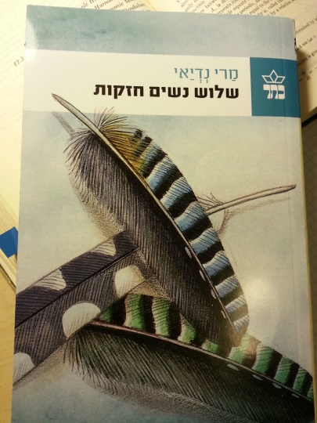
Thee Strong Women
by Marie NDiaye

Slide 2
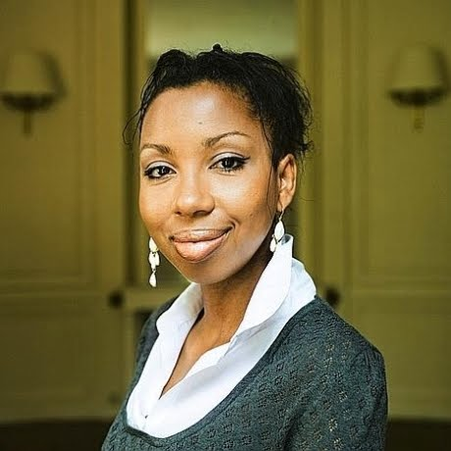
Marie NDiaye (1967)
French writer born in France from French mother and Senegalese father;
Father left when she was one year old;
First visited Senegal when she was 20 years old;
Started writing from adolescence;
Married, has three children;
First black woman to win the Prix Goncourt in 2009;

Slide 3
Marie NDiaye
The issue of origin
« From the outset, the need to situate NDiaye, to make clear what she is, quietly suggests itself. However innocent or well-intentioned the information provided may be, it sets out, I suggest, to answer two unstated questions: if this author is ‘really’ French, why is her skin brown and, if she is ‘really’ French, why does she have that strange surname? It is not that these questions are necessarily offensive in themselves. More troubling is the fact that the questions are never directly posed as such. They hover, spectre-like, behind the surfeit of biographical information offered, designed, perhaps, to produce an ‘Oh, so that’s it!’ response in the reader or listener, while never acknowledging the nature of the query the listener may (or may not) have had in the first place. The information offers itself as relief for a racialized anxiety that has never been diagnosed as such and, what is worse, fails to provide much relief, since we are still none the wiser about what NDiaye really ‘is’. »
Andrew Asibong, 2014

Slide 4
Marie NDiaye
The issue of origin
« I was raised in France, having no contact with my Senegalese family, only with my mother, a family that can not be more traditional and typical, I was, I felt exclusively French [...] Abroad I feel very Strongly my complete affiliation, lovingly, with the French culture, the French landscapes. I feel it in the absence of France, without nostalgia but with a kind of emotion at the memory of all that I love in France and that formed me essentially. I do not feel either cosmopolitan or of a double culture, which, from various points of view, would be more interesting, but mainly the cultural heiress of Moliere, Rousseau or Proust ... I am exclusively French .. »
Marie Ndiaye, 1997 interview

Slide 5
Marie Ndiaye’s works
Novels
Quant au riche avenir - Minuit, 1985
Comédie classique - P.O.L., 1988
La femme changée en bûche - Minuit, 1989
En famille - Minuit, 1991
Un temps de saison - Minuit, 1994
La Sorcière - Minuit, 1996
Rosie Carpe - Minuit, Prix Femina 2001 (trans. 2004)
Tous mes amis, nouvelles - Minuit, 2004
Autoportrait en vert - Mercure de France, 2005 (trans.2014)
Mon cœur a l'etroit - Éditions Gallimard, 2007
Trois femmes puissantes - Gallimard, Prix Goncourt, 2009 (trans.2012)
Ladivine - Gallimard, 2013 (Trans. 2016)
Plays
Hilda - Minuit, 1999
Papa doit manger - Minuit, 2003
Rien d'humain - Les Solitaires Intempestifs, 2004
Les serpents - Minuit, 2004
Children's novels
La diablesse et son enfant, illustration Nadja - 2000
Les paradis de Prunelle, illustration Pierre Mornet - Albin Michel Jeunesse, 2003
Le souhait, illustration Alice Charbin - École des Loisirs, 2005
Essays
La naufragée - Flohic, 1999
Screenplay
White Material (2009), co-written with director Claire Denis
1st phase
2nd phase

Slide 6
Films
Hilda
by Andrés Clariond Rangel Mexico 2014, 88 min Production: Pimienta Films
https://www.youtube.com/watch?v=r1dOQY81ie0
White Material
by Claire Denis 2009
https://www.youtube.com/watch?v=OKzFi39XHI8

Slide 7
Three Strong Women
Plot
3 numbered novellas
3 women
Norah
Fanta
Khady Demba
3 places
France
Senegal
Africa
3 men
Norah’s father
Rudy Descas
Lamine

Slide 8
“One”
Story of the half white and half black Frenchwoman Norah, summoned by her father to Senegal to represent her brother Sony, who is in jail for the murder of his stepmother with whom he had a love affair
Themes
Story of a broken family (race and emotional attachment);
Separated by gender, race and locus of enunciation;
Parent-child traumatic relationships:
Mother-son;
Father-daughter;
Repression of traumatic memories;
Motherhood;
Relationship between past and present;
Resolution;
Journey from France to Senegal
Form
79 pages;
Plot develops over weeks;
3rd person narrator;
Stream of consciousness;
Short paragraphs, short sentences;
Use of symbolism;
Presence of repetition;

Slide 9
“Two”
Story of the white Frenchman Rudy Descas, who has a family history in Senegal, where he meets Fanta whom he marries and brings to live in the interior of France with him. They have a son and plot is structured around an argument with his wife.
Themes
Story of a broken family (race and emotional attachment);
Separated by colonial history
Parent-child traumatic relationships:
Mother-son;
Father-son;
Repression of traumatic memories;
Masculinity;
Relationship between past and present;
Resolution;
Journey from Senegal to France
Form
134 pages;
Plot develops one business day;
3rd person narrator;
Stream of consciousness;
Longer sentences and paragraphs;
Use of symbolism;
Presence of repetition;

Slide 10
“Three”
Story of Khady Demba, who loses her husband and is forced to live with her family-in-law. They try to smuggle her to Europe, to find Fanta and send them money. She endures a journey of continuous violence, rape, disease and dies at the fences of Fortress Europe.
Themes
Impossibility of making a family;
Rejection;
Migration;
Exploitation and physical suffering;
Resignation;
Clarity of purpose;
Focus on the present;
Sense of self
Form
60 pages;
Plot develops over the course of months;
3rd person narrator;
Stream of consciousness;
Short sentences and paragraphs;
Presence of repetition;
Use of symbolism;

Slide 11
Three Strong Women - Form
Common elements
Different elements
3 narrative novellas
fragmented memories
3rd person omniscient narrator
stream of consciousness
Present tensions
Memory feedbacks
Narrative clues
Symbology
Total length of story
Length of sentences and paragraphs
Plot time-span
Use of symbology and recurrence to past events

Slide 12
Three Strong Women - Themes
Gender
Race
Trauma/Memory
Roots
Routs
Family
Class
Poverty
Migration
Colonialism
Violence
Strength
Blankness
Silence
Intersection

Slide 13
Three Strong Women – Questions
Can we call Three Strong Women a novel? Why?
How is Fanta strong in comparison to Norah and Khady?
Can we call Three Strong Women an European novel?

