Slide 1
Madame Bovary, Flaubert
Literature of the Industrial Revolution
***
Dr Margaux Whiskin

Slide 2
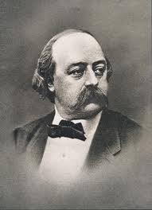

Slide 3
Origins
1848: Delamare case
1851-1856: writing of Madame Bovary
1856-1857: publication in the Revue de Paris
Feuilleton
Sainte-Beuve, ‘On Industrial Literature’, in Revue des Deux Mondes, 1/09/1839

Slide 4
The trial
1857
Charles Baudelaire, Les Fleurs du Mal
‘The aim of literature must be to polish and rejuvenate the spirit by increasing intelligence and purifying moral values, which is far more important than reinforcing disgust of vice by portraying immoral actions which can take place in society. It is unacceptable to depict the transgressions whether in actions or words of those characters an author has decided to put on the page, under the pretence of being true to personality or local colour. Such a system, applied to literature as well as to visual art, would lead to a realism which would ultimately be the negation of beauty and goodness, and which would engender works which would be offensive to the eye as well as to the mind.’ (Attendus du jugement sur Madame Bovary)

Slide 5
Realism
‘Realism’s aim is the exact, full and honest reproduction of the social background and context in which we live, because such a direction is justified by reason, the necessities of intelligence and the interest of the public, and because it is exempt of lies, of trickery… This reproduction should be as simple as possible to be understood by everyone.’ (Journal Le Réalisme 1856)

Slide 6
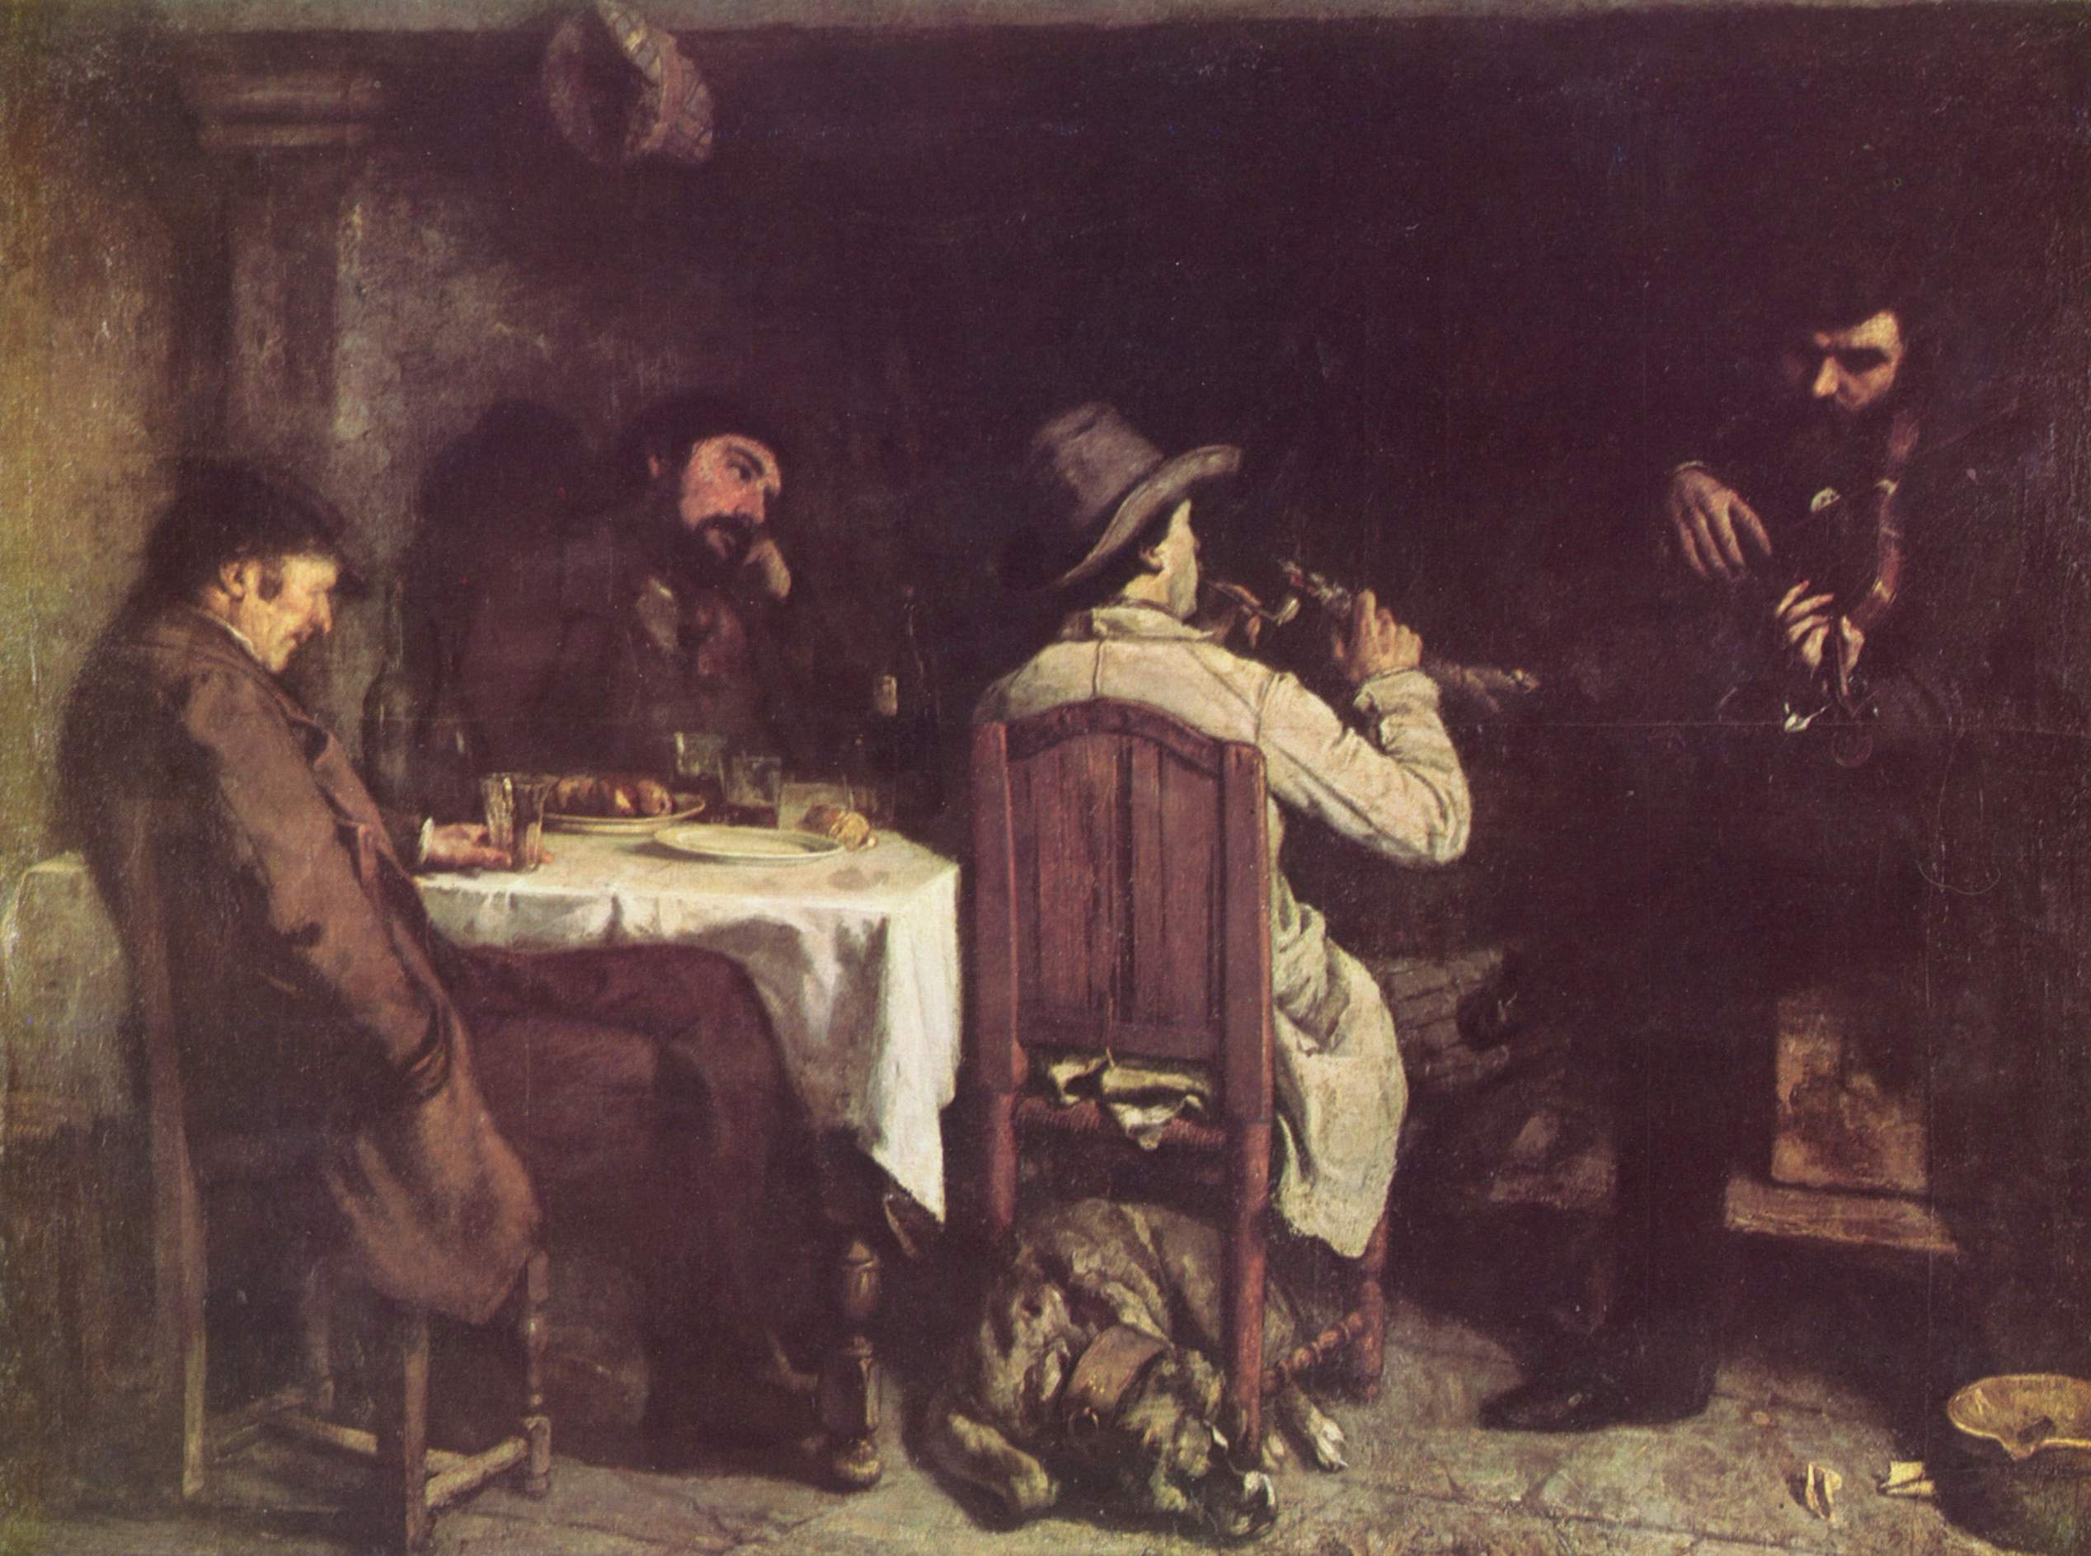
Après dînée à Ornans, Courbet 1849

Slide 7
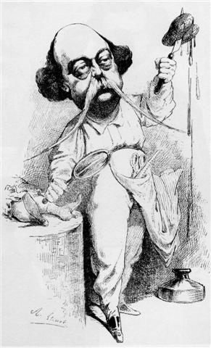

Slide 8


Slide 9
‘love affairs, lovers and their beloveds, damsels in distress swooning in secluded summerhouses, postilions slain at every posting house, horses ridden to death on every page, gloomy forests, wounded hearts, vows, sobs, tears, and kisses, gondolas by moonlight, nightingales in the woods, and ‘gentlemen’ brave as lions, meek as lambs, unbelievably virtuous, always immaculately turned out, who weep buckets of tears’ (p. 34)
‘I loathe commonplace heroes and temperate feelings, the kind of thing you find in real life’ (p. 75)

Slide 10
A desire to escape
Desperate to escape her rural environment
Bovary = bovine
Dreams of Paris but only goes so far as Rouen
Dreams of exotic landscapes but is stuck in muddy Normandy
Claustrophobic feeling
Men as a possibility of escape

Slide 11


Slide 12
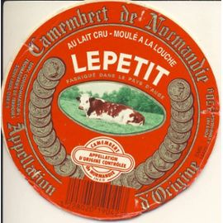

Slide 13
Buying dreams
Industrial Revolution
Growing number of factories
Paris as centre of fashion
Props, costumes and accessories to live out her fantasies
Bourgeois industrials mass producing and merchandising objects for the Romantic dream

Slide 14
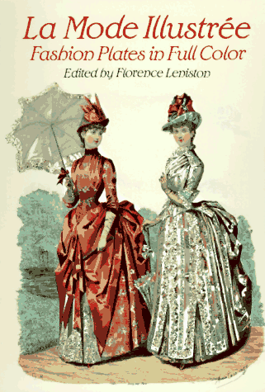

Slide 15
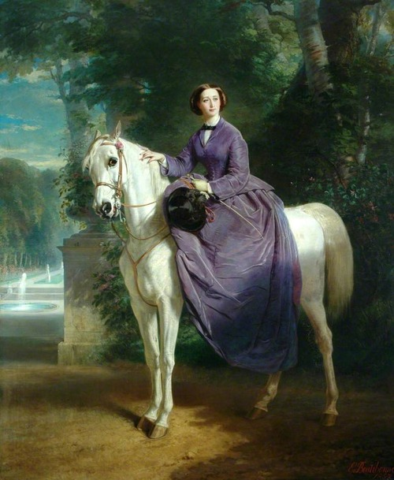

Slide 16
Emma’s relationship with men
Lovers kept at a distance
The masculine attire: whip, cigar, leather boots
Accessories which become fetishized objects
In love not with men but with fictional representations of herself
Men as props for her fantasies

Slide 17
‘When everything had been sold up, there remained twelve francs seventy-five centimes, which paid Mademoiselle Bovary’s fare to her grandmother’s house. The good woman died that very same year; and, as Père Rouault was now paralysed, Berthe became the responsibility of an aunt. She is poor, and sends the child to earn her keep at a cotton mill.’ (p. 311)

