Slide 1

EN201 The European Novel: The Trial

Slide 2
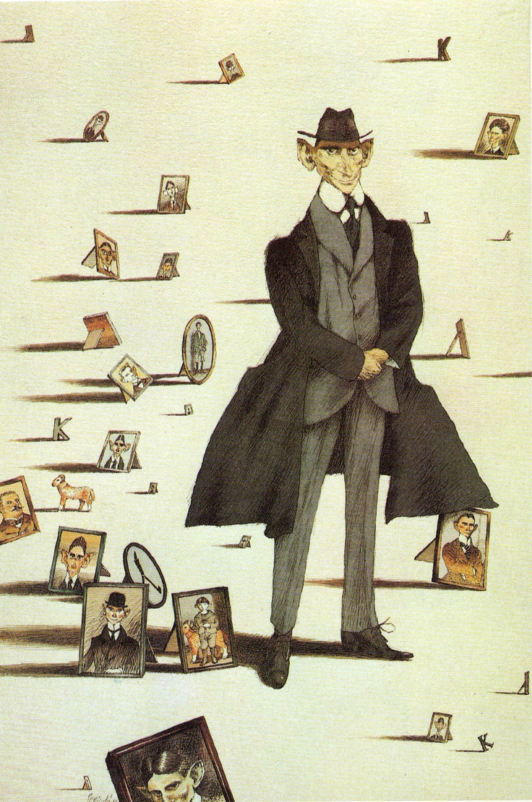
Franz Kafka (1883-1924)
Background
Historical Context

Slide 3
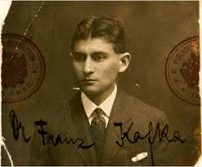

Slide 4
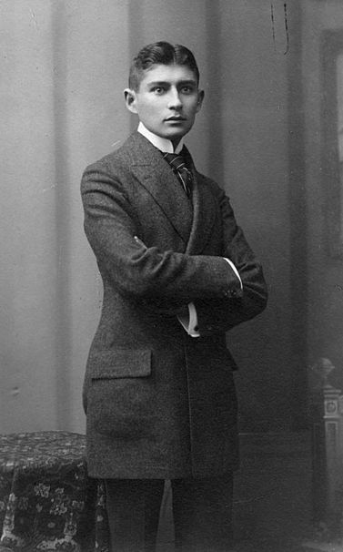

Slide 5
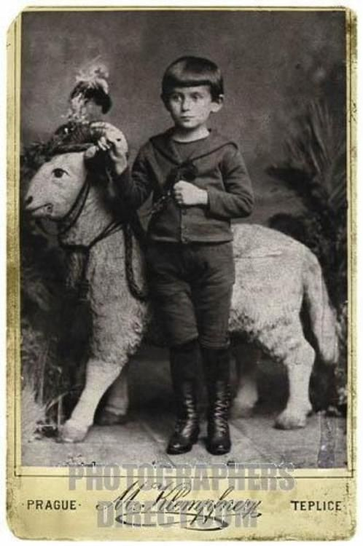

Slide 6
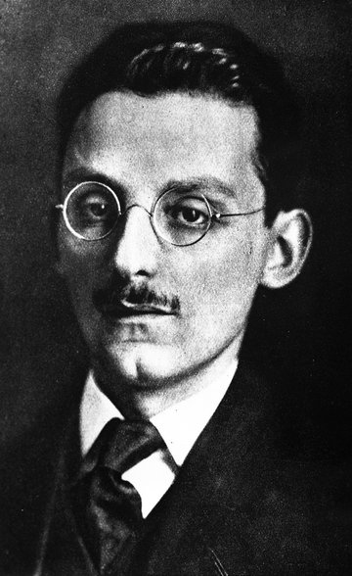
Max Brod (1884-1968)

Slide 8
Reading The Trial
Importance of Kafka for European Modernism
Novels as exemplary failures
Institutions and individuals
The Law
State of Exception
Guilt and Punishment

Slide 9
Adorno’s Notes on Kafka

Slide 10
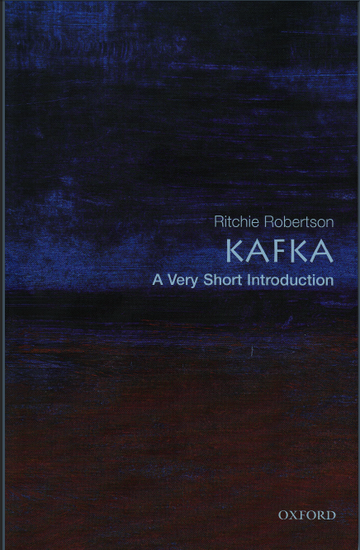

Slide 11
Reading The Trial
Importance of Kafka for European Modernism

Slide 12
Reading The Trial
Novels as exemplary failures
Kafka’s texts as a form of failure
Family issues (Letter to the Father)
Other texts (Metamorphosis, Hunger Artist, Josephine, The Silence of the Sirens Report to an Academy)

Slide 13
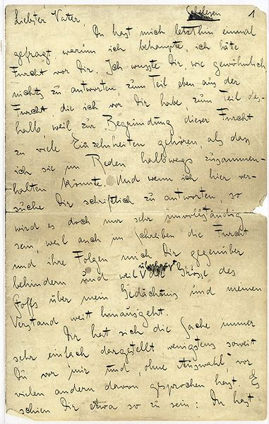
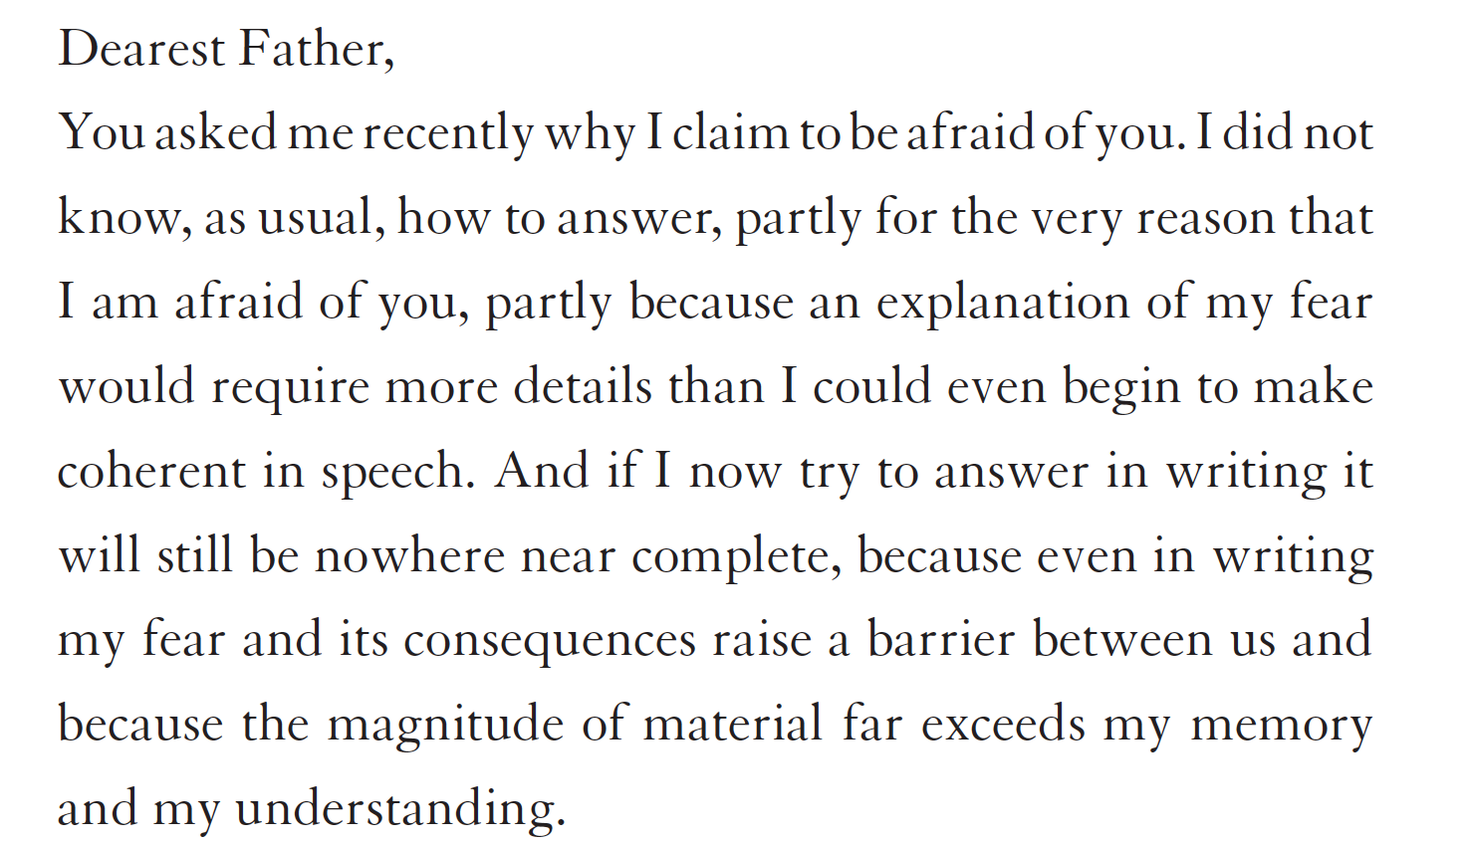

Slide 14
Reading The Trial
Institutions and individuals
The Law
State of Exception
Guilt and Punishment

Slide 15
“Before the Law”
Parable
Aporetic logic
Modernity, Transcendence, Religion
Totalitarianism (today)
Nietzsche and responsibility

Slide 23
The madman jumped into their midst and pierced them with his eyes. "Whither is God?" he cried; "I will tell you. We have killed him—you and I. All of us are his murderers. But how did we do this? How could we drink up the sea? Who gave us the sponge to wipe away the entire horizon? What were we doing when we unchained this earth from its sun? Whither is it moving now? Whither are we moving? Away from all suns? Are we not plunging continually? Backward, sideward, forward, in all directions? Is there still any up or down? Are we not straying as through an infinite nothing? Do we not feel the breath of empty space? Has it not become colder? Is not night continually closing in on us? Do we not need to light lanterns in the morning? Do we hear nothing as yet of the noise of the gravediggers who are burying God? Do we smell nothing as yet of the divine decomposition? Gods, too, decompose. God is dead. God remains dead. And we have killed him.
Friedrich Nietzsche. The Gay Science. Aphorism 125 (The Madman)

Slide 24
Dialectics and Abyssal Thought
W. Benjamin, T. Adorno
G. Deleuze, F. Guattari: “Minor Literature”
Gerhard Neumann: Outsider Perspective, Sliding Paradox
Stanley Corngold: “The negativity of the vermin has to be seen as rooted, in an absolute sense, in the literary enterprise itself, as coming to light in the perspective which the act of writing offers of itself. Here the activity of writing appears only autonomous enough to demand the loss of happiness and the renunciation of life. But of its own accord it has no power to restitute these sacrifices in a finer key. Over Kafka's writing stands a constant sign of negativity and incompleteness”. (1973)

Slide 25
Letter to Oskar Pollack (1904)
“If the book we are reading does not wake us, as with a fist hammering on our skulls, then why do we read it? Good God, we also would be happy if we had no books and such books that make us happy we could, if need be, write ourselves.. …. What we need are books that hit us like a most painful misfortune, like the death of someone we loved more than we love ourselves, that make us feel as though we had been banished to the woods, far from any human presence, like a suicide.”

