Slide 1
Dr. Graeme Macdonald
Anna Karenina and Germinal
Nov. 2016
g.macdonald@warwick.ac.uk

Slide 2
The approach of the train was made more and more evident by the preparatory movements in the station, the running of attendants, the appearance of gendarmes and porters, and the arrival of those coming to meet the train. Through the frosty steam, workers in sheepskin jackets and soft felt boots could be seen crossing the curved tracks. The whistle of the engine could be heard down the line, and the movement of something heavy. AK I, XVII

Slide 3
A watchman, either drunk or too bundled up because of the freezing cold, had not heard a train being shunted and had been run over.
Even before Vronsky and Oblonsky came back, the ladies had learned these details from the butler.
Oblonsky and Vronsky had both seen the mangled corpse. Oblonsky was obviously suffering. He winced and seemed ready to cry.
‘Ah how terrible! Ah, Anna, if you’d seen it! Ah, how terrible!’ he kept saying.
Vronsky was silent, and his handsome face was serious but perfectly calm.
‘Ah, if you’d seen it, Countess,’ said Stepan Arkadyich. ‘And his wife is here . . . It was terrible to see her . . . She threw herself on the body. They say he was the sole provider for a huge family. It’s terrible!’
‘Can nothing be done for her?’ Mme Karenina said in an agitated whisper.
[…]
The people coming out were still talking about what had happened.
‘What a terrible death! Said some gentleman passing by. ‘Cut in two pieces they say.’
‘On the contrary, I think it’s the easiest, its instantaneous,’ observed another.
‘How is it they don’t take measures?’ said a third.
Mme Karenina got into the carriage, and Stepan Arkadyich saw with surprise that her lips were trembling and she could hardly keep back her tears.
‘What is it, Anna?’ he asked, when they had driven several hundred yards.
‘A bad omen,’ she said. AK, I, XVIII

Slide 4
Apart from the political and socio-economic significance of the event, it presupposed the liberation of new and multitudinous human forces that brought new and altogether larger dimensions to the backdrop against which the literature was to be understood. Consequently, there is in the realism and assumption of multiplicity, of spaciousness and depth, to be seen in the sheer plenitude of words or the sheer multitude of persons, lives, relationships and places which the foreground of the fiction subsumes. Hierarchies or even class differences seem blurred or diminished to the point of caricature through the literature’s profound concern to enfranchise all conditions of humanity, from the highest to the humblest. Freedom, equality and brotherhood may not have existed in the reality of Russian life, but in the realism of Russian Literature they were the motive forces which determined the veracity of the realism.“
Richard Freeborn, ‘The Age of Realism’ in Charles Moser (ed.) The Cambridge History of Russian Literature (CUP, 1989)

Slide 5
Yes I must collect myself and think it over,’ he thought, looking intently at the untrampled grass before him and following the movements of a little green bug that was climbing a stalk of couch-grass and was blocked in its ascent by a leaf of angelica. ‘From the very beginning,’ he said to himself, holding back the leaf of angelica so that it no longer hindered the bug and bending down some other plant so that the bug could get over on to it. ‘What makes me so glad? What have I discovered? 8, XII
Understanding clearly then for the first time that for every man and for himself nothing lay ahead but suffering, death and eternal oblivion, he decided it was impossible to live that way, that he had either to explain his life so that it did not look like the wicked mockery of some devil, or shoot himself. 8, XII

Slide 6
The conversation turned to the new trend in art, to the new bible illustrations by a French artist. Vorkuev accused the artist of realism pushed to the point of coarseness. Levin said that the French employed conventions in art as no one else did, and therefore they saw particular merit in the return to realism. They saw poetry in the fact that they were no longer lying. (Anna Karenina 7, X, trans. Pevear & Volokhonsky)
It was all drowned in the sea of cheerful common labour […] And whom was this labour for? What would its fruits be? These considerations were irrelevant and insignificant. (AK, 3, XII)

Slide 7
Naturalism: Literary Science, Scandal and Hyper-Realism
Germinal : ethnography, documentary, politics

Slide 8
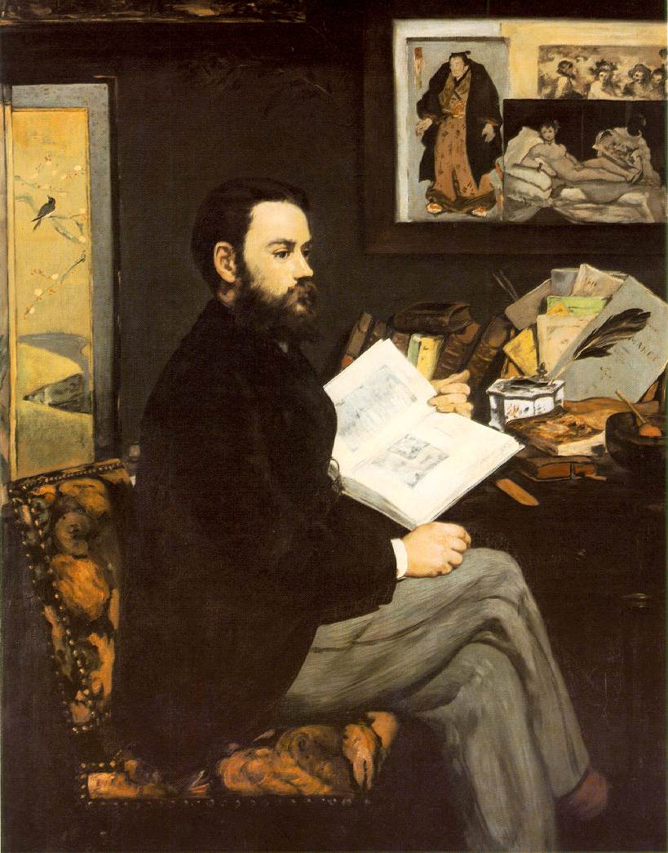

Slide 9
Auguste Comte/Herbert Spencer (Positivism in Sociology and Social Philosophy)
Thomas Huxley (Eugenics)
Prosper Lucas (Heredity)
Karl Marx (Capitalism/Political Economy)
Charles Letourneau (Biology)
Hippolyte Taine (Literature and Culture)
Jules Antoine-Castagnary (Visual Art)
Claude Bernard (Experimental Medicine)
“Western” Naturalist Novelists and Playwrights
The Goncourt Brothers (France)
Guy De Maupassant (France)
Gerhardt Hauptmann (Germany)
August Strindberg (Sweden)
Henrik Ibsen (Norway)
George Gissing (England)
George Moore (Ireland/England)
George Douglas Brown (Scotland)
George MacDougal Hay (Scotland)
Giovanni Verga (Italy)
Benito Cortez Galdos (Spain)
Stephen Crane, Theodore Dreiser, Upton Sinclair, Frank Norris, John Dos Passos(USA)
See also Balzac’s ‘Preface’ to his cycle La Comèdie Humaine, on the novel and zoology.

Slide 10
Les Rougon-Macquart: ‘The Natural History of a Family in the Second Empire’
The Third Republic (1870-1890)
The Second Empire (1852-1870)

Slide 11



Slide 12



Slide 13

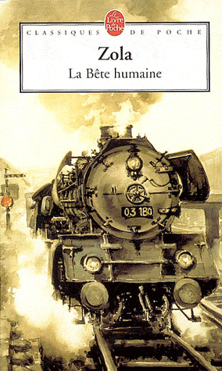

Slide 14
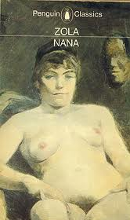


Slide 15


Slide 16
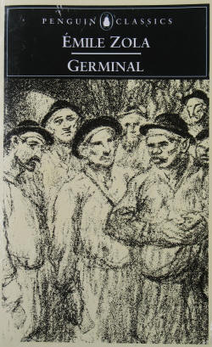
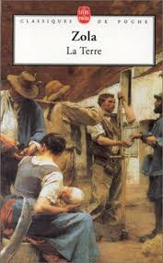

Slide 17
Auguste Comte, ‘Positivism’
Hippolyte Taine, ‘race, milieu, moment’
Claude Bernard, ‘Introduction to Experimental Medicine’ (1865)

Slide 18
It will only be necessary to work on the individuals and surroundings if we wish to find the best social condition. In this way we shall construct a practical sociology and our work will be a help to political and economical sciences […] It is but a question of degree in the same path which runs from chemistry to physiology, then from physiology to anthropology and to sociology. The Experimental Novel is the goal. (Zola, The Experimental Novel)

Slide 19
In the past several years there has grown up a monstrous school of novelists which pretends to replace carnal eloquence with eloquence of the charnel house, which invokes the weirdest medical anomalies, which musters the plague stricken so that we can admire their blotchy skin . . . and which makes pus squirt out of the conscience […] the disease is epidemic. Let us force novelists to display their talent instead of their pickings from the law court and the city dump. (Louis Ulbach, ‘La Littérature Putride’, Le Figaro, 23 Jan, 1868)

Slide 20
Where science is concerned, the accusation of immorality has no relevance […] In Thérèse Raquin my aim has been to study temperaments and not characters. That is the whole point of the book. I have chosen people completely dominated by their nerves and blood, without free will, drawn into each action of their lives by the inexorable laws of their physical nature […] There is a complete absence of soul, I freely admit, since that is how it is meant to be. I hope that by now it is becoming clear that my object has been first and foremost a scientific one. [Naturalist Critics and writers] would not be surprised by the kind of scientific analysis I have attempted in Thérèse Raquin, for in it they would recognise the modern method of universal enquiry which is the tool our age is using so enthusiastically to open up the future. Whatever their own conclusions they would approve of my starting point, the study of temperament, and of the profound modifications of an organism subjected to the pressure of environments and circumstances […] if the writer is now to write a good novel, he must see society with greater breadth of vision, depict it in its many and varied aspects, and above all use clear and natural language. Émile Zola, ‘Preface to the Second Edition’, Thérèse Raquin (1868)

Slide 21
By resolving the duplex question of temperament and environment, I shall endeavour to discover and follow the thread of connection which leads mathematically from one man to another. And when I have possession of every thread, and hold a complete social group in my hands, I shall show this group at work, participating in a historical period. (‘Preface to the Series’, in The Fortune of the Rougons, 1871)

Slide 22
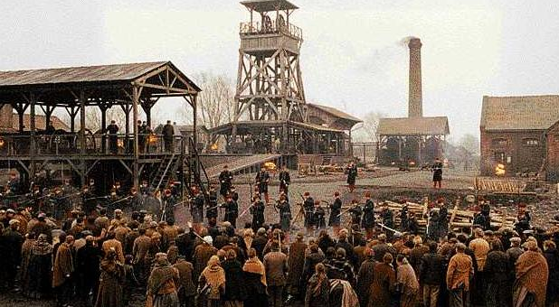
Germinal

Slide 23
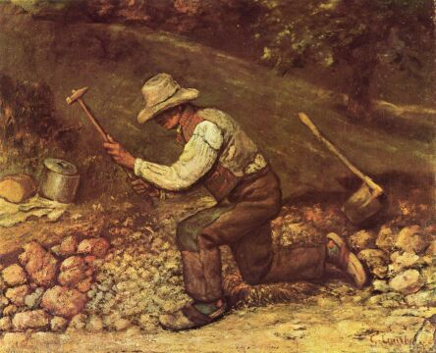
Gustave Courbet, ‘Quarryman’, 1850

Slide 24
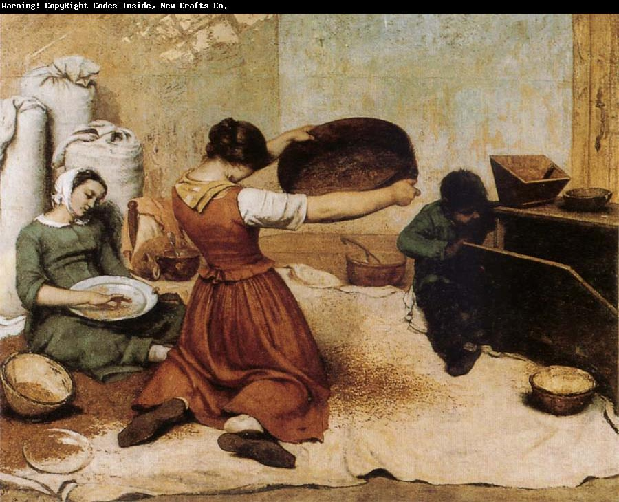
Gustave Courbet, The Winnowers’, 1855

Slide 25
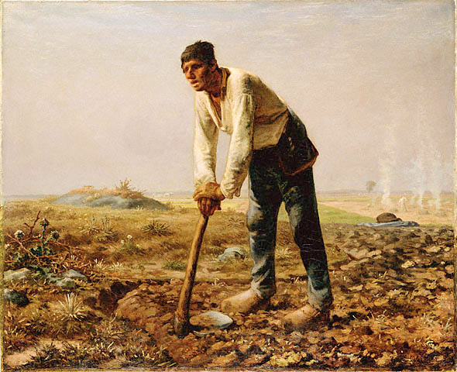
Jean-Francois Millet, ‘Man with a Hoe’ (1860)

Slide 26
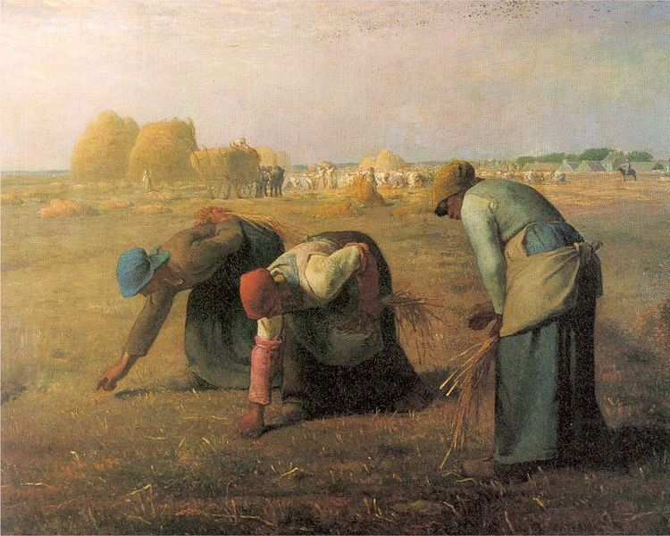
Jean-Francois Millet, ‘The Gleaners’ (1857)

Slide 27
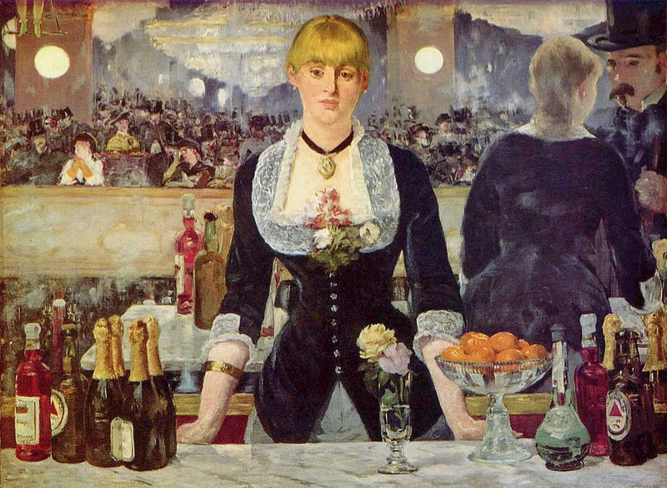
Édouard Manet, Le Bar des Folies-Bergère (1881)

Slide 28
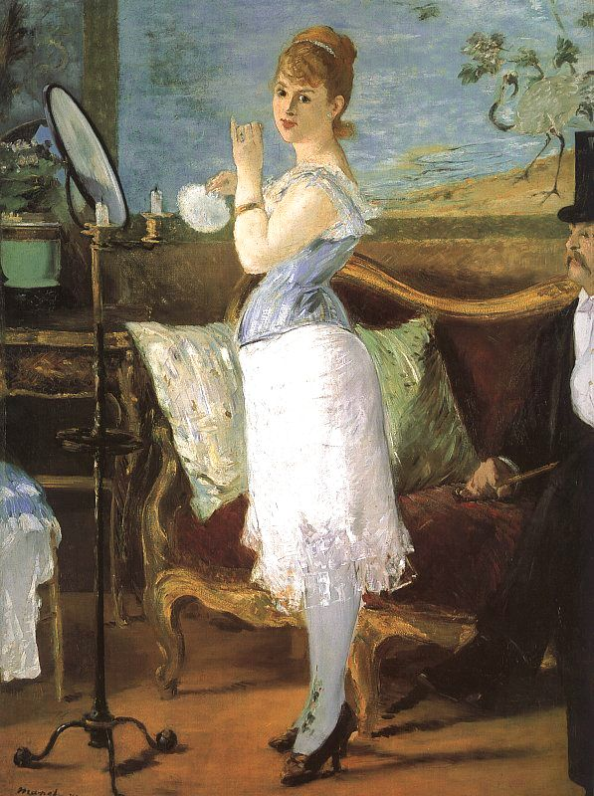

Slide 29
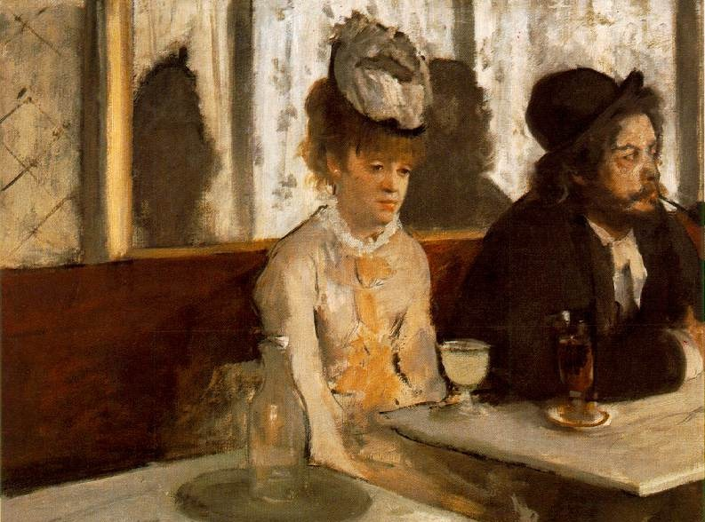
Degas, ‘L’Absinthe’ (1876)

Slide 30
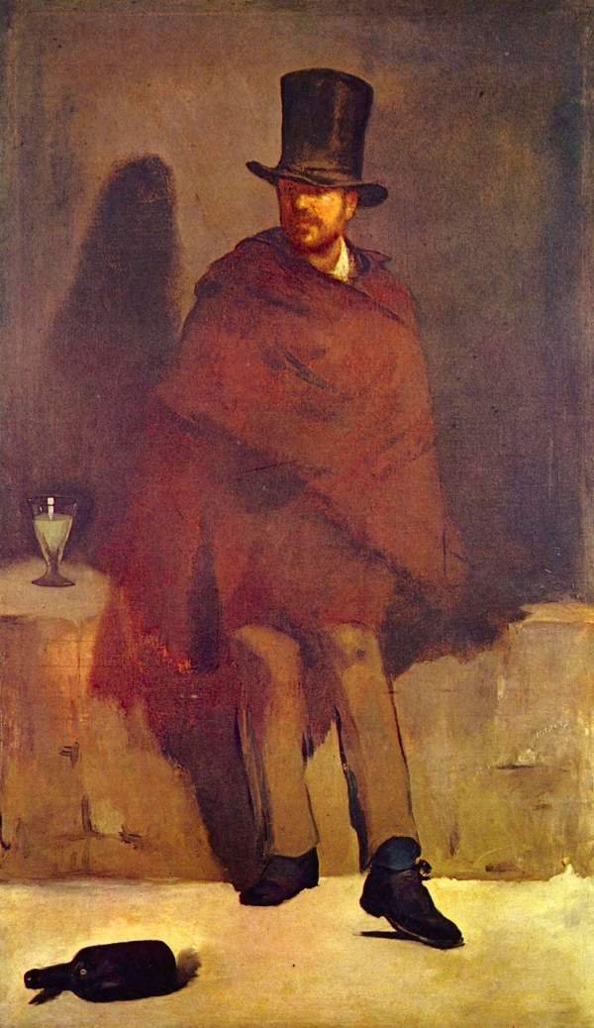
Édouard Manet, Absinthe Drinker
Notes:
Manet, The Absinthe Drinker

Slide 31
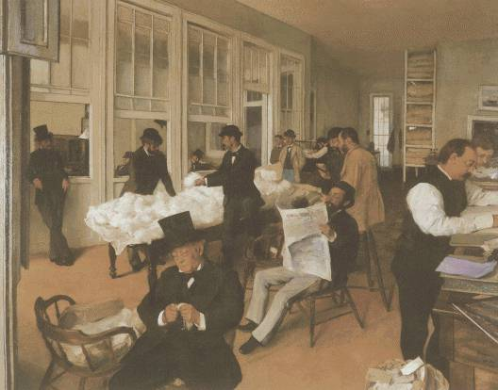
Edgar Degas, ‘Portraits in an Office’ (1873)

Slide 32
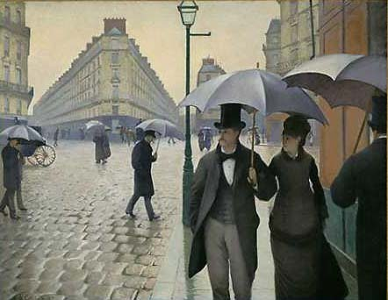
Gustave Caillebotte, ‘Paris Street, Rainy Day’ (1877)

Slide 33
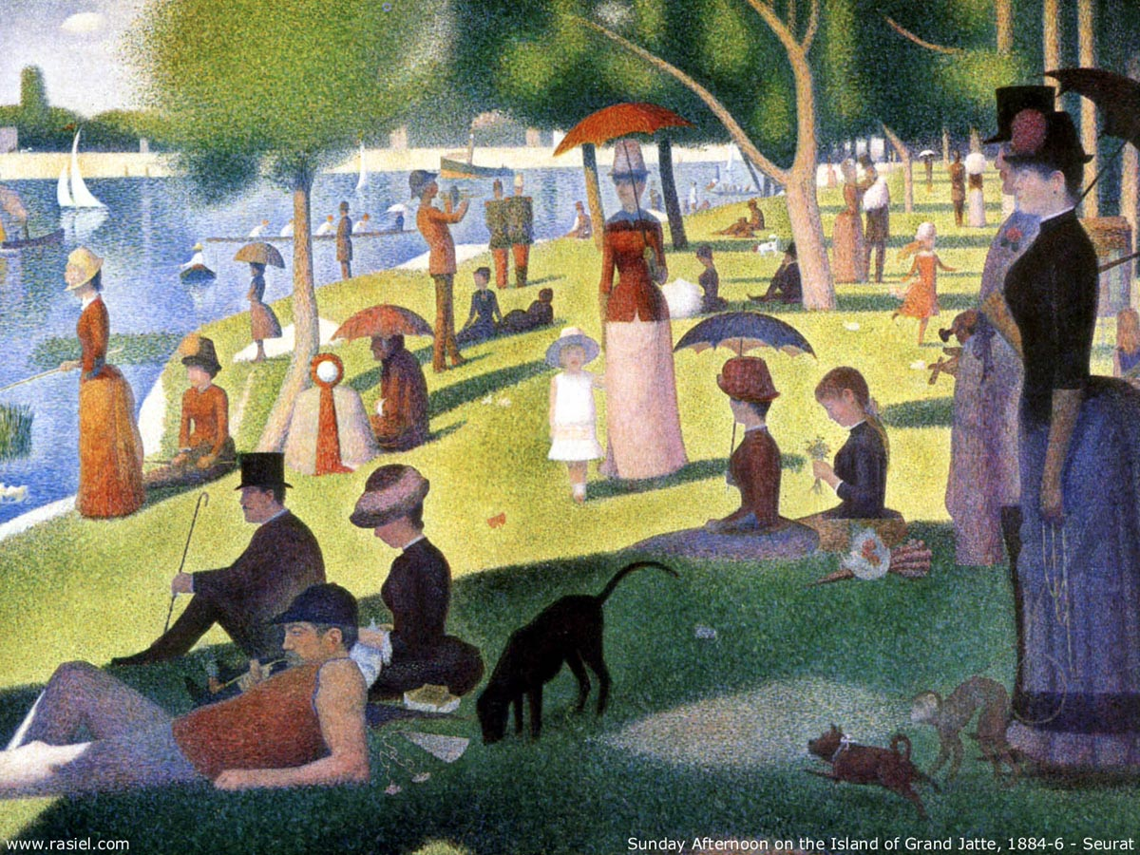
Georges Seurat, Sunday Afternoon on Grand Jatte (1884-6)

Slide 34
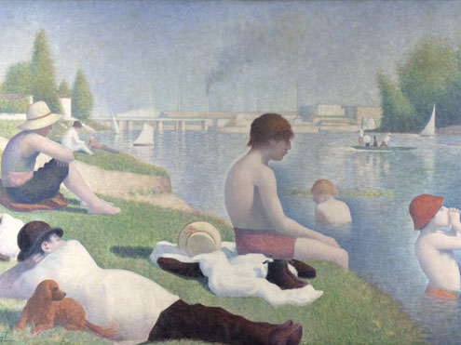
Georges Seurat, Bathers at Asnières

Slide 35
Crossing the open plain, wading through the thick, dark ink of a starless night, a solitary figure followed the highway from Marchiennes to Montsou, which cut its paved pathway straight through ten kilometres of beet fields. The man could not even see the black earth beneath his feet, and his only sense of the vast, flat horizons came from the gusting March wind, blowing in wide swathes as if sweeping across the sea, but icy cold from its passage over leagues of marshland and barren earth. Not a tree marked the sky with its shadow, and the paved road jutted forward like a pier straight out into the murky waves of this world of shadows. […] There was a dip in the road, and the vision vanished. On his right a fence appeared, a rough wooden barricade blocking off a railway track; while over to the left rose a grass mound, covered with a jumbled arrangement of gables, giving the impression of a village with a low, regular line of rooftops. About 200 paces further on, a sudden bend in the road brought the fires back into sight, nearer this time, yet he could not guess how they could be burning so high up in the lifeless sky, looking like smouldering moons. But then he was suddenly brought to a halt by the sight at ground level of a great shapeless heap of low buildings topped by the outline of a factory chimney rising from its midst; here and there a lonely light flickered through a filthy window, five or six miserable lanterns were hung up outside on brackets whose blackened timber projected mysterious silhouettes like giant scaffolds, and, from the midst of this fantastic apparition, swimming in smoke and darkness, there rose a lone voice, the prolonged, loud wheezing of a steam engine exhaust valve, hidden somewhere out of sight.
Then he recognized it as a pit head. Germinal, opening to Ch1

Slide 36
At first the foreman told them to wait, and shut the door on them. Then he came back and led them into the drawing room, pulling back the curtains. A soft light filtered through the lace. Left alone, the miners were afraid to sit down, but stood about awkwardly, all in their Sunday best and carefully shaved, with fair hair and moustaches, twisting their caps in their hands and throwing sidelong glances at the furniture, which was in that jumble of all the styles made fashionable by the craze for the antique: Henri II armchairs, Louis VX occasional chairs, a seventeenth-century Italian cabinet, a fifteenth century Spanish contador, an altar front draping the mantelshelf, and old chasuble embroideries cut out and sewn on to the portieres. The display of old gold, the tawny hues of old silks, and all this ecclesiastical splendour filled them with respectful awe. The deep pile of the oriental carpets seemed to cling to their feet. But the heat, above all, overwhelmed them: they could not understand this uniform heat given by the stoves, especially as their cheeks were stinging from the icy wind outside. Five minutes went by, and this discomfort increased in this sumptuous room so snugly closed to the outer world.
Monsieur Hennebeau came in at last, with his frock coat buttoned up in military fashion, and wearing on his lapel the little rosette of his decoration. He was the first to speak.
‘Ah! – here you are! This is a revolt, it seems.’
He broke off to add with stiff politeness:
‘Sit down. I am only too delighted to have a chat.’
The miners turned round looking for seats. A few ventured to sit on chairs, but most of them took fright at the look of the silken embroideries, and preferred to stand.
Germinal Pt 4, Ch2.

Slide 37
Oppositions in Germinal
Bourgeois (owner) Government Wealth Greed Conservatism Commitment
--------------------------------------------------------------------------------------------------------------------
Worker (producer) Citizen Poverty Need Progressivism Apathy
Collectivism Light Leisure Surface Rationalism
-------------------------------------------------------------------------------------------------------------------
Individualism Dark Labour Pit Instinct

Slide 38
Economic conditions had first transformed the mass of the people of the country into workers. The domination of capital has created for this mass a common situation, common interests. The mass is thus already a class against capital, but not yet for itself. In the struggle … this mass becomes united, and constitutes itself as a class for itself. The interests it defends become class interests.
Karl Marx, The Poverty of Philosophy, 1847

Slide 39
Not a word was exchanged. They were all hacking away, their irregular blows setting up a dull, distant-sounding, but pervasive barrage of noise. The sound had a harsh timbre in the thick air, which stifled any echo at birth. And the darkness seemed to be coloured an unnatural black, with swirling waves of coal-dust, and vapours which hung heavy on the eyelids. The wicks of the lamps, beneath their gauze chimneys, failed to penetrate the gloom with their small red glow. Hardly anything could be seen at the coalface, whose wide mouth led diagonally upwards like a wide but shallow chimney, where the soot had been gathering for a decade of winters to form an impenetrable blackness. Ghostly figures could be seen gesticulating, as a stray gleam revealed at random an arched hip, a muscular arm, or a grim face, camouflaged as if for some crime…nothing was audible but chesty breathing, and tired or painful grunts and groans, muffled by the heavy air and the sound of running water. (Germinal, PtI, CH4)

Slide 40
‘Come along and I’ll show you something,’ she murmured gaily.
She led him to the end of the coalface and showed him a fissure from which was coming a sort of soft bubbling sound, like the chirping of a bird.
‘Hold your hand there, you can feel the draught. That’s fire-damp.’
He was amazed. Was that all there was to it? So this was the terrible stuff that blew everything sky-high? She laughed, and said that there was a lot of it about today to make the lamps turn blue.
‘When you’ve done chattering, you lazy devils!’ broke in the rough voice of Maheu.
Catherine and Étienne hastily filled their tubs and pushed them to the incline, crawling stiff-backed under the bulging roof. By the time they had done two journeys they were soaked in sweat and the bones were cracking again.
The colliers had again started work at the coalface, for they usually cut down their lunch time so as not to get cold. Far from the light of day they gulped down their food without a word, and now their sandwiches lay in their stomachs as heavy as lead. Stretched out on their sides, they were picking away harder than ever, with only one idea in their heads: to make up a large total of tubs. In this desperate fight for such hard earned gain, everything else faded into insignificance. They no longer noticed the water running down them and making their limbs swell, the cramps from unnatural postures, the stifling darkness in which they were blanched like plants in a cellar. And yet, as the day wore on, the air became more and more foul, what with the heat and the smoke from the lamps, the bad breath, the asphyxiating gas, which clung to their eyes like cobwebs and would only be cleared away by the night’s ventilation. Like moles burrowing under the weight of the earth, without a breath of air in their burning lungs, they went on picking away.
Germinal, Pt I, End Ch4

Slide 41
Gradually, his vanity at being their leader and the constant necessity of doing their thinking for them was setting him apart and creating within him the soul of one of the bourgeois he hated so much [...] he felt that sensation of repugnance and embarrassment that assails the workman who has risen above his class, been refined by study and begun to harbour ambitions (Germinal, Pt VI, Ch 3).

Slide 42
Étienne was leaving the road to Vandame and came on to the main paved highway. To the right he made out Montsou sloping away into the distance. Opposite him were the ruins of Le Voreux, the cursed abyss that three pumps worked tirelessly to empty. Then over on the horizon there were other pits, La Victoire, Saint-Thomas, Feutry-Cantel; while towards the north, smoke from the high chimneys of the blast furnaces and the batteries of coke ovens curled up through the clear morning air. If he wanted to catch the eight o’clock train he’d have to hurry up, for there were still six kilometres to go.
And far below, beneath his feet, the stubborn tapping of the picks continued. His comrades were all down there, and he could hear them following his every step. Wasn’t that La Maheude under the beetfield, her back broken, and her raucous breathing rising up to the accompanying rumble of the ventilator? Further away, to the left and to the right, he thought he could recognise others, beneath the wheat, the green hedges, and the young saplings. High in the sky the April sun now shone down in its full glory, warming the bountiful earth and breathing life into her fertile bosom, as the buds burst into verdant leaf, and the fields quivered under the pressure of the rising grass. All around him seeds were swelling and shoots were growing, cracking the surface of the plain, driven upwards by their need for warmth and light. The sap flowed upwards and spilled over into soft whispers; the sound of germinating seeds rose and swelled to form a kiss. Again and again, and even more clearly, as if they too were rising towards the sunlight, his comrades kept tapping away. Beneath the blazing rays of the sun, in that morning of new growth, the countryside rang with song, as its belly swelled with a black and avenging army of men, germinating slowly in its furrows, growing upwards in readiness for harvests to come, until one day soon their ripening would burst open the earth itself.
Zola, Germinal, final paragraphs.

