Slide 1

Hauntings: On Algerian White
EN201 The European Novel
English & Comparative Literary Studies

Slide 2
Assia Djébar (1936-2015)
http://www.theguardian.com/books/2015/feb/09/assia-djebar-algerian-novelist-dies

Slide 3
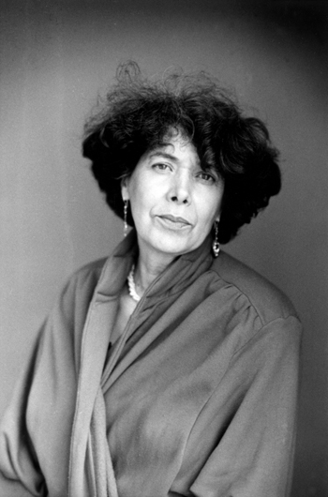
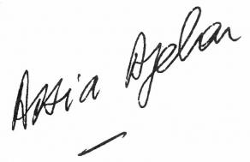

Slide 4
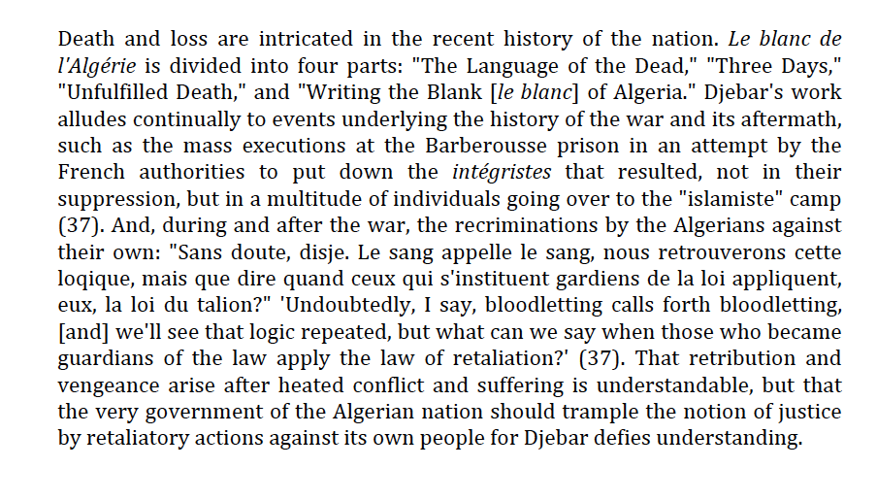
John Erickson. ‘Translating the Untranslated: Djébar’s Le blanc de l’Alg´´riweResearch in African Literatures 30.3 (1999) 95-107

Slide 5

What is a novel? Challenging notions of genre
Fiction/Reality
Prose/Poetic Language
Autobiographical/ Testimony/Imagined
Memory and Ethics
And Europe? Algerian White as European novel

Slide 6
“What forms the common core of a European identity is the character of the painful learning process it has gone through, as much as its results. It is the lasting memory of nationalist excess and moral abyss that lends to our present commitments the quality of a peculiar achievement.” (Jürgen Habermas, New Left Review, 2001, p. 21)

Slide 7
Postcolonial Violence
Imbrications
Conflations
Distinctions

Slide 8
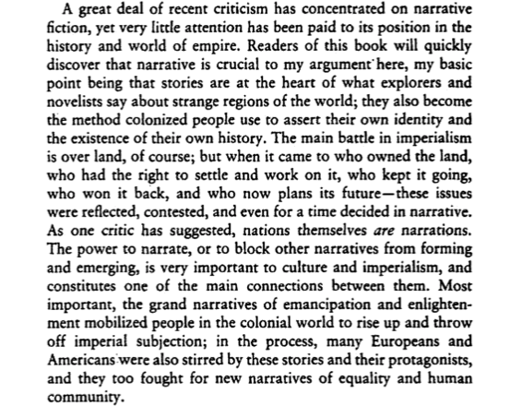
Edward Said. Culture and Imperialism, 1994, p. xiii

Slide 9
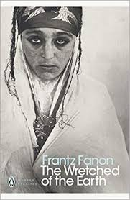
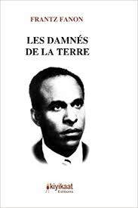

Slide 10
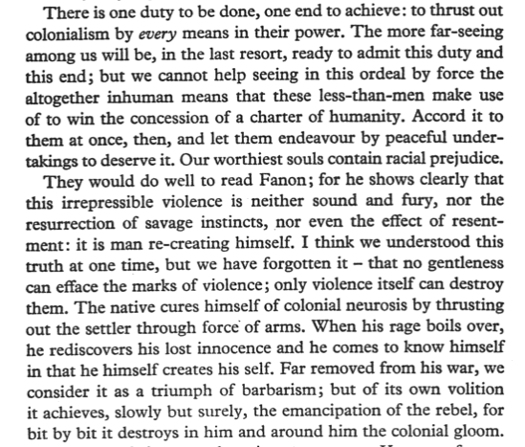

Slide 11
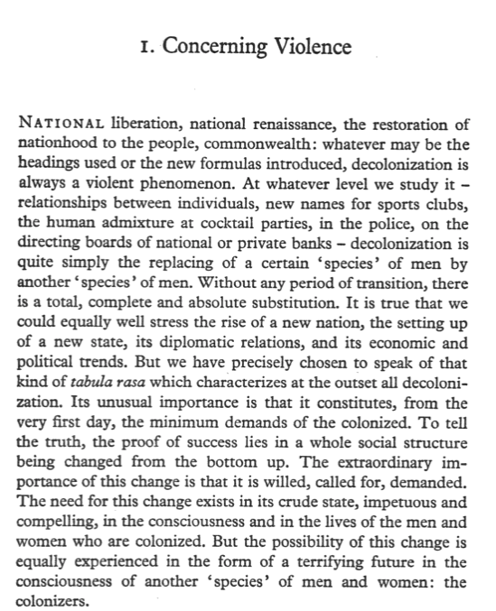

Slide 12
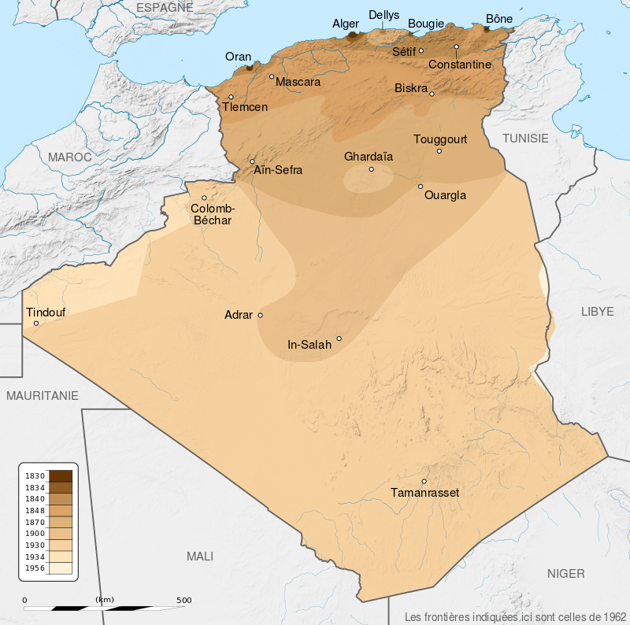

Slide 13
1830 French invasion
1954-1962 War of Independence
1991 – 2002(?) civil war
FLN
And Europe?

Slide 14
FLN is considered responsible for over 16,000 Algerian civilians killed and over 13,000 disappeared between 1954 and 1962.^{[5]} After the ceasefire of 19 March 1962, FLN is thought to have massacred between 60,000 and 70,000 harkis: Muslim Algerians who had served in the French army and whom the French, contrary to promises given, had denied a "repatriation" to France.^{[6][7]}
Notorious examples of FLN massacres include the Philippeville massacre. An estimated 4,300 people were also killed in France in FLN-related violence.^{[7]}
Source: https://en.wikipedia.org/wiki/National_Liberation_Front_(Algeria). Accessed: 20-02-2019

Slide 15
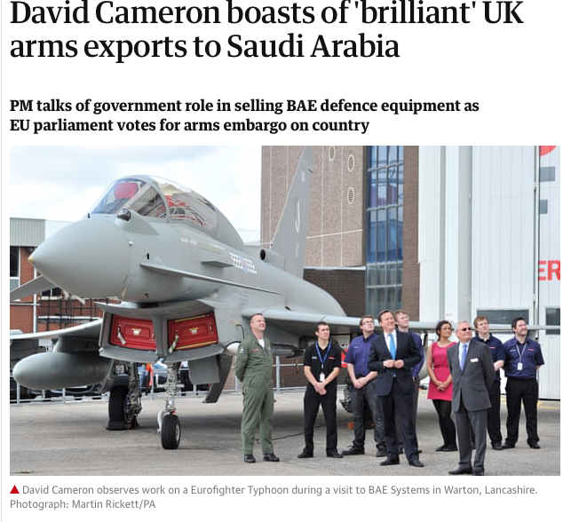

Slide 16
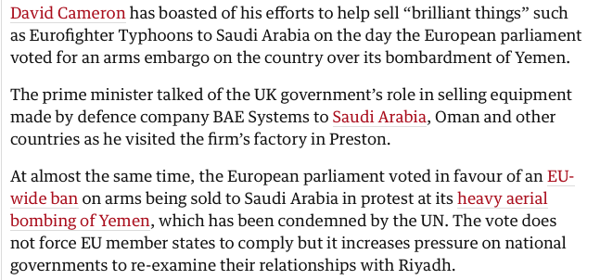
https://www.theguardian.com/world/2016/feb/25/david-cameron-brilliant-uk-arms-exports-saudi-arabia-bae

Slide 18


Slide 20
Rewriting History
Opening up public sphere
Checking imbrications
Writing back

Slide 23
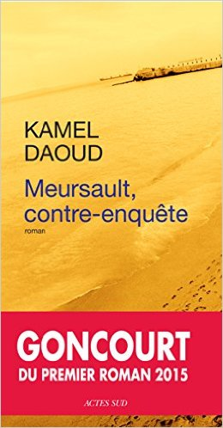

Slide 25
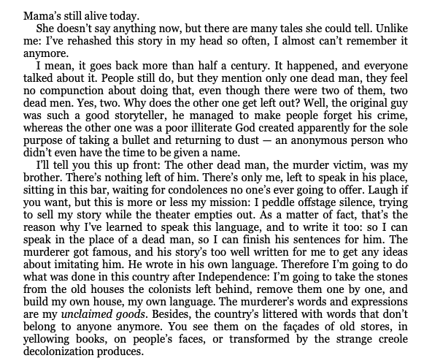

Slide 26
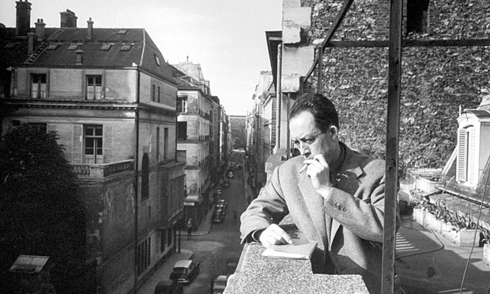
Albert Camus (1913-1960)

Slide 27
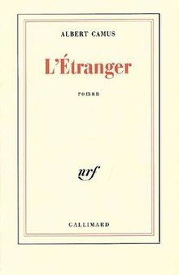

Slide 28
The Question of Algiers

Slide 29


Slide 30
Hanneke and Silence
Language of the dead
French as imperial language, as neutral, as always impossible

Slide 31
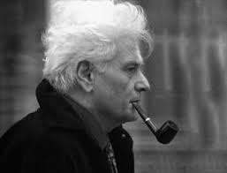

Slide 32
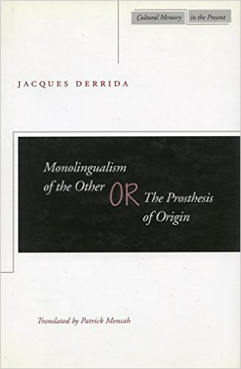
Notes:
1996

Slide 33
Ethics, Aesthetics, Duty, Responsibility; Witnessing, Dialogue of the Dead, What is a novel? And Europe?

Slide 36
