Slide 1
Gustave Flaubert, Madame Bovary
Professor Kate Astbury
SMLC

Slide 2
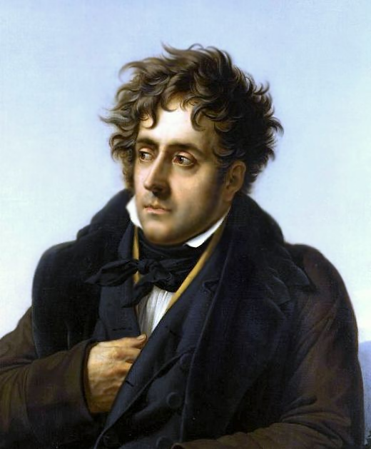
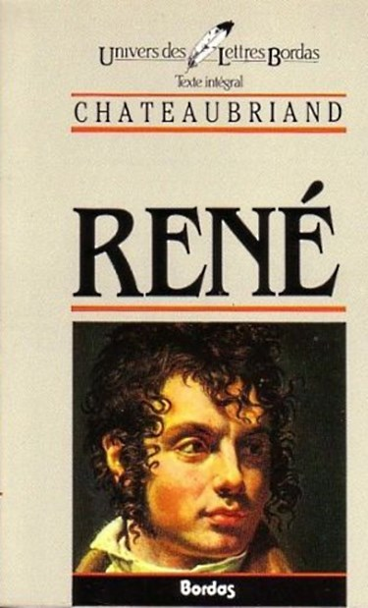

Slide 3
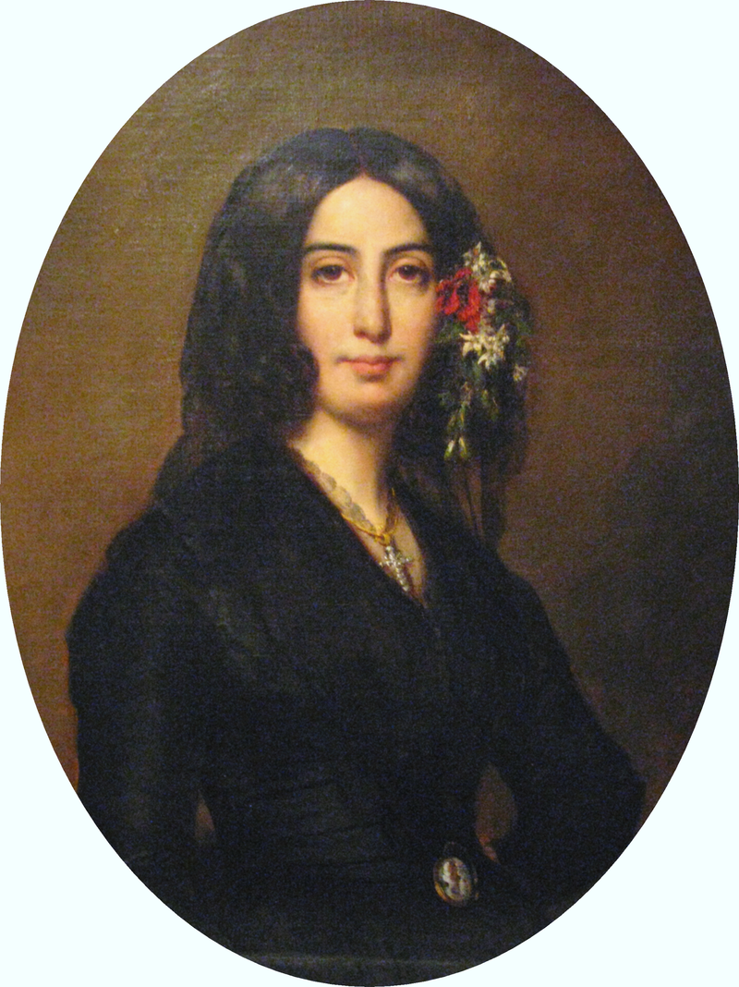
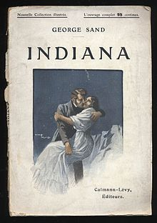

Slide 4

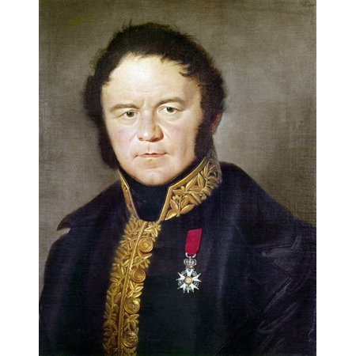

Slide 5
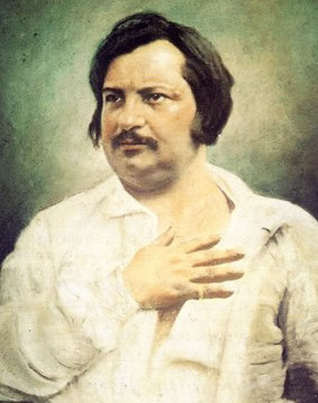


Slide 6
“The author firmly believes that details alone will henceforth constitute the merit of works improperly called novels” (Balzac, 1830)

Slide 7
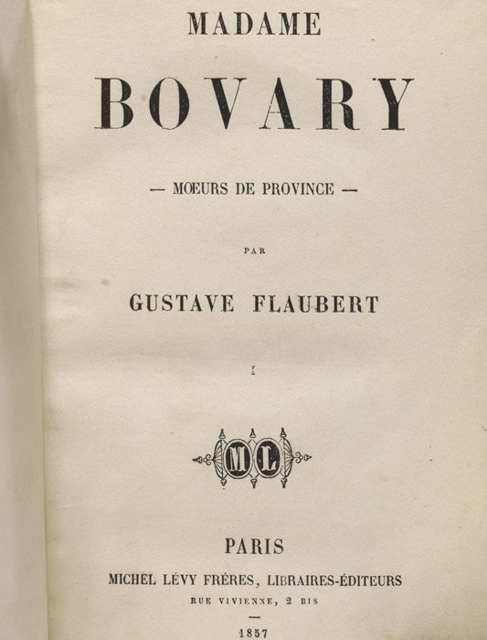
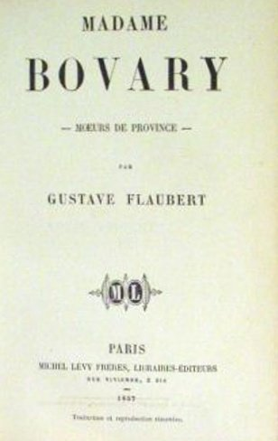

Slide 8
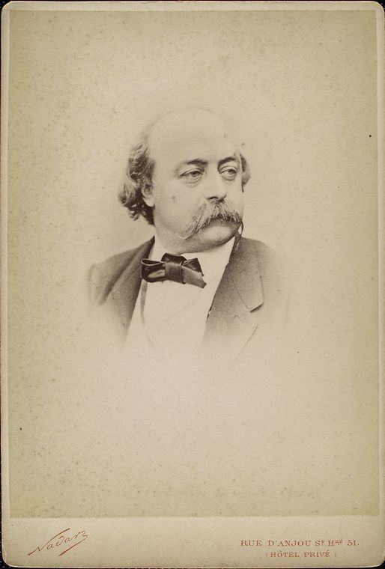

Slide 9
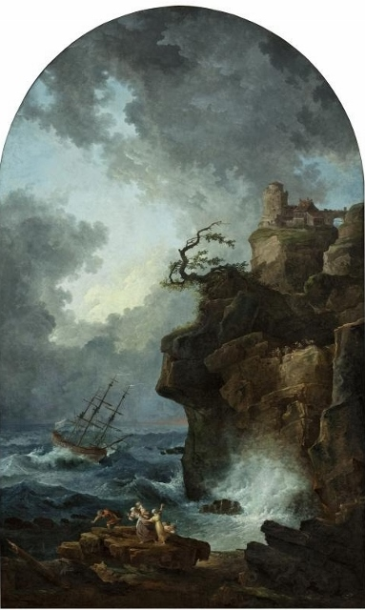

Slide 10
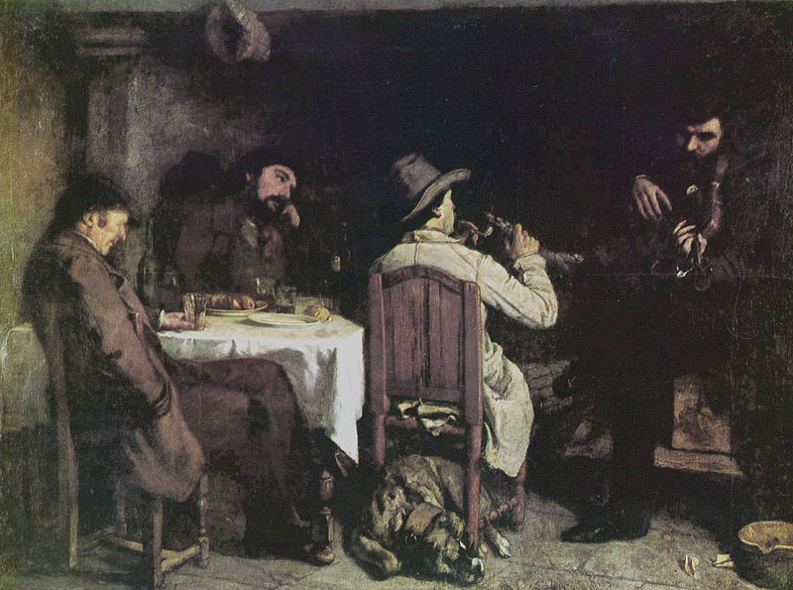

Slide 11
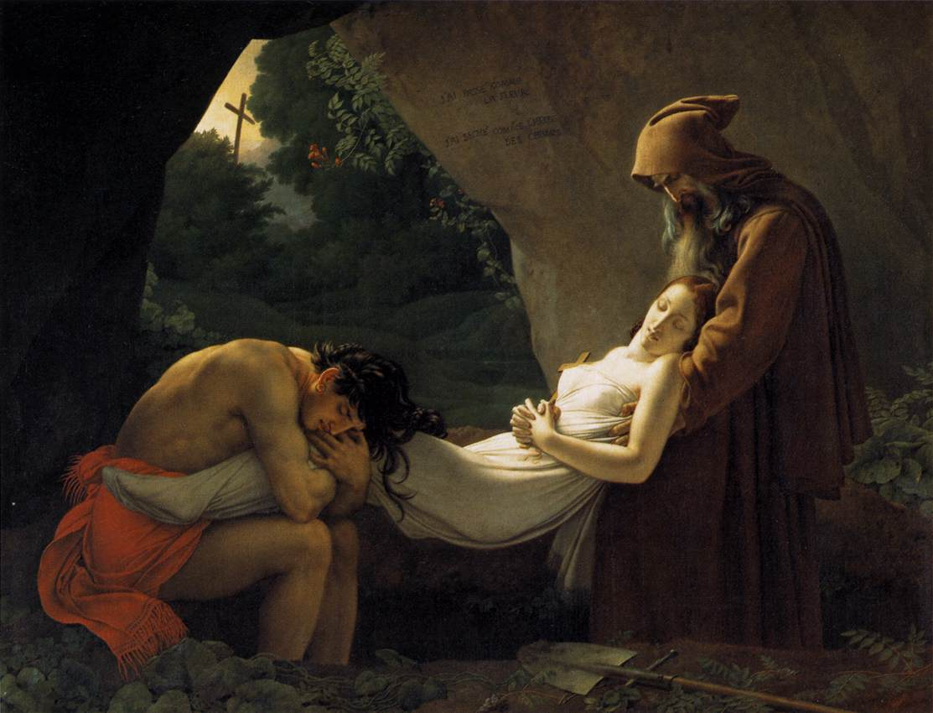

Slide 12
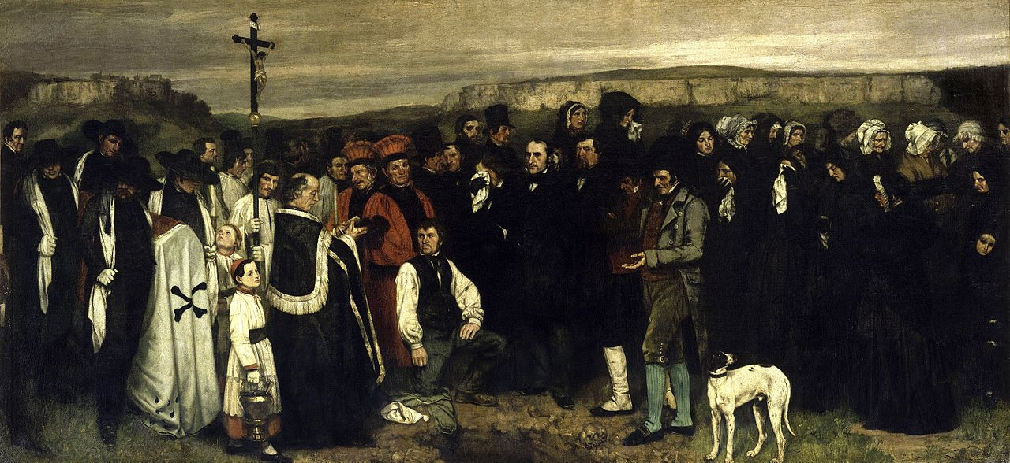

Slide 13
The comparisons of betrothed, husband, celestial lover and eternal marriage that recur in sermons, stirred within her soul depths of unexpected sweetness.

Slide 14
Through Walter Scott, later on, she fell in love with historical events, dreamed of old chests, guard-rooms and minstrels, She would have liked to live in some old manor-house, like those long-waisted chatelaines who, in the shade of pointed arches, spent their days leaning on the stone, chin in hand, watching a cavalier with white plume galloping on his black horse from the distant fields.

Slide 15
She was in love with Leon, and sought solitude that she might with the more ease delight in his image. The sight of his form troubled the voluptuousness of this meditation. Emma thrilled at the sound of his step, then in his presence the emotion subsided, and afterwards there remained to her only an immense astonishment that ended in sorrow.

Slide 16
But it was above all the meal-times that were unbearable to her, in this small room on the ground floor, with its smoking stove, its creaking door, the walls that sweated, the damp flags; all the bitterness in life seemed served up on her plate, and with the smoke of the boiled beef there rose from her secret soul whiffs of sickliness.

Slide 17
Some flies on the table were crawling up the glasses that had been used, and buzzing as they drowned themselves in the dregs of the cider. The daylight that came in by the chimney made velvet of the soot at the back of the fireplace, and touched with blue the cold cinders. Between the window and the hearth Emma was sewing; she wore no fichu; he could see small drops of perspiration on her bare shoulders.
After the fashion of country folks she asked him to have something to drink. He said no; she insisted, and at last laughingly offered to have a glass of liqueur with him. So she went to fetch a bottle of curacao from the cupboard, reached down two small glasses, filled one to the brim, poured scarcely anything into the other, and, after having clinked glasses, carried hers to her mouth. As it was almost empty she bent back to drink, her head thrown back, her lips pouting, her neck on the strain. She laughed at getting none of it, while with the tip of her tongue passing between her small teeth she licked drop by drop the bottom of her glass.

