Slide 1
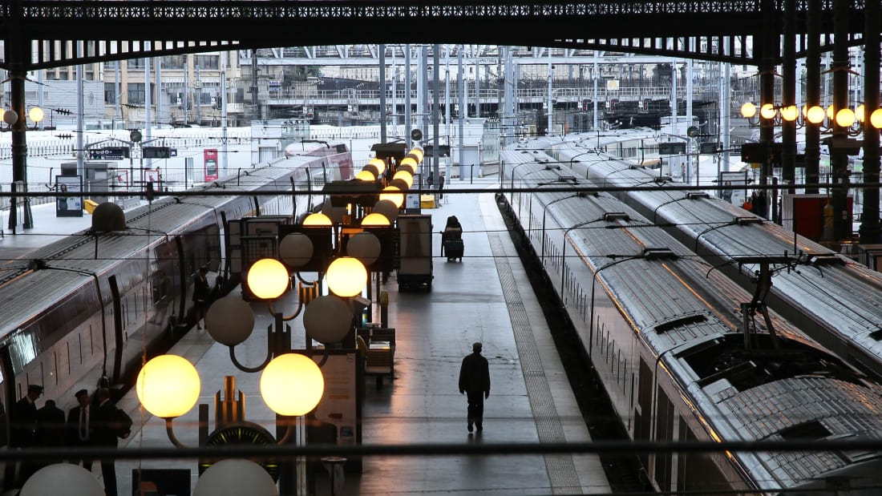
EN201 The European Novel

Slide 3
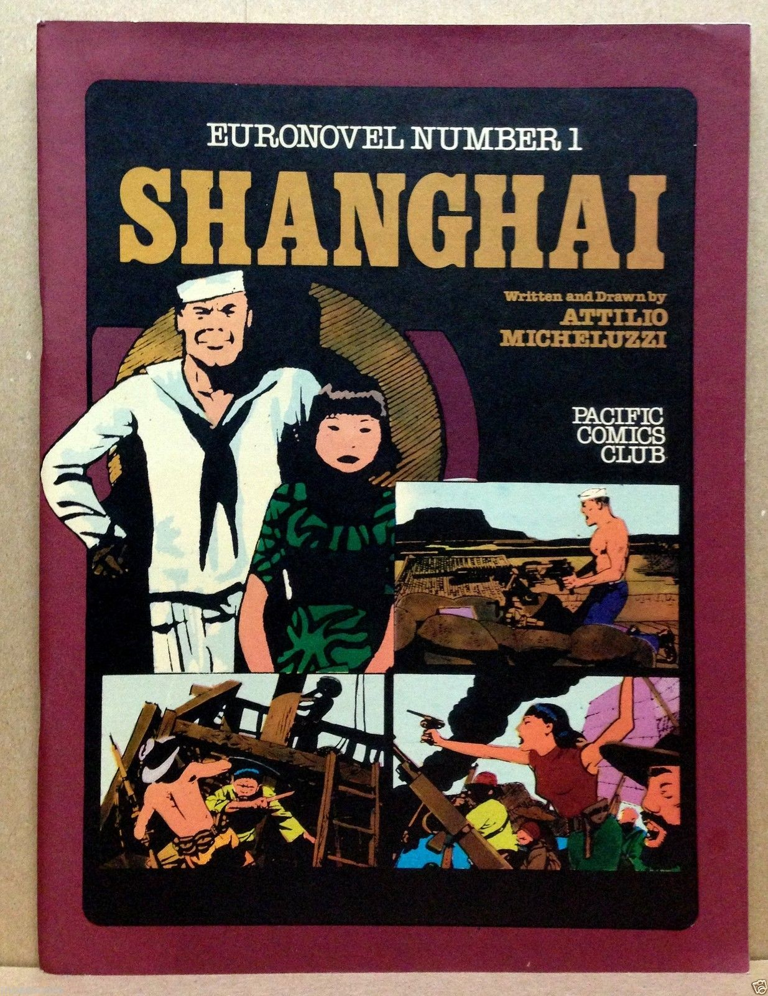

Slide 4
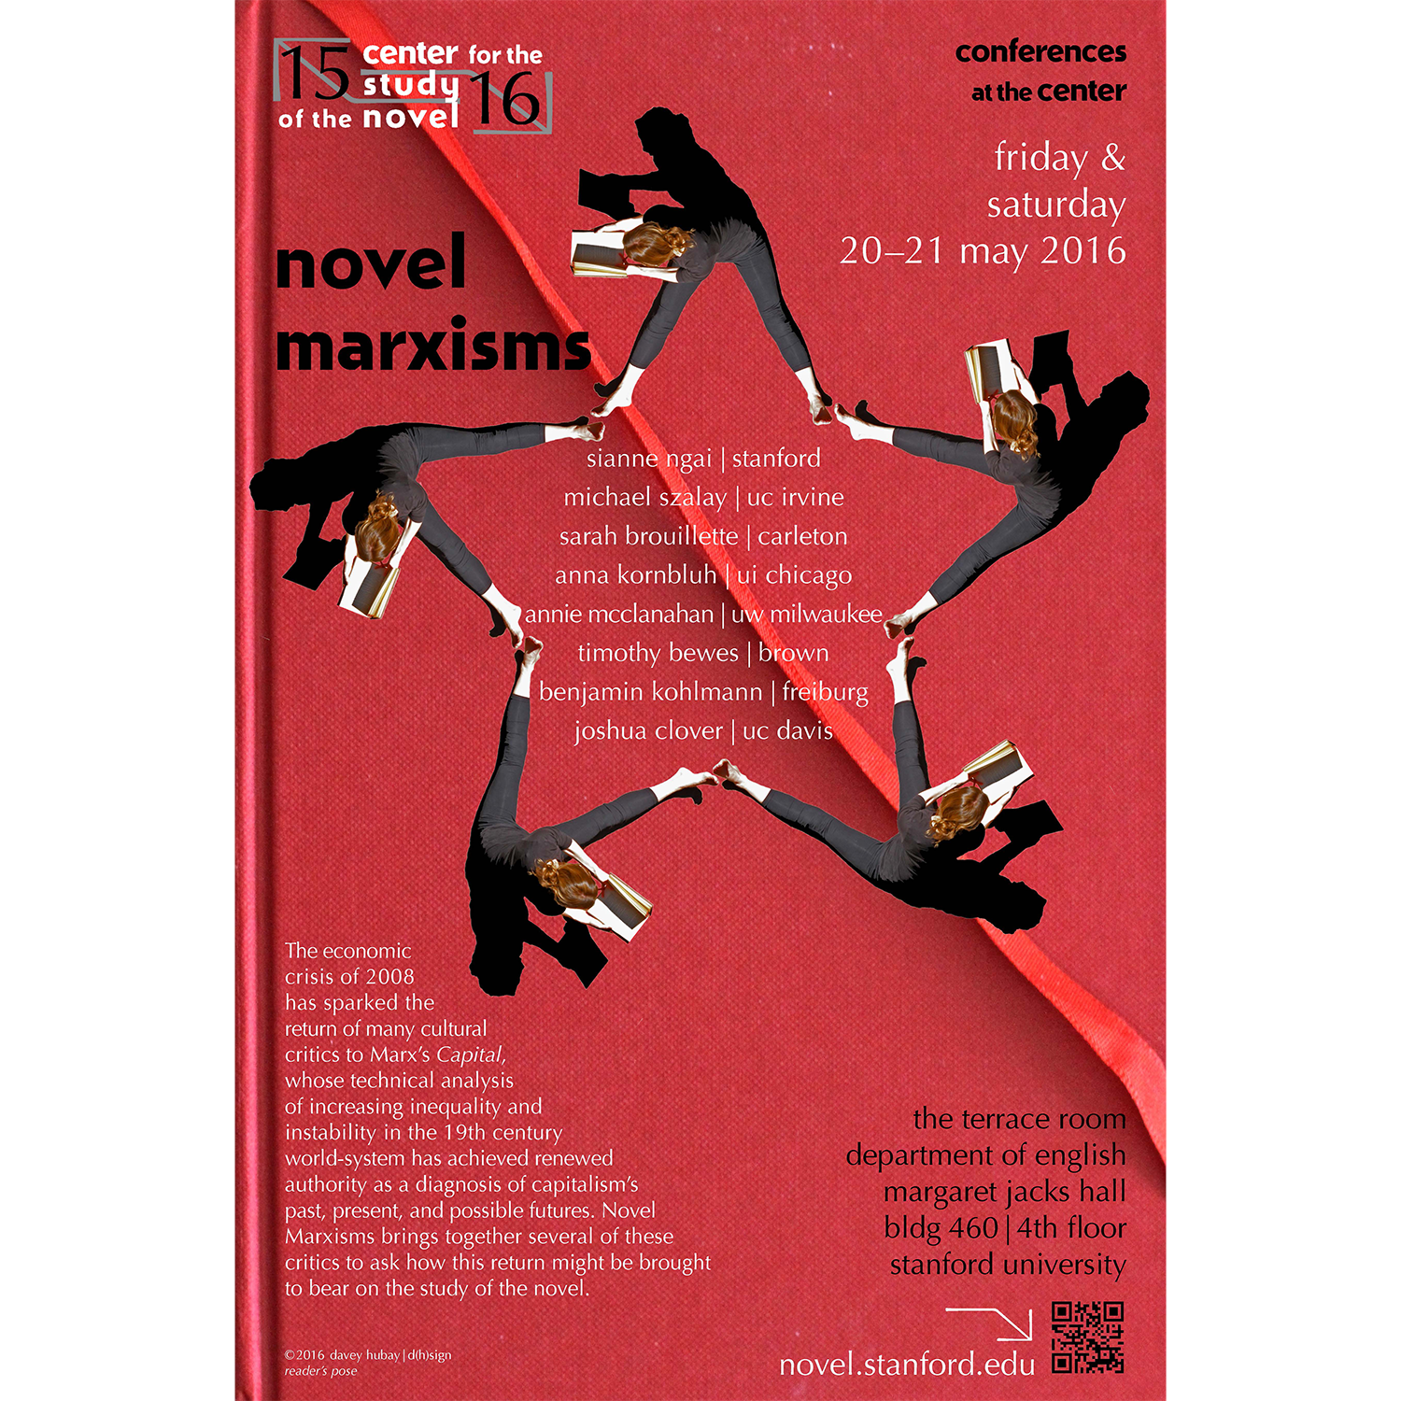

Slide 8
Practical Matters
Aims of the Module
Lectures
Assessment
  50/50
  Optional formative essay unassessed in term 1
  5000 word essay (week 10, term 2)
  2 hour exam

Slide 9
The European Novel module seeks to provide an understanding of the novel form through the study of works of European long fiction from the late eighteenth to the late twentieth century. It aims to explore key stages and transitions in the history of the form across Europe and the range of narrative possibilities and thematic concerns it encompasses. We will focus in particular on similarities and differences of period, region and culture; on the nature of novelistic narrative and the formal techniques and devices of narration; and on the issues raised by theories of narrative and the idea of realism.

Slide 10
Primary Texts
Johann Wolfgang Von Goethe, The Sorrows of Young Werther (1774)
Jane Austen, Emma (1815)
Gustave Flaubert, Madame Bovary (1857)
Fyodor Dostoyevsky, Crime and Punishment (1866)
Leo Tolstoy, Anna Karenina (1877)
Émile Zola, Germinal (1885)
Knut Hamsun, Hunger (1890)
Franz Kafka, The Trial (1925)
Virginia Woolf, Mrs. Dalloway (1925)
António Lobo Antunes, The Land at the End of the World (1979)
Assia Djebar, Algerian White (1996)
W. G. Sebald, Austerlitz (2001)
Seamus Deane, Reading in the Dark (1996)
Javier Marías, Thus Bad Begins (2016)

Slide 11
Good Books
“If the book we are reading does not wake us, as with a fist hammering on our skulls, then why do we read it? Good God, we also would be happy if we had no books and such books that make us happy we could, if need be, write ourselves.. …. What we need are books that hit us like a most painful misfortune, like the death of someone we loved more than we love ourselves, that make us feel as though we had been banished to the woods, far from any human presence, like a suicide.” Kafka, Letter to Oskar Pollack (1904)

Slide 12
“It is still widely believed that the traditional culture of the English people was broken and disintegrated by the Industrial Revolution. What then emerged, it is said, was on the one hand a debased synthetic commercial culture – the world of the newspapers and popular entertainment; on the other hand an increasingly threatened minority culture – an educated tradition within which the finest literature and thought of the time sought to maintain and extend itself and to keep its connections, its continuities, with the best work of the past” (Raymond Williams, The English Novel from Dickens to Lawrence (1970) 28)

Slide 13
“What forms the common core of a European identity is the character of the painful learning process it has gone through, as much as its results. It is the lasting memory of nationalist excess and moral abyss that lends to our present commitments the quality of a peculiar achievement” (Jürgen Habermas “Why Europe Needs a Constitution” (New Left Review 11, 2001 21)

Slide 14
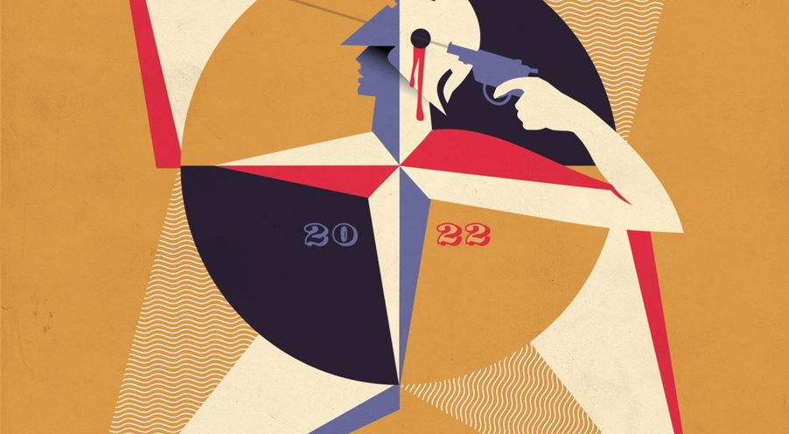

Slide 15
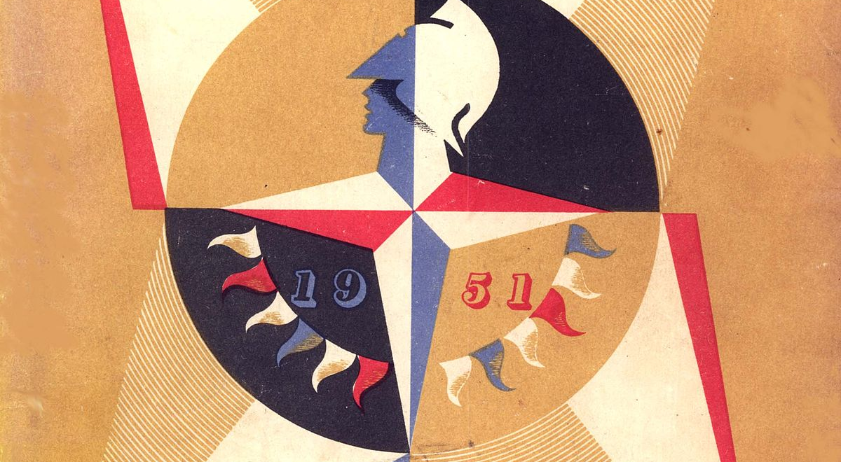

Slide 16
“The year 2010 was a time of reflection. A financial crisis two years before had eliminated much of the world’s wealth, and a halting recovery was favoring the rich. An African American was president of the United States. The great adventure of Europe in the 2000s, the enlargement of the European Union to the east, seemed complete. A decade into the twenty-first century, two decades away from the end of communism in Europe, seven decades after the beginning of the Second World War, 2010 seemed like a year for reckonings.” Timothy Snyder, The Road to Unfreedom: Russia, Europe, America (2018)

Slide 17
To articulate what is past does not mean to recognize “how it really was.” It means to take control of a memory, as it flashes in a moment of danger. For historical materialism it is a question of holding fast to a picture of the past, just as if it had unexpectedly thrust itself, in a moment of danger, on the historical subject. The danger threatens the stock of tradition as much as its recipients. For both it is one and the same: handing itself over as the tool of the ruling classes. In every epoch, the attempt must be made to deliver tradition anew from the conformism which is on the point of overwhelming it. For the Messiah arrives not merely as the Redeemer; he also arrives as the vanquisher of the Anti-Christ. The only writer of history with the gift of setting alight the sparks of hope in the past, is the one who is convinced of this: that not even the dead will be safe from the enemy, if he is victorious. And this enemy has not ceased to be victorious. Walter Benjamin, Thesis VI on the Concept of History (1940)

Slide 18
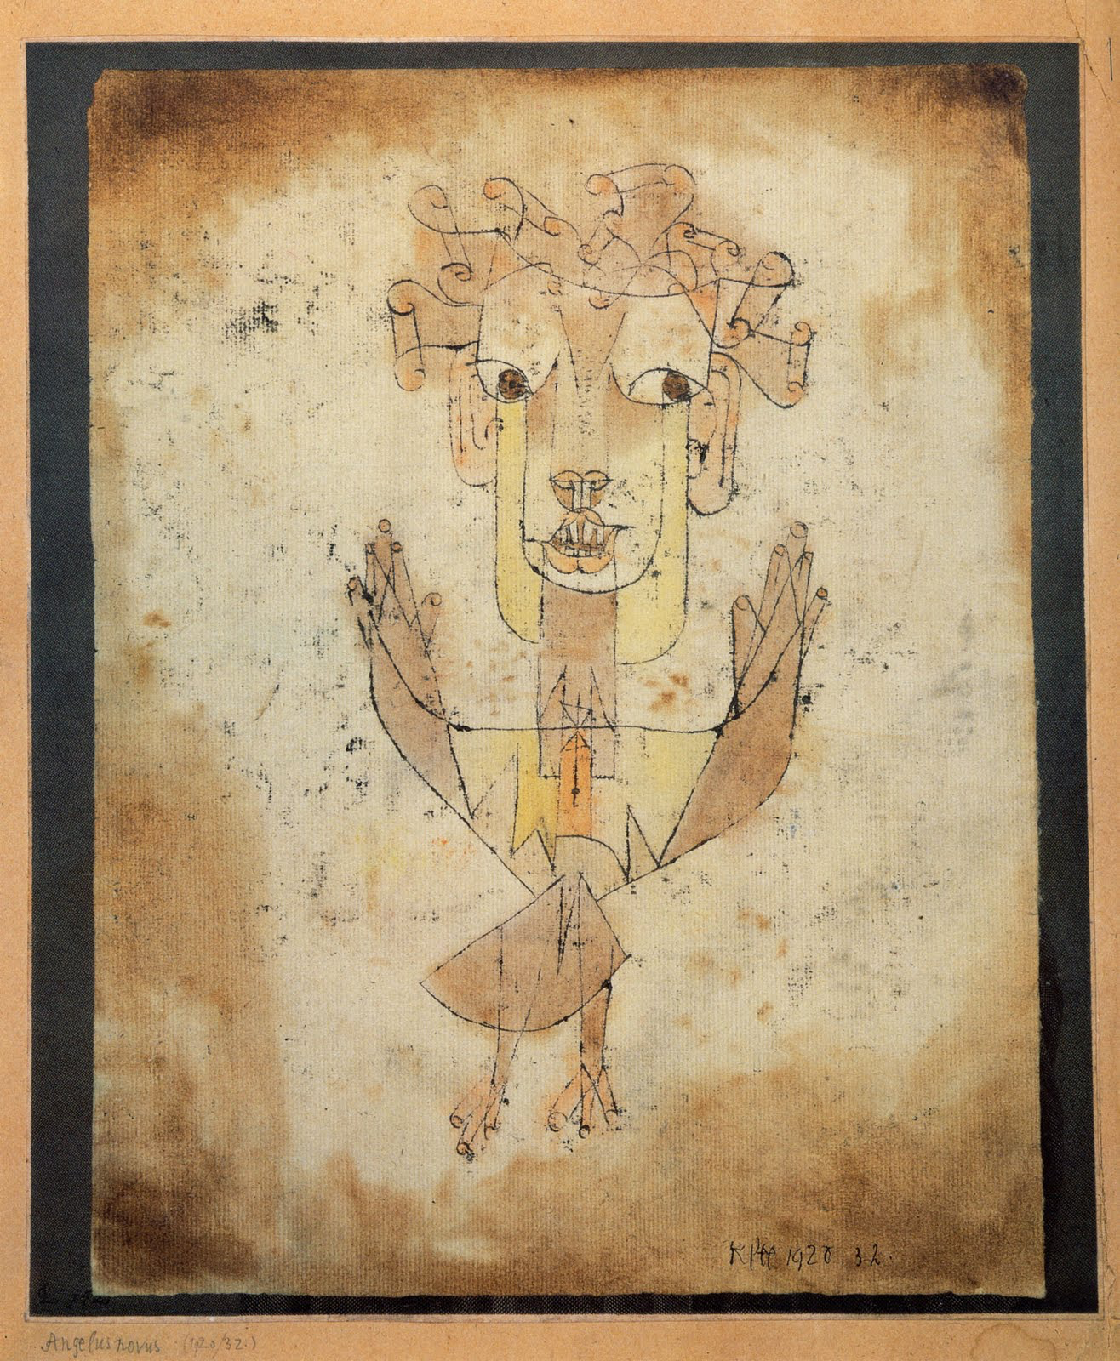

Slide 19
1. Historicize
“Whoever until this day emerges victorious, marches in the triumphal procession in which today’s rulers thread over those who are sprawled underfoot. The spoils are, as was ever the case, carried along in the triumphal procession. They are known as the cultural heritage. In the historical materialist they have to reckon with a distanced observer. For what he surveys as the cultural heritage is part and parcel of a lineage [Abkunft: descent] which he cannot contemplate without horror. It owes its existence not only to the toil of the great geniuses, who created it, but also to the nameless drudgery of its contemporaries. There has never been a document of culture, which is not simultaneously one of barbarism. And just as it is itself not free from barbarism, neither is it free from the process of transmission, in which it falls from one set of hands into another. The historical materialist thus moves as far away from this as measurably possible. He regards it as his task to brush history against the grain.” Walter Benjamin, ‘On the Concept of History’, Thesis VII (1940)

Slide 20
2. Problematize
What, when, where and why
Genre criticism
Canon formation
Three Europes? (Franco Moretti based on I. Wallerstein)
NOVEL. A fictitious prose narrative or tale of considerable length (now usually one long enough to fill one or more volumes), in which characters and actions representative of the real life of past or present times are portrayed in a plot of more or less complexity. In 17-18th c. freq. contrasted with a romance, as being shorter than this, and having more relation to real life. (OED, 2nd edition)

Slide 21
“. The point about the novel […] is not just that it eludes definitions, but that it actively undermines them. It is less a genre than an anti-genre. It cannibalizes other literary modes and mixes the bits and pieces promiscuously together. You can find poetry and dramatic dialogue in the novel, along with epic, pastoral, satire, history, elegy, tragedy and any number of other literary modes. Virginia Woolf described it as ‘this most pliable of all forms’. The novel quotes, parodies and transforms other genres, converting its literary ancestors into mere components of itself in a kind of Oedipal vengeance on them. It is the queen of literary genres in a rather less elevated sense of the word than one might hear around Buckingham palace.
The novel is a mighty melting pot, a mongrel among literary thoroughbreds. There seems to be nothing it cannot do. It can investigate a single human consciousness for eight hundred pages. Or it can recount the adventures of an onion, chart the history of a family over six generations, or recreate the Napoleonic wars. If it is a form particularly associated with the middle class, it is partly because the ideology of that class centres on a dream of total freedom from restraint. In a word in which God is dead, everything, so Dostoevsky remarked, is permitted; and the same goes for a world in which the old autocratic order is dead and the middle class reigns triumphant. The novel is an anarchic genre, since its rule is not to have rules.”
Terry Eagleton, ‘What is a Novel?’, The English Novel: An Introduction (2005)

Slide 24
3. Compare
Genre
Narrative
Politics
Development of modernity
Various struggles

Slide 25
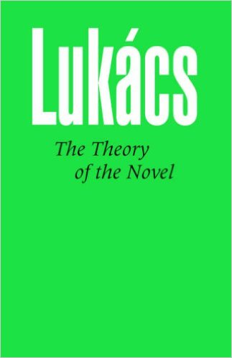
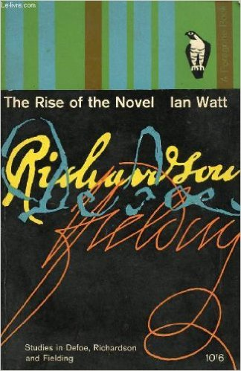

Slide 29
3. Compare
Genre
Narrative
Politics
Development of modernity
Ideas of Europe: implicit vs. explicit
Realism (?)

Slide 31
Werther at the End of the World
Goethe & Lobo Antunes: Postimperial considerations and the present

Slide 33
‘Prescription to read me’
“Whenever anyone declares having read a book of mine I am disappointed by the error. That’s because my books are not to be read in the sense usually called reading: the only way it seems to me to approach the novels that I write is to catch them in the same manner that one catches an illness. (…)
I demand that the reader have a voice among the voices of the novel or poem, or vision, or what- ever name you feel like giving it in order to be able to have a place among the demons and the angels of the Earth. Any other approach to what I write is a reading, not an initiation to the wilderness where the visitor will have his flesh consumed in solitude and in happiness. It is not complicated if you accept the work as this illness I referred to above: you will see that you return from yourselves loaded with treasures. António Lobo Antunes, 2002

