Slide 1
Lev N. Tolstoy, Anna Karenina (1873-7)
EN201 Week 8:
Dr Birgit Breidenbach (b.breidenbach@uea.ac.uk)

Slide 2
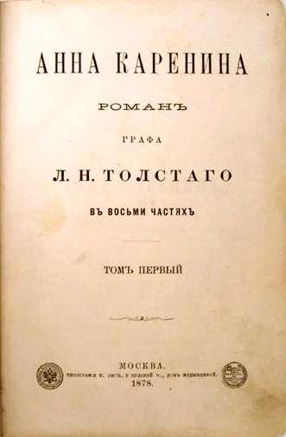
Structure
    Historical background
    Central themes
    The question of realism
    Anna Karenina as artifice

Slide 3
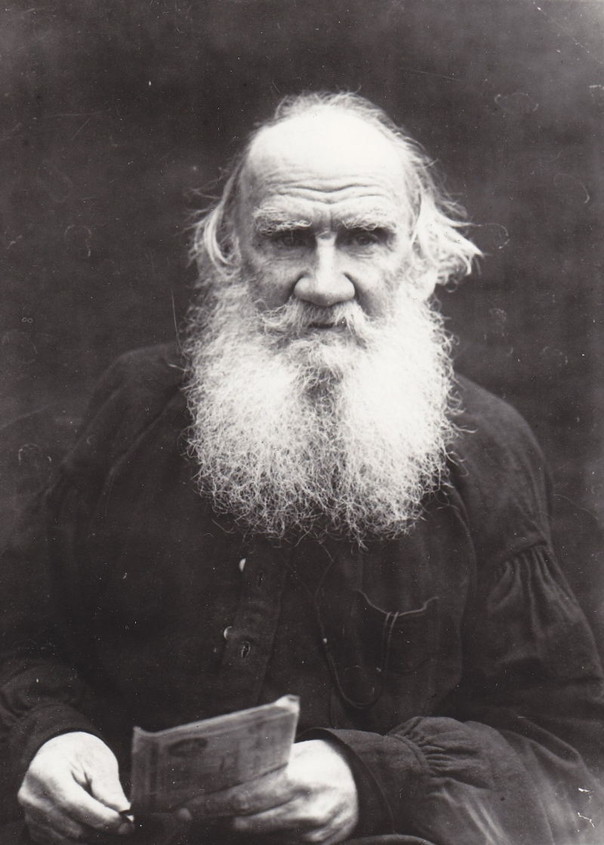
1. Lev Nikolayevich Tolstoy
(Лев Николаевич Толстой)
1828-1910
‘Tolstoy is the greatest Russian writer
of prose fiction.’
Vladimir Nabokov, Lectures on Russian Literature, (London: Weidenfield & Nicolson, 1981), p. 137.

Slide 4
1. Historical Background
1855: Alexander II becomes Tsar → reforms to modernise Russia
1861: Emancipation of the Serfs
1864/1870: Establishment of local government: Zemstvo system → Rise of mass politics
Mid-19th century: Different forms of Russian nationalism emerge, amongst others the Slavophile movement and the Narodniks (‘narod’: the people)

Slide 5
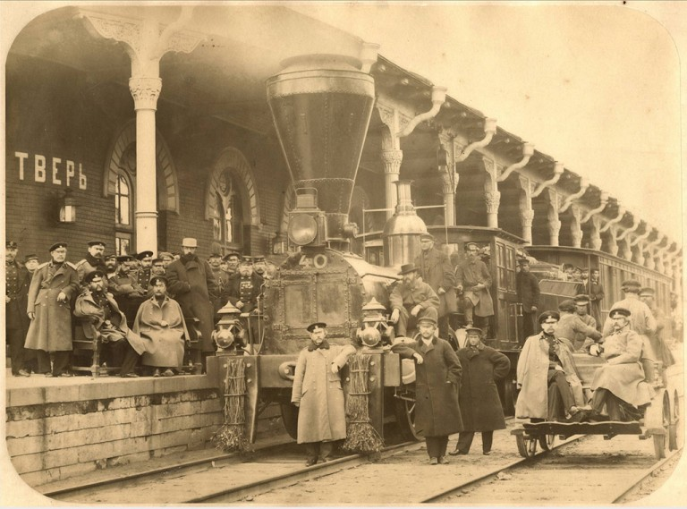
Tver Station on Moscow - St Petersburg Railway, ca.1860
(Source: http://www.railstaff.uk/2015/09/25/history-of-russian-railways-part-1-the-tsars/)

Slide 6
1. The ‘Woman Question’ in Russia
‘Can it be that in our time when everywhere, in all of Russian society, there is so much activity, so much seething, so much striving forward—can it be that the Russian woman alone remains a passive, non-participating spectator to all this activity? Cannot some role for her in this common endeavor be found?’
Nadezhda Destunis qtd. in Richard Stites, The Women’s Liberation Movement in Russia: Feminism, Nihilism, and Bolshevism,1860-1930 (Princeton, NJ: Princeton UP, 1991), p. 34.

Slide 7
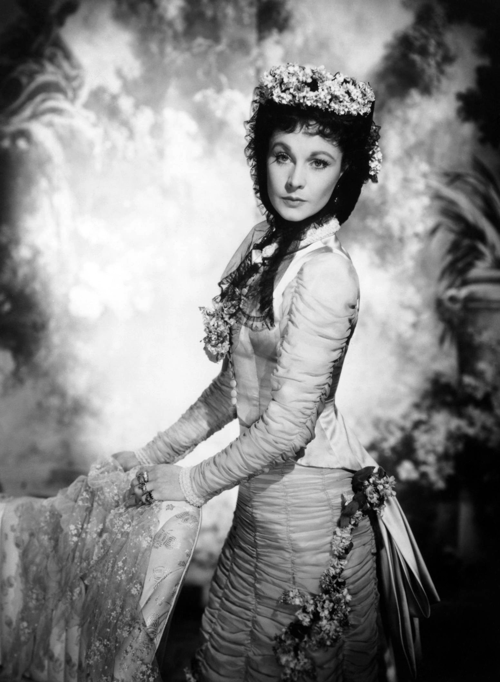
1. The ‘Woman Question’
‘Karenin expressed the view that the higher education of women is generally confounded with the question of women’s emancipation, and that was the only reason for considering it injurious.
“I, on the contrary, think that these two questions are firmly bound together,” said Petsov. “It is a vicious circle. Women are deprived of rights because of their lack of education, and their lack of education results from their lack of rights. We must not forget that the subjection of women is so widespread and so old that we often refuse to recognize the abyss that separates them from us.”’
L. Tolstoy, Anna Karenina, trans. by Louise & Aylmer Maude (Oxford et al.: OUP, 1995) p. 386.
(p. 386)

Slide 8
2. Themes
Family and marriage
Social institutions and conventions
Adultery and transgression
Individual freedom
The ‘woman question’
Romantic love and sexuality
Modernisation and political development in C19 Russia

Slide 9
2. Dichotomies
Individual vs. society
Private vs. public life
Passionate love vs. social institution of marriage
City vs. countryside
Tradition vs. progress
Russia vs. Europe
Material world vs. spiritual world

Slide 10
2. Tolstoy on the Concept of Family
‘In order for a work to be good, one must love its main basic idea, as in Anna Karenina I love the idea of family.’
Diary of Sofya Tolstaya, 3 March, 1877, qtd. in Barbara Lönnqvist, ‘Anna Karenina’, The Cambridge Companion to Tolstoy, ed. by Donna Tussing Orwin (Cambridge: CUP, 2002), pp. 80-95 (80).

Slide 11
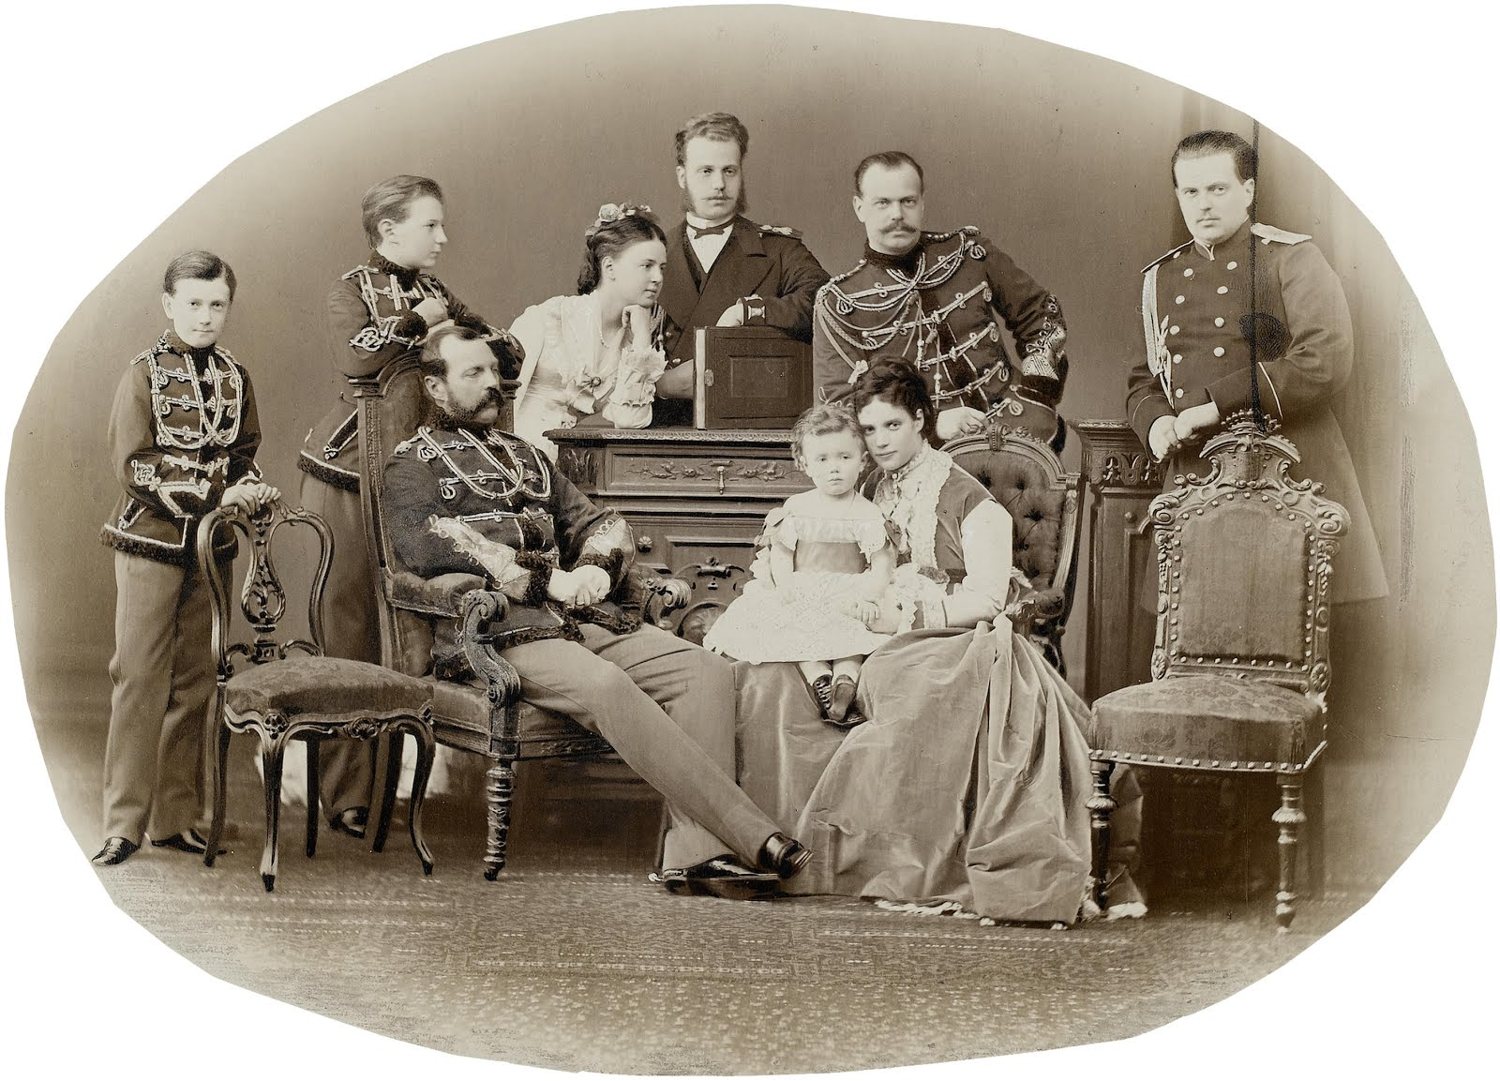
Family of Alexander II, 1871
Source: http://crownstiarasandcoronets.blogspot.co.uk/2016/07/maria-alexandrovna-empress-of-russia.html

Slide 12
2. The famous first sentence
‘All happy families resemble one another, each unhappy family is unhappy in its own way.
Everything was upset in the Oblonsky’s house. The wife had discovered an intrigue between her husband and their former French governess, and declared that she would not continue to live under the same roof with him.’
Anna Karenina, p. 1.

Slide 13
‘All happy families resemble each other, each unhappy family is unhappy in its own way.’
Oblonsky family
Karenin family
Lyovin family

Slide 14
2. The 19th-Century Novel of Adultery
‘Women, not yet fully absorbed into capitalism, and the vehicles of unpaid labor, are more likely narrative occasions for revolt and resistance than men. The latter, unless they are young and dissatisfied […], are more likely to be absorbed into the dynamics of business, and by way of success to open up the paradigms of the mass-cultural bestseller […]. But women cannot be successful in this sense (unless domestic contentment and satisfaction is considered to be something positive, at which point the woman character falls to the second rank of minor character and of Dickensian foil or Mediterranean matriarch)…

Slide 15
The novel of adultery (taken in the largest sense) is thus a unique space in which the negation of the social order can be narrativized in the person of this other half of ‘mankind’: it is paradoxical and even a contradiction that women figures […] become the great stars of the nineteenth-century novel – only compare Madame Bovary to the ineffectual Frédéric, or Anna Karenina to the vacillating Pierre! – a situation in which the role of the adulteress is the negative or privative one of showing that there is no place for them in bourgeois society and its most faithful expression, the bourgeois novel, in the first place!’
Fredric Jameson, ‘A Note on Literary Realism in Conclusion’, Adventures in Realism, ed. Matthew Beaumont (Malden, MA, et al.: Blackwell Publishing, 2008), pp. 261-71 (264f.).

Slide 16
2. The 19th-Century Novel of Adultery
Nathaniel Hawthorne, The Scarlet Letter (1850)
Gustave Flaubert, Madame Bovary (1856/7)
Émile Zola, Thérèse Raquin (1867)
Anna Karenina, (1873-1877)
Theodor Fontane, Effi Briest (1896)

Slide 17


Slide 18
2. Transgression
‘Moral probity was bounded and even defined by acts of transgression. The most radical were sexual, homicidal or suicidal challenges to both social stability and contemporary moral sensibilities (the Russian word for crime, prestuplenie, comes from the verb, prestupit’, ‘to transgress’). The authors of transgression were moral entrepreneurs who, wittingly or unwittingly, stepped outside the shifting bounds of the permissible in late Imperial and early Soviet society and challenged the sanctity of the status quo.’
Daniel Beer, ‘Morality and Subjectivity, 1860s–1920s’, The Oxford Handbook of Modern Russian History, ed. by Simon Dixon (OUP: Oxford Handbooks Online, 2013).

Slide 19
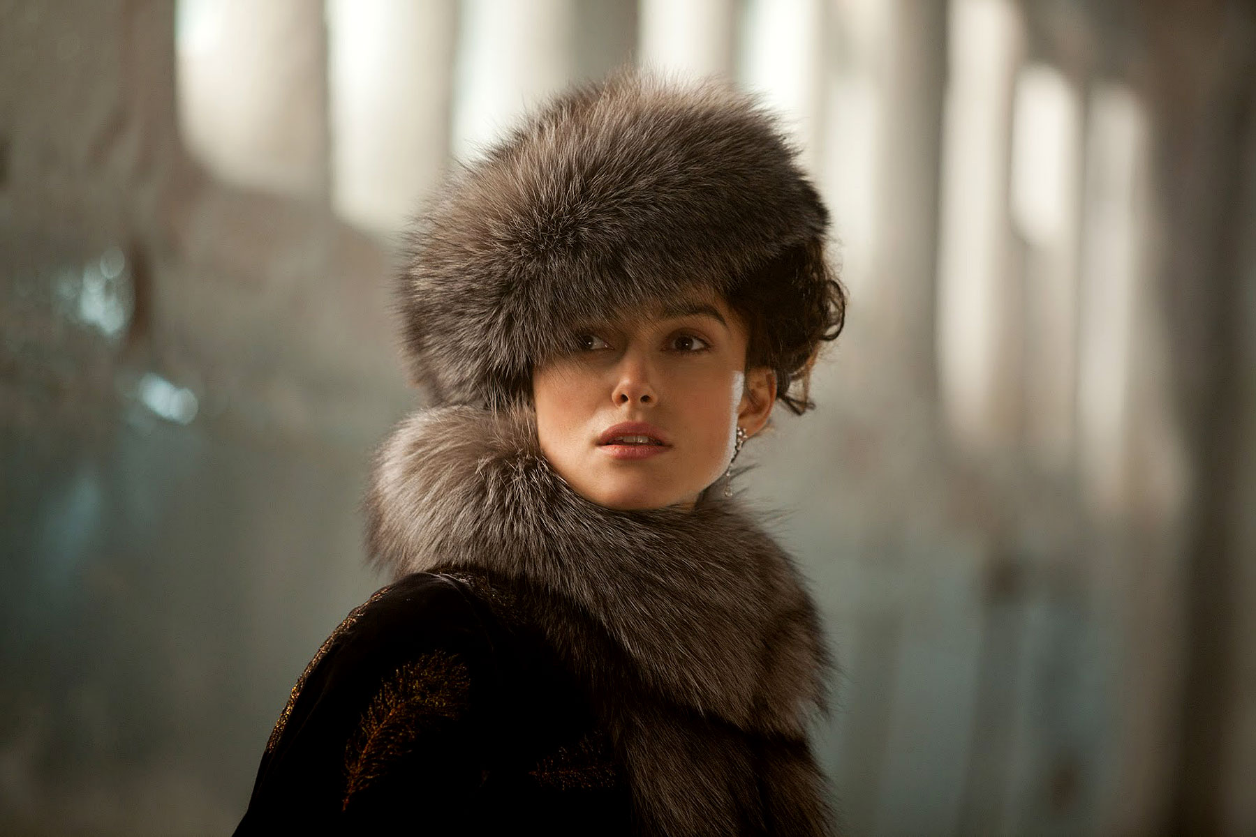
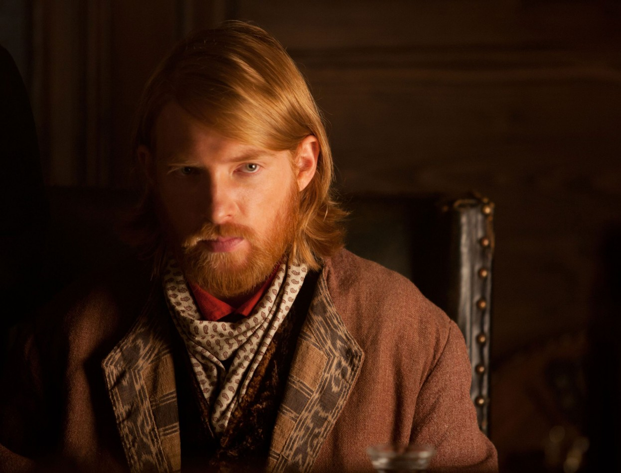
‘Again she glanced at [Lyovin]. And her smile and glance told him that she was speaking for him alone, valuing his opinion and knowing in advance that they would understand one another.’ (Anna Karenina, p. 693)
Anna
Lyovin
‘And he, who had formerly judged her so severely, now by some strange process of reasoning justified her and at the same time pitied her and feared that Vronksy did not fully understand her.’ (Anna Karenina, p. 695)

Slide 20
3. What does realism in literature mean?
1) Ontological realism
- Relatable/likely characters and events
- Literature as representational/mimetic
2) Realistic modes of depiction
- Reliable narration
- ‘Unfiltered’ and ‘untainted’ representation

Slide 21
3. The Question of Realism
‘[W]e are not to take Anna Karenin as a work of art; we are to take it as a piece of life. A piece of life it is. The author has not invented and combined it, he has seen it; it has all happened before his inward eye, and it was in this wise that it happened. Levin’s shirts were packed up, and he was late for his wedding in consequence; Varenka and Serge Ivanovitch met at Levin’s country-house and went out walking together; Serge was very near proposing, but did not. The author saw it all happening so—saw it, and therefore relates it; and what his novel in this way loses in art it gains in reality…’
Matthew Arnold, ‘Essays in Criticism’ (1888), Second Series, <http://www.bartleby.com/ 316/1003.html>

Slide 22
… For this is the result which, by his extraordinary fineness of perception, and by his sincere fidelity to it, the author achieves; he works in us a sense of the absolute reality of his personages and their doings. Anna’s shoulders, and masses of hair, and half-shut eyes; Alexis Karenin’s updrawn eyebrows, and tired smile, and cracking finger-joints; Stiva’s eyes suffused with facile moisture—these are as real to us as any of those outward peculiarities which in our own circle of acquaintance we are noticing daily, while the inner man of our circle of acquaintance, happily or unhappily, lies a great deal less clearly revealed to us than that of Count Tolstoy’s creations.’
Matthew Arnold, ‘Essays in Criticism’ (1888), Second Series, <http://www.bartleby.com/ 316/1003.html>

Slide 23
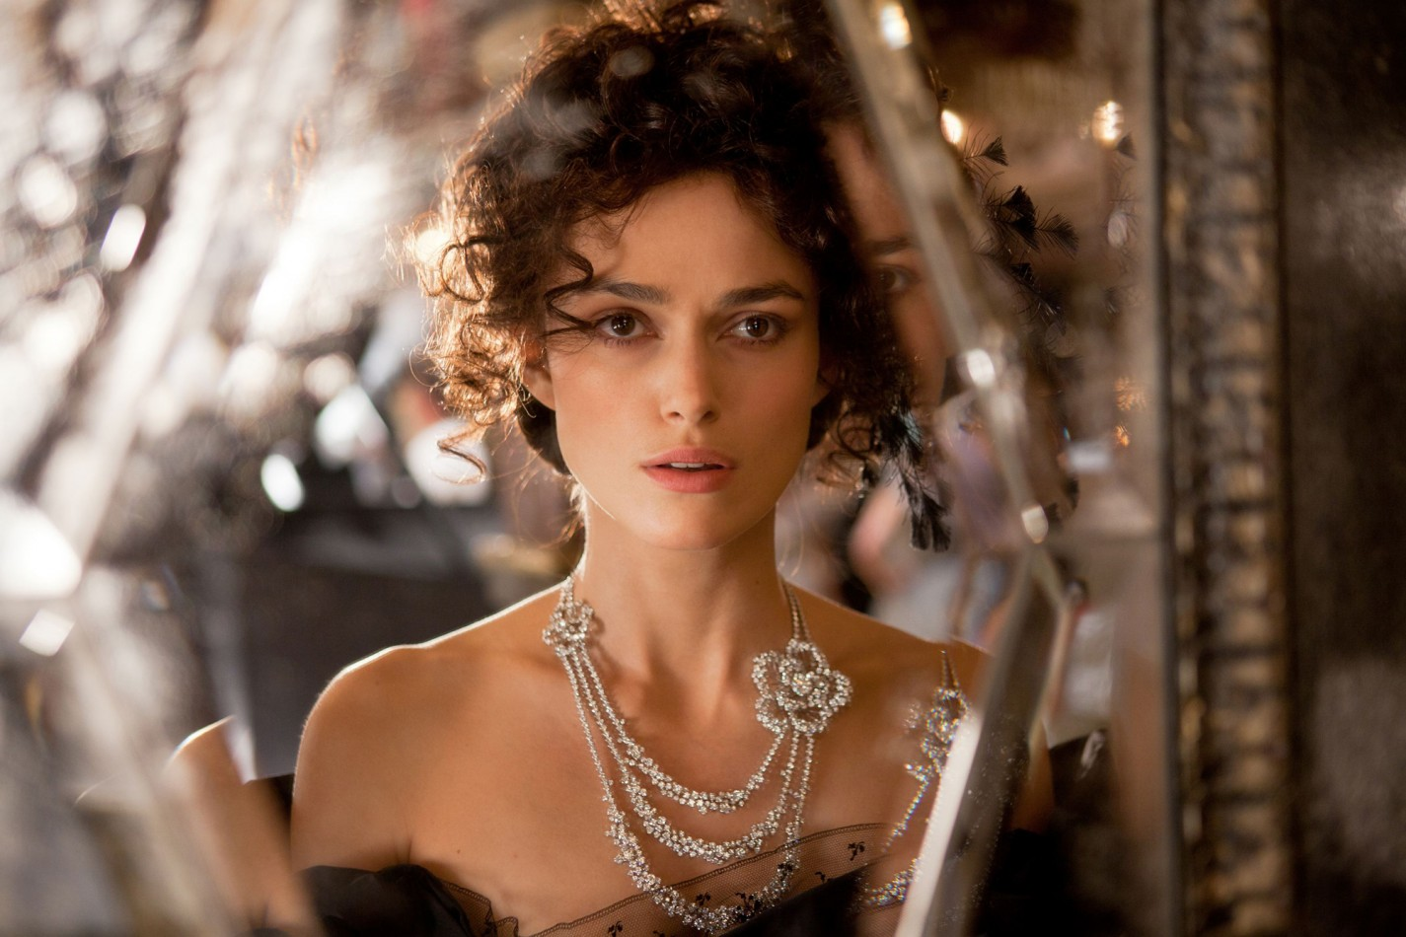

Slide 24
3. Tolstoy on Realism
‘The highest limit of the artist’s relation to his subject will be such as evokes in all men an impression of reality—the reality not so much of what exists, as what goes on in the soul of the artist. This impression of reality is produced by truth only, and therefore the highest relation of an author to his subject is sincerity.’
L. Tolstoy, What is Art? And Essays on Art, trans. Aylmer Maude (London: OUP, 1930), p. 56.

Slide 25
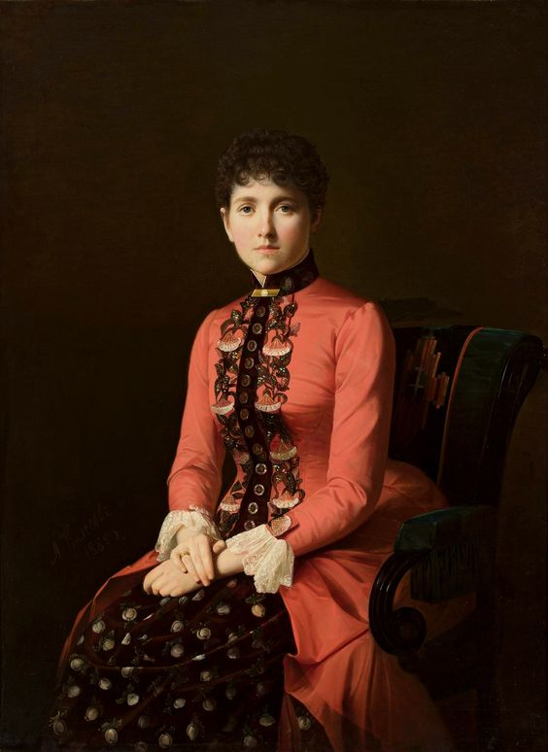
‘He copied that new pose, and, suddenly remembering the energetic pose and prominent chin of a shopman from whom he had bought cigars, he gave the figure that man’s face and chin. He laughed with joy, for the inanimate, unnatural figure had become alive, and was just the thing. The figure was alive, clear, and well-defined. It was just the thing.’ (Anna Karenina, p. 467)
Portrait of a young lady (so-called Anna Karenina) by Aleksei Mikhailovich Kolesov, 1885

Slide 26

4. Anna Karenina as Artifice: Tom Stoppard and Joe Wright’s 2012 Adaptation

Slide 27
The European Novel in Russia
‘The Russian achievement was realized in sharp differentiation from the prevailing European mode, even in opposition to it. The Russian masters […] did violence to the conventions of the genre as it had been conceived from the time of Defoe to that of Flaubert.’
George Steiner, Tolstoy or Dostoevsky: An Essay in Contrast. London: Faber & Faber, 1980), p. 18.

