Slide 1
Ghostly Silences
Javier Marías
Thus Bad Begins
Paulo de Medeiros 2019

Slide 2
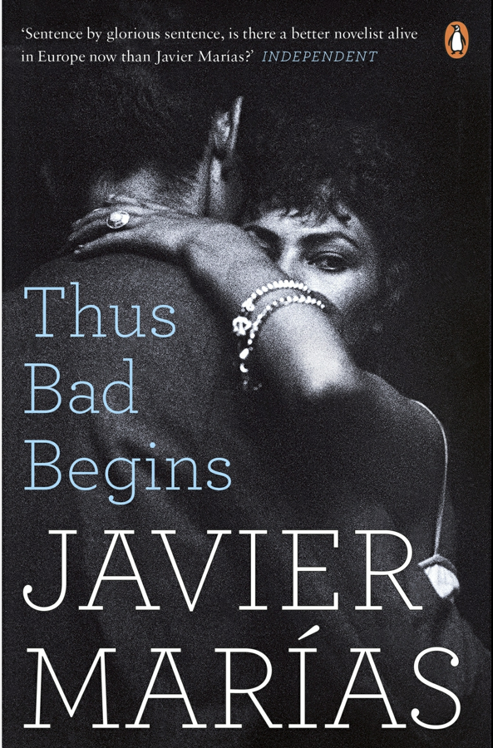

Slide 3


Slide 4
Hamlet, Act III, scene, iv

Slide 5
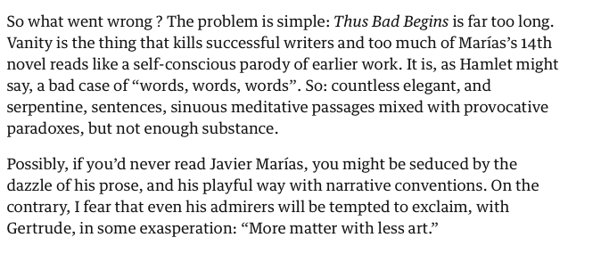

Slide 6
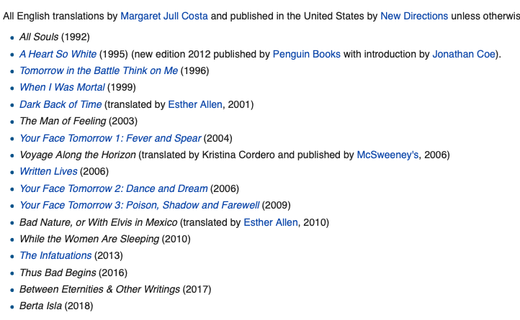
Javier Marías (1951-)
Javier Marías (1951)

Slide 7
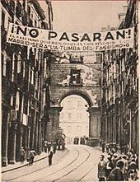
Civil War 1936-1939

Slide 8
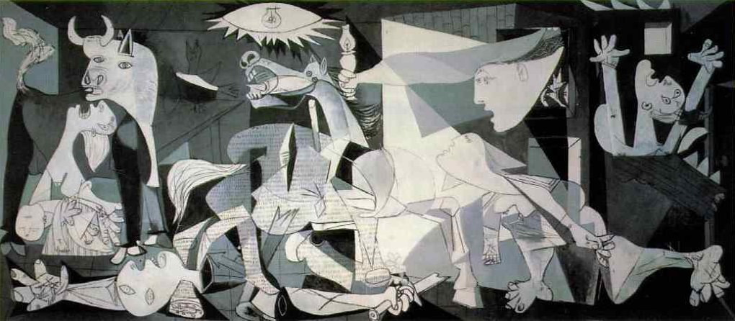
Guernica (1937)

Slide 9
Memory and Postmemory

Slide 10
Memory and Postmemory
Haunting
Nation-Individual

Slide 11
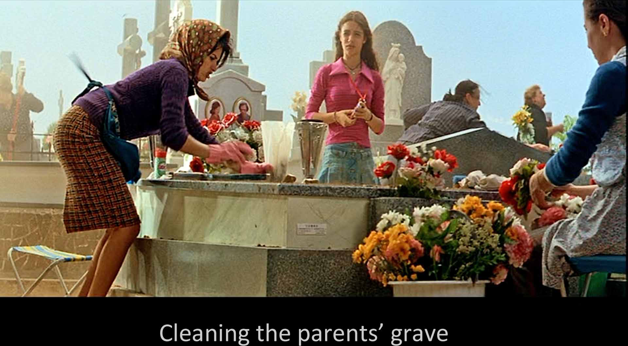
https://www.youtube.com/watch?v=9L2AJmNoUgo

Slide 12
Memory and Postmemory
Haunting
Nation-Individual
Vile Crime, Guilt, Silence

Slide 13
Memory and Postmemory
Haunting
Nation-Individual
Vile Crime, Guilt, Silence
Suicide

Slide 14
﻿Or perhaps she would have calmly and slowly filled the bathtub and then climbed in before slitting her veins – if you cut them ﻿before, the blood will start to flow at once and stain the towels and the hotel’s immaculate bathrobe, very few suicides are entirely indifferent to the mess they make or the image they leave behind – and what happened once she was in the water would depend on various factors: the number, length and depth of the cuts, whether on one wrist or on both; whether the water was really hot or not hot enough, because the cold would make the incisions close up, thus delaying death, not yet, not yet, although the cold is sure to come sooner or later; and two other things would determine the speed or otherwise of that death: if the person lost consciousness and her head slipped beneath the water, then she would drown, unless her body became wedged in the tub, her nose and mouth unsubmerged; in that case, if she didn’t drown, she would lie there unconscious until her heart stopped, incapable of pumping the little remaining
Marías, Javier. Thus Bad Begins (p. 290). Penguin Books.

Slide 15
Time
Past, present, Future
Cruelty
Hamlet

Slide 16
﻿What is ﻿perhaps most regrettable (or, perhaps, disquieting because impossible to assimilate) about these intersecting images is that I am now that older man who, in our youth, appears in our unconscious mind and whispers mysteriously to us, like a ghost from the future: ‘Remember this experience and note every detail, experience it with me in mind and as if you knew it would never happen again except in your memory, which is my memory; you won’t be able to preserve the excitement or relive it, but you will recall the sense of triumph and, more especially, the knowledge: you will know that this happened and you always will; grasp it firmly, take a long look at this woman and keep that image safe, because later on, I will ask you for it and you will have to offer it to me as consolation.’
Marías, Javier. Thus Bad Begins (pp. 501-502). Penguin Books

Slide 17
Thus bad begins and the European Novel

Slide 18
and how right I’ve been to love her during all these years, all these past years. I’ve probably never done anything better. That’s why I find it so worrying when the image of Beatriz suddenly, and however fleetingly, comes into my mind in the middle of some intimate moment. Then I try to summon up that remote foreshadowing, which disquieted and troubled me at the time, the ephemeral, intrusive vision of an adolescent Susana. Now, on the other hand, I’d like to recover that vision, so that, through the memory of that vision, reality can be restored and that forgotten yesterday can return the today, which, just for an instant, has slipped away from us.
Marías, Javier. Thus Bad Begins (p. 503). Penguin Books

Slide 19
﻿I stop too, become distracted, absent, turn my face away as if I didn’t want to be kissed on ﻿mouth by a ghost who also once turned away her face and denied me her mouth when she was still flesh, brimming, moving flesh. And then there’s a moment when one of us, either Susana or me, I’m not sure, must be thinking: ‘No, no kisses.’ We look at each other without saying anything, and perhaps what we’re saying to ourselves is something on which we both agree: ‘And no, no words.’
Marías, Javier. Thus Bad Begins (p. 503). Penguin Books

