Slide 1
Crime and Expectations
Dickens and Dostoevsky

Slide 2
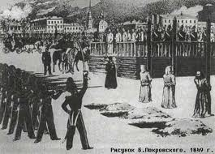
The Urban Savage: St. Petersburg

Slide 3
From the Scaffold
Today, December 22 [1849], we were driven to Semyonovsky Parade Ground. There the death sentence was read to us all, we were given the cross to kiss, swords were broken over our heads, and our final toilet was arranged (white shirts). Then three of us were set against the posts so as to carry out the executions. We were summoned in threes; consequently I was in the second group, and there was not more than a minute left to live. I remembered you, my brother, and all yours [….] Life everywhere is life, life is in ourselves and not in the external. (Dostoevsky, Letter to Mikhail Dostoevsky, 1849)

Slide 4
From the Prison
And in four years in prison I at last came to distinguish human beings among the thieves. Will you believe me: there are deep, strong, beautiful characters, and what a joy it was to discover gold beneath the rough, hard shell. And not one, not tow, but several. (Dostoevsky, Letter to Mikhail Dostoevsky, 1854)

Slide 5
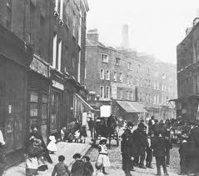
The Urban Savage: London

Slide 6
Fellowship Across the World
We understand Dickens in Russia, I am convinced, almost as well as the English, and maybe even all the subtleties; maybe even we love him no less than his own countrymen; and yet how typical, distinctive, and national Dickens is. (Dostoevsky, Diary of a Writer)

Slide 7
Night Walking: London
Walking the streets under the pattering rain, Houselessness would walk and walk and walk, seeing nothing but the interminable tangle of streets, save at a corner, here and there, two policemen in conversation, or the sergeant or inspector looking after his men. Now and then in the night--but rarely--Houselessness would become aware of a furtive head peering out of a doorway a few yards before him, and, coming up with the head, would find a man standing bolt upright to keep within the doorway`s shadow, and evidently intent upon no particular service to society. (Charles Dickens, Night Walks)

Slide 8
Street Walking:St.Petersburg
The heat in the street was terrible: and the airlessness, the bustle and the plaster, scaffolding, bricks, and dust all about him, and that special Petersburg stench, so familiar to all who are unable to get out of town in summer--all worked painfully upon the young man's already overwrought nerves. The insufferable stench from the pot- houses, which are particularly numerous in that part of the town, and the drunken men whom he met continually, although it was a working day, completed the revolting misery of the picture. An expression of the profoundest disgust gleamed for a moment in the young man's refined face [….] he walked along not observing what was about him and not caring to observe it. From time to time, he would mutter something, from the habit of talking to himself, to which he had just confessed. At these moments he would become conscious that his ideas were sometimes in a tangle and that he was very weak; for two days he had scarcely tasted food. (Dostoevsky, Crime and Punishment)

Slide 9
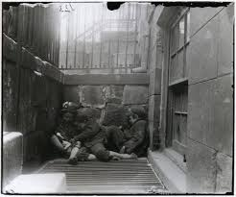
Through Raskolnikov’s Eyes

Slide 10
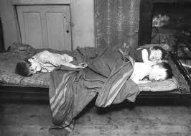
Through Raskolnikov’s Eyes

Slide 11
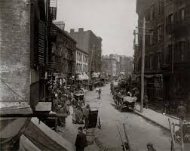
Through Raskolnikov’s Eyes

Slide 12
Mystery of Suffering
I think I should like to turn myself into Eugene Sue and describe the mysteries of Petersburg. I have a passionate love for mystery. I am a fantasist, a mystic, and I confess to you that Petersburg – I do not know why – has always seemed to me to be some kind of mystery. (Dostoevsky, Petersburg Visions in Verse and Prose)

Slide 13
Fantasy of Underdevelopment
At an opposite pole we find a modernism that arises from backwardness and underdevelopment. This modernism first arose in Russia … in our own era with the spread of modernization – but generally, as in old Russia, a truncated and warped modernization – it has spread throughout the Third World. The modernism of underdevelopment is forced to build on fantasies and dreams of modernity, to nourish itself on an intimacy and struggle with mirages and ghosts. (Marshall Berman, All That is Solid Melts Into Air)

Slide 14
What Is A Modern Murder?
the evil-doer [ . . .] cannot escape the slower torture of incessantly doing the evil deed again and doing it more efficiently [ Dickens, Our Mutual Friend]
You won’t run away [….] The fugitive’s life is hard and hateful, and your first need is for a definite position and existence, and a suitable atmosphere, and what sort of atmosphere would you have? If you ran away, you would come back of yourself. You can’t get on without us. (Dostoevsky, Crime and Punishment)

Slide 15
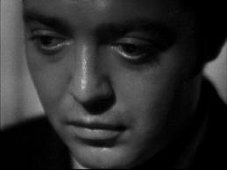
Who is a Modern Murderer?

Slide 16
The Modern Murderer
Far more mercilessly, far more pitilessly than the sternest law, he condemns himself for his crime (F. Dostoevsky)
N.B. His moral development begins from the crime itself (F. Dostoevsky, 1865)
This is an obscure and fantastic case, a contemporary case, something that could only happen in our day, when the heart of an has grown troubled, when people quote sayings about blood “refreshing”….He forgot to shut the door behind him, but he murdered, and murdered two people, for a theory. (F. Dostoevsky, Crime and Punishment)

Slide 17
Reasonable Violence
Crime and Punishment, The Possessed, and The Brothers Karamazov embody a reassertion and an elaboration of this compelling concern [with violence] in terms of both their thematic import and structural pattern. Murder is presented as an act generated exclusively by the rational mind of the murderer. It is a product of pure intellection, a rationally argued “calculated” act of violence. (Alexandra F. Rudicina, ‘Crime and Myth’)

Slide 18
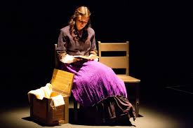
Unreasonable Redemption

Slide 19
The Mystery of Redemption
Dostoevsky creates a youthful and quasi-educated heroine, Sonya Marmeladova, who must endure many tribulations from the men in Crime and Punishment before abandoning her futile self-sacrifice. She, like the novel’s protagonist Rodion Raskolnikov, transgresses a Christian moral precept in the belief that she is acting in the name of a higher justice [….] In reacting to this test of faith, Sonya affirms a renewed belief in divine providence, for which she is rewarded (in accordance with the structure of a Christian resurrection tale) with a new life, provided for financially Svidrigailov and spiritually by Raskolnikov. (Elizabeth Blake, ‘Sonya, Silent No More’)

Slide 20
The Time of Redemption
As such, the hero enables a series of temporal shapes, laden with historiographic significance, to be considered and then either chosen or dismissed. A re-inscription of Crime and Punishment into the context of journalistic debates from the period of Great Reforms thus allows us to read the novel as a political allegory that stages and imaginatively resolves the socio-temporal contradictions structuring a world torn between conflicting demands for continuity and radical change. (Ilya Kliger, ‘Shapes of History’)

