Slide 1
EN201 The European Novel
30 January 2019
The crashing of the sea:
GiuseppeTomasi di Lampedusa. Il Gattopardo (1958)

Slide 2


Slide 3
“Nunc et in hora mortis nostrae. Amen”
1958
EEC
Italian national elections
Nabokov’s Lolita
Achebe’s Things Fall Apart

Slide 4
The Prince
Critical and Public Reception
Narrative Structure
Historical Novel
Birth of the Nation
Materiality
Time and death
The crashing of the sea

Slide 5
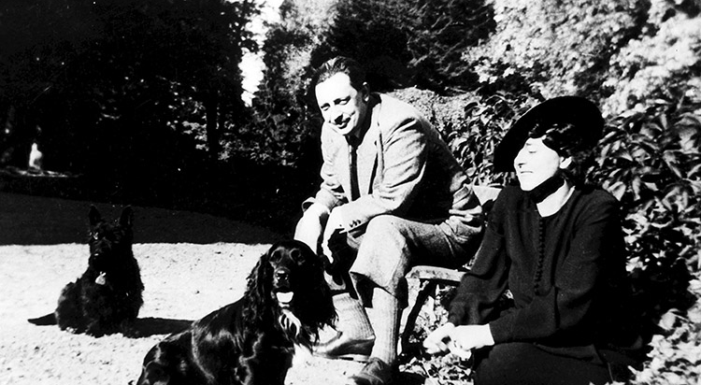
The Prince

Slide 6
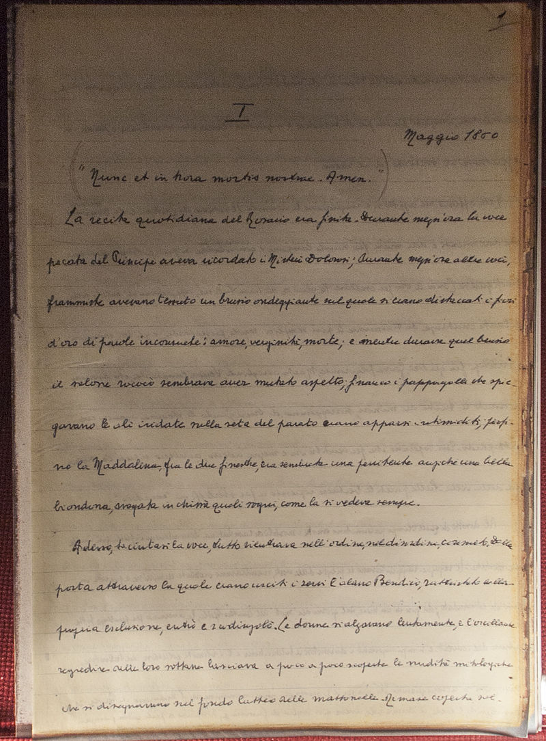
Critical and Public Reception

Slide 7

Narrative Structure

Slide 8
Introduction to the Prince, May 1860
Donnafugata, August 1860
The Troubles of Don Fabrizio, October 1860
Love at Donnafugata, November 1860
Father Pirrone Pays a Visit, February 1861
A Ball, November 1862
Death of a Prince, July 1883
Relics, May 1910

Slide 9
Narrative Strategy
Repetition
Doubling
Framing
Irony
Memory
Critique

Slide 10
Historical Context
Garibaldi and the expedition of the thousand

Slide 11
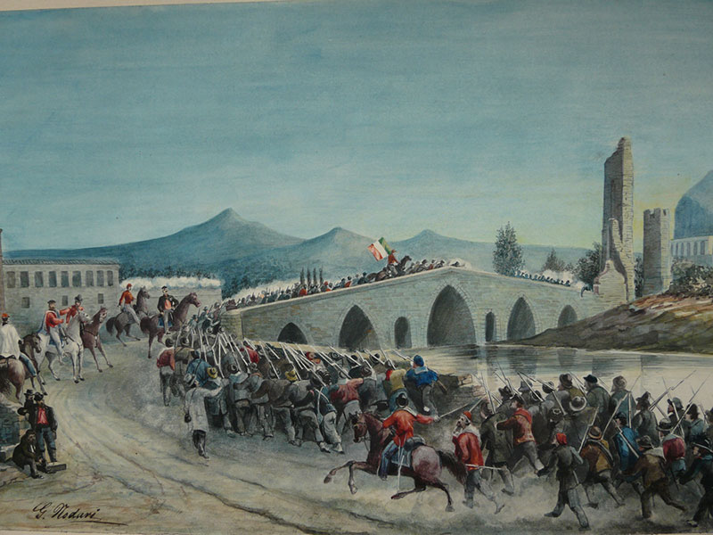
Historical crisis, revolution, , war, unification of Italy

Slide 12


Slide 13
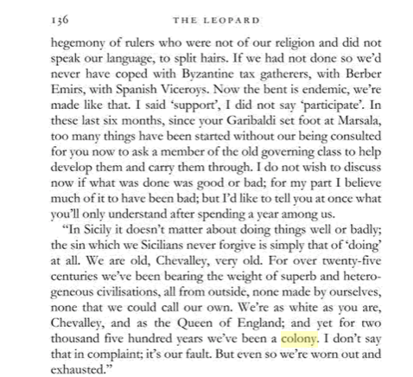

Slide 14
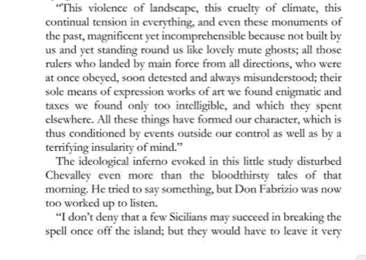

Slide 15
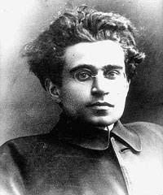
The Southern Question
Antonio Gramsci (1891-1937)

Slide 16
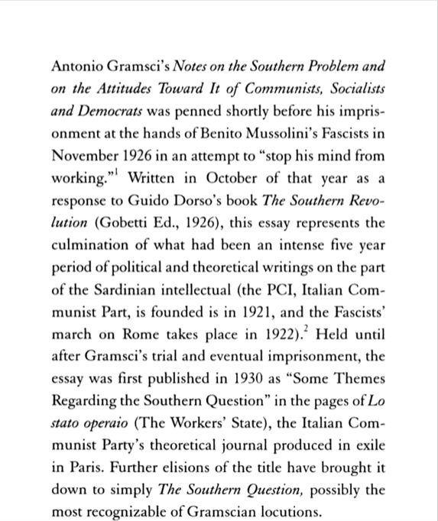

Slide 17
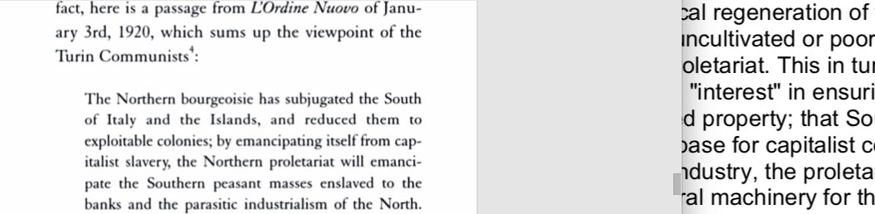

Slide 18
Materiality
Centrality of financial concerns
Objects
Spirituality and Materiality: relics
Meals
Ball
Marriage as contract
Sensuality and violence
The secret core
Permanence and finitude
Decay, Ruins, Death

Slide 19
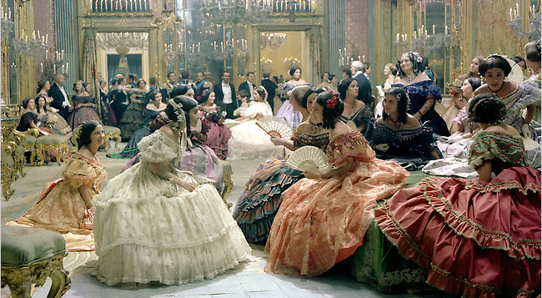
Visconti’s The Leopard (1963)

Slide 20
Time and Death
Revolution
Rise of the Bourgeoisie
Inequality
Underclass view
Death of soldier, Death of the Prince, Death of a class

Slide 21
Father Pirrone
“It's a class difficult to suppress because it's in continual renewal-and because if needs be it can die well, that is it can throw out a seed at the moment of death. Look at France; they let themselves be massacred with elegance there and now they're back as before. I say as before, because it's differences of attitude, not estates and feudal rights, which make a noble.”
“And I can tell you too, Don Pietrino, that if, as has often happened before, this class were to vanish, an equivalent one would be formed straight away with the same qualities and the same defects; it might not be based on blood any more, but possibly on . .. ”
“Thank you, I'm used to it. We'll meet tomorrow, then you'll tell me what the Prince of Salina feels about the Revolution." "I can tell you that at once “and in a few words: he says there's been no revolution and that all will go on as it did before.” (152-153)

Slide 22
Tancredi to the Prince
“The eyes began smiling again. "For the King, yes, of course. But which King?" The lad had one of those sudden serious moods which made him so mysterious and so endearing. "Unless we ourselves take a hand now, they'll foist a republic on us. If we want things to stay as they are, things will have to change. D'you understand?" Rather moved, he embraced his uncle. "Well, goodbye, for now. I'll be ” (19)

Slide 23
The crashing of the sea
“Suddenly amid the group appeared a young woman, slim, in brown travelling dress and wide bustle, with a straw hat trimmed by a speckled veil which could not hide the sly charm of her face. She slid a little suede-gloved hand between one elbow and another of the weeping kneelers, apologized, drew closer. It was she, the creature forever yearned for, coming to fetch him; strange that one so young should yield to him; the time for the train's de parture must be very close. When she was face to face with him she raised her veil, and there, modest, but ready to be possessed, she looked lovelier than she ever had when glimpsed in stellar space. The crashing of the sea subsided altogether.” (193)

Slide 24
Final chapter, “Relics” final ironies
Concetta as the true Salina
Angelica’s completion (after Tancredi’s death)
A new society?
Bendicò’s end
Dust to dust, ashes to ashes

Slide 25
“this dog has really become too moth-eaten and dusty. Take it out and throw it away." As the carcass was dragged off, the glass eyes stared at her with the humble reproach of things that are thrown away, that are being annulled. A few minutes later what remained of Bendico was flung into a corner of the courtyard visited every day by the dustman. During the flight down from the window his form recomposed itself for an instant; in the air one could have seen dancing a quadruped with long whiskers, and its right foreleg seemed to be raised in imprecation. Then all found peace in a heap of livid dust.” (212)

