Slide 1

Dr. Graeme Macdonald
Anna Karenina and Germinal
Nov. 2018
g.macdonald@warwick.ac.uk

Slide 2
The approach of the train was made more and more evident by the preparatory movements in the station, the running of attendants, the appearance of gendarmes and porters, and the arrival of those coming to meet the train. Through the frosty steam, workers in sheepskin jackets and soft felt boots could be seen crossing the curved tracks. The whistle of the engine could be heard down the line, and the movement of something heavy. AK I, XVII

Slide 3
A watchman, either drunk or too bundled up because of the freezing cold, had not heard train being shunted and had been run over.
Even before Vronsky and Oblonsky came back, the ladies had learned these details from the butler.
Oblonsky and Vronsky had both seen the mangled corpse. Oblonsky was obviously suffering. He winced and seemed ready to cry.
‘Ah how terrible! Ah, Anna, if you’d seen it! Ah, how terrible!’ he kept saying.
Vronsky was silent, and his handsome face was serious but perfectly calm.
‘Ah, if you’d seen it, Countess,’ said Stepan Arkadyich. ‘And his wife is here . . . It was terrible to see her . . . She threw herself on the body. They say he was the sole provider for a huge family. It’s terrible!’
‘Can nothing be done for her?’ Mme Karenina said in an agitated whisper.
[…]
The people coming out were still talking about what had happened.
‘What a terrible death! Said some gentleman passing by. ‘Cut in two pieces they say.’
‘On the contrary, I think it’s the easiest, its instantaneous,’ observed another.
‘How is it they don’t take measures?’ said a third.
Mme Karenina got into the carriage, and Stepan Arkadyich saw with surprise that her lips were trembling and she could hardly keep back her tears.
‘What is it, Anna?’ he asked, when they had driven several hundred yards.
‘A bad omen,’ she said. AK, I, XVIII

Slide 4
The conversation turned to the new trend in art, to the new bible illustrations by a French artist. Vorkuev accused the artist of realism pushed to the point of coarseness. Levin said that the French employed conventions in art as no one else did, and therefore they saw particular merit in the return to realism. They saw poetry in the fact that they were no longer lying. (Anna Karenina 7, X, trans. Pevear & Volokhonsky)
It was all drowned in the sea of cheerful common labour […] And whom was this labour for? What would its fruits be? These considerations were irrelevant and insignificant. (AK, 3, XII)

Slide 5
Naturalism: Literary Science, Scandal and Hyper-Realism
Germinal : ethnography, documentary, politics

Slide 6
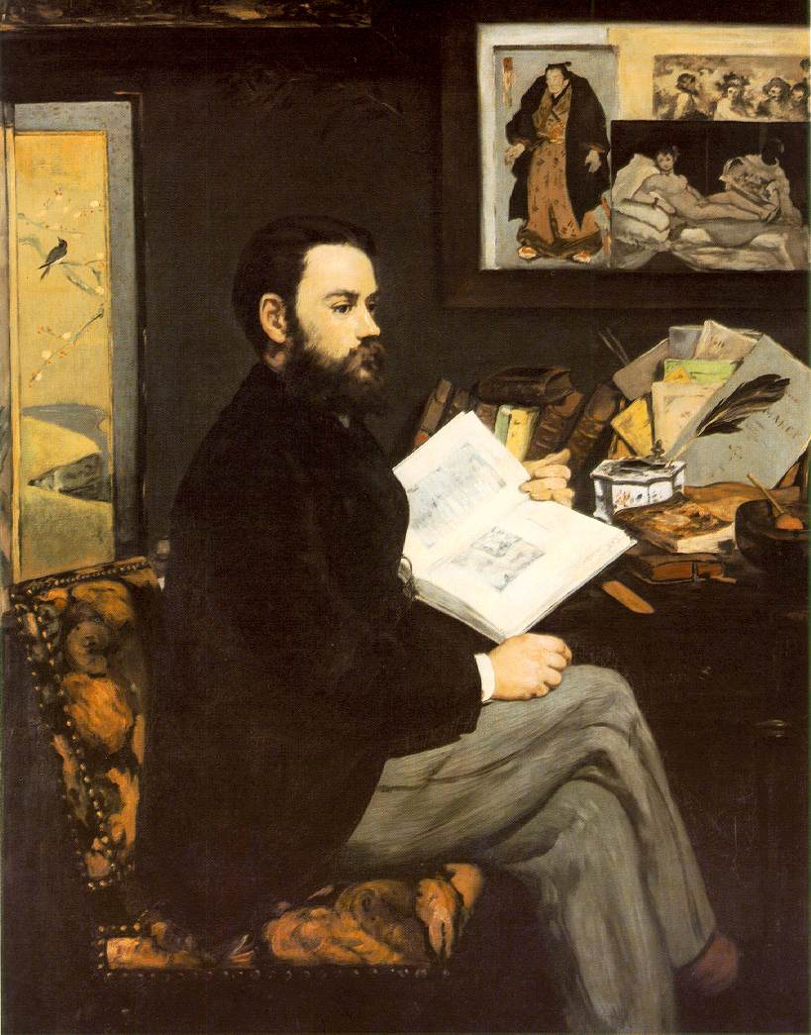
Naturalism: Literary Science, Scandal and Hyper-Realism
Germinal (1885): ethnography, documentary, class politics
Zola by Édouard Manet, 1868

Slide 7
Auguste Comte/Herbert Spencer (Positivism in Sociology and Social Philosophy)
Thomas Huxley (Eugenics)
Prosper Lucas (Heredity)
Karl Marx (Capitalism/Political Economy)
Charles Letourneau (Biology)
Hippolyte Taine (Literature and Culture)
Jules Antoine-Castagnary (Visual Art)
Claude Bernard (Experimental Medicine)
“Western” Naturalist Novelists and Playwrights
The Goncourt Brothers (France)
Guy De Maupassant (France)
Gerhardt Hauptmann (Germany)
August Strindberg (Sweden)
Henrik Ibsen (Norway)
George Gissing (England)
George Moore (Ireland/England)
George Douglas Brown (Scotland)
George MacDougal Hay (Scotland)
Giovanni Verga (Italy)
Benito Cortez Galdos (Spain)
Stephen Crane, Theodore Dreiser, Upton Sinclair, Frank Norris, John Dos Passos(USA)
See also Balzac’s ‘Preface’ to his cycle La Comèdie Humaine, on the novel and zoology.

Slide 8
Les Rougon-Macquart: ‘The Natural History of a Family in the Second Empire’
The Third Republic (1870-1890)
The Second Empire (1852-1870)

Slide 9



Slide 10



Slide 11



Slide 12
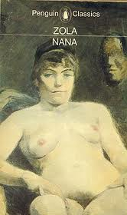


Slide 13


Slide 14
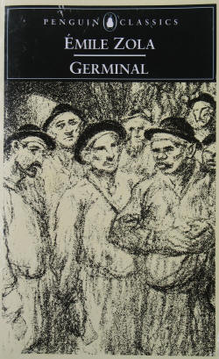
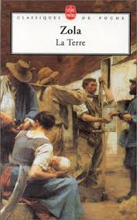

Slide 15
Auguste Comte, ‘Positivism’
Hippolyte Taine, ‘race, milieu, moment’
Claude Bernard, ‘Introduction to Experimental Medicine’ (1865)

Slide 16
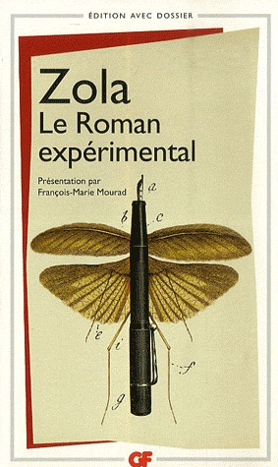
It will only be necessary to work on the individuals and surroundings if we wish to find the best social condition. In this way we shall construct a practical sociology and our work will be a help to political and economical sciences […] It is but a question of degree in the same path which runs from chemistry to physiology, then from physiology to anthropology and to sociology. The Experimental Novel is the goal. (Zola, The Experimental Novel 1880)

Slide 17
In the past several years there has grown up a monstrous school of novelists which pretends to replace carnal eloquence with eloquence of the charnel house, which invokes the weirdest medical anomalies, which musters the plague stricken so that we can admire their blotchy skin . . . and which makes pus squirt out of the conscience […] the disease is epidemic. Let us force novelists to display their talent instead of their pickings from the law court and the city dump. (Louis Ulbach, ‘La Littérature Putride’, Le Figaro, 23 Jan, 1868)

Slide 18

Where science is concerned, the accusation of immorality has no relevance […] In Thérèse Raquin my aim has been to study temperaments and not characters. That is the whole point of the book. I have chosen people completely dominated by their nerves and blood, without free will, drawn into each action of their lives by the inexorable laws of their physical nature […] There is a complete absence of soul, I freely admit, since that is how it is meant to be. I hope that by now it is becoming clear that my object has been first and foremost a scientific one. [Naturalist Critics and writers] would not be surprised by the kind of scientific analysis I have attempted in Thérèse Raquin, for in it they would recognise the modern method of universal enquiry which is the tool our age is using so enthusiastically to open up the future. Whatever their own conclusions they would approve of my starting point, the study of temperament, and of the profound modifications of an organism subjected to the pressure of environments and circumstances […] if the writer is now to write a good novel, he must see society with greater breadth of vision, depict it in its many and varied aspects, and above all use clear and natural language. Émile Zola, ‘Preface to the Second Edition’, Thérèse Raquin (1868)

Slide 19
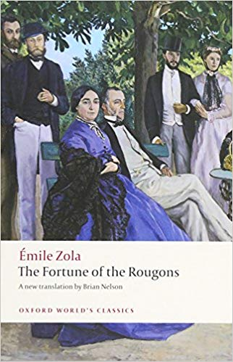
By resolving the duplex question of temperament and environment, I shall endeavour to discover and follow the thread of connection which leads mathematically from one man to another. And when I have possession of every thread, and hold a complete social group in my hands, I shall show this group at work, participating in a historical period…[…] I wish to explain how a family, a small group of human beings conducts itself in a given social system [...] Heredity, like gravity, has its laws (FR, xi).
(‘Preface to the Series’, in The Fortune of the Rougons, 1871)

