Slide 1
All novels are in some sense knowable communities. It is part of a traditional method – an underlying stance and approach – that the novelist offers to show people and their relationship sin essentially knowable and communicable ways. The full extent of Dickens’s genius can then only be realised when we see that for him, in the experience of the city, so much that was important, and even decisive, could not simply be known, or simply communicated, but had, as I have said, to be revealed, to be forced into consciousness. And it would then be possible to set up a contrast between the fiction of the city and the fiction of the country. In the city kind, experience and community would be essentially opaque, in the country kind, essentially transparent. As a first way of thinking, there is some use in this contrast. There can be no doubt, for example, that identity and community become more problematic, as a matter of perception and as a matter of valuation, as the scale and complexity of the characteristic social organisation increased. Up to that point, the transition from city to country – from a predominantly rural to a predominantly urban society – is transforming and significant. The growth of towns and especially of cities and a metropolis; the increasing division and complexity of labour; the altered and critical relations between and within social classes: in changes like these any assumption of a knowable community – a whole community, wholly knowable – became harder and harder to sustain. But this is not the whole story, and once again in realising the new fact of the city, we must be careful not to idealise the old and new facts of the country. For what is knowable is not only a function of objects – of what is there to be known. It is also a function of subjects, of observers – of what is desired and what needs to be known. And what we have then to see, as throughout, in the country writing, is not only the reality of the rural community; it is the observer’s position in and towards it; a position which is part of the community being known.’
Raymond Williams, The Country and the City (London: The Hogarth Press, 1973)

Slide 2
Chapter 20
1. The journey from our town to the metropolis, was a journey of about five hours. It was a little past mid-day when the fourhorse stage-coach by which I was a passenger, got into the ravel of traffic frayed out about the Cross Keys, Wood-street, Cheapside, London.
We Britons had at that time particularly settled that it was treasonable to doubt our having and our being the best of everything: otherwise, while I was scared by the immensity of London, I think I might have had some faint doubts whether it was not rather ugly, crooked, narrow, and dirty.
[…]
I came into Smithfield; and the shameful place, being all asmear with filth and fat and blood and foam, seemed to stick to me. So, I rubbed it off with all possible speed by turning into a street where I saw the great black dome of Saint Paul's bulging at me from behind a grim stone building which a bystander said was Newgate Prison. Following the wall of the jail, I found the roadway covered with straw to deaden the noise of passing vehicles; and from this, and from the quantity of people standing about, smelling strongly of spirits and beer, I inferred that the trials were on.
While I looked about me here, an exceedingly dirty and partially drunk minister of justice asked me if I would like to step in and hear a trial or so: informing me that he could give me a front place for half-a-crown, whence I should command a full view of the Lord Chief Justice in his wig and robes - mentioning that awful personage like waxwork, and presently offering him at the reduced price of eighteenpence. […] This was horrible, and gave me a sickening idea of London: the more so as the Lord Chief Justice's proprietor wore (from his hat down to his boots and up again to his pocket-handkerchief inclusive) mildewed clothes, which had evidently not belonged to him originally, and which, I took it into my head, he had bought cheap of the executioner.
Dickens, Great Expectations:

Slide 3
I now found Barnard to be a disembodied spirit, or a fiction, and his inn the dingiest collection of shabby buildings ever squeezed together in a rank corner as a club for Tom-cats.
We entered this haven through a wicket-gate, and were disgorged by an introductory passage into a melancholy little square that looked to me like a flat burying-ground. I thought it had the most dismal trees in it, and the most dismal sparrows, and the most dismal cats, and the most dismal houses (in number half a dozen or so), that I had ever seen. I thought the windows of the sets of chambers into which those houses were divided, were in every stage of dilapidated blind and curtain, crippled flower-pot, cracked glass, dusty decay, and miserable makeshift; while To Let To Let To Let, glared at me from empty rooms, as if no new wretches ever came there, and the vengeance of the soul of Barnard were being slowly appeased by the gradual suicide of the present occupants and their unholy interment under the gravel. A frouzy mourning of soot and smoke attired this forlorn creation of Barnard, and it had strewn ashes on its head, and was undergoing penance and humiliation as a mere dust-hole. Thus far my sense of sight; while dry rot and wet rot and all the silent rots that rot in neglected roof and cellar - rot of rat and mouse and bug and coaching-stables near at hand besides - addressed themselves faintly to my sense of smell, and moaned, "Try Barnard's Mixture."
Charles Dickens, Great Expectations:

Slide 4
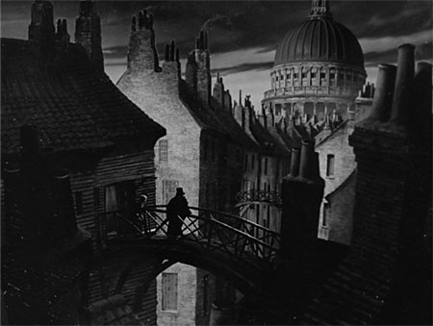
http://www.youtube.com/watch?v=0THtiZENnDk

Slide 5
When one of his travelling companions announced that they had reached Madrid, Manuel was filled with genuine anxiety. A red dusk flushed the sky, which was streaked with blood like some monster’s eye; the train gradually slackened speed; it glided through squalid suburbs and past wretched houses; by this time, the electric lights were gleaming pallidly above the high signal lanterns…..
The train rolled on between long lines of coaches, the round-tables trembled with an iron rumble, and the Estacion de Mediodia, illuminated by arc lamps, came into view.
From the bridge, the town seemed more fantastic and mysterious than ever; upon a wall might be made out the galleries of a palace, and several lofty, sombre towers shot up from amidst the jumbled dwellings of the town; a strip of moon gleamed close to the horizon, and the rive, divided by a few islets into arms, glittered as if it were mercury.
Baroja, The Quest, Part One, ChII)

Slide 6
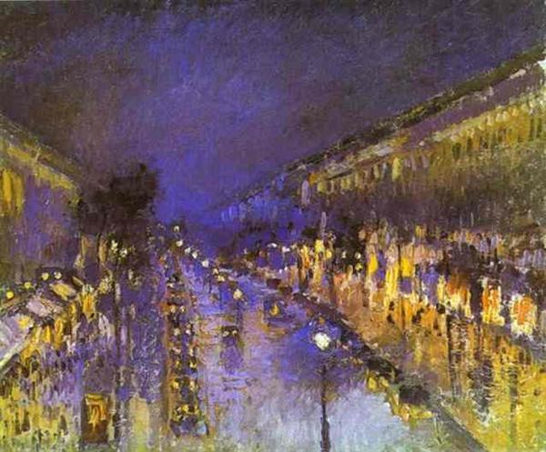

Slide 7
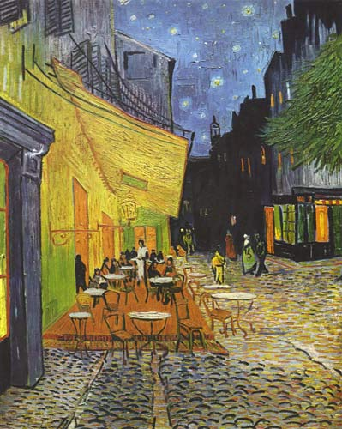

Slide 8
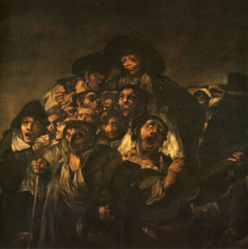

Slide 9
Raskolnikov went straight to Voznessensky Bridge, stopped in the middle of it, put his elbows on the railing, and gazed into the distance. After parting with Razumikhin, he felt so dreadfully weak that he just managed to get to this place. He wished he could sit or lie down somewhere in the street. Bending over the water of the canal, he watched mechanically the last pink reflection of the sunset, the row of houses, getting darker and darker in the gathering dusk, an attic window on the left bank blazing, as though on fire, in the last rays of the sun, which lit up for an instant, and the darkening water of the canal, on which his whole attention seemed to be more and more concentrated. At length red circles began whirling before his eyes, the houses seemed to move, the passers-by, the quays, the carriages – everything began to dance and rotate before his eyes. Suddenly he gave a start, and was perhaps saved from fainting again by a strange and horrible sight. He became aware that someone was standing close beside him, on his right. He looked up, and saw a tall woman with a shawl on her head and a long, yellow, haggard face and red hollow eyes. She looked straight at him, but she quite obviously saw nothing, nor did she seem to be aware of the presence of anyone. Suddenly she put her right hand on the parapet, lifted first her right, then her left leg over the railing and threw herself into the canal. The dirty water parted, swallowed up its victim for a moment, but in another instant the drowning woman came up again and floated gently down with the current, face downwards, her head and legs in the water, and her skirt gathered up and puffed out like a pillow.
‘A woman’s drowned herself! A woman’s drowned herself!’ dozens of voices shouted.
People came running from all over the place; both sides of the canal were thronged with onlookers; a whole crowd of people gathered round Raskolnikov, pressing him against the railing. (Part 2, Ch6)
Fyodor Dostoevsky, Crime and Punishment:

Slide 10
It was in those days when I wandered about hungry in Kristiania, that strange city which no one leaves before it has set its mark upon him. . . . (Part One)
However estranged from myself I was at this moment, so completely at the mercy of invisible influences, nothing that was taking place around me escaped my perception. A big brown dog ran across the street, towards the Students’ Promenade and down to the amusement park; it had a narrow collar of German silver. Farther up the street a window was opened on the second floor and a maid with her sleeves turned up leaned out and began to clean the panes on the outside. Nothing escaped my attention, I was lucid and self-possessed, and everything rushed in upon me with a brilliant distinctness, as if an intense light had suddenly sprung up around me. The ladies before me had each a blue-bird’s wing in their hats and a plaid silk band around their necks. It occurred to me that they were sisters. (Part One)
It was nine o’clock. The air was filled with voices and the rumble of carriages, an immense morning chorus that mingled with the footsteps of the pedestrians and the cracks of the coachmen’s whips. This noisy traffic everywhere put me in a brighter mood immediately and I started feeling more and more contented. […] a strange, delicate mood, a feeling of nonchalance, had taken possession of me. I began to observe the people I met or passed, read the posters on the walls, caught a glance cast my way from a passing streetcar, and laid myself open to every trifle – all the little fortuitous things that crossed my path and disappeared. […] I experienced an irrepressible sense of well-being and started humming for joy for no particular reason. A woman with a basket on her arm stood outside a butcher shop pondering sausages for dinner; she glanced at me as I walked past. She had only a single tooth in the front of her mouth. Nervous and susceptible as I had become during the last few days, the woman’s face made an repellent impression on me right off; that long yellow tooth looked like a little finger sticking up from her jaw, and her eyes were still full of sausage as she turned toward me. I lost my appetite instantly and felt nauseated. […] Continuing through the streets, I roamed about without a care in the world, stopped at a corner without having to, turned and went down a side street without an errand there, I went with the flow, borne from place to place this happy morning, rocking serenely to and from among other happy people. The sky was clear and bright and my mind was without a shadow.
For ten minutes now I had constantly had a limping old man ahead of me….
(Part One)
Knut Hamsun, Hunger:

Slide 11
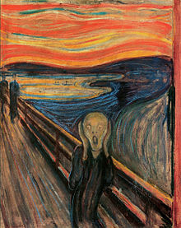

Slide 12
Trams passed one another, ingoing, outgoing, clanging. Useless words. Things go on same ; day after day : squads of police marching out, back : trams in, out. Those two loonies mooching about. Dignam carted off. Mina Purefoy swollen belly on a bed groaning to have a child tugged out of her. One born every second somewhere. Other dying every second. Since I fed the birds five minutes. Three hundred kicked the bucket. Other three hundred born, washing the blood off, all are washed in the blood of the lamb, bawling maaaaaa.
Cityful passing away, other cityful coming, passing away too : other cityful coming on, passing on. Houses, lines of houses, streets, miles of pavements, piledup bricks, stones. Changing hands. This owner, that. Landlord never dies they say. Other steps into his shoes when he gets his notice to quit. They buy the place up with gold and still they have all the gold. Swindle in it somewhere. Piled up in cities, worn away age after age. Pyramids in sand. Built on bread and onions. Slaves Chinese wall. Babylon. Big stones left. Round towers. Rest rubble, sprawling suburbs, jerrybuilt. Kerwans mushroom houses, built of breeze. Shelter for the night.
No one is anything.
This is the very worst hour of the day. Vitality. Dull, gloomy : hate this hour. Feel as if I had been eaten and spewed.
James Joyce, “Lestrygonians”, Ulysses, (1922 text)

Slide 13
I stagger away from the gate, drag myself along the walls of the buildings and come out onto the bright streets again. As I shuffle down Youngsbakken Lane, my brain suddenly begins to act in a strange manner. It occurs to me that those wretched hovels at the edge of the marketplace, the storage shacks and the old stalls with second hand clothing, were a real disgrace to the place. They spoiled the entire appearance of the marketplace and were a blot on the city – ugh, away with the junk!
Hunger, Part Three
All this black earth filled Manuel with an impression of ugliness, yet at the same time with a sense of tranquillity and shelter; it seemed a proper setting for him. This soil formed the daily deposits of the dumping-place; this earth, whose sole products were old sardine-cans, oyster-shells, broken combs and shattered pots; this earth, black and barren, composed of the detritus of civilisation, of bits of lime and mortar and factory refuse, of all that the city had cast off as useless, seemed to Manuel a place made especially for him, for he himself was a bit of the flotsam and jetsam likewise cast adrift by the life of the city.
….
This dark depression attracted Manuel somehow or other, with its rubbish heaps, its gloomy hovels, its comical, dismantled merry-go-round, its swings, and its ground that held so many surprises, for a rough, ordinary pot burgeoned from its depths as easily as a lady’s elegant perfume vial; the rubber bulb of a prosaic syringe grew side by side with the satin, scented sheet of a love letter.
This rough, humble life, sustained by the detritus of a refined, vicious existence; this almost savage career in the suburbs of a metropolis, filled Manuel with enthusiasm. It seemed to him that all the stuff cast aside in scorn by the capital, - the ordure and broken tubs, the old flower-pots and toothless combs, buttons and sardine tins, - all the rubbish thrown aside and spurned by the city, was dignified and purified by contact with the soil.
Baroja, The Quest, Pt 3, CHVI

Slide 14
Kinshasa, Khartoum, Dar es Salaam, Dhaka and Lima grow prodigiously despite ruined import-substitution industries, shrunken public sectors and downwardly mobile middle classes. The global forces ‘pushing’ people from the countryside—mechanization in Java and India, food imports in Mexico, Haiti and Kenya, civil war and drought throughout Africa, and everywhere the consolidation of small into large holdings and the competition of industrial-scale agribusiness—seem to sustain urbanization even when the ‘pull’ of the city is drastically weakened by debt and depression. At the same time, rapid urban growth in the context of structural adjustment, currency devaluation and state retrenchment has been an inevitable recipe for the mass production of slums. Much of the urban world, as a result, is rushing backwards to the age of Dickens.
Mike Davis, Planet of Slums, Verso, 2006

