Slide 1
Crime and Expectations
Dickens and Dostoevsky

Slide 2
Night Walking: London
Walking the streets under the pattering rain, Houselessness would walk and walk and walk, seeing nothing but the interminable tangle of streets, save at a corner, here and there, two policemen in conversation, or the sergeant or inspector looking after his men. Now and then in the night--but rarely--Houselessness would become aware of a furtive head peering out of a doorway a few yards before him, and, coming up with the head, would find a man standing bolt upright to keep within the doorway`s shadow, and evidently intent upon no particular service to society. Under a kind of fascination, and in a ghostly silence suitable to the time, Houselessness and this gentleman would eye one another from head to foot, and so, without exchange of speech, part, mutually suspicious. (Charles Dickens, Night Walks)

Slide 3
Street Walking:St.Petersburg
The heat in the street was terrible: and the airlessness, the bustle and the plaster, scaffolding, bricks, and dust all about him, and that special Petersburg stench, so familiar to all who are unable to get out of town in summer--all worked painfully upon the young man's already overwrought nerves. The insufferable stench from the pot- houses, which are particularly numerous in that part of the town, and the drunken men whom he met continually, although it was a working day, completed the revolting misery of the picture. An expression of the profoundest disgust gleamed for a moment in the young man's refined face. He was, by the way, exceptionally handsome, above the average in height, slim, well-built, with beautiful dark eyes and dark brown hair. Soon he sank into deep thought, or more accurately speaking into a complete blankness of mind; he walked along not observing what was about him and not caring to observe it. From time to time, he would mutter something, from the habit of talking to himself, to which he had just confessed. At these moments he would become conscious that his ideas were sometimes in a tangle and that he was very weak; for two days he had scarcely tasted food. (F.Dostoevsky: Crime and Punishment)

Slide 4
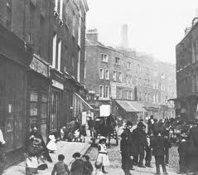
The Urban Savage: London

Slide 5
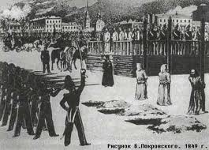
The Urban Savage:
St. Petersburg

Slide 6
Sins of the Fathers
Look’ee here Pip. I’m your second father. You’re my son – more to me nor any son….I’ll make that boy a gentleman! And I done it. Why, look at you, dear boy! Look at these here lodgings o’yourn, fit for a lord? Ah! You shall show money with lords for wagers, and beat ‘em. (Charles Dickens, Great Expectations)
I have been bent and broken, but – I hope – into a better shape. (Charles Dickens, Great Expectations)

Slide 7
Sins of the Sons
Far more mercilessly, far more pitilessly than the sternest law, he condemns himself for his crime (F. Dostoevsky)
N.B. His moral development begins from the crime itself (F. Dostoevsky, 1865)
This is an obscure and fantastic case, a contemporary case, something that could only happen in our day, when the heart of an has grown troubled, when people quote sayings about blood “refreshing”….He forgot to shut the door behind him, but he murdered, and murdered two people, for a theory. (F. Dostoevsky, Crime and Punishment)

