Slide 1
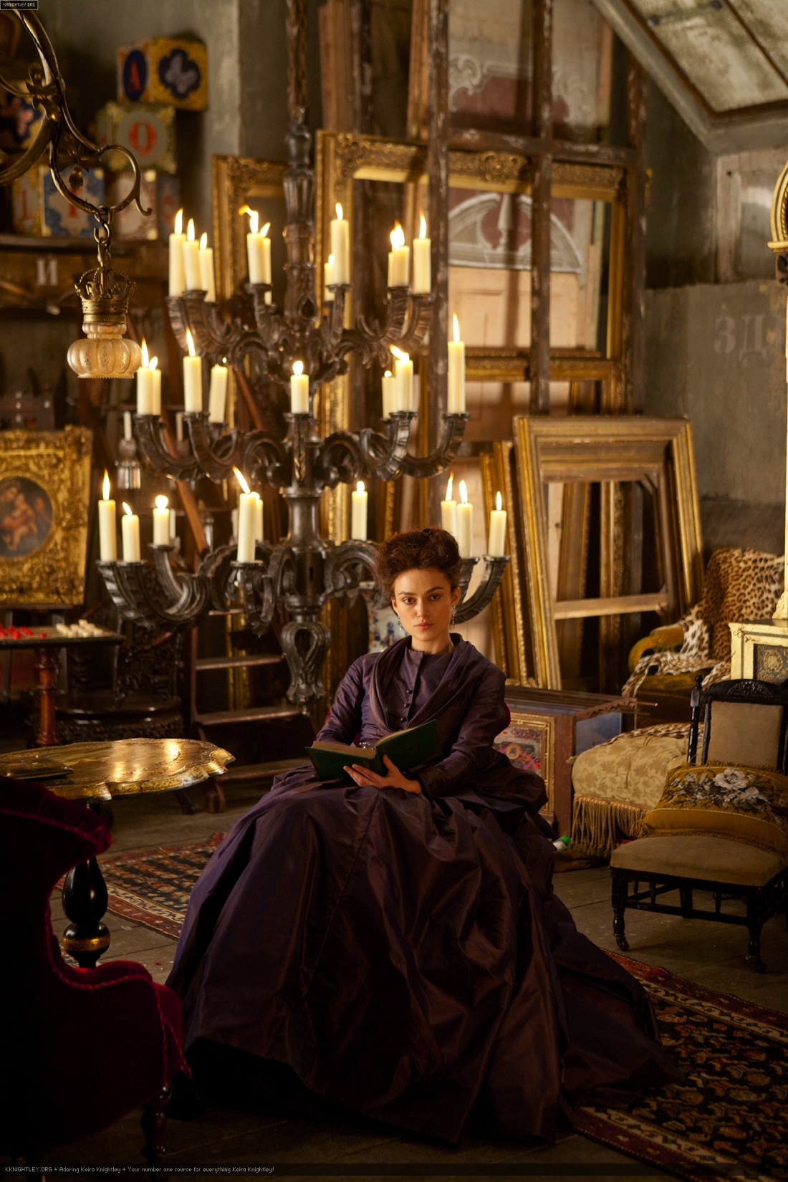
Anna Karenina: Realism and some of its paradoxes
EN201
The European Novel
3 December 2014

Slide 2
1. Realism as movement in historical time
2. Realism as a mirror of society
3. Realism as a representational technique
4.Realism as ideology

Slide 3
Johann Wolfgang Von Goethe, The Sorrows of Young Werther (1774)
Jane Austen, Emma (1815)
Gustave Flaubert, Madame Bovary (1857)
Charles Dickens, Great Expectations (1861)
Fyodor Dostoyevsky, Crime and Punishment (1866)
Leo Tolstoy, Anna Karenina (1877)
Émile Zola, Germinal (1885)
Knut Hamsun, Hunger (1890)
Pío Baroja, The Quest (1904)
Karin Michaëlis, The Dangerous Age (1910)
Dezsö Kosztolányi, Skylark (1924)
Halldór Laxness, The Atom Station (1948)
Giuseppe Tomasi di Lampedusa, The Leopard (1958),
António Lobo Antunes, The Land at the End of the World (1979)

Slide 4
“. The point about the novel […] is not just that it eludes definitions, but that it actively undermines them. It is less a genre than an anti-genre. It cannibalizes other literary modes and mixes the bits and pieces promiscuously together. (…) The novel is a mighty melting pot, a mongrel among literary thoroughbreds. There seems to be nothing it cannot do. It can investigate a single human consciousness for eight hundred pages. Or it can recount the adventures of an onion, chart the history of a family over six generations, or recreate the Napoleonic wars. If it is a form particularly associated with the middle class, it is partly because the ideology of that class centres on a dream of total freedom from restraint. In a word in which God is dead, everything, so Dostoevsky remarked, is permitted; and the same goes for a world in which the old autocratic order is dead and the middle class reigns triumphant. The novel is an anarchic genre, since its rule is not to have rules.”
Terry Eagleton, ‘What is a Novel?’, The English Novel: An Introduction (2005)

Slide 5
Fredric Jameson, Antinomies of Realism, 1

Slide 6
Fredric Jameson ‘The Antinomies of Realism’ (6)

Slide 11
"To enter into all the details of your feelings I have no right, and besides, I regard that as useless and even harmful," began Alexey Alexandrovitch. "Ferreting in one’s soul, one often ferrets out something that might have lain there unnoticed. Your feelings are an affair of your own conscience; but I am in duty bound to you, to myself, and to God, to point out to you your duties. Our life has been joined, not by man, but by God. That union can only be severed by a crime, and a crime of that nature brings its own chastisement."
"I don’t understand a word. And, oh dear! how sleepy I am, unluckily," she said, rapidly passing her hand through her hair, feeling for the remaining hairpins.
"Anna, for God’s sake don’t speak like that!" he said gently. "Perhaps I am mistaken, but believe me, what I say, I say as much for myself as for you. I am your husband, and I love you."
For an instant her face fell, and the mocking gleam in her eyes died away; but the word love threw her into revolt again. She thought: "Love? Can he love? If he hadn’t heard there was such a thing as love, he would never have used the word. He doesn’t even know what love is.” AK, 2, chapter 9

Slide 12
"No honor, no heart, no religion; a corrupt woman. I always knew it and always saw it, though I tried to deceive myself to spare her," he said to himself. And it actually seemed to him that he always had seen it: he recalled incidents of their past life, in which he had never seen anything wrong before—now these incidents proved clearly that she had always been a corrupt woman. "I made a mistake in linking my life to hers; but there was nothing wrong in my mistake, and so I cannot be unhappy. It’s not I that am to blame," he told himself, "but she. But I have nothing to do with her. She does not exist for me..."
Everything relating to her and her son, towards whom his sentiments were as much changed as towards her, ceased to interest him. The only thing that interested him now was the question of in what way he could best, with most propriety and comfort for himself, and thus with most justice, extricate himself from the mud with which she had spattered him in her fall, and then proceed along his path of active, honorable, and useful existence.” AK, 3, chapter 13

Slide 13
Realism and Representation

Slide 14
Trailer

Slide 15
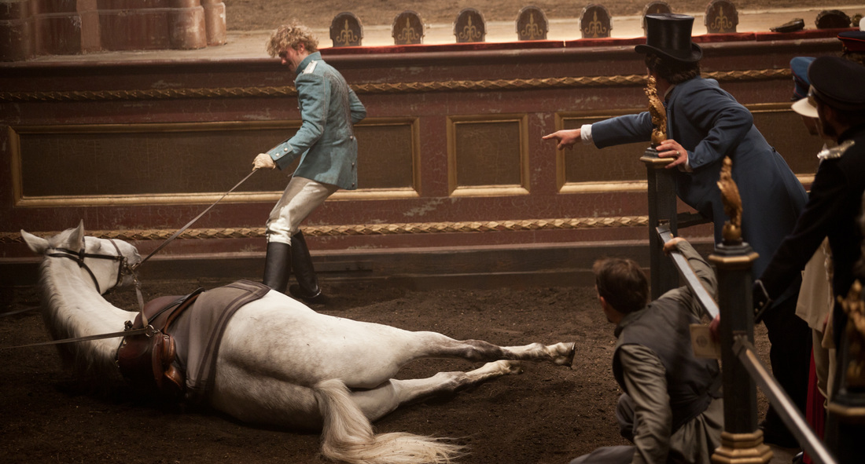

Slide 16
At first Anna sincerely believed that she was displeased with him for daring to pursue her. Soon after her return from Moscow, on arriving at a soirée where she had expected to meet him, and not finding him there, she realized distinctly from the rush of disappointment that she had been deceiving herself, and that this pursuit was not merely not distasteful to her, but that it made the whole interest of her life.
A celebrated singer was singing for the second time, and all the fashionable world was in the theater. Vronsky, seeing his cousin from his stall in the front row, did not wait till the entr’acte, but went to her box. AK, 2, chapter 4

Slide 17
Vronsky for the first time experienced a feeling of anger against Anna, almost a hatred for her willfully refusing to understand her own position. This feeling was aggravated by his being unable to tell her plainly the cause of his anger. If he had told her directly what he was thinking, he would have said:
"In that dress, with a princess only too well known to everyone, to show yourself at the theater is equivalent not merely to acknowledging your position as a fallen woman, but is flinging down a challenge to society, that is to say, cutting yourself off from it forever.” AK, 5, chapter 33

Slide 18
That year races and a steeplechase had been arranged for the officers. Vronsky had put his name down, bought a thoroughbred English mare, and in spite of his love affair, he was looking forward to the races with intense, though reserved, excitement...
These two passions did not interfere with one another. On the contrary, he needed occupation and distraction quite apart from his love, so as to recruit and rest himself from the violent emotions that agitated him. AK, 2, chapter 18

Slide 19
It was only from feeling himself nearer the ground and from the peculiar smoothness of his motion that Vronsky knew how greatly the mare had quickened her pace. She flew over the ditch as though not noticing it. She flew over it like a bird; but at the same instant Vronsky, to his horror, felt that he had failed to keep up with the mare’s pace, that he had, he did not know how, made a fearful, unpardonable mistake, in recovering his seat in the saddle. All at once his position had shifted and he knew that something awful had happened. He could not yet make out what had happened, when the white legs of a chestnut horse flashed by close to him, and Mahotin passed at a swift gallop. Vronsky was touching the ground with one foot, and his mare was sinking on that foot. He just had time to free his leg when she fell on one side, gasping painfully, and, making vain efforts to rise with her delicate, soaking neck, she fluttered on the ground at his feet like a shot bird. The clumsy movement made by Vronsky had broken her back. AK, 2, chapter 25

Slide 20
Steeplechase

Slide 21
Realism and (as) Ideology

Slide 22
“To identify the great artist with the revolution which he has obviously failed to understand, and from which he obviously stands aloof, may at first sight seem strange and artificial. A mirror which does not reflect things correctly could hardly be called a mirror. Our revolution, however, is an extremely complicated thing. Among the mass of those who are directly making and participating in it there are many social elements which have also obviously not understood what is taking place and which also stand aloof from the real historical tasks with which the course of events has confronted them. And if we have before us a really great artist, he must have reflected in his work at least some of the essential aspects of the revolution.” Lenin, ‘Leo Tolstoy as the Mirror of the Russian Revolution’ 1908

Slide 23
The contradictions in Tolstoy’s works, views, doctrines, in his school, are indeed glaring. On the one hand, we have the great artist, the genius who has not only drawn incomparable pictures of Russian life but has made first-class contributions to world literature. On the other hand we have the landlord obsessed with Christ. On the one hand, the remark ably powerful, forthright and sincere protest against social falsehood and hypocrisy; and on the other, the “Tolstoyan”, i.e., the jaded, hysterical sniveller called the Russian intellectual, who publicly beats his breast and wails: “I am a bad wicked man, but I am practising moral self-perfection; I don’t eat meat any more, I now eat rice cutlets.” On the one hand, merciless criticism of capitalist exploitation, exposure of government outrages, the farcical courts and the state administration, and unmasking of the profound contradictions between the growth of wealth and achievements of civilisation and the growth of poverty, degradation and misery among the working masses. On the other, the crackpot preaching of submission, “resist not evil” with violence. On the one hand, the most sober realism, the tearing away of all and sundry masks; on the other, the preaching of one of the most odious things on earth, namely, religion, the striving to replace officially appointed priests by priests who will serve from moral conviction, i. e., to cultivate the most refined and, therefore, particularly disgusting clericalism. Lenin, 1908

Slide 24
"Well, what is it perplexes me?" Levin said to himself, feeling beforehand that the solution of his difficulties was ready in his soul, though he did not know it yet. "Yes, the one unmistakable, incontestable manifestation of the Divinity is the law of right and wrong, which has come into the world by revelation, and which I feel in myself, and in the recognition of which—I don’t make myself, but whether I will or not—I am made one with other men in one body of believers, which is called the church. Well, but the Jews, the Mohammedans, the Confucians, the Buddhists—what of them?" he put to himself the question he had feared to face. "Can these hundreds of millions of men be deprived of that highest blessing without which life has no meaning?" He pondered a moment, but immediately corrected himself. "But what am I questioning?" he said to himself. "I am questioning the relation to Divinity of all the different religions of all mankind. I am questioning the universal manifestation of God to all the world with all those misty blurs. What am I about? To me individually, to my heart has been revealed a knowledge beyond all doubt, and unattainable by reason, and here I am obstinately trying to express that knowledge in reason and words.” AK, 8, chapter 19

Slide 25
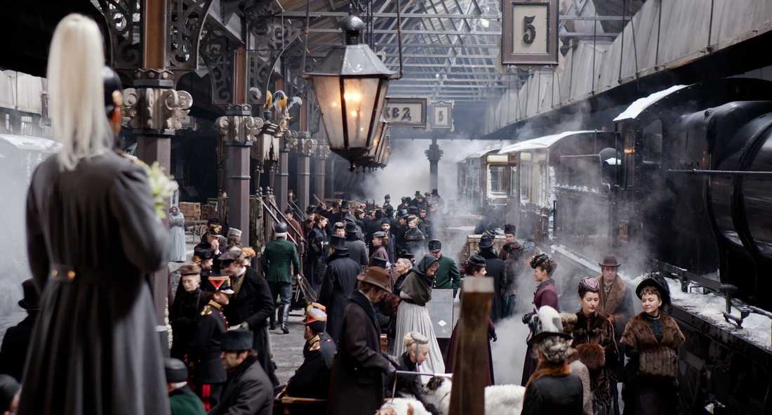

Slide 26
She tried to fling herself below the wheels of the first carriage as it reached her; but the red bag which she tried to drop out of her hand delayed her, and she was too late; she missed the moment. She had to wait for the next carriage. A feeling such as she had known when about to take the first plunge in bathing came upon her, and she crossed herself. That familiar gesture brought back into her soul a whole series of girlish and childish memories, and suddenly the darkness that had covered everything for her was torn apart, and life rose up before her for an instant with all its bright past joys. But she did not take her eyes from the wheels of the second carriage. And exactly at the moment when the space between the wheels came opposite her, she dropped the red bag, and drawing her head back into her shoulders, fell on her hands under the carriage, and lightly, as though she would rise again at once, dropped on to her knees. And at the same instant she was terror-stricken at what she was doing. "Where am I? What am I doing? What for?" She tried to get up, to drop backwards; but something huge and merciless struck her on the head and rolled her on her back. "Lord, forgive me all!" she said, feeling it impossible to struggle. A peasant muttering something was working at the iron above her. And the light by which she had read the book filled with troubles, falsehoods, sorrow, and evil, flared up more brightly than ever before, lighted up for her all that had been in darkness, flickered, began to grow dim, and was quenched forever. AK, 7, chapter 31

Slide 27
F. R. Leavis. ‘Anna Karenina and Other Essays’ (1967: 32)
“Anna Karenina one of the great European novels? – it is, surely, the European novel. The completeness with which Tolstoy, with his genius, was a Russian of his time made him an incomparably representative European, and made the book into which his whole experience (…) went what it is for us: the great novel of modern – of our – civilization”

Slide 28
Happy families are all alike; every unhappy family is unhappy in its own way.
Everything was in confusion in the Oblonskys’ house. The wife had discovered that the husband was carrying on an intrigue with a French girl, who had been a governess in their family, and she had announced to her husband that she could not go on living in the same house with him. This position of affairs had now lasted three days, and not only the husband and wife themselves, but all the members of their family and household, were painfully conscious of it. Every person in the house felt that there was no sense in their living together, and that the stray people brought together by chance in any inn had more in common with one another than they, the members of the family and household of the Oblonskys. The wife did not leave her own room, the husband had not been at home for three days. The children ran wild all over the house; the English governess quarreled with the housekeeper, and wrote to a friend asking her to look out for a new situation for her; the man-cook had walked off the day before just at dinner time; the kitchen-maid, and the coachman had given warning. AK 1, chapter 1

Slide 29
"But what am I questioning?" he said to himself. "I am questioning the relation to Divinity of all the different religions of all mankind. I am questioning the universal manifestation of God to all the world with all those misty blurs. What am I about? To me individually, to my heart has been revealed a knowledge beyond all doubt, and unattainable by reason, and here I am obstinately trying to express that knowledge in reason and words.” AK, 8, chapter 19

