Slide 1
Narration and Nation in
Great Expectations
The European Novel 2014-15
Dr Charlotte Mathieson

Slide 2
Narrating the nation
What is the “nation”
Narrating the nation: space and identity
The nation and the novelist

Slide 3
England / Britain
Nation and Empire
(Europe)

Slide 4
England / Britain
    Country/ city
Nation and Empire
    Australia

Slide 5
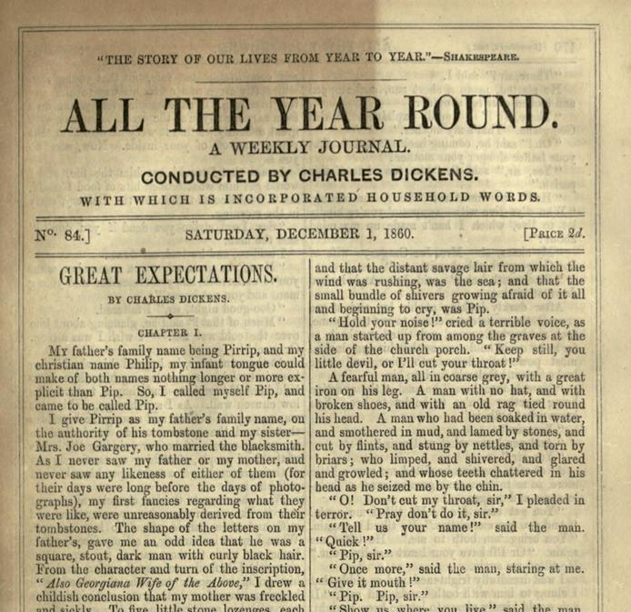
Great Expectations (1860-61)

Slide 6
The country
    Nature
    Simplicity, innocence
    Peace
    Tradition
    Limitation
    The past
The city
    Modernity
    Progress
    Experience
    Education
    Ambition
    The future

Slide 7
The country
    Nature
    Simplicity, innocence
    Peace
    Tradition
    Limitation
    The past
    England
The city
    Modernity
    Progress
    Experience
    Education
    Ambition
    The future
    Britain

Slide 8
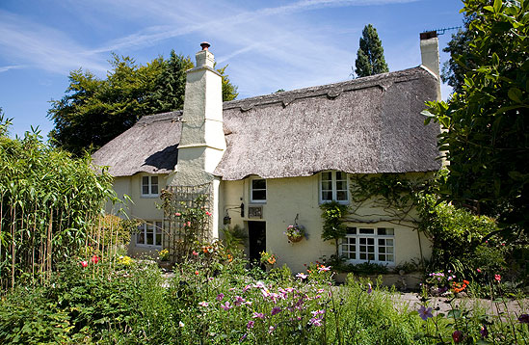
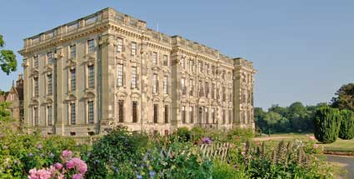
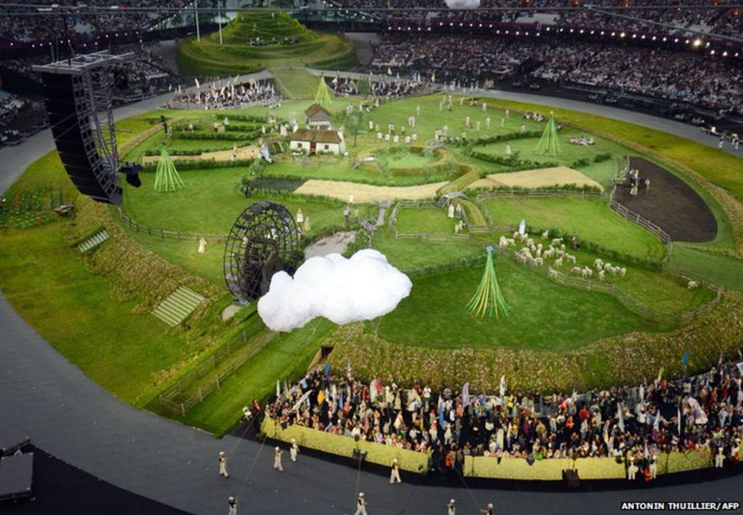
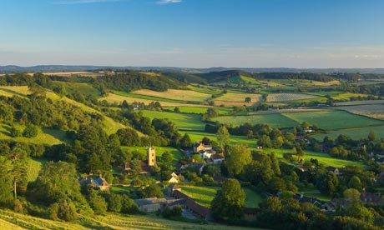

Slide 9
“Englishness has consistently been defined through appeals to the identity-endowing properties of place. […] Englishness has been generally understood to reside within some type of imaginary, abstract, or actual locale, and to mark itself upon that locale’s familiars.... the identifications of Englishness with the locale – and with the local knowledges, local dialects, local traditions, and local memories that are held to emerge from the locale.”

Slide 10
“The dominant image of English countryside … touches on questions of national identity. The countryside, as it is represented by those who have privileged place within it, is the essence of Englishness, so those who are excluded from this purified space are also, in a sense, un-English. It is those parts of national territory that are pictured as stable, culturally homogenous, historically unchanging which are taken to represent nation in nationalistic discourse. These are generally rural areas which stand in opposition to cosmopolitan cities.”

Slide 11
“Ours was the marsh country, down by the river [...] the dark flat wilderness beyond the churchyard, intersected with dykes and mounds and gates, with scattered cattle feeding on it, was the marshes; and that low leaden line beyond it, was the river.”

Slide 12
“It was pleasant and quiet, out there with the sails on the river passing beyond the earthwork... Whenever I watched the vessels standing out to sea with their white sails spread, I somehow thought of Miss Havisham and Estella; and whenever the light struck aslant, afar off, upon a cloud or sail or green hill-side or water-line, it was just the same. – Mss Havisham and Estella and the strange life appeared to have something to do with everything that was picturesque.”

Slide 13
“… it was clear to me that village boys could not go stalking about the country, ravaging the houses of gentlefolks and pitching into the studious youth of England, without laying themselves open to severe punishment.”
“Sir,” Mr. Wopsle began to reply, “as an Englishman myself, I—”
“my sister leading the way in a very large beaver bonnet, and carrying a basket like the Great Seal of England.”
“A Englishman’s ’ouse is his Castle.”

Slide 14
“The journey from our town to the metropolis, was a journey of about five hours. It was a little past mid-day when the four-horse stage-coach by which I was a passenger, got into the ravel of traffic frayed out about the Cross Keys, Wood-street, Cheapside, London.
We Britons had at that time particularly settled that it was treasonable to doubt our having and our being the best of everything; otherwise, while I was scared by the immensity of London, I think I might have had some faint doubts whether it was not rather ugly, crooked, narrow and dirty.”

Slide 15
“the sense of a common identity here did not come into being, then, because of an integration and homogenisation of disparate cultures. Instead, Britishness was superimposed over an array of internal differences in response to contact with the Other, and above all in response to conflict with the Other.”

Slide 16
“The journey from our town to the metropolis, was a journey of about five hours. It was a little past mid-day when the four-horse stage-coach by which I was a passenger, got into the ravel of traffic frayed out about the Cross Keys, Wood-street, Cheapside, London.
We Britons had at that time particularly settled that it was treasonable to doubt our having and our being the best of everything; otherwise, while I was scared by the immensity of London, I think I might have had some faint doubts whether it was not rather ugly, crooked, narrow and dirty.”

Slide 17
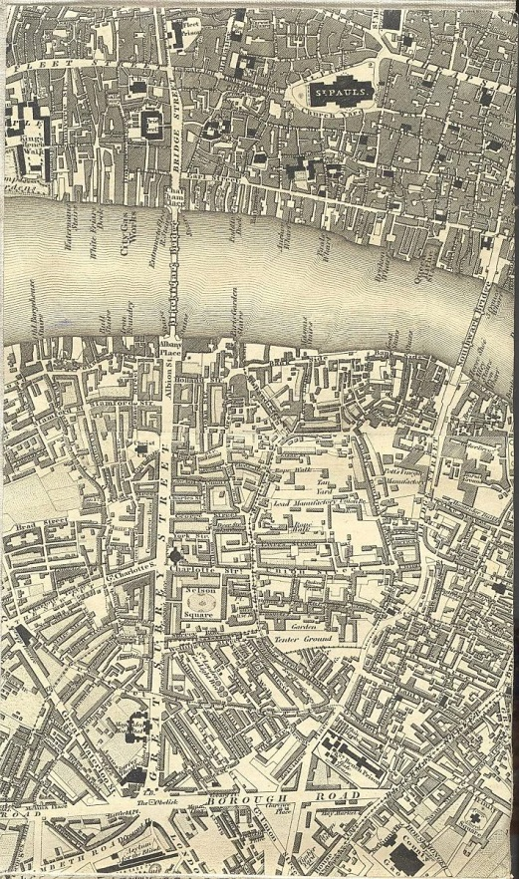
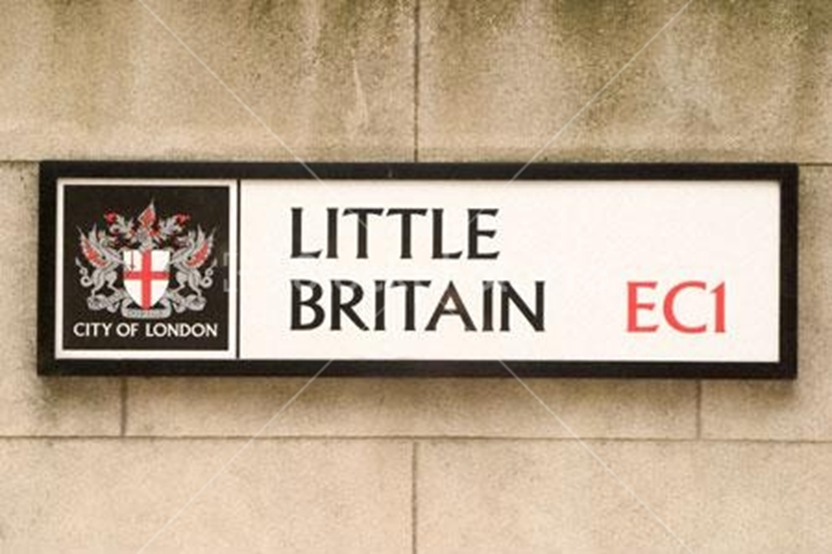

Slide 18
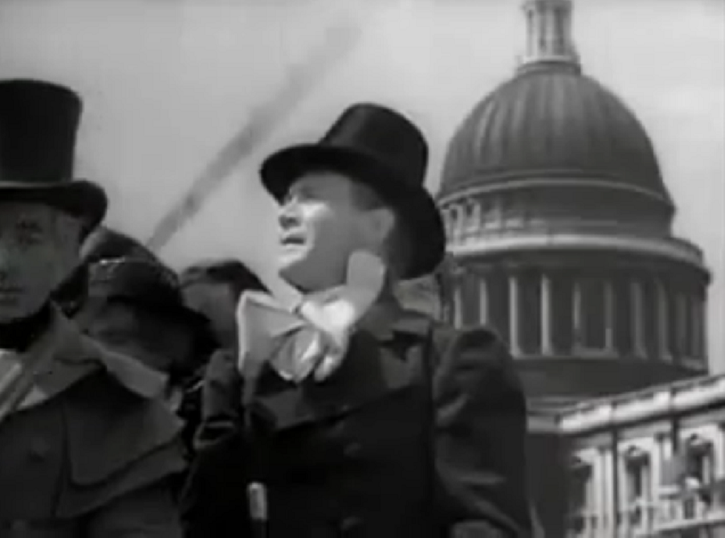
Great Expectations, dir. David Lean (1946)

Slide 19
“Wemmick’s house was a little wooden cottage in the midst of plots of garden, and the top of it was cut out and painted like a battery mounted with guns … ‘That’s a real flagstaff, you see, and on Sundays I run up a real flag. Then look here. After I have crossed this bridge, I hoist it up – so – and cut off the communication…
At nine o’clock every night, Greenwich time, the gun fires.... Then at the back, out of sight, so as not to impede the idea of fortifications...’”

Slide 20
“This spot and these beautiful works upon it ought to be kept together by the Nation, after my son’s time, for the people’s enjoyment.”

Slide 21
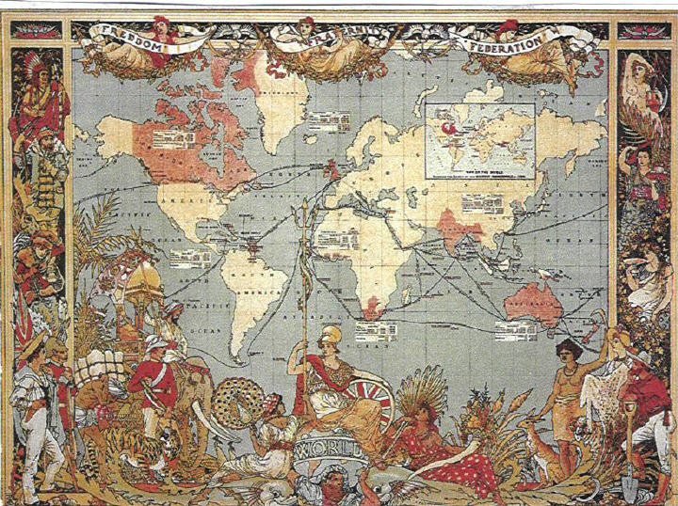
“I think I shall trade to the East Indies, for silks, shawls, spices, dyes, drugs and precious woods. Its an interesting trade.”
“I think I shall trade also to the West Indies, for sugar, tobacco, and rum. Also to Ceylon, specially for elephants’ tusks.”
“You will want a good many ships” said I.
“A perfect fleet,” said he.

Slide 22
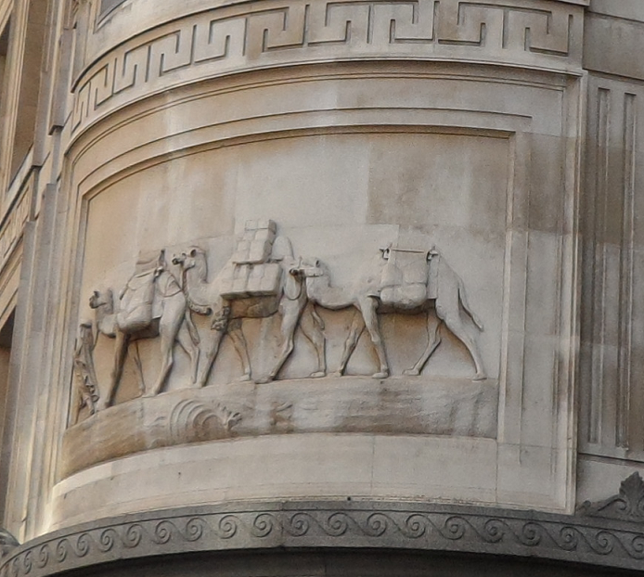
“…you look about you. Then the time comes when you see your opening. And you go in, and you swoop upon it and you make your capital, and then there you are!”

Slide 23
“its conservators could save Englishness by insisting that the empire had little or nothing to do with England, by defining imperial space as something subordinate but quite different from English space, and by identifying the empire’s subjects as persons subordinate to but quite different from England’s subjects –by identifying these as British spaces and British subjects: a solution that manages the neat trick of allowing England to simultaneously avow and disavow its empire.”

Slide 24
“I strolled out alone, purposing to finish off the marshes at once, and get them done with. As I passed the church, I felt (as I had during service in the morning) a sublime compassion for the poor creatures who were destined to go there, Sunday after Sunday, all their lives through, and to lie obscurely at last among the low green mounds.”

Slide 25
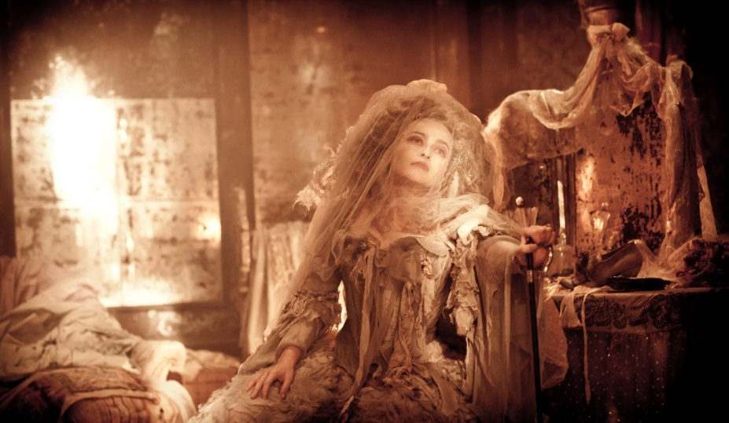
Great Expectations, dir. Mike Newell (2012)
“So unchanging was the dull old house, the yellow light in the darkened room, the faded spectre in the chair by the dressing-table glass, that I felt as if the stopping of the clocks had stopped Time in that mysterious place, and while I and everything else outside it grew older, it stood still.”

Slide 26
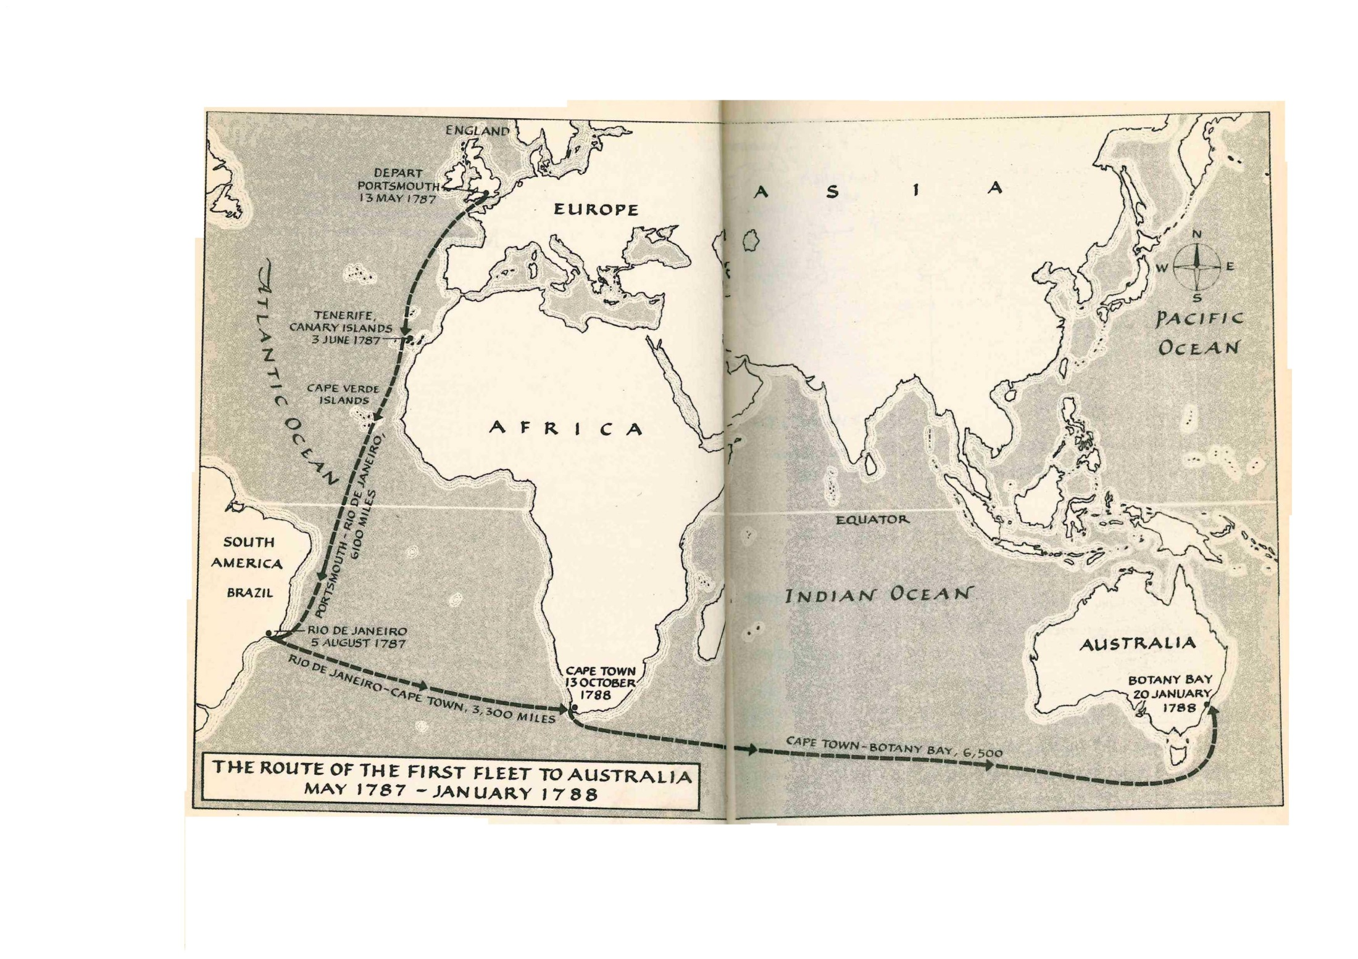

Slide 27
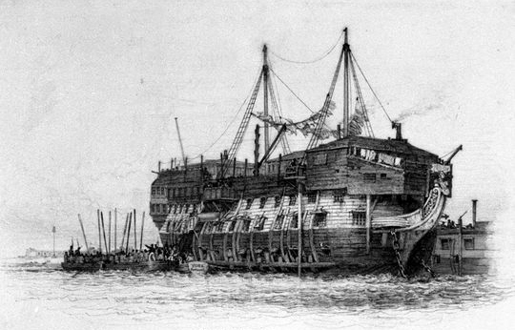
HMS York in Prison-ship in Portsmouth Harbour with the convicts going on board, by Edward William Cooke

Slide 28
“in the person of Magwitch, Dickens knotted several strands in the English perception of convicts in Australia at the end of transportation. They could succeed, but they could hardly, in the real sense, return. They could expiate their crimes in a technical, legal sense, but what they suffered there warped them into permanent outsiders.”

Slide 29
http://www.youtube.com/watch?v=h_JveFpGyUw

Slide 30
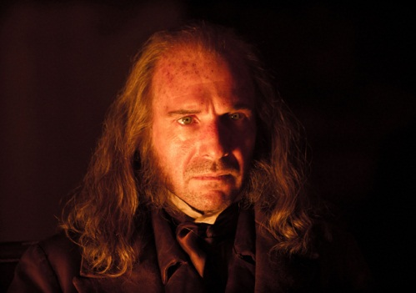
“from head to foot there was Convict in the very grain of the man. The influences of his solitary hut-life were upon him besides, and gave him a savage air that no dress could tame; added to these were the influences of his subsequent branded life among men, and, crowning all, his consciousness that he was dodging and hiding now.”

Slide 31
“In all his ways of sitting and standing, and eating and drinking – of brooding about, in a high-shouldered reluctant style… In these ways and a thousand other small nameless instances arising every minute in the day, there was Prisoner, Felon, Bondsman, plain as plain could be.”

Slide 32
“The prohibition placed on Magwitch’s return is not only penal but imperial: subjects can be taken to places like Australia, but they cannot be allowed a ‘return’ to metropolitan space.”

Slide 33
“I lived rough, that you should live smooth; I worked hard, that you should be above work. What odds, dear boy? Do I tell it, fur you to feel a obligation? Not a bit. I tell it, fur you to know as that there hunted dunghill dog wot you kep life in, got his head so high that he could make a gentleman – and, Pip, you’re him!”

Slide 34
“Let me introduce the topic, Handel, by mentioning that in London it is not the custom to put the knife in the mouth [...]
Take another glass of wine, and excuse my mentioning that society as a body does not expect one to be so strictly conscientious in emptying one’s glass[...]
– merely breaking off, my dear Handel, to remark that a dinner napkin will not go into a tumbler”

Slide 35
“[Magwitch] appeared to me to have obscurely hinted in his letter at some distant idea he had of seeing you in England here.”
“that is his power over you as long as he remains in England… the first and the main thing to be done is to get him out of England....”
“you must get him out of England before you stir a finger to extricate yourself.”

Slide 36
“...almost indifferent what port we made for – Hamburg, Rotterdam, Antwerp – the place signified little, so that he was got out of England. Any foreign steamer that fell in our way and would take us up, would do…”
“he put his pipe back in his mouth with an undisturbed expression of face, and sat as composed and contented as if we were already out of England.”

Slide 37
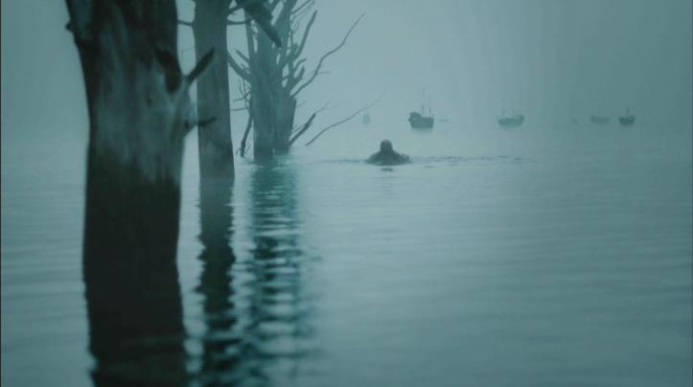
Great Expectations, BBC series (2011)

Slide 38
“If I had often thought before, with something allied to shame, of my companionship with the fugitive whom I had once seen limping among those graves, what were my thoughts on this Sunday, when the place recalled the wretch, ragged and shivering, with his felon iron and badge! My comfort was, that it happened a long time ago, and that he had doubtless been transported a long way off, and that he was dead to me, and might be veritably dead into the bargain.”

Slide 39
“Day after day, a vast heavy veil had been driving over London from the East, and it drove still, as if in the East there were an Eternity of cloud and wind. So furious had been the gusts that high buildings in town had had the lead stripped off their roofs; and in the country, trees had been torn up, and sails of windmills carried away; and gloomy accounts had come in from the coast, of shipwreck and death.”

Slide 40
“Within a month I had quitted England […] I was left in sole charge of the Eastern Branch.”
“For eleven years, I had not seen Joe nor Biddy with my bodily eyes – though they had both been often before my fancy in the East.”

Slide 41
“There was no house now, no brewery, no building whatever left, but the wall of the old garden. The cleared space had been enclosed... and some ivy was growing green on low quiet mounds of ruin.”

Slide 42
“I took her hand in mine and we went out of the ruined place; and as the morning mists had risen long ago when I first left the forge, so the evening mists were rising now, and in all the broad expanse of tranquil light they showed to me, I saw the shadow of no parting from her.”

Slide 43
https://www.youtube.com/watch?v=fPLkFU3oIyc

Slide 44
“she reserved it for me to restore the desolate house, admit the sunshine into the dark rooms, set the clocks a going and the cold hearths a blazing, tear down the cobwebs, destroy the vermin – in short, do all the shining deeds of the young Knight of romance, and marry the Princess.”

Slide 45
