Slide 1
The Dangerous Age
Karin Michaelis

Slide 2
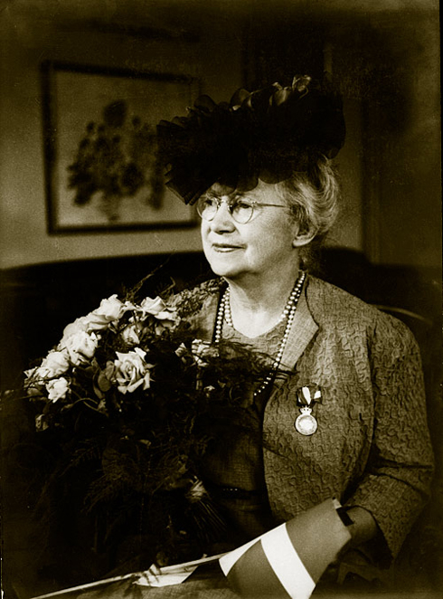
If it were not for your books, I could not have written mine - Colette

Slide 3
A Grey Area
The two decades following the turn of the century have been described by Danish critic Bo Hakon Jorgensen as a “skyggezone” (a grey area) in Danish literature [….] While a single trend, movement, or zeitgeist does not define the first two decades of the century, many competing and concurrent trends came into play: naturalism and realism, symbolism and Romanticism, social orientation and psychological introspection. (M. Stacher Hansen)

Slide 4
Fear and Trembling
Kierkegaard’s obsessive meditation about Abraham’s covenant with God – a covenant defines faith as a willingness to sacrifice/murder one’s son – defies all standard codes, not just ethical but familial, tribal, and lingual. Here is a story one has thought one understood, but the Danish philosopher is at pains to show how fraudulent our “knowledge” is, how unspeakable these matters are, since they resist both logic and language. (Arnold Weinstein)

Slide 5
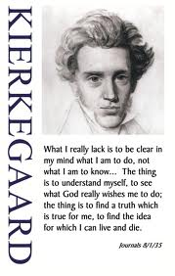
“What I am to do, not What I am to know”

Slide 6
The Language Problem
From the first page of her letters and diaries to the last, she challenges herself and her readers unrelentingly, without intervention by any other narrator, about the politics of women’s ageing [….] Den Farlige Alder dispenses with the conventional narrator who foresees and analyzes character’s development. (M. Stacher Hansen )

Slide 7
Against Fatherly Language
The double movement of negation and conquest can most clearly be seen in the domain of language. Here too, a ‘NO’ can be heard, a refusal to be content with existing structures of language on the grounds that they are always an expression of existing social structures [….] a counter language has to becreated – in short, ‘écriture féminine’. (Annegret Heitmann)

Slide 8
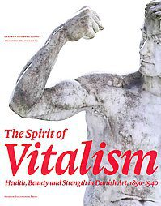
Bodily Language

Slide 9
A hymn to the life of human beings, from birth to death, rendered in stone and bronze [….] I wanted to express their joys and sorrows, their loves and separations, their struggles, victories and defeats, until solitude takes each in its embrace. (Rudolph Tegner, The Arch of Life, 1912-15)

Slide 10
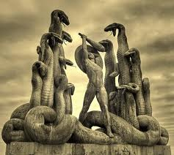

Slide 11
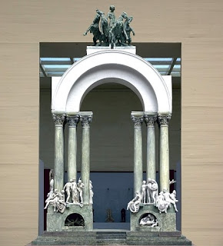

Slide 12
