Slide 1
The European Novel
Self-Conscious Fiction

Slide 2
He’s behind you

Slide 3
Now he’s in the proper place for a lecture….

Slide 4
Are you?

Slide 5
The lecturer stood at the front of the lecture theatre and began. Blah Blah Blah. He was bored and tired. He was lecturing on self-consciousness in novels but he was thinking about how much other work he had to do. He was thinking of how garbled this might be coming across. He was worried about how he may not be too worried about it. He was thinking of his five year old’s recent request for a One Direction lunchbox – had he failed with that one? In the very depths - the nagging thought that he could have stuck in at football more….. “The European Novel”…”self-conscious fiction” ….blah blah blah…

Slide 6
The present increased awareness of ‘meta’ levels of discourses and experience is partly a consequence of an increased social and cultural self-consciousness. Beyond this however, it also reflects a greater awareness within contemporary culture of the function of language in constructing and maintaining our sense of everyday ‘reality’ […] Metafiction explicitly lays bare the conventions of realism; it does not ignore or abandon them. Very often realistic conventions supply the ‘control’ in metafictional texts, the norm of background against which the experimental strategies can foreground themselves […] What metafiction does is re-examine the conventions of realism in order to discover – through its own self-reflection – a fictional form that is culturally relevant and comprehensible to contemporary readers. In showing us how literary fiction creates its imaginary worlds, metafiction helps us to understand how the reality we live day by day is similarly constructed, similarly written.
Metafiction is a term given to fictional writing which self-consciously and systematically draws attention to its status as an artefact in order to pose questions about the relationship between fiction and reality.
Patricia Waugh, ‘What is Metafiction and Why are They Saying Such Awful Things About it?’ in Metafiction , Mark Currie (ed) (London: Longman, 1995)

Slide 7
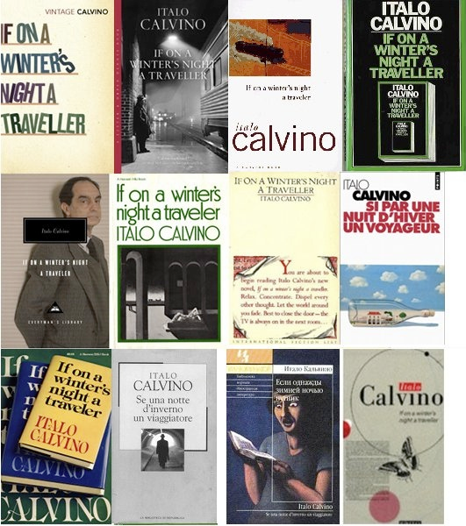
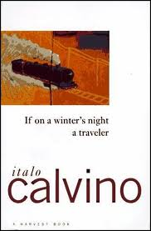
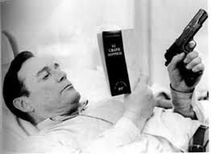

Slide 8
Chapter One
You are about to begin reading Italo Calvino’s new novel, If on a winter’s night a traveller. Relax. Concentrate. Dispel every other thought. Let the world around you fade. Best to close the door; the TV is always on in the next room. Tell the others right away, “No I don’t want to watch TV!” Raise your voice – they won’t hear you otherwise – “I’m reading! I don’t want to be disturbed!” Maybe they haven’t heard you, with all that racket; speak louder, yell: “I’m beginning to read Italo Calvino’s new novel!” Or, if you prefer, don’t say anything; just hope they’ll leave you alone.
Find the most comfortable position: seated stretched out, curled up, or lying flat. Flat on your back, on your side, on your stomach. In an easy chair, on the sofa, in the rocker, the deck chair, on the hassock. In the hammock, if you have a hammock. On top of your bed, of course, or in the bed. You can even stand on your hands, head down, in the yoga position. With the book upside down, naturally.
Of course, the ideal position for reading is something you can never find. In the old days they used to read standing up, at a lectern. People were accustomed to standing on their feet, without moving […] It’s not that you expect anything in particular from this particular book. You’re the sort of person who, on principle, no longer expects anything of anything.
[…] So then, you noticed in a newspaper that If on a winter’s night a traveller had appeared, the new book by Italo Calvino, who hadn’t published for several years. You went to the bookshop and bought the volume. Good for you.
In the shop window you have promptly identified the cover with the title you were looking for. Following this visual trail, you have forced your way through the shop past the thick barricades of Book You Haven’t Read, which were frowning at you from the tables and shelves, trying to cow you. But you know you must never allow yourself to be awed, that among them, extend for acres and acres the Books You Needn’t Read, the Book Made For Purposes Other Than Reading, Books Read Even Before You Open Them Since They Belong To The Category Of Books Read Before Being Written. And thus you pass the outer girdle of ramparts, but then you are attacked by the infantry of the Books That If You Had More Than One Life You Would Certainly Also Read But Unfortunately Your Days Are Numbered.
Italo Calvino, If on a winter’s night a traveller (1979)

Slide 9
Hey, you lot. Come on! What is the point of this lecture? Is it worth the money? The time?

Slide 10
STOP: LOOKING AT FACEBOOK TEXTING LOOKING AT PHOTOS OF YOU AND Insert name here IN Insert NIGHTCLUB here

Slide 11
On second thoughts, just keep doing it…..keep it ‘real’

Slide 12
3. “Are – are you – from the – the Arts Festival?” he said. His eyes rolled and rolled.
“I am from the Everything Festival,” I replied.
‘The what?” he said.
I thought it would be a good idea to let him have a good look at me, and so attempted to flick on the dome light. I turned on the windshield washers instead. I turned them off again. My view of the lights of the County Hospital was garbled by beads of water. I pulled at another switch, and it came away in my hand. It was a cigarette lighter. So I had no choice but to continue to speak from darkness.
“Mr Trout,” I said, “I am a novelist, and I created you for use in my books.”
“Pardon me?” he said.
“I’m your Creator,” I said. “You’re in the middle of a book right now – close to the end of it actually.”
[…]
I laughed there in the dark, tried to turn on the light again, activated the windshield washer again. “I don’t need a gun to control you, Mr Trout. All I have to do is write down something about you, and that’s it.”
⇒ “Are you crazy?” he said.
“No,” I said. And I shattered his power to doubt me. I transported him to the Taj Mahal and then to Venice and then to Dar es Salaam and then to the surface of the Sun, where the flames could not consume him – and then back to Midland City again.
The poor old man crashed to his knees. He reminded me of the way my mother and Bunny Hoover’s mother used to act whenever somebody tried to take their photographs.
As he cowered there, I transported him to the Bermuda of his childhood, had him contemplate the infertile egg of a Bermuda Ern. I took him from there to the Indianapolis of my childhood. I put him in a circus crowd there. I had him see a man with locomotor ataxia and a woman with a goiter as big as a zucchini.
Kurt Vonnegut, Breakfast of Champions (1973)

Slide 13
4. Which of the three clocks was correct? Which of those three devices for the mensuration of time was the most exact in its indications?
The author cannot say and he regrets it.
Pío Baroja, The Quest, opening page.

Slide 14
5. The inhabitant of Madrid who at some times finds himself by accident in the poor quarters near the Manzanares river, is surprised at the spectacle of poverty and sordidness, of sadness and neglect, presented by the environs of Madrid with their wretched Rondas, laden with dust in the summer and in winter wallowing in mire. The capital is a city of contrasts; it presents brilliant light in close proximity to deep gloom; refined life, almost European, in the centre; in the suburbs, African existence, like that of an Arab village. Some years ago, not many, in the vicinity of the Ronda de Sevilla and of el Campo de Gil Imon, there stood a house of suspicious aspect and of not very favourable repute, to judge by popular rumour. The observer …
In this and other paragraphs of the same style I had placed some hope, for they imparted to my novel a certain phantasmagoric and mysterious atmosphere; but my friends have convinced me I ought to suppress these passages, arguing that they would be quite in place in a Parisian novel, but not one in dealing with Madrid, - not at all. They add, moreover, that here nobody goes astray, not even if one wishes to. Neither are there here any observers, nor houses of suspicious aspect, not anything else. In resignation, then, I have excised these paragraphs, through which I hoped some day to be elected to the Spanish Academy; and so I continue my tale in more pedestrian language. Pío Baroja, The Quest, opening Part Two, Ch1.

Slide 15
Still with me? Nearly lunch time……..

Slide 16
Random idea: Let’s all take a selfie!

Slide 17
How can it be a random idea?
It’s on a powerpoint?

Slide 18
6. ‘I shall call to Razhumikhin of course; but not now – I shall call on him another time, on the day after I’ve done it, after that has been settled, and when everything is different . . .’
And suddenly he realised what he was saying.
‘After that? He cried, jumping from the seat. ‘But is that to be? Will it really happen?’
He left the seat and walked away almost at a run; he was about to turn back home, but the idea of going home suddenly appalled him: it was there, in that awful cubby hole of his, in that terrible cupboard, all that had been taking shape in his head fro the past month! […]
When people are in a bad state of health, their dreams are often remarkable for their extraordinary distinctness and vividness as well as for their great verisimilitude. The whole picture is sometimes utterly monstrous, but everything about it and the whole process of its presentation are so amazingly plausible, and all its details are so delicately etched and unexpected, and yet so artistically consistent with everything else in it, that the man who is dreaming it could never have invented it in real life, were he as great an artist as Pushkin or Turgenev […]
‘Good God!’ he cried, ‘is it possible that I will really take a hatchet, hit her on the head with it, crack her skull, slither about in warm sticky blood, break the lock, steal and shake with fear, hide myself all covered in blood and with the hatchet – Good God! Is it possible?
Crime and Punishment, Pt I, Ch5

Slide 19
Dammit here he is again, trying to fit too much in….why don’t they just lecture on ONE text….!!!

Slide 20
7. What sense could there possibly be to having absolutely all one’s most sincere and diligent endeavours come to nothing? Why had I written 1848 anyway? What was that damned year to me? Here I was walking around so hungry that my intestines were squirming inside me like snakes, and I had no guarantee there would be something in the way of food later in the day either […] I quickened my walk […] I didn’t stop, not even for a second, but the entire curious décor of the entrance immediately penetrated my consciousness. As I ran up the stairs, the most trifling details of the doors, the ornaments, and the paving stone stood out clearly in my mind’s eye. I furiously rang a bell on the second floor. Why did I stop exactly on the second floor? And why grab exactly this bell rope, which was the farthest from the stairway?
Knut Hamsun Hunger, Pt I

Slide 21
8. Then there is the clittterclatter on the cobblestones, and the officer takes a turn along the pier. I sat there with tears in my eyes, gasping for breath, quite beside myself with feverish merriment. I began to talk aloud, told myself the story of the cornet, aped the policeman’s movements, peeped into the hollow of my hand and repeated over and over to myself: He coughed when he threw it away! He coughed when he threw it away! I added new words, with titillating supplements, changed the whole sentence and made it more pointed: He coughed once – huh-huh!
I spent myself on variations of these words, and it got to be late evening before my merriment ceased. Hunger, Part III
9. The fate of my story filled me with dark forebodings; the more I thought about it, the more absurd it seemed that I could have written something usable so suddenly, half asleep at that, my brain full of fever and dreams. I had deceived myself of course. Hunger, Pt I

Slide 22
10. During recent years it has become the fashion for notorious women to publish their reminisces in the form of a diary. But has any woman reader discovered in all this literature a single intimate feature, a single frank revelation of all that is kept hidden behind a thousand veils? (27)
I sit here and write for myself alone. I know that no one else will ever read my words; and yet I am not quite sincere, even with myself. (28)
If I had more sensibility, and a little imagination –– even as much as Torp, who makes verses with the help of her hymn-book ­­–– I think I should turn my attention to literature. Women like to wade in their memories as one wades through dry leaves in autumn. I believe I should be very clever in opening a series of whited sepulchres, and, without betraying any personalities, I should collect my exhumed mummies under the general title of, “Woman at the Dangerous Age.” But besides imagination, I lack the necessary perseverance to occupy myself for long together with other people’s affairs.
Karin Michaëlis, The Dangerous Age

Slide 23
Goodbye!

