Slide 1
The Leopard (1958)
Tomasi Di Lampedusa

Slide 2
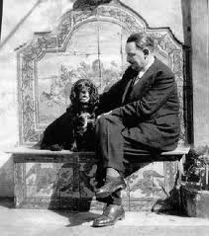
“I Can’t Do a Ulysses”

Slide 3
Europe Endless?
The Capital is a city of contrasts; it presents brilliant light in close proximity to deep gloom; refined life, almost European, in the centre; in the suburbs, African existence, like that of an Arab village. (Baroja, The Quest)
The princess found everything admirable and, in spite of her established position in Russian society, she tried abroad to be like a European lady, which she was not – for the simple reason that she was typically Russian. (Tolstoy, Anna Karenina)

Slide 4
The European ‘South’
In northern climates, you shall find peoples who have few vices, a sufficient number of virtues, and a lot of frankness and sincerity. Draw near the southern countries, and you will think you have left morality far behind. (Montesquieu, 1748)
The man of the south, placed like a king of the universe under the canopy of an ever serene sky, daily revelling in flowers and fruits….intoxicated, not with ideal, but with sensual gratification, has no distant future to anticipate. (Charles-Victor de Bonstetten, 1824)

Slide 5
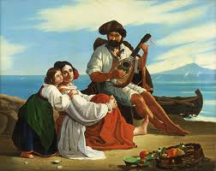
Imagining the South: August Riedel

Slide 6
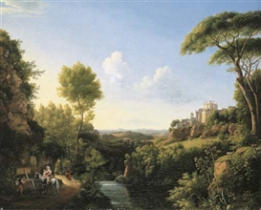
Imagining the South:Pierre-Athanase Chauvin

Slide 7
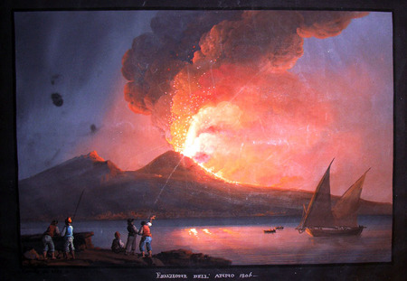
Imagining the South:Girolano Gianni

Slide 8
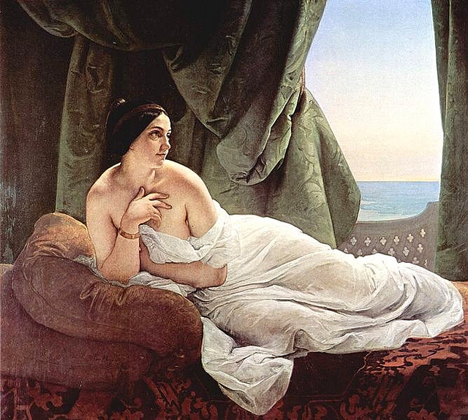
Imagining the South: Francesco Hayez

Slide 9
Italy’s ‘Southern Question’
In Italy…the “Southern Question” evokes a powerful image of the provinces south of Rome as different from the rest of the peninsula, above all for their historic poverty and economic underdevelopment, their engagement in a clientelistic style of politics, and their cultural support for patriarchal gender relations and for various manifestations of organized crime. (Jane Schneider, 1998)

Slide 10
Italy’s ‘Southern Question’
This is not Italy! This is Africa: compared to these peasants the Bedouins are the pinnacle of civilization. (Luigi Carlo Farini, 1860)
In Milan, in Turin, one finds modern society…In Florence it is like the time of the Medicis…In Rome you are immersed in the Middle Ages…In Naples, we re-enter the pagan era…Move from there into Puglia, into the principality of Salerno, and the customs present themselves to you with all the naïve simplicity of ancient times. (Alfred Maury, 1854)

Slide 11
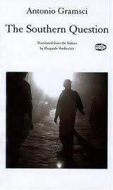
Italy’s ‘Southern Question’

Slide 12
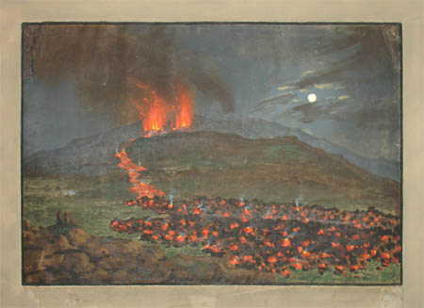
Volcanic History

Slide 13
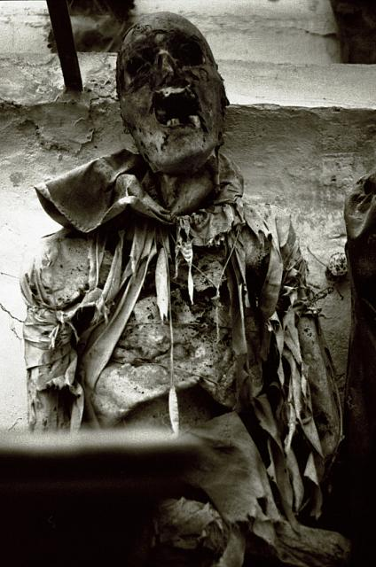
A Taste For Death

Slide 14
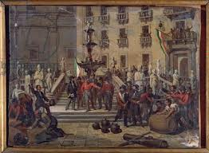
Canalizing History

Slide 15
“One of Those Lonely Books”
The Leopard generated much confusion….Out of what literary genre did The Leopard spring? Where does it belong? Who did Lampedusa emulate in his writing? Proust, Tolstoy, Pirandello, Stendhal – there are so many candidates they cancel one another out. The difficulty of matching the novel with something familiar to the intellegentsia is perhaps the reason E.M.Forster called it “one of those lonely books”. (Richard O’Mara, 2008)

Slide 16
“A Kind of Double Vision”
Don Fabrizio heard the preceding rumbles, but it was Lampedusa who lived in the time of the full social avalanche….Hence …a certain disjunction and diffraction…A kind of double vision…The renunciation itself of the classical mode of continuous narration of the 19th century novel in favour of a narration by “leaps and bounds”. (Eduardo Saccone, 1991)

Slide 17
A View From the Terminus
Do you really think, Chevally, that you are the first who has hoped to canalise Sicily into the flows of universal history?….. But there’s been feudalism everywhere and foreign invasions too….the reason for the difference must lie in this sense of superiority that dazzles every Sicilian eye, and which we ourselves call pride while in reality it’s blindness. For the moment, for a long time to come, there’s nothing to be done. (The Leopard)

Slide 18
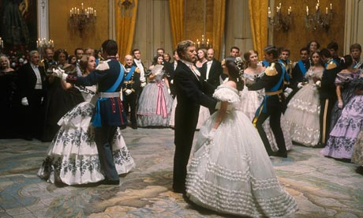
Dancing at the End of Time

