Slide 1
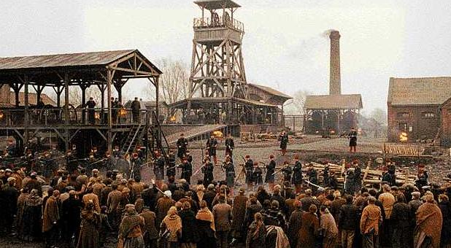
Naturalism and Germinal

Slide 2
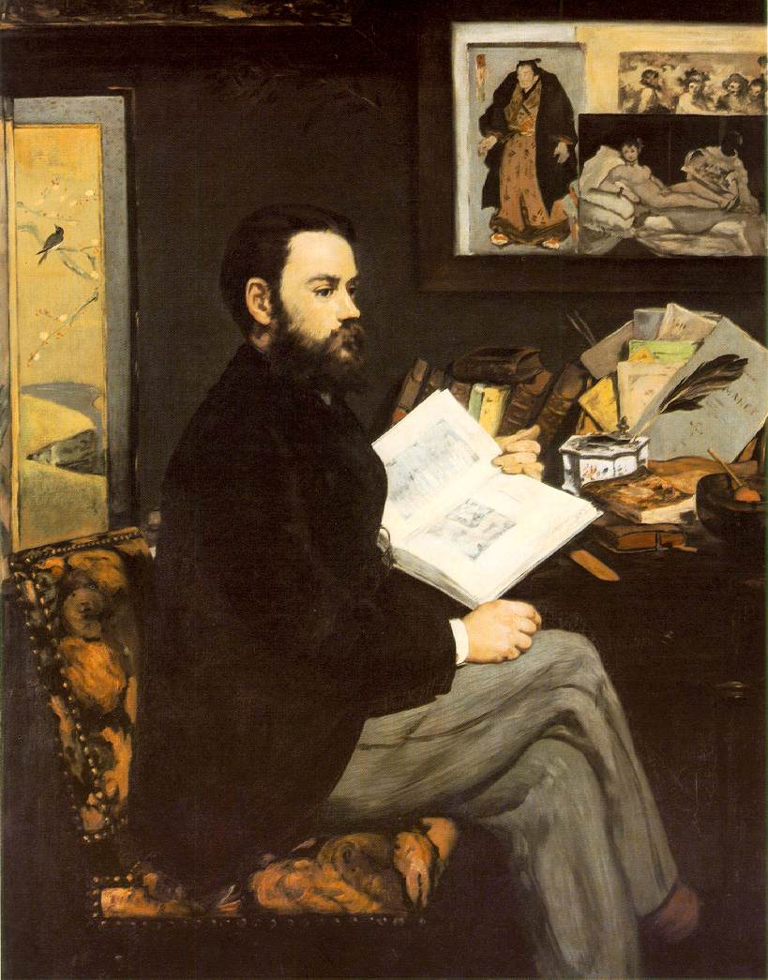

Slide 3
Naturalism: Literary Science, Scandal and Hyper-Realism
Germinal : ethnography, documentary, politics

Slide 4
Auguste Comte/Herbert Spencer (Positivism in Sociology and Social Philosophy)
Thomas Huxley (Eugenics)
Prosper Lucas (Heredity)
Karl Marx (Capitalism/Political Economy)
Charles Letourneau (Biology)
Hippolyte Taine (Literature and Culture)
Jules Antoine-Castagnary (Visual Art)
Claude Bernard (Experimental Medicine)
“Western” Naturalist Novelists and Playwrights
The Goncourt Brothers (France)
Guy De Maupassant (France)
Gerhardt Hauptmann (Germany)
August Strindberg (Sweden)
Henrik Ibsen (Norway)
George Gissing (England)
George Moore (Ireland/England)
George Douglas Brown (Scotland)
George MacDougal Hay (Scotland)
Giovanni Verga (Italy)
Benito Cortez Galdos (Spain)
Stephen Crane, Theodore Dreiser, Upton Sinclair, Frank Norris, John Dos Passos(USA)
See also Balzac’s ‘Preface’ to his cycle La Comèdie Humaine, on the novel and zoology.

Slide 5
Les Rougon-Macquart: ‘The Natural History of a Family in the Second Empire’
The Third Republic (1870-1890)
The Second Empire (1852-1870)

Slide 6



Slide 7



Slide 8

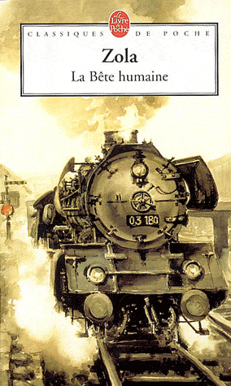

Slide 9
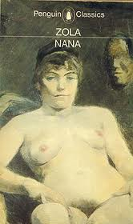


Slide 10


Slide 11
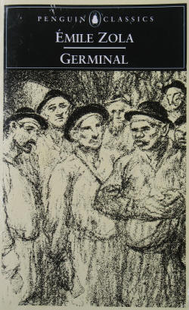
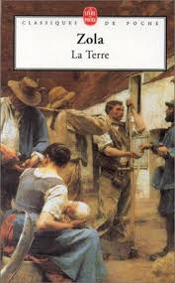

Slide 12
Auguste Comte, ‘Positivism’
Hippolyte Taine, ‘race, milieu, moment’
Claude Bernard, ‘Introduction to Experimental Medicine’ (1865)

Slide 13
It will only be necessary to work on the individuals and surroundings if we wish to find the best social condition. In this way we shall construct a practical sociology and our work will be a help to political and economical sciences […] It is but a question of degree in the same path which runs from chemistry to physiology, then from physiology to anthropology and to sociology. The Experimental Novel is the goal. (Zola, The Experimental Novel)

Slide 14
In the past several years there has grown up a monstrous school of novelists which pretends to replace carnal eloquence with eloquence of the charnel house, which invokes the weirdest medical anomalies, which musters the plague stricken so that we can admire their blotchy skin . . . and which makes pus squirt out of the conscience […] the disease is epidemic. Let us force novelists to display their talent instead of their pickings from the law court and the city dump. (Louis Ulbach, ‘La Littérature Putride’, Le Figaro, 23 Jan, 1868)

Slide 15
Where science is concerned, the accusation of immorality has no relevance […] In Thérèse Raquin my aim has been to study temperaments and not characters. That is the whole point of the book. I have chosen people completely dominated by their nerves and blood, without free will, drawn into each action of their lives by the inexorable laws of their physical nature […] There is a complete absence of soul, I freely admit, since that is how it is meant to be. I hope that by now it is becoming clear that my object has been first and foremost a scientific one. [Naturalist Critics and writers] would not be surprised by the kind of scientific analysis I have attempted in Thérèse Raquin, for in it they would recognise the modern method of universal enquiry which is the tool our age is using so enthusiastically to open up the future. Whatever their own conclusions they would approve of my starting point, the study of temperament, and of the profound modifications of an organism subjected to the pressure of environments and circumstances […] if the writer is now to write a good novel, he must see society with greater breadth of vision, depict it in its many and varied aspects, and above all use clear and natural language. Émile Zola, ‘Preface to the Second Edition’, Thérèse Raquin (1868)

Slide 16
By resolving the duplex question of temperament and environment, I shall endeavour to discover and follow the thread of connection which leads mathematically from one man to another. And when I have possession of every thread, and hold a complete social group in my hands, I shall show this group at work, participating in a historical period. (‘Preface to the Series’, in The Fortune of the Rougons, 1871)

Slide 17
Crossing the open plain, wading through the thick, dark ink of a starless night, a solitary figure followed the highway from Marchiennes to Montsou, which cut its paved pathway straight through ten kilometres of beet fields. The man could not even see the black earth beneath his feet, and his only sense of the vast, flat horizons came from the gusting March wind, blowing in wide swathes as if sweeping across the sea, but icy cold from its passage over leagues of marshland and barren earth. Not a tree marked the sky with its shadow, and the paved road jutted forward like a pier straight out into the murky waves of this world of shadows.
He had left Marchiennes around two o’clock. He was walking with long strides, shivering in his thin, worn, cotton jacket and corduroy trousers. […] He was unemployed and homeless, and had only one thought in his head; the hope that the cold would be less keen after daybreak. He had been struggling onward like this for an hour, and was still a good way from Montsou, when he noticed the red glow of three braziers, burning apparently suspended in mid-air. At first he hesitated, apprehensively; then he could no longer resist the painful need to warm his hands, if only for a moment.
There was a dip in the road, and the vision vanished. On his right a fence appeared, a rough wooden barricade blocking off a railway track; while over to the left rose a grass mound, covered with a jumbled arrangement of gables, giving the impression of a village with a low, regular line of rooftops. About 200 paces further on, a sudden bend in the road brought the fires back into sight, nearer this time, yet he could not guess how they could be burning so high up in the lifeless sky, looking like smouldering moons. But then he was suddenly brought to a halt by the sight at ground level of a great shapeless heap of low buildings topped by the outline of a factory chimney rising from its midst; here and there a lonely light flickered through a filthy window, five or six miserable lanterns were hung up outside on brackets whose blackened timber projected mysterious silhouettes like giant scaffolds, and, from the midst of this fantastic apparition, swimming in smoke and darkness, there rose a lone voice, the prolonged, loud wheezing of a steam engine exhaust valve, hidden somewhere out of sight.
The he recognized it as a pit head. Germinal, opening to Ch1

Slide 18
Le Voreux started to emerge from its shadowy dream world … and seemed to take on the sinister air of a voracious beast, crouching ready to pounce and gobble you up […] Etienne now commanded a view of the whole district. It was still very dark, but the old man had peopled the darkness with untold sufferings, which the young one could sense all around him in the limitless space. […] With his roving eye he tried to peer through the gloom, with a tormenting desire to see and yet a fear of seeing. Everything slid away into the dark unknown […] Two blast furnaces were burning blue in the sky like monstrous torches. It was as depressing to watch as a building on fire: as far as the threatening horizon the only stars which rose were the nocturnal fires of the land of coal and iron. Germinal, PtI, Ch1

Slide 19
‘Come along and I’ll show you something,’ she murmured gaily.
She led him to the end of the coalface and showed him a fissure from which was coming a sort of soft bubbling sound, like the chirping of a bird.
‘Hold your hand there, you can feel the draught. That’s fire-damp.’
He was amazed. Was that all there was to it? So this was the terrible stuff that blew everything sky-high? She laughed, and said that there was a lot of it about today to make the lamps turn blue.
‘When you’ve done chattering, you lazy devils!’ broke in the rough voice of Maheu.
Catherine and Étienne hastily filled their tubs and pushed them to the incline, crawling stiff-backed under the bulging roof. By the time they had done two journeys they were soaked in sweat and the bones were cracking again.
The colliers had again started work at the coalface, for they usually cut down their lunch time so as not to get cold. Far from the light of day they gulped down their food without a word, and now their sandwiches lay in their stomachs as heavy as lead. Stretched out on their sides, they were picking away harder than ever, with only one idea in their heads: to make up a large total of tubs. In this desperate fight for such hard earned gain, everything else faded into insignificance. They no longer noticed the water running down them and making their limbs swell, the cramps from unnatural postures, the stifling darkness in which they were blanched like plants in a cellar. And yet, as the day wore on, the air became more and more foul, what with the heat and the smoke from the lamps, the bad breath, the asphyxiating gas, which clung to their eyes like cobwebs and would only be cleared away by the night’s ventilation. Like moles burrowing under the weight of the earth, without a breath of air in their burning lungs, they went on picking away.
Germinal, Pt I, End Ch4

