Slide 1
Frederick Douglass
Key historical moments

Slide 2
The Abolition movement
Antislavery activity in the US began in colonial times
1680s: Quakers in Pennsylvania
1700s: Thomas Jefferson and Patrick Henry (American Revolutionary movement)
1816: American Colonization Society
  Send freed slaves to Liberia
  Elihu Embree: The Emancipator
  William Lloyd Garrison, The Liberator

Slide 3
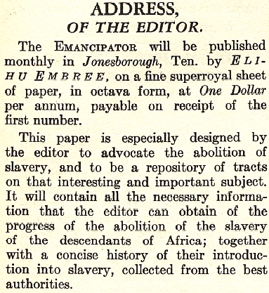
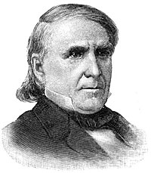
The Emancipator

Slide 4
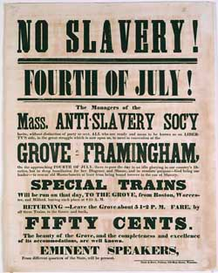
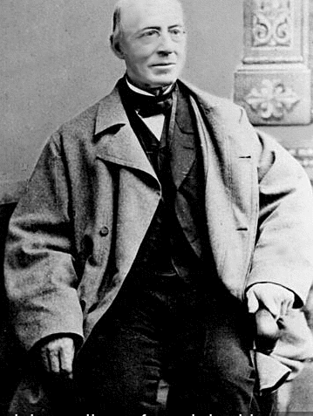
The Liberator

Slide 5
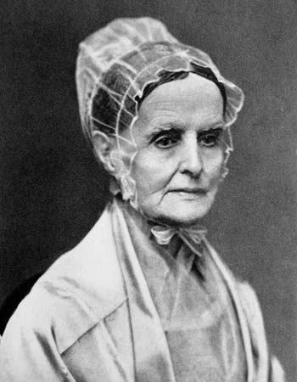
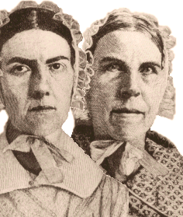
Lucretia Mott
Grimke sisters

Slide 6
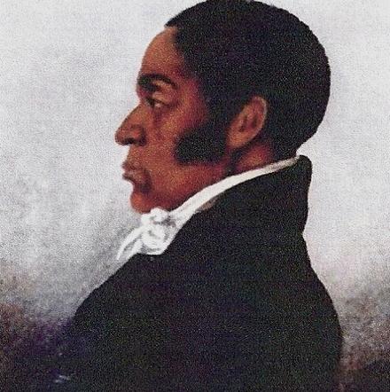
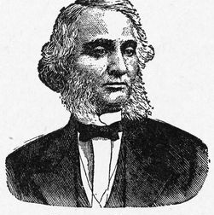
Wealthy African-American abolitionists
James Forten
Robert Purvis

Slide 7
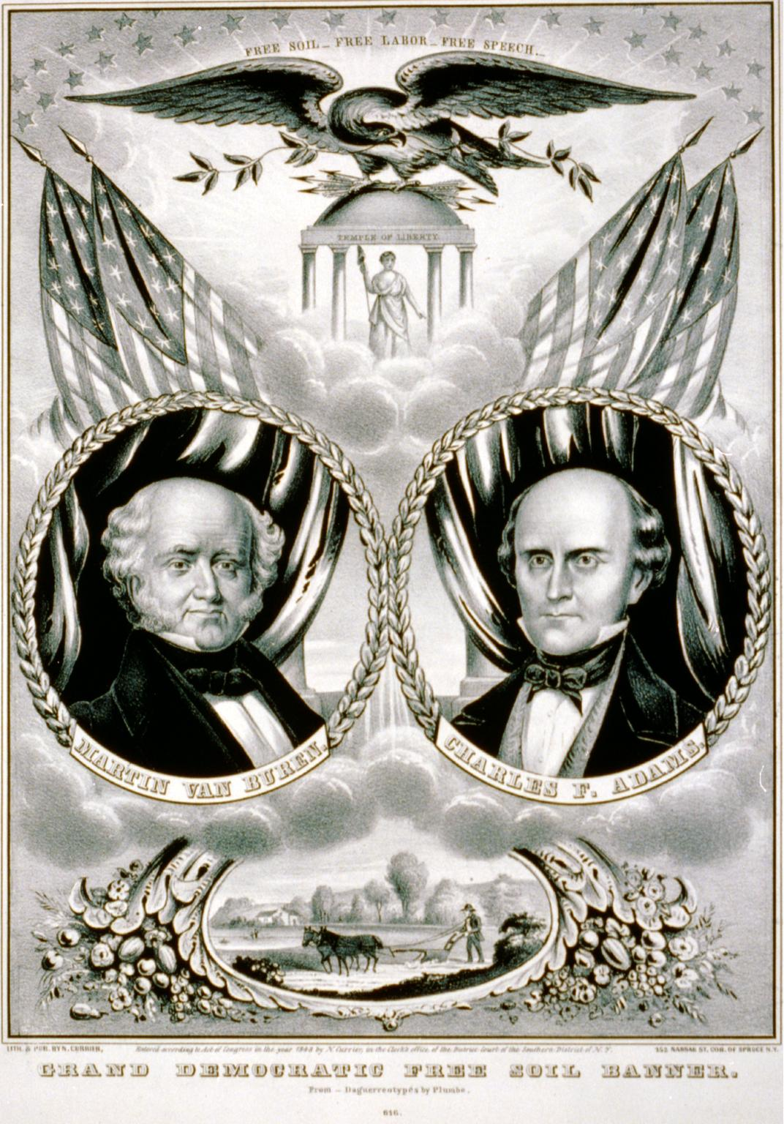
Free Soil Party campaign slogan:
“We inscribe on our banner, ‘Free Soil, Free Labor, and Free Men,’ and under it we will fight on and fight ever, until triumphant victory shall rewards our exertions”

Slide 8
The Abolition movement
1840: The Liberty Party
1848: Free Soil Party
The Underground Railroad; read an interesting essay on the Quaker and Slavery site

