Slide 1
Ruth Hall
Fanny Fern (1854)

Slide 2
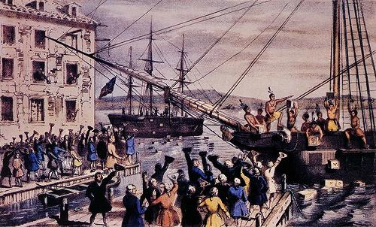
Boston Tea Party
1773 Tea Act
North Carolina boycotts all British Tea

Slide 3
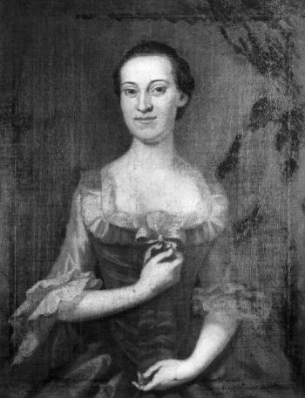
Penelope Barker
-1774, gathering to denounce “taxation without representation”
Signed a petition to give:
-“memorable proof of their patriotism” because they
-“could not be indifferent on any occasion that appears nearly to affect the peace and happiness of our country”;
-they declared: “it is a duty that we owe, not only to our near and dear connections but to ourselves”

Slide 4
Is there a female congress at Edenton, too? I hope not, for we Englishmen are afraid of the male congress, but if the ladies, who have ever since the Amazonian era been esteemed the most formidable enemies: if they, I say, should attack us, the most fatal consequence is to be dreaded. So dextrous in the handling of a dart, each wound they give is mortal: whilst we, so unhappily formed by nature, the more we strive to conquer them, the more we are conquered. The Edenton ladies, conscious, I suppose, of this superiority on their side, by a former experience, are willing, I imagine, to crush us into atoms by their omnipotency: the only security on our side to prevent the impending ruin, that I can perceive, is the probability that there are but few places in America which possess so much female artillery as Edenton.
Arthur Iredell’s letter to his brother James Iredell. James was married to Hannah Johnston, one of the signatories of the petition

Slide 5
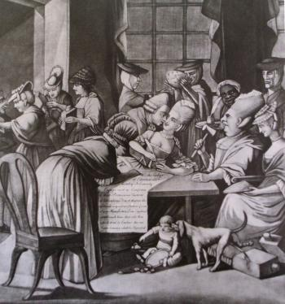
A Society of Patriotic Ladies
- 1775
The Edenton Tea Party
Satirizes 51 patriotic ladies of Edenton North Carolina

Slide 6
Text of the petition
“The Provincial Deputies of North Carolina, having resolved not to drink any more tea, nor wear any more British cloth, many ladies of this province have determined to give memorable proof of their patriotism, and have accordingly entered into the following honourable and spirited association.
I send it to you to shew your fair countrywomen, how zealously and
faithfully, American ladies follow the laudable example of their husbands, and what opposition your matchless Ministers may expect to receive from a people thus firmly united against them…We cannot be indifferent on any occasion that appears nearly to affect the peace and happiness of our country, and . . . it is a duty which we owe, not only to our near and dear connections, . . . but to ourselves. . . .”
Text of the cartoon
“We the ladyes of Edenton do hereby solemnly engage not to conform to ye pernicious Custom of Drinking Tea or that we, the aforesaid Ladyes, will not promote ye wear of any manufacture from England, until such time that all Acts which tend to enslave this our Native Country shall be repealed”

Slide 7
John Adams to John Sullivan (1776)
Why, according to Adams, did many men believe women should be barred from voting?
What did Adams say about women’s minds and judgement? Did it follow then, that women should vote?

Slide 8
Benjamin Rush (1787)
Why, according to Rush, were traditional views about women’s education unsuited to women in the US?
What kind of education did Rush advocate for American women?
What roles did Rush envision for women in American society?

