Slide 1
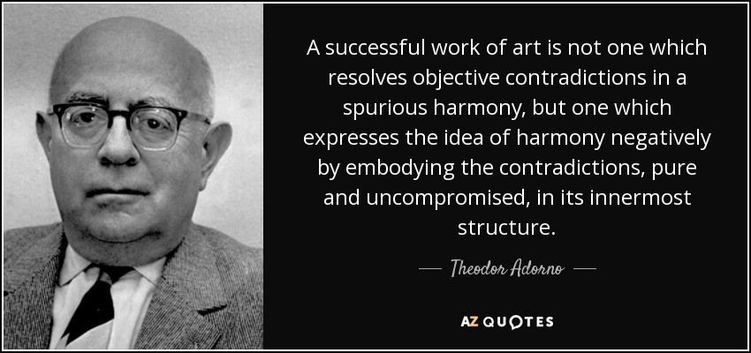

Slide 2
Born on September 11, 1903 as Theodor Ludwig Wiesengrund, Adorno lived in Frankfurt am Main for the first three decades of his life and the last two. He was the only son of a wealthy German wine merchant of assimilated Jewish background and an accomplished musician of Corsican Catholic descent. Adorno studied philosophy with the neo-Kantian Hans Cornelius and music composition with Alban Berg. He completed his Habilitationsschrift on Kierkegaard's aesthetics in 1931, under the supervision of the Christian socialist Paul Tillich. After just two years as a university instructor (Privatdozent), he was expelled by the Nazis, along with other professors of Jewish heritage or on the political left. A few years later he turned his father's surname into a middle initial and adopted ‘Adorno’, the maternal surname by which he is best known.
Adorno left Germany in the spring of 1934. During the Nazi era he resided in Oxford, New York City, and southern California. There he wrote several books for which he later became famous, including Dialectic of Enlightenment (with Max Horkheimer), Philosophy of New Music, The Authoritarian Personality (a collaborative project), and Minima Moralia. From these years come his provocative critiques of mass culture and the culture industry. Returning to Frankfurt in 1949 to take up a position in the philosophy department, Adorno quickly established himself as a leading German intellectual and a central figure in the Institute of Social Research. Founded as a free-standing center for Marxist scholarship in 1923, the Institute had been led by Max Horkheimer since 1930. It provided the hub to what has come to be known as the Frankfurt School. Adorno became the Institute's director in 1958.

Slide 3
Marx: ‘A commodity is therefore a mysterious thing, simply because in it the social character of men’s labour appears to them as an objective character stamped upon the product of that labour… [A] definite social relation between men… assumes, in their eyes, the fantastic form of a relation between things’.
Lukács: ‘The transformation of the commodity relation into a thing of “ghostly objectivity” cannot therefore content itself with the reduction of all objects for the gratification of human needs to commodities. It stamps its imprint upon the whole consciousness of man; his qualities and abilities are no longer an organic part of his personality, they are things which he can “own” or “dispose of” like the various objects of the external world’.
‘How far is commodity exchange together with its structural consequences able to influence the total inner and outer life of society?’

Slide 4
‘Culture industry’ is a better term than ‘mass culture’, since the latter conveys the (mis-) impression that what is at issue is ‘something like a culture that arises spontaneously from the masses themselves, the contemporary form of popular art’, whereas what is really at issue is more accurately understood as being imposed on the masses, who are its objects.
‘The masses are not primary, but secondary, they are an object of calculation; an appendage of the machinery. The customer is not king… not its subject but its object’.

Slide 5
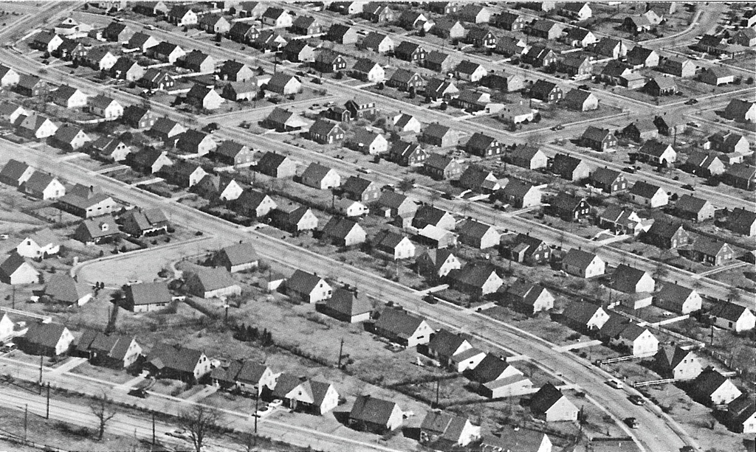
Levittown, early 1950s
The culture industry intentionally integrates its consumers from above

Slide 6
https://www.youtube.com/watch?v=458IiCmXpX4

Slide 7
The logic of cultural production is the logic of commodity production, governed by the principles of capital valorisation and exchange value. What is new is not production for the market (exchange) as such, but the ‘direct and undisguised primacy’ of an economic calculus.

Slide 8
Top Grossing Movies of 2018
Movie Distributor Genre 2018 Gross
1. Black Panther Walt Disney Action $700,059,566
2. Avengers: Infinity War Walt Disney Action $678,815,482
3. Incredibles 2 Walt Disney Adventure $608,581,744
4. Jurassic World Fallen K’dom Universal Action $416,769,345
5. Deadpool 2 20th C. Fox Action $324,563,523

Slide 9
‘The concept of technique in the culture industry is only in name identical with technique in works of art. In the latter, technique is concerned with the internal organization of the object itself, with its inner logic. In contrast, the technique of the culture industry is, from the beginning, one of distribution and mechanical reproduction, and therefore always remains external to its object’.

Slide 10
https://www.youtube.com/watch?v=Ue4PCI0NamI

Slide 11


Slide 12
‘Entertainment is the prolongation of work under late capitalism. It is sought by those who want to escape the mechanized labor process so that they can cope with it again. At the same time, however, mechanization has such power over leisure and its happiness, determines so thoroughly the fabrication of entertainment commodities, that the off-duty worker can experience nothing but after-images of the work process itself’

Slide 13


...the prolongation of work

Slide 14
Culture used, in ‘accommodat[ing] itself to human beings’, at the same time to ‘protest against the petrified relations under which they lived, thereby honouring them’. Today, cultural ‘entities’ are ‘no longer also commodities, they are commodities through and through’

Slide 15
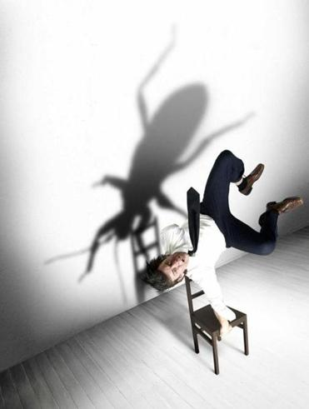
Artistic Director. David Farr
Actor/Director Gisli Öorn Gardarsson

Slide 16
https://www.youtube.com/watch?v=SSf0FmXB_6M

Slide 17
Universal history is to be construed and denied. The assertion that an all-encompassing world-plan for the better manifests itself in history would be, after past catastrophes and in view of future ones, cynical. This however is not a reason to deny the unity which welds together the discontinuous, chaotically fragmented
moments and phases of history, that of the control of nature, progressing into domination over human beings and ultimately over internalized nature. No universal history leads from savagery to humanity, but one indeed from the slingshot to the H-bomb. It culminates in the total threat of organized humanity against organized human beings, in the epitome of discontinuity.
(Adorno, Negative Dialectics [1966])

Slide 18
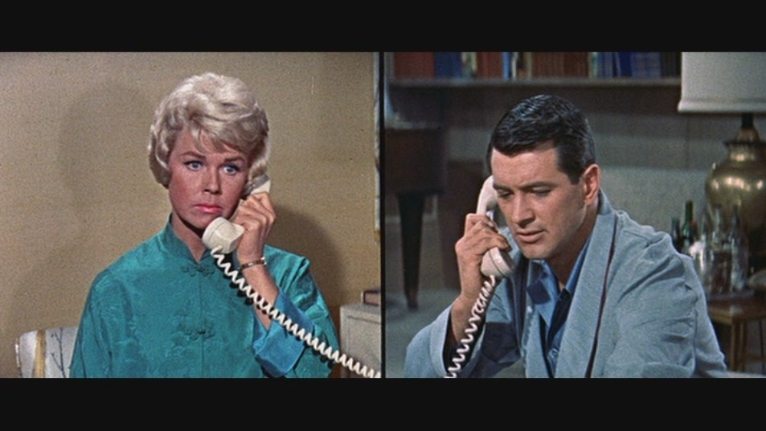
Doris Day/Rock Hudson
Pillow Talk (1959)

Slide 19
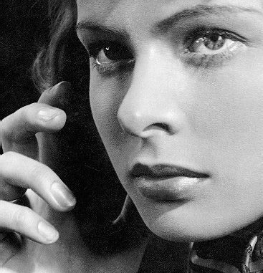
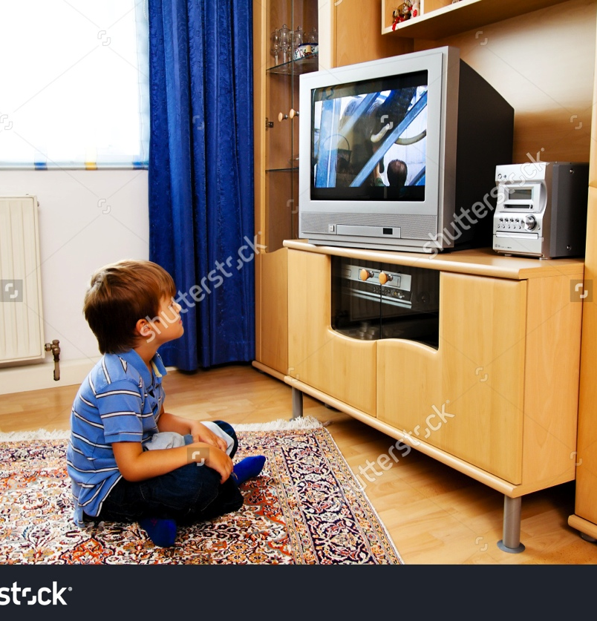
The media are anti-mediatory (Baudrillard)

Slide 20
Technology is making gestures precise and brutal, and with them people. It expels from movements all hesitation, deliberation, civility. It subjects them to the implacable, as it were ahistorical demands of objects. Thus the ability is lost, for example, to close a door quietly and discreetly, yet firmly. Those of cars and refrigerators have to be slammed, others have the tendency to snap shut by themselves, imposing on those entering the bad manners of not looking behind them, not shielding the interior of the house which receives them. The new human type cannot be properly understood without awareness of what he is continuously exposed to from the world of things about him, even in his most secret innervations. What does it mean for the person that there are no more casement windows to open, but only sliding frames to shove, no gentle latches but turnable handles, no forecourt, no doorstep before the street, no wall around the garden? And which driver is not tempted, merely by the power of his engine, to wipe out the vermin of the street, pedestrians, children and cyclists? The movements machines demand of their users already have the violent, hard-hitting, unresting jerkiness of Fascist maltreatment. Not least to blame for the withering of experience is the fact that things, under the law of pure functionality, assume a form that limits contact with them to mere operation, and tolerates no surplus, either in freedom of contact or in autonomy of things, which would survive as the core of experience, because it is not consumed by the moment of action.
(Adorno, Minima Moralia [1951])

Slide 21
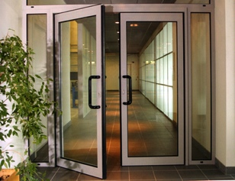

Slide 22
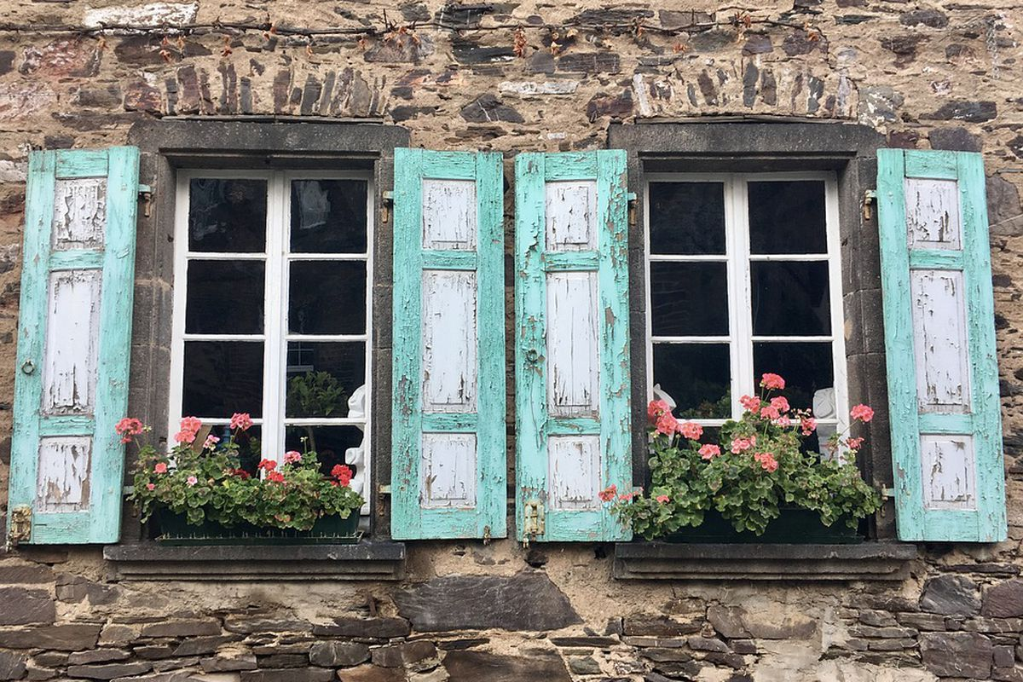

Slide 23


‘Wipe out the vermin of the street, pedestrians, children and cyclists…’

Slide 24
‘Light’ art as such, entertainment, is not a form of decadence. Those who deplore it as a betrayal of the ideal of pure expression harbor illusions about society. The purity of bourgeois art, hypostatized as a realm of freedom contrasting to material praxis, was bought from the outset with the exclusion of the lower class; and art keeps faith with the cause of that class, the true universal, precisely by freeing itself from the purposes of the false. Serious art has denied itself to those for whom the hardship and oppression of life make a mockery of seriousness and who must be glad to use the time not spent at the production line in being simply carried along. Light art has accompanied autonomous art as its shadow. It is the social bad conscience of serious art. The truth which the latter could not apprehend because of its social premises gives the former an appearance of objective justification. The split between them is itself the truth: it expresses at least the negativity of the culture which is the sum of both spheres. The antithesis can be reconciled least of all by absorbing light art into serious or vice versa. That, however, is what the culture industry attempts.

Slide 25
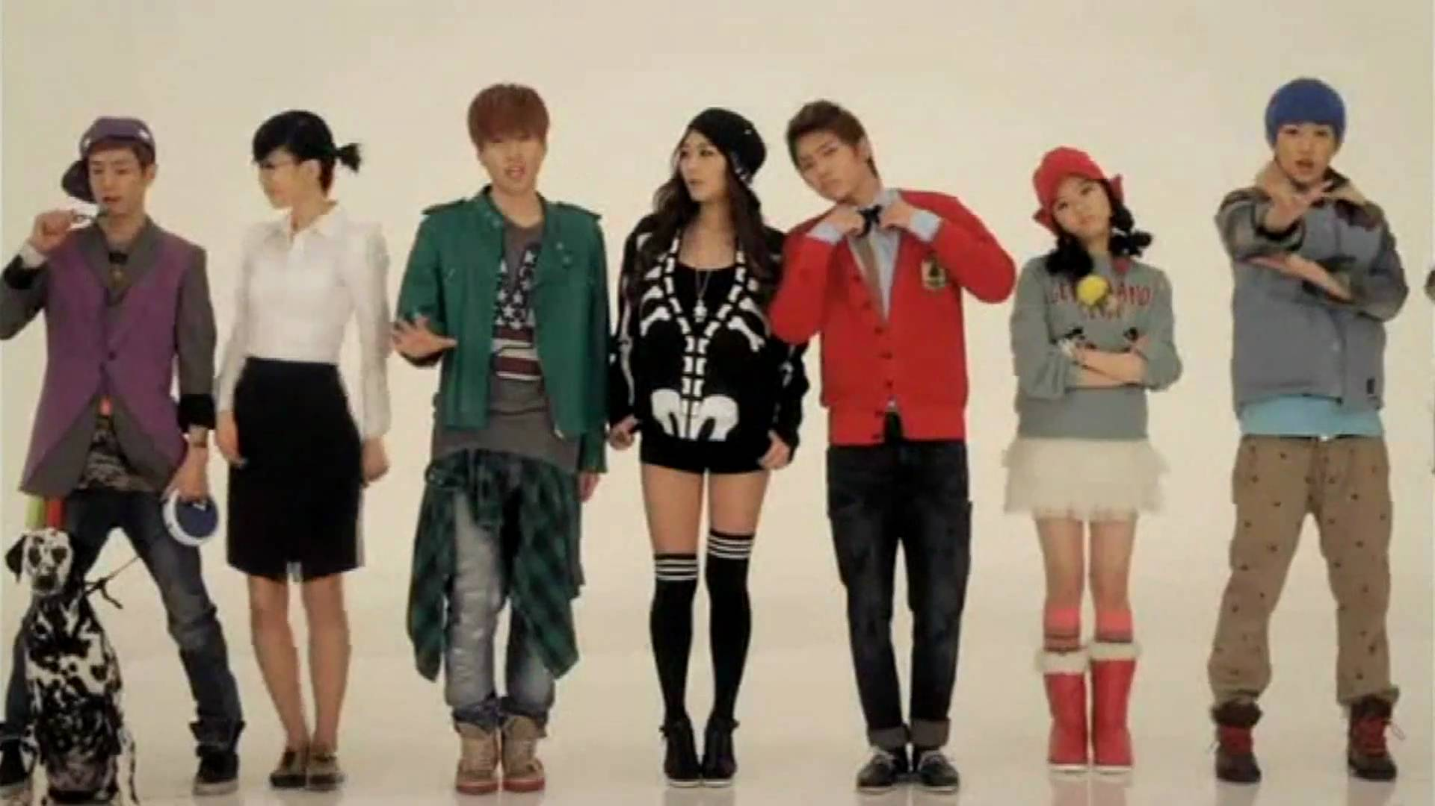

Slide 26
There is laughter because there is nothing to laugh about. Laughter, whether reconciled or terrible, always accompanies the moment when a fear is ended. It indicates a release, whether from physical danger or from the grip of logic. Reconciled laughter resounds with the echo of escape from power; wrong laughter copes with fear by defecting to the agencies which inspire it. It echoes the inescapability of power. Fun is a medicinal bath which the entertainment industry never ceases to prescribe.

Slide 27
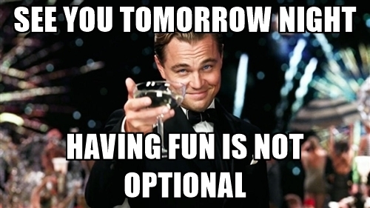

Slide 28


Slide 29
Taken in its strict sense… there is something vacuous (Hegel would have said abstract) about the notion of free time. An archetypal instance is the behaviour of those who grill themselves brown in the sun merely for the sake of a sun-tan, although dozing in the blazing sunshine is not at all enjoyable, might very possibly by physically unpleasant, and certainly impoverishes the mind. In the sun-tan, which can be quite fetching, the fetish character of the commodity lays claim to actual people; they themselves become fetishes. The idea that a girl is more erotically attractive because of her brown skin is probably only another rationalization. The sun-tan is an end in itself, of more importance than the boy-friend it was perhaps supposed to entice.

Slide 30
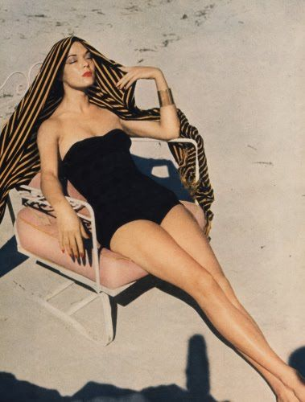

Slide 31
‘I should like to elucidate the problem with the help of a trivial experience of my own. Time and time again, when questioned or interviewed, one is asked about one’s hobbies. When the illustrated weeklies report on the life of one of those giants of the culture industry, they rarely forego the opportunity to report, with varying degrees of intimacy, on the hobbies of the person in question. I am shocked by the question when I come up against it. I have no hobby. Not that I am the kind of workaholic, who is incapable of doing anything with his time but applying himself industriously to the required task. But, as far as my activities beyond the bounds of my recognised profession are concerned, I take them all, without exception, very seriously. So much so, that I should be horrified by the very idea that they had anything to do with hobbies – preoccupations with which I had become mindlessly infatuated merely in order to kill the time – had I not become hardened by experience to such examples of this now widespread, barbarous mentality. Making music, listening to music, reading with all my attention, these activities are part and parcel of my life; to call them hobbies would make a mockery of them. On the other hand, I have been fortunate enough that my job, the production of philosophical and sociological works and university teaching, cannot be defined in terms of that strict opposition to free time, which is demanded by the current razor-sharp division of the two. I am however well aware that in this in enjoy a privilege, with both the element of fortune and of guilt which this involves: I speak as one who has had the rare opportunity to follow the path of his own intentions and to fashion his work accordingly. This is certainly one good reason why there is no hard and fast opposition between my work itself and what I do apart from it. If free time really was to become just that state of affairs in which everyone could enjoy what once was once the prerogative of a few – and compared to feudal society bourgeois society has taken some steps in this direction – then I would picture it after my own experience of life outside work, although given different conditions, this model would in its turn necessarily alter’

Slide 32
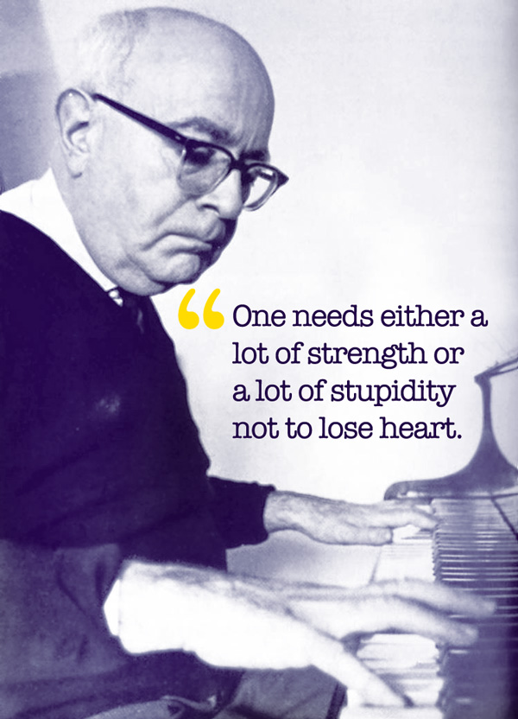

Slide 33
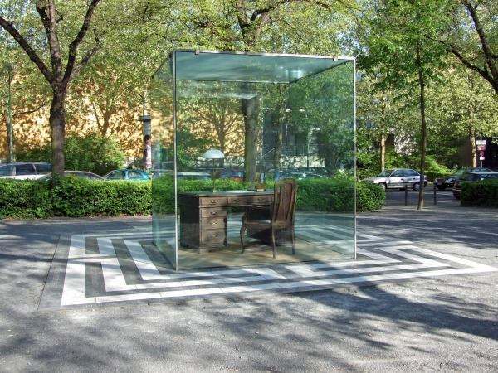

Slide 34
https://www.youtube.com/watch?v=2_2lGkEU4Xs

