Slide 1
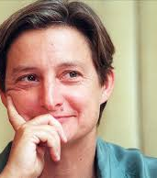
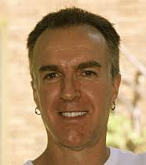
Judith Butler Rob Nixon

Slide 2
Left politics… would aim first to refocus and expand the political critique of state violence, including both war and those forms of legalized violence by which populations are differentially deprived of the basic resources needed to minimize precariousness. This seems urgently necessary in the context of crumbling welfare states and those in which social safety nets have been torn asunder or denied the chance to emerge. Second, the focus would be less on identity politics, or the kinds of interests and beliefs formulated on the basis of identity claims, and more on precarity and its differential distributions, in the hope that new coalitions might be formed… Precarity cuts across identity categories as well as multicultural maps, thus forming the basis for an alliance focused on opposition to state violence and its capacity to produce, exploit, and distribute precarity for the purposes of profit and territorial defense.
Judith Butler, Frames of War

Slide 3
the structural violence embodied by a neoliberal order of austerity measures, structural adjustment, rampant deregulation, corporate megamergers, and a widening gulf between rich and poor is a form of covert violence in its own right that is often a catalyst for more recognizably overt violence
Rob Nixon, Slow Violence

Slide 4
I am seeking to draw attention to the epistemological problem raised by [the]… issue of framing: the frames through which we apprehend or, indeed, fail to apprehend the lives of others as lost of injured (lose-able or injurable) are politically saturated. They are themselves operations of power… On the other hand, the problem is ontological, since the question at issue is: What is a life? (Butler)

Slide 5
https://www.youtube.com/watch?v=o7vVIduge3c

Slide 6
[I]t is necessary to consider how we might distinguish between “apprehending” and “recognizing” a life. “Recognition” is the stronger term, one that has been derived from Hegelian texts and subject to revisions and criticisms for many years. “Apprehension” is less precise, since it can imply marking, registering, acknowledging without full cognition. If it is a form of knowing, it is bound up with sensing and perceiving, but in ways that are not always – or not yet – conceptual forms of knowledge. What we are able to apprehend is surely facilitated by norms of recognition, but it would be a mistake to say that we are utterly limited by existing norms of recognition when we apprehend a life. We can apprehend, for instance, that something is not recognized by recognition. Indeed, that apprehension can become the basis for a critique of norms of recognition.

Slide 7
[t]he problem is not merely how to include more people within existing norms, but to consider how existing norms allocate recognition differentially. What new norms are possible, and how are they wrought? What might be done to produce a more egalitarian set of conditions for recognisability? What might be done, in other words, to shift the very terms of recognisability in order to produce more radically democratic results? (Butler)

Slide 8
[I]f the frame is understood as a certain “breaking out” or “breaking from,” then it would seem to be more analogous to a prison break. This suggests a certain release, a loosening of the mechanism of control, and with it, a new trajectory of affect. The frame, in this sense, permits – even requires – this breaking out. This happened when the photos of Guantánamo prisoners kneeling and shackled were released to the public and outrage ensued; it happened again when the digital images from Abu Ghraib were circulated globally across the internet, facilitating a widespread visceral turn against the war. What happens at such moments? And are they merely transient moments or are they, in fact, occasions when the frame as a forcible and plausible con is exposed, resulting in a critical and exuberant release from the force of illegitimate authority? (Butler)

Slide 9
The production of new frames, as part of the general project of alternative media, is clearly important, but we would miss a critical dimension of this project if we restricted ourselves to this view. What happens when a frame breaks within itself is that a taken-for-granted reality is called into question, exposing the orchestrating designs of the authority who sought to control the frame. This suggests that it is not only a question of finding new content, but also of working with received renditions of reality to show how they can and do break with themselves (Butler)

Slide 10
The body is exposed to socially and politically articulated forces as well as to claims of sociality – including language, work, and desire – that make possible the body’s persisting and flourishing. The more or less existential conception of “precariousness” is thus linked with a more specifically political notion of “precarity”.
Bodies come into being and cease to be: as physically persistent organisms, they are subject to incursions and to illnesses that jeopardize the possibility of persisting at all. These are necessary features of bodies – they cannot “be” thought without their finitude, and they depend on what is “outside themselves” to be sustained – features that pertain to the phenomenological structure of bodily life. To live is always to live a life that is at risk from the outset and can be put at risk or expunged quite suddenly from the outside and for reasons that are not always under one’s control.

Slide 11
How do we bring home – and bring emotionally to life – threats that take time to wreak their havoc, threats that never materialize in one spectacular, explosive, cinematic scene? Apprehension is a critical word here, a crossover term that draws together the domains of perception, emotion, and action. To engage slow violence is to confront layered predicaments of apprehension: to apprehend – to arrest, or at least mitigate – often imperceptible threats requires rendering them apprehensible to the senses through the work of scientific and imaginative testimony.... But what happens when we are unsighted, when what extends before us – in the space and time that we most deeply inhabit – remains invisible? How, indeed, are we to act ethically toward human and biotic communities that lie beyond our sensory ken? What then, in the fullest sense of the phrase, is the place of seeing in the world that we now inhabit? What, moreover, is the place of the other senses? How do we both make slow violence visible yet also challenge the privileging of the visible?’

Slide 12
The most common view is that the Anthropocene started in modern times. One frequently cited study proposes the year 1610: depopulation of the Americas, after European conquest, had by then led to the reforestation of the New World, and the newly abundant trees of the Western Hemisphere withdrew so much CO2 from the air that the thinner atmosphere, along with diminished sunspot activity, brought on the so-called Little Ice Age of the 17th century. Two centuries later, around 1800, a more familiar climate dynamic was at work: ever greater quantities of fossil fuels were burned each year, releasing ever more CO2, resulting in an ever warmer climate. Accordingly, in one popular view, it’s the Industrial Revolution that installed the Anthropocene. For others it dawned punctually on 6 August 1945, when the US air force exploded an atomic bomb over Hiroshima and demonstrated the destructive power now wielded by humanity. By the 1960s at the latest the new times were upon us, with the postwar ‘green revolution’ (the name may sound ironic today) well underway. Scientific farming encouraged galloping growth in human numbers, through higher crop yields; the breakneck urbanisation of the global South, as redundant farmworkers swelled the cities; and widespread deforestation and pesticide contamination. Disputes over dates aside, the idea of the Anthropocene is the same. Human beings now largely determine the make-up of the biosphere as well as the chemistry of the atmosphere and oceans, and this episode of the species’ dominion will one day be as legible in the fossil record as the advancing ice sheets, asteroid impacts or proliferation of new life-forms that distinguished other epochs (Benjamin Kunkel)

Slide 13
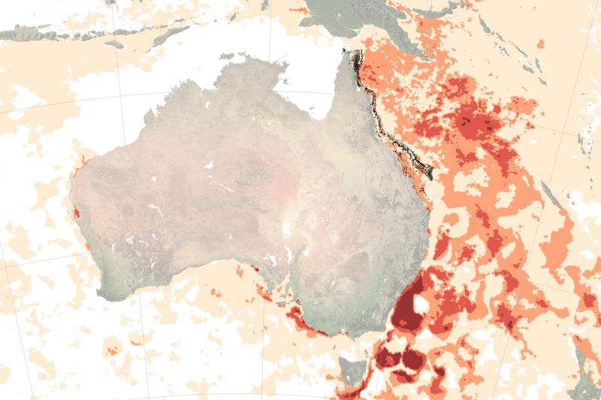

Slide 14
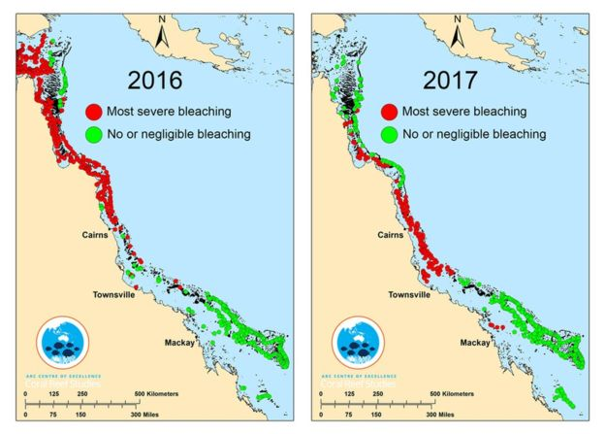

Slide 15
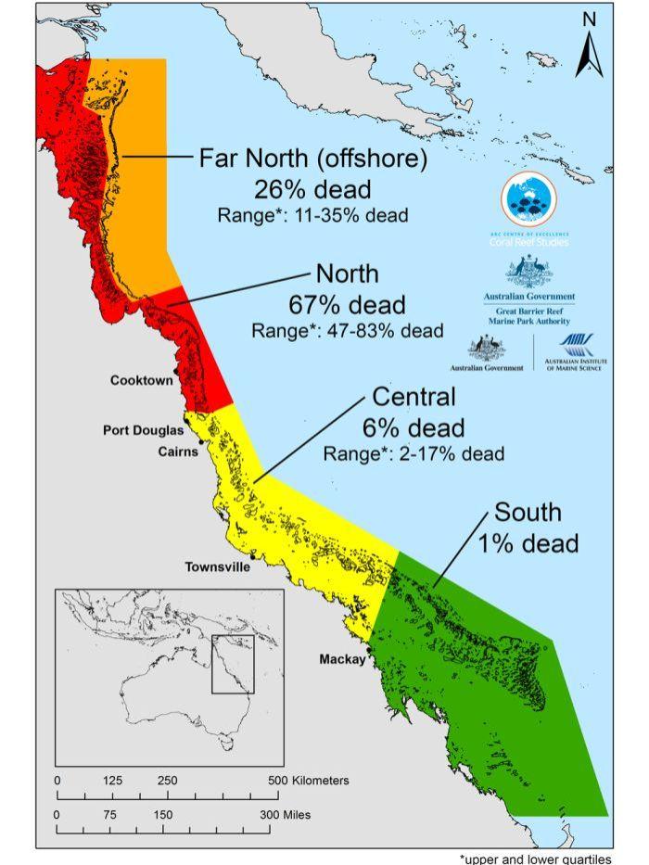

Slide 16
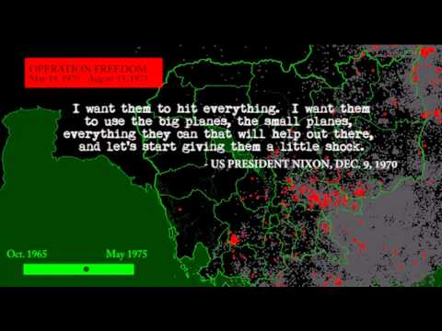

Slide 17
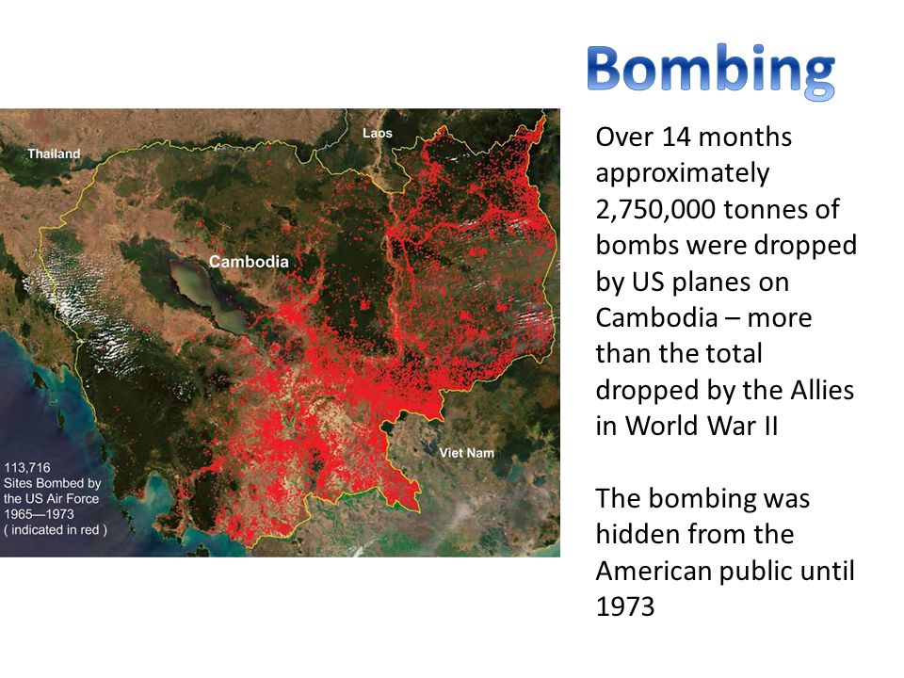

Slide 18
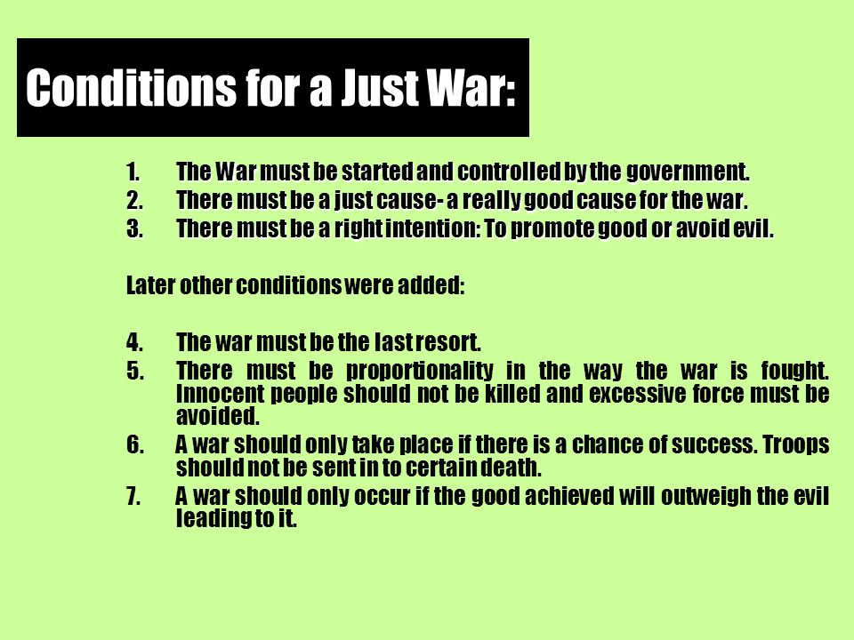

Slide 19
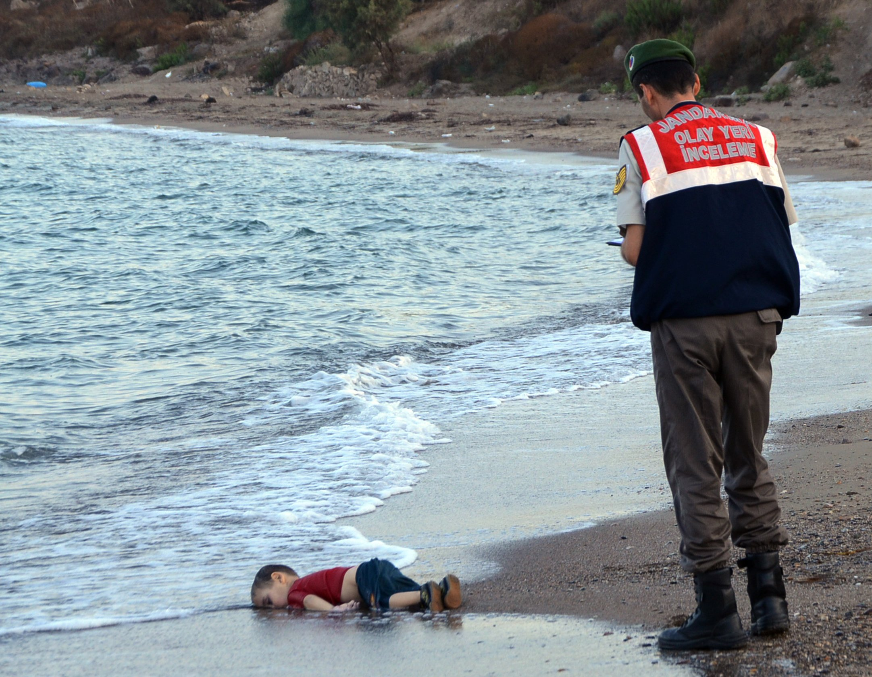

Slide 20
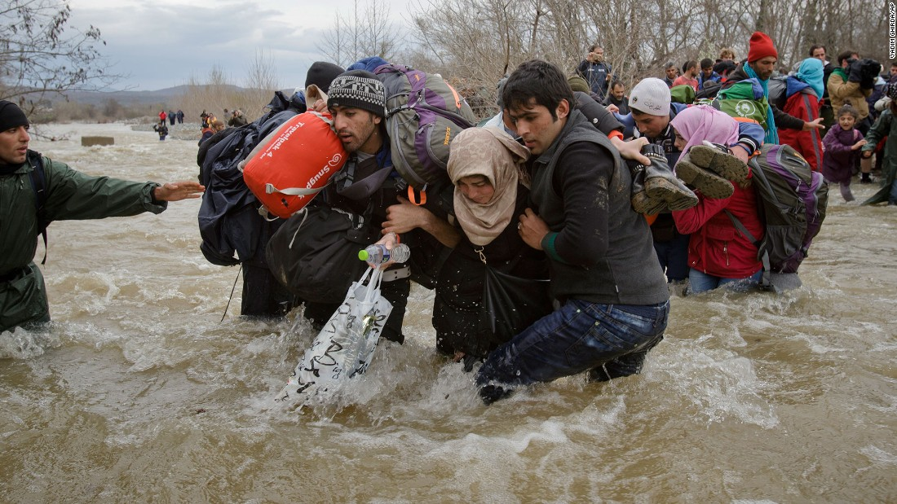

Slide 21
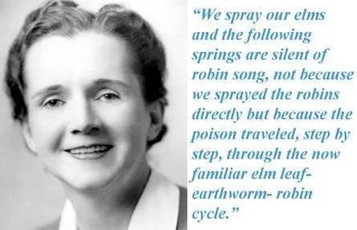

Slide 22
Carson’s focus [in The Silent Spring] was DDT, but for her the problem was not a particular chemical; it was a logic. The ‘control of nature,’ Carson wrote, ‘is a phrase conceived in arrogance, born of the Neanderthal age of biology and philosophy, when it was supposed that nature exists for the convenience of man… It is our alarming misfortune that so primitive a science has armed itself with the most modern and terrible weapons, and that in turning them against the insects it has also turned them against the earth’.
Naomi Klein, This Changes Everything: Capitalism
vs. the Climate

Slide 23
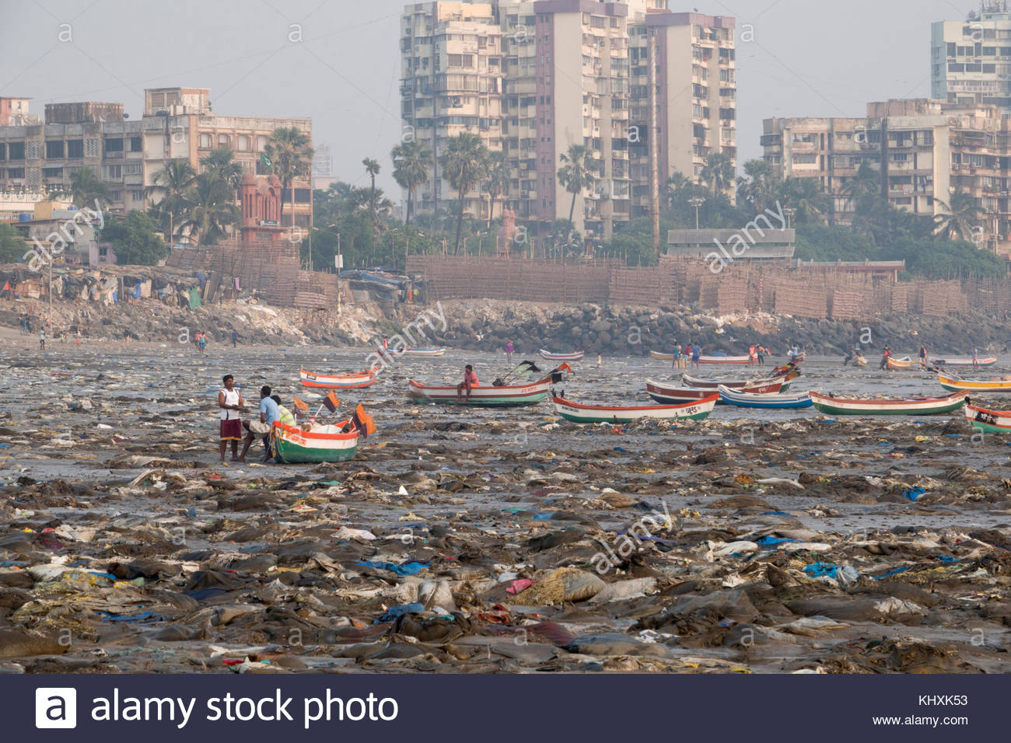

Slide 24
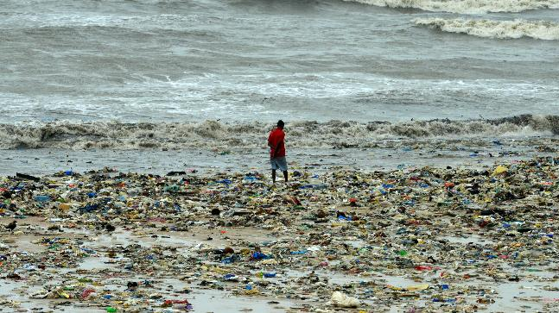

Slide 25
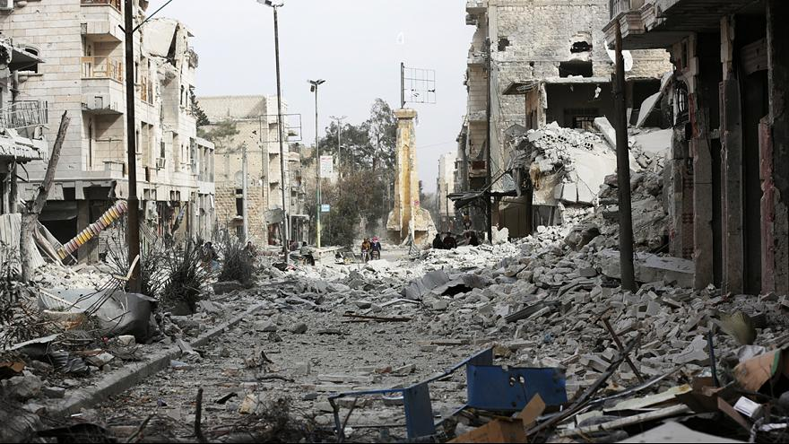

Slide 26
Joni Mitchell, ‘Big Yellow Taxi’
https://www.youtube.com/watch?v=2595abcvh2M

Slide 27
Traffic. When the Eagle Flies
When the eagle flies you'd better watch your eyes
He's gonna sweep everything in his path
And when the heavens cry it's gonna drown the sky
And you'll get caught in the aftermath
When the mountains move it's no good trying
To prove that you've been doing everything you can
And don't you start to cry when you're about to die
You gotta stand up and take it like a man
Because you've been taking instead of giving
And all the while you've been living lies
Economics, all your atomics
Ain't gonna save you from that bird in the sky
And when the good times roll wrapped up in your mink coat
You will be stepping from your Cadillac
You will be stepping from your Cadillac
And in a micro flash you're gonna feel the lash
Of big eagle's wing across your back
And…

Slide 28
Traffic, ‘When the Eagle Flies’
https://www.youtube.com/watch?v=t8qPgMDwjR8

Slide 29
Marshall Islands, location
https://www.google.com/maps/place/Marshall+Islands/@-10.5955947,146.6987557,5z/data=!4m5!3m4!1s0x650119b22129ca2b:0x8b3e03e8aa09b776!8m2!3d7.131474!4d171.184478

Slide 30
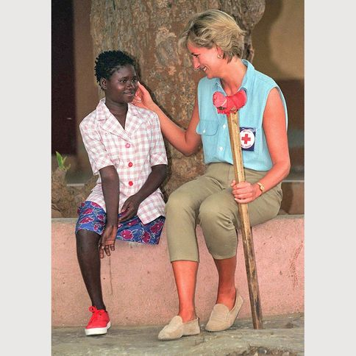
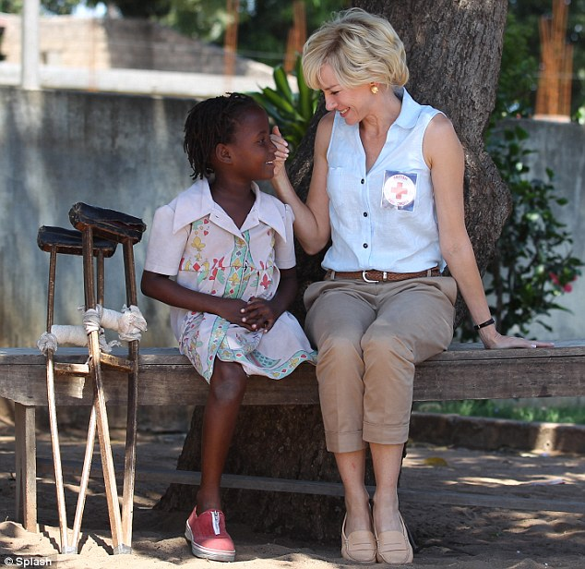
Princess Diana and Naomi Watts with children maimed by landmines, Angola

