Slide 1
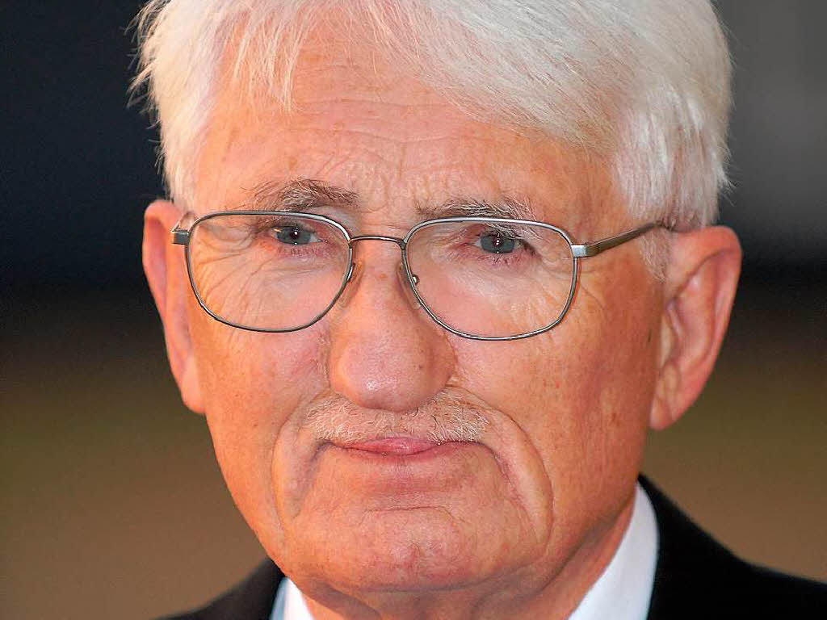

Slide 2
Thomas McCarthy’s ‘Introduction’ to The Structural Transformation of the Public Sphere
Habermas combines materials and methods from sociology and economics, law and political science, and social and cultural history in an effort to grasp the preconditions, structures, functions, and inner tensions of [what he calls ‘the public sphere’]… [T]he liberal public sphere took shape in the specific historical circumstances of a developing market economy. In its clash with the arcane and bureaucratic practices of the absolutist state, the emergent bourgeoisie gradually replaced a public sphere in which the ruler’s power was merely represented before the people with a sphere in which state authority was publicly monitored through informed and critical discourse by the people.
Habermas… weav[es] together accounts of the rise of the novel and of literary and political journalism and the spread of reading societies, salons, and coffee houses into a Bildungsroman of this ‘child of the eighteenth century’.

Slide 3
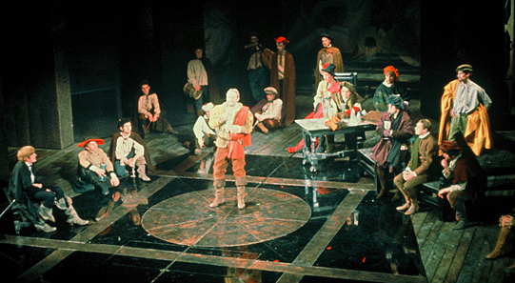
RSC production of Hamlet (1965)

Slide 4
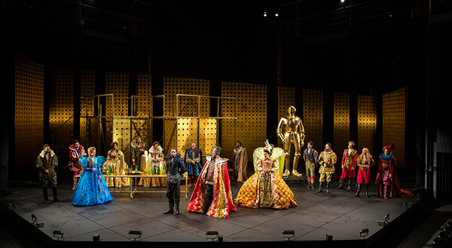
Old Globe Theatre (San Diego) production of Hamlet (2017)

Slide 5


Slide 6
The new stratum of ‘bourgeois’ people
Along with the apparatus of the modern state, a new stratum of ‘bourgeois’ people arose which occupied a central position within the ‘public’. The officials of the rulers’ administrations were its core… [and also] doctors, pastors, officers, professors, and ‘scholars’, who were at the top of a hierarchy reaching down through schoolteachers and scribes to the ‘people’… At the same time, the great merchants outgrew the confining framework of the towns and in the form of companies linked themselves directly with the state… [These] ‘capitalists’, the merchants, bankers, entrepreneurs, and manufacturers… belonged to that group of the ‘bourgeois’ who, like the new category of scholars, were not really ‘burghers’ in the traditional sense. This stratum of ‘bourgeois’ was the real carrier of the public, which from the outset was a reading public.

Slide 7
Absolutist opposition to public reason
Even the use of one’s own reason as such was subjected to regulation. All chaired professors of the faculties of law, medicine, and philosophy were to take turns in ‘submitting to the editor of the gazette, expeditiously and no later than Thursday, a special note, composed in a pure and clear style of writing’… In a rescript of Frederick II from 1784 one reads: ‘A private person has no right to pass public and perhaps even disapproving judgment on the actions, procedures, laws, regulations, and ordinances of sovereigns and courts, their officials, assemblies, and courts of law, or to promulgate or publish in print pertinent reports that he manages to obtain. For a private person is not at all capable of making such judgment, because he lacks complete knowledge of circumstances and motives’

Slide 8
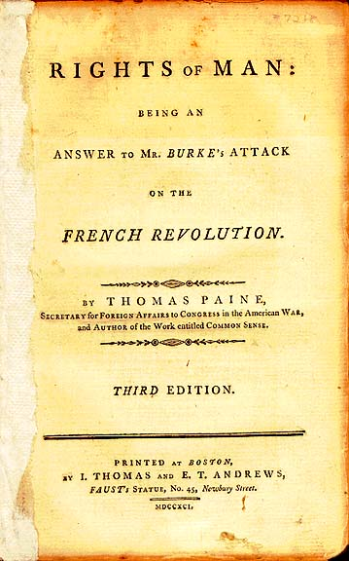

Slide 9
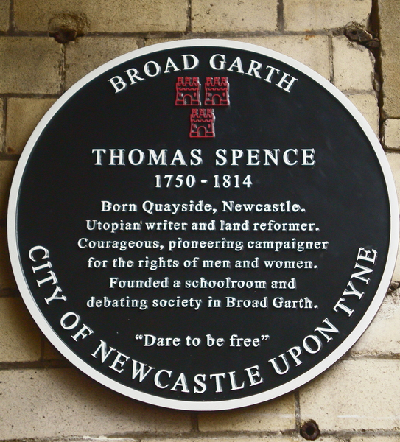

Slide 10
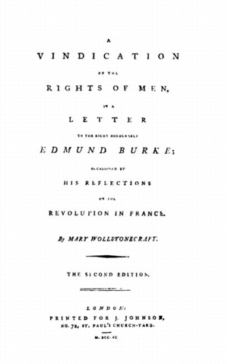

Slide 11
The basic blueprint of the public sphere
The bourgeois public sphere may be conceived above all as the sphere of private people come together as a public; they soon claimed the public sphere regulated from above against the public authorities themselves, to engage them in a debate over the general rules governing relations in the basically privatized but publicly relevant sphere of commodity exchange and social labor. The medium of this political confrontation was peculiar and without historical precedent: people’s public use of their reason

Slide 12
Thomas Burger’s ‘Translator’s Note’
The Structural Transformation of the Public Sphere contains a number of terms that present problems to the translator. One of these, Öffentlichkeit, which appears in the very title of the book, may be rendered variously as ‘(the) public’, ‘public sphere’, or ‘publicity’.
Another troublesome term is bürgerlich, an adjective related to the noun Bürger, which may be translated as ‘bourgeois’ or ‘citizen’. Bürgerlich possesses both connotations. In expressions such as ‘civil code’, ‘civil society’, ‘civic duty’, ‘bourgeois strata’, and ‘bourgeois family’ the German term for ‘civil’, ‘civic’ and ‘bourgeois’ is ‘bürgerlich’. Bürgerlich also means ‘middle class’ in contrast to ‘noble’ or ‘peasant’. Bürgerliche Öffentlichkeit thus is difficult to translate adequately. For better or worse, it is rendered here as ‘bourgeois public sphere’.

Slide 13
English coffeehouses
Before the 17th century, coffee was little known in England. But in that century, it became very popular as a beverage. Patrons would gather in coffeehouses to drink coffee and for conversation and social interaction. For the price of a penny, men could purchase a cup of coffee and listen to or join the general conversation in the public houses in which it was served. Topics discussed in the coffeehouses included politics and political scandals, daily gossip, fashion, current events, and debates surrounding philosophy and the natural sciences.
Coffeehouses acted as an alternate sphere for intellectual thought, supplementary to the university. Political groups of various kinds frequently used them as meeting places, and they were frequented in general by a diverse demographic of customers. Relative equality existed among patrons of coffeehouses despite station: one could participate in conversation regardless of class, rank, or political leaning. In some respects, coffeehouses were socially similar to alehouses or inns: but the absence of alcohol created an atmosphere in which one could engage in sober conversation.
English coffeehouses also implemented a strict set of rules. According to the first ‘Rules and Orders of the Coffee House’ broadside, illustrated and printed in 1674, equality was supposed to prevail among all men in these establishments, and ‘no man of any station need give his place to a finer man’. Anyone guilty of swearing had to pay a fine in forfeit. If a quarrel broke out, the instigator was required to purchase the offended party a cup of coffee. The topic of ‘sacred things’ was barred from coffeehouses, and rules existed against speaking poorly of the state as well as of the scriptures. The rules forbade games of chance, such as cards and dice, as well.

Slide 14
Ned Ward’s Wealthy Shopkeeper
Unlike the cafés of Continental Europe, the English coffeehouse served business as well as social purposes. Writing in 1706, the grub-street wit, Ned Ward, described the daily routine of a ‘Wealthy Shopkeeper’ thus: ‘Rise at 5; counting house till 8; then breakfast on toast and Cheshire cheese; in his shop for 2 hours; then a neighbouring coffeehouse for news; shop again till dinner… 1 o'clock on change; 3 Lloyd's Coffeehouse for business; shop again for an hour; then another coffeehouse (not Lloyd's) for recreation’. Businessmen often kept regular hours at a particular house, where clients would know to find them.

Slide 15
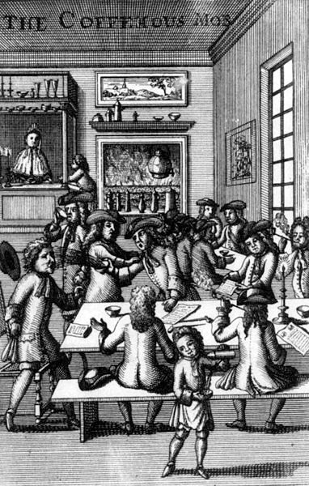
‘The coffeehous mob’ (1710)

Slide 16
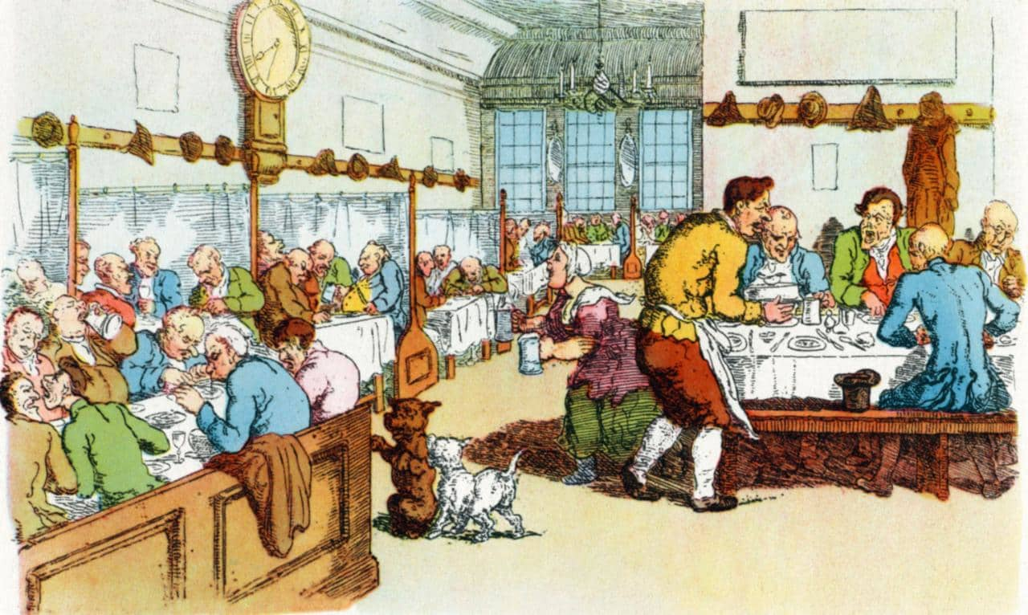
Jonathan’s Coffee House (London)

Slide 17
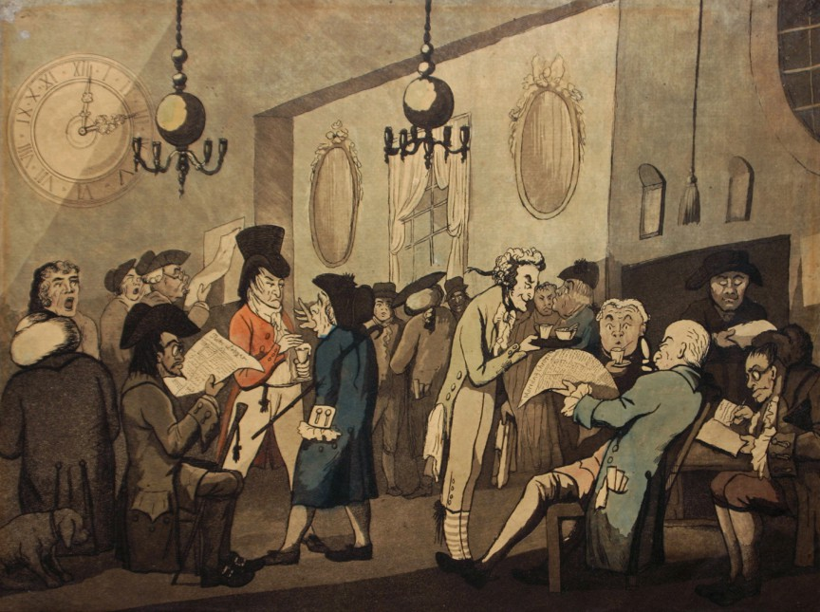

Slide 18
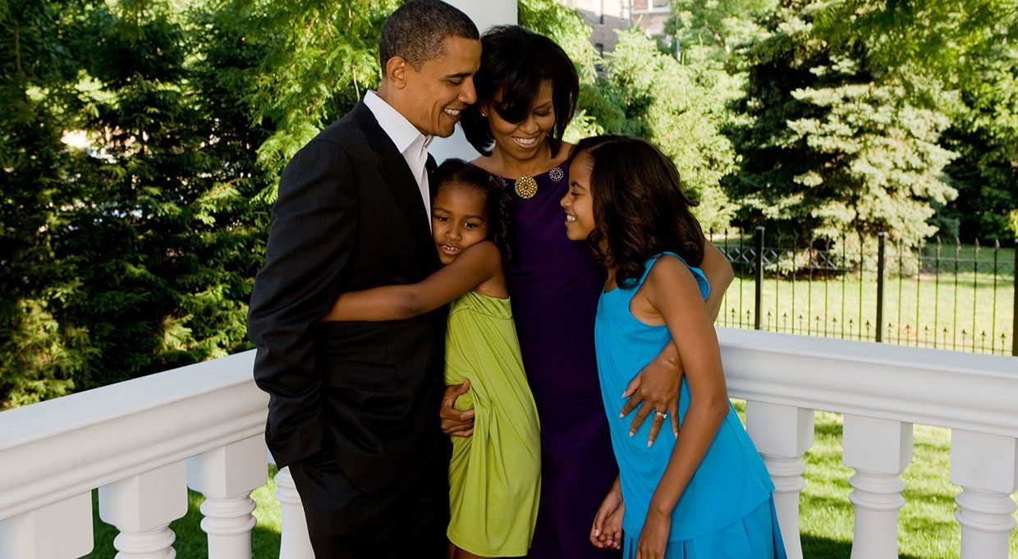
The Obama family

Slide 19
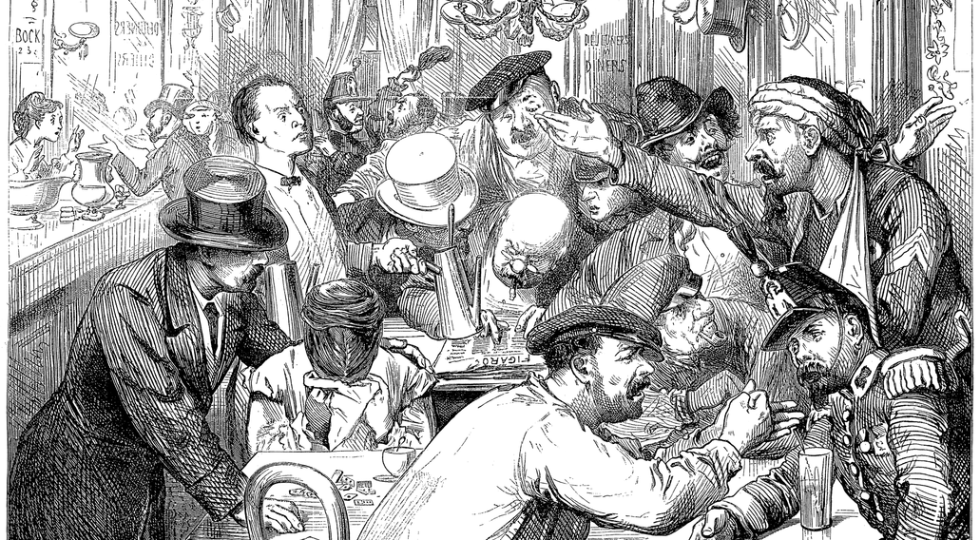
‘Discussing the war in a Paris café’

Slide 20
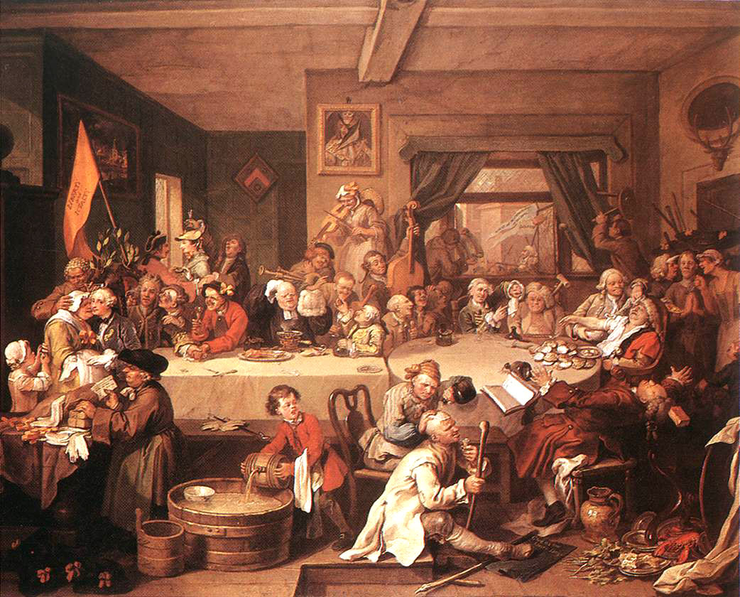
Hogarth, ‘Coffee morning shenanigans’

Slide 21
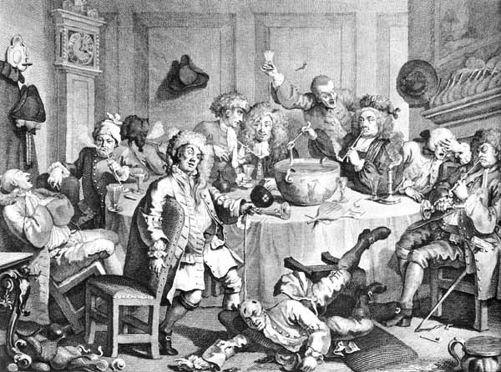
Hogarth, ‘A midnight modern conversation’

Slide 22
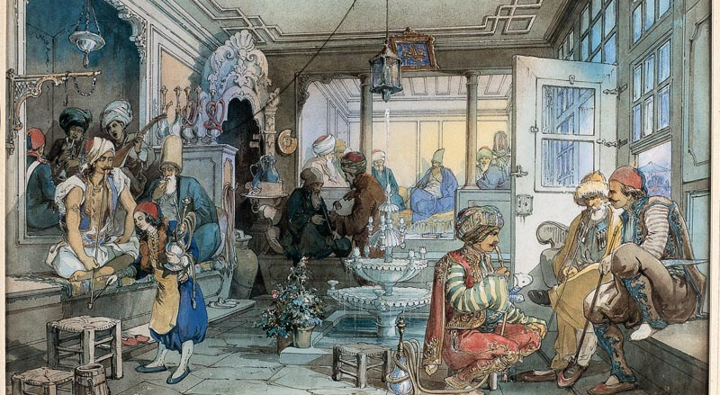
Istanbul café, 19th century

Slide 23
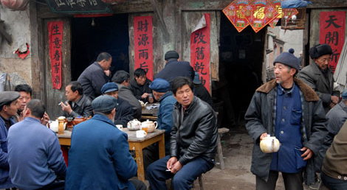
Workers’ tea house, China

