Slide 1
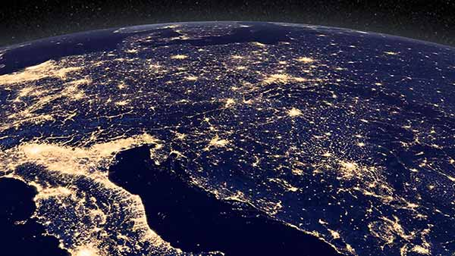
Ursula K. Heise
Sense of Place and Sense of Planet: The Environmental Imagination of the Global (2008)

Slide 2
Rise of modern environmental movement in the US/W. Europe
Late 1960s/1970s
shift in environmental consciousness signalled by series of events, eg.: Earth Day, 1970; Stockholm, 1972; Club of Rome report, 1972;
On the one hand: ‘new imaging technologies’ (Heise); rise of new ways of seeing/conceiving the earth and possibility of different kind of politics / styles of life
On the other, looming global disaster: nuclear destruction/environmental collapse

Slide 3
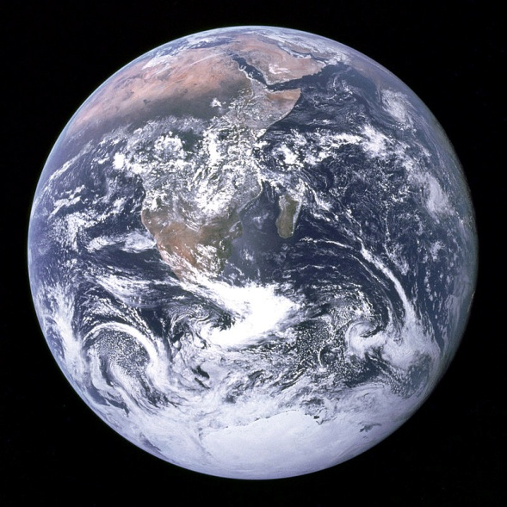
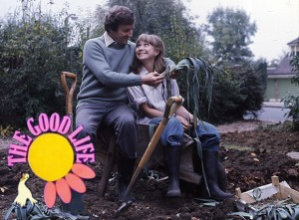
‘Blue Marble’ earth shot, 1972;
The Good Life, 1975

Slide 4
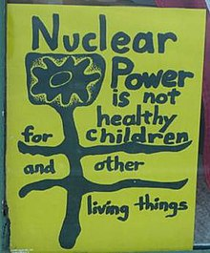
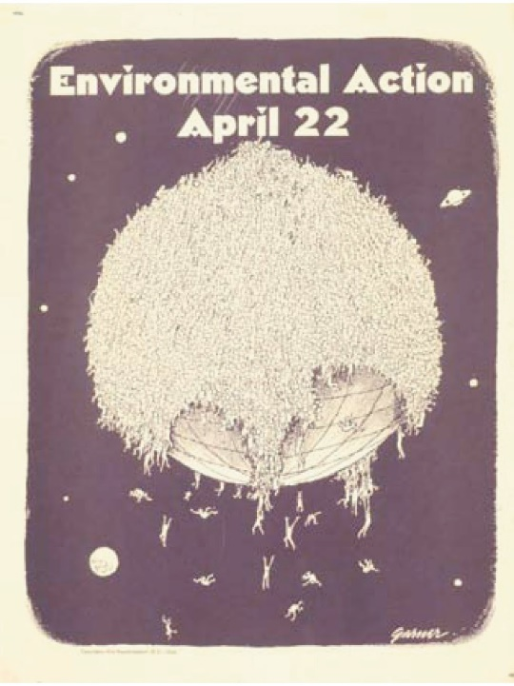
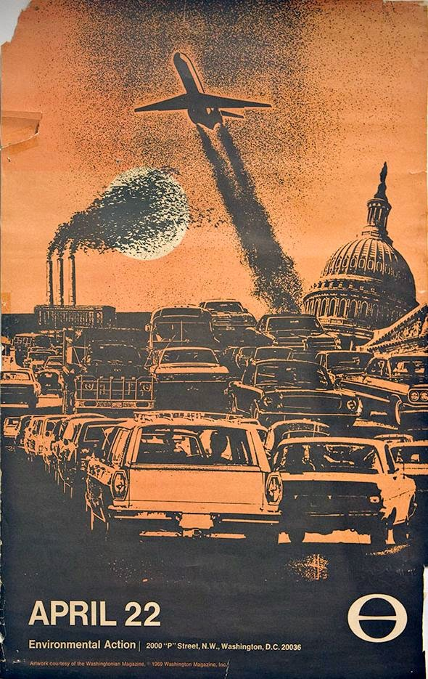
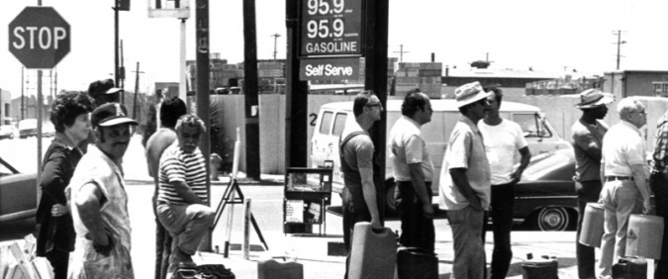

Slide 5


Slide 6
Eco-cosmopolitanism:
“it seems to me imperative to reorient current U.S. environmentalist discourse, ecocriticism included, toward a more nuanced understanding of how both local cultural and ecological systems are imbricated in global ones. This argument for an increased emphasis on a sense of planet, a cognitive understanding and affective attachment to the global, should be understood not as a claim that environmentalism should welcome globalization in every form (there are good reasons to resist some of its dimensions) or as a refusal to acknowledge that appeals to indigenous traditions, local knowledge, or national law are in some cases appropriate and effective strategies. Rather, it is intended as a call to ground any such discourses in a thorough cultural and scientific understanding of the global—that is, an environmentally oriented cosmopolitanism or “world environmental citizenship.” (p. 59)

Slide 7
“Historically, cosmopolitanism has combined two distinct significations. On the one hand, it designates an enthusiasm for customary differences, but as ethical or aesthetic material for a unified polychromatic culture—a new singularity born of a blending and merging of multiple local constituents. Typically, in this conception, a subjunctive ‘ought’ contains a normative ‘is’: the suggestion that the period in question is—for the first time in history—already substantially cosmopolitan. On the other hand, cosmopolitanism projects a theory of world government and corresponding citizenship. Here the structure of underlying unity conveyed by the cultural meaning of the term is carried over to the political. The cosmopolitan ideal envisages less a federation or coalition of states than an all-encompassing representative structure in which delegates can deliberate on a global scale.”
(Timothy Brenan, “Cosmopolitanism and Internationalism”, New Left Review, Jan-Feb. 2001

Slide 8
“We need to be very cautious in contemplating any cosmopolis that would short-circuit the existing nation-states in the name of the people: on that imaginary terrain, too many powerful interests are already entrenched. There are alternatives to a standoff between a suspect utopianism of the cosmopolitical community and a blinkered defence of the existing nation-state system. It is better to view the latter as a transitional arena, which for the moment contains the only structures through which transnational forms of solidarity might emerge in the only way they can—slowly and over many generations.” (Brenan, “Cosmopolitanism…”

Slide 9
“In the course of the 1990s, climate change also began to make its way into the cultural imagination. Like other processes of global systemic transformation, ecological or not, climate change poses a challenge for narrative and lyrical forms that have conventionally focused above all on individuals, families, or nations, since it requires the articulation of connections between events at vastly different scales.” (Heise, Sense of Place, Sense of Planet p. 207)

Slide 10
“imagining how such a planetary transformation might affect particular places and individuals, therefore, amounts to a paradigmatic exercise in “secondhand nonexperience,” envisioning a kind of change that has not occurred before. Understanding climate change ecologically and conveying a sense of the quite divergent impacts it might have on communities around the globe is a task of such magnitude that relatively few writers and filmmakers have attempted it so far, and those who have—with a few exceptions—have done so with limited success. In their portrayal of climate change as a global risk scenario, some films and novels—Robert Silverberg’s novel Hot Sky at Midnight (1994), David Twohy’s film The Arrival (1996), and Roland Emmerich’s movie The Day after Tomorrow (2004), for example—fall back on apocalyptic narrative in some of its most dated and formulaic clichés of urban disaster and alien invasion.” (Heise, Sense of Place, p. 206)

Slide 11
“That climate change casts a much smaller shadow within the landscape of literary fiction than it does even in the public arena is not hard to establish. To see that this is so we need only glance through the pages of a few highly regarded literary journals and book reviews, for example, the London Review of Books, the New York Review of Books, the Los Angeles Review of Books, the Literary Journal and the New York Times Review of Books. When the subject of climate change appears in these publications, it is almost always in relation to non-fiction; novels and short stories are very rarely to be glimpsed within this horizon. Indeed, it could even be said that fiction that deals with climate change is almost by definition not of the kind that is taken seriously by serious literary journals: the mere mention of the subject is often enough to relegate a novel or a short story to the genre of science fiction. It is as though in the literary imagination climate change were somehow akin to extraterrestrials or interplanetary travel.” (Amitav Ghosh, The Great Derangement, p. 14)
“Are the currents of global warming too wild to be navigated in the accustomed barques of narration? But the truth, as is now widely acknowledged, is that we have entered a time when the wild has become the norm: if certain literary forms are unable to negotiate these torrents, then they will have failed—and their failures will have to be counted as an aspect of the broader imaginative and cultural failure that lies at the heart of the climate crisis.” (Ibid.)

Slide 12
“Because this application is able to display satellite images from around the globe in very high resolution and in close-up [. . .] it has become not only a popular entertainment but also a threat to governments and institutions who would prefer to keep certain parts of their territory shielded from public view. This latest metamorphosis of the Blue Planet image into a searchable and zoomable database in the shape of a virtual globe [. . .]. No longer relying on allegorical images of the planet, Google Earth instead instantiates what media theorist Lev Manovich has called the “database aesthetic” of much new media art, in his view a new aesthetic configuration that is neither narrative nor metaphorical in its basic structure but instead presents infinitely expandable sets of data with the possibility of establishing different sorts of sets and linkages between them. In its ability to display the whole planet as well as the minute details of particular places in such a way that the user can zoom from one to the other and focus on different types of information, Google Earth’s database imaginary may well be the latest and post-postmodernist avatar of modernist collage, which has now turned global, digital, dynamic, and interactive. It also, more metaphorically, points the way to some of the information, as well as formal structures, that eco-cosmopolitanism of the kind I have described here can rely on, and through which it can express itself.

Slide 13
“Planetarian Accountancy”
the mapping sciences (e.g., remote sensing, GIS etc.), have sought to “reduce the Earth . . . to little more than a vast standing reserve, serving as a ready resource supply center and/or accessible waste reception site . . . [They] aspire to scan and appraise the most productive use of . . . [the] resourcified flows of energy, information, and matter as well as the sinks, dumps, and wastelands for all the by-products that commercial products leave behind.” (Timothy W. Luke, “Developing Planetarian Accountancy”)

Slide 14
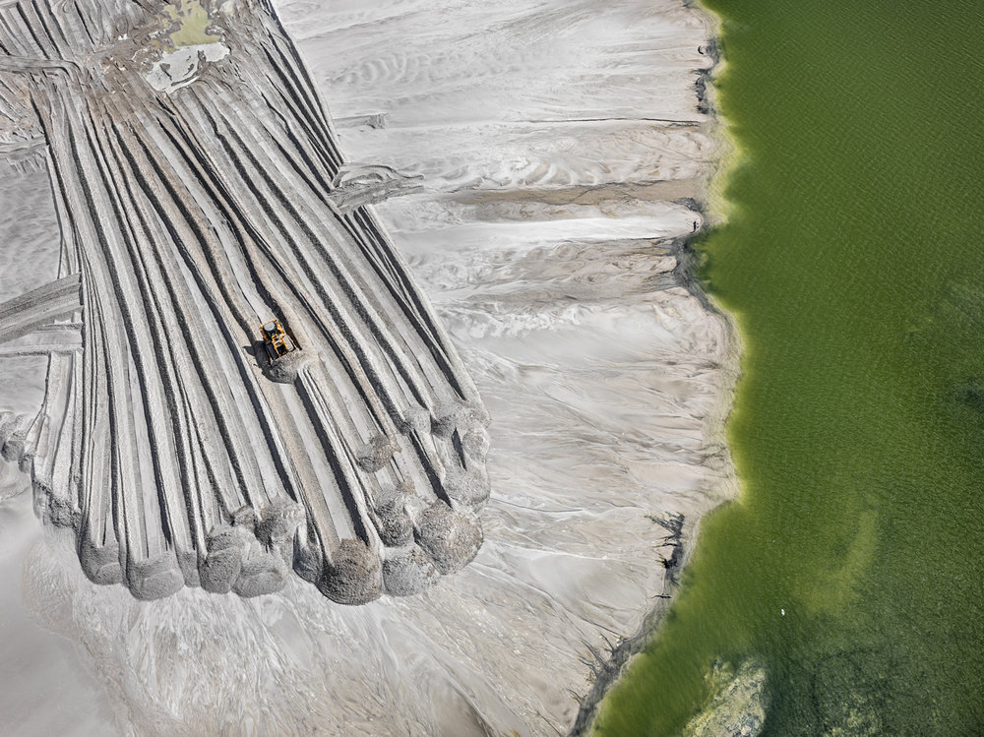

Slide 15
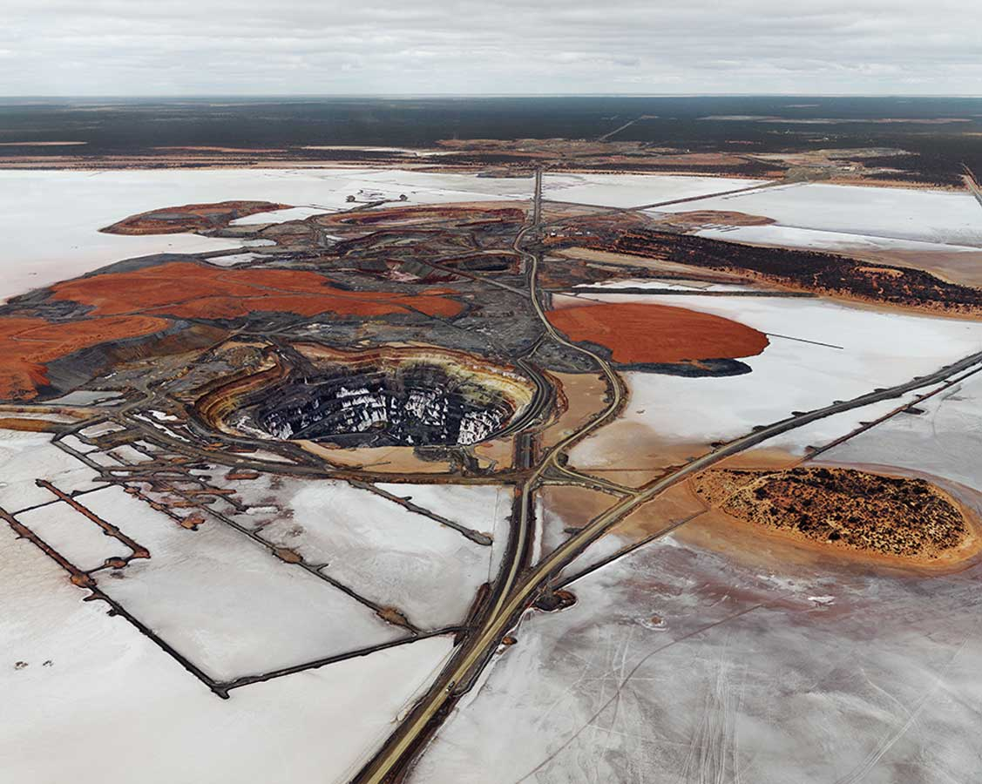

Slide 16
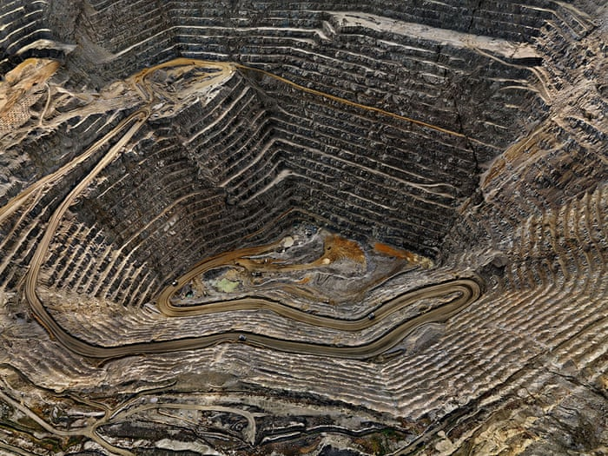

Slide 17


Slide 18


Ursula K. Heise Mike Davis

Slide 19
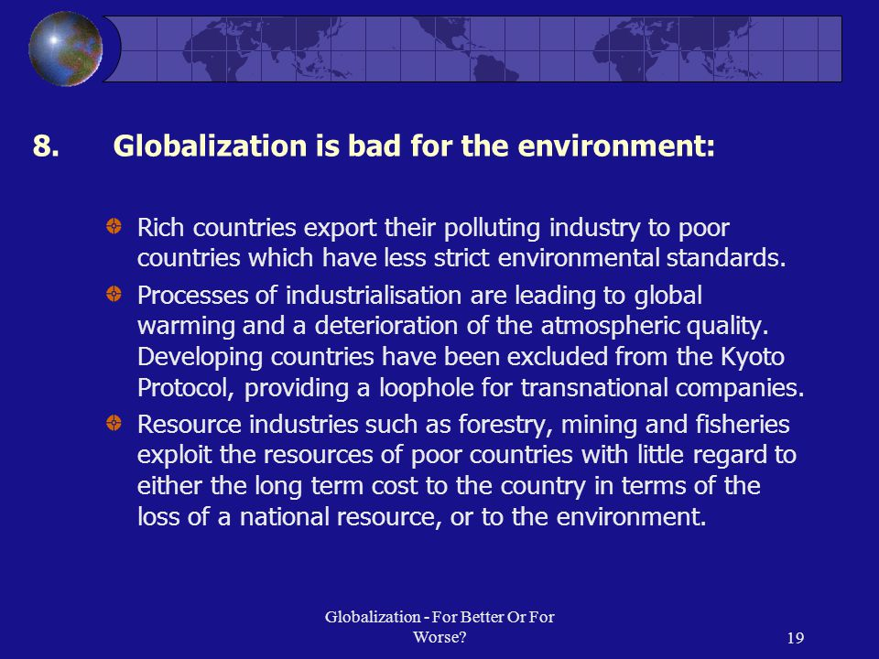

Slide 20
Pessimism of the Intellect ‘socio-economic inequality will have a meteorological mandate…’
The Kyoto Protocol, in the smug but sadly accurate words of one of its chief opponents, has done ‘nothing measurable’ about climate change. Global carbon dioxide emissions rose by the same amount they were supposed to fall because of it. It is highly unlikely that greenhouse gas accumulation can be stabilized this side of the famous ‘red line’ of 450 ppm [parts per million] by 2020. If this is the case, the most heroic efforts of our children’s generation will be unable to forestall a radical reshaping of ecologies, water resources and agricultural systems. In a warmer world, moreover, socio-economic inequality will have a meteorological mandate, and there will be little incentive for the rich northern hemisphere countries, whose carbon emissions have destroyed the climate equilibrium of the Holocene, to share resources for adaptation with those poor subtropical countries most vulnerable to droughts and floods.

Slide 21
those qualities that are most ‘classically’ urban, even on the scale of small cities and towns, combine to generate a more virtuous circle. Where there are well-defined boundaries between city and countryside, urban growth can preserve open space and vital natural systems, while creating environmental economies of scale in transportation and residential construction. Access to city centres from the periphery becomes affordable and traffic can be regulated more effectively. Waste is more easily recycled, not exported downstream. In classic urban visions, public luxury replaces privatized consumption through the socialization of desire and identity within collective urban space. Large domains of public or non-profit housing reproduce ethnic and income heterogeneity at fractal scales throughout the city. Egalitarian public services and cityscapes are designed with children, the elderly and those with special needs in mind. Democratic controls offer powerful capacities for progressive taxation and planning, with high levels of political mobilization and civic participation, the priority of civic memory over proprietary icons and the spatial integration of work, recreation and home life.

Slide 22
there is no planetary shortage of ‘carrying capacity’ if we are willing to make democratic public space, rather than modular, private consumption, the engine of sustainable equality. Public affluence – represented by great urban parks, free museums, libraries and infinite possibilities for human interaction – represents an alternative route to a rich standard of life based on Earth-friendly sociality. Although seldom noticed by academic urban theorists, university campuses are often little quasi-socialist paradises around rich public spaces for learning, research, performance and human reproduction

Slide 23
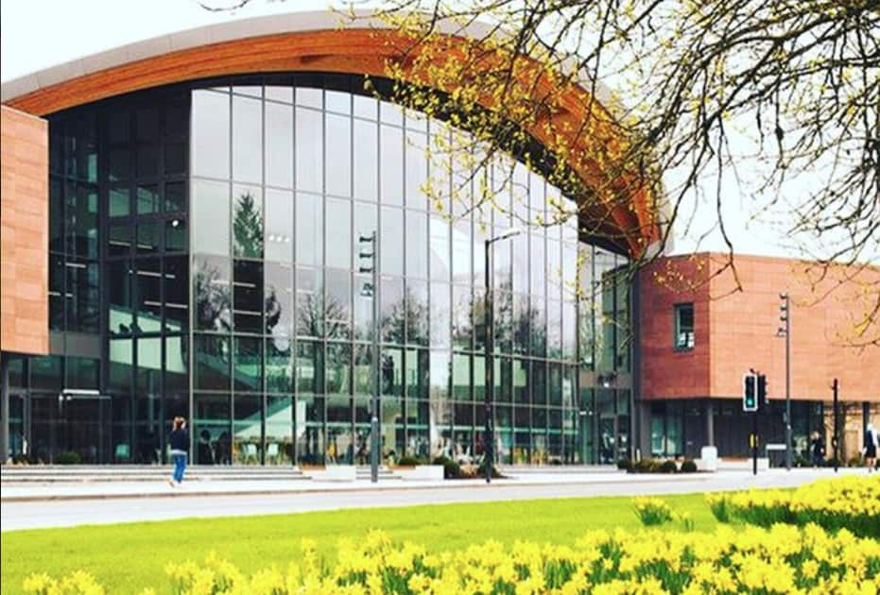
‘little quasi-socialist paradises around rich public spaces for learning, research, performance and human reproduction’

Slide 24
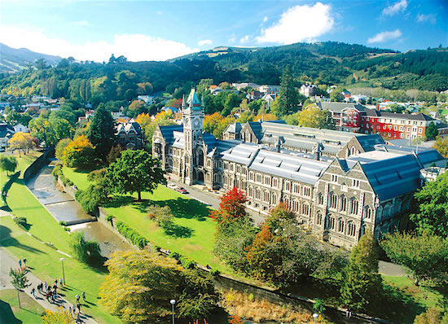
‘little quasi-socialist paradises around rich public spaces for learning, research, performance and human reproduction’

Slide 25
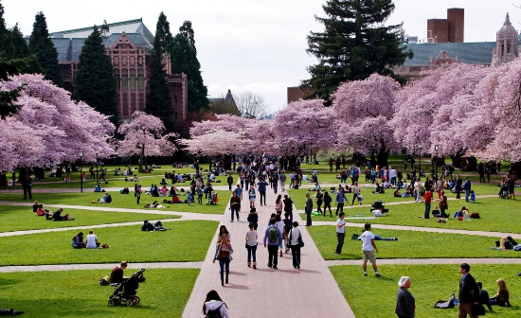

Slide 26
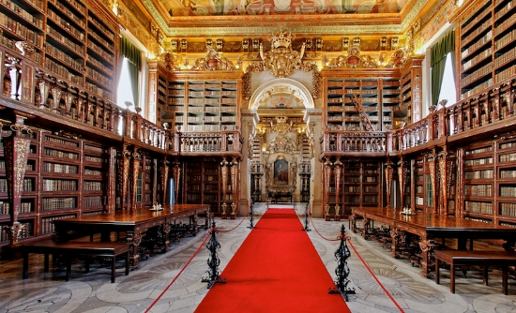

Slide 27
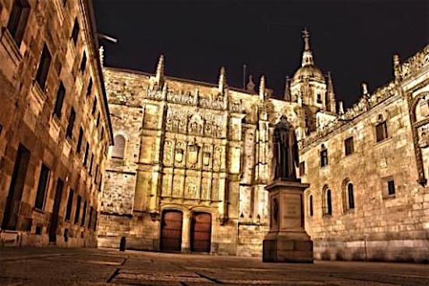

Slide 28
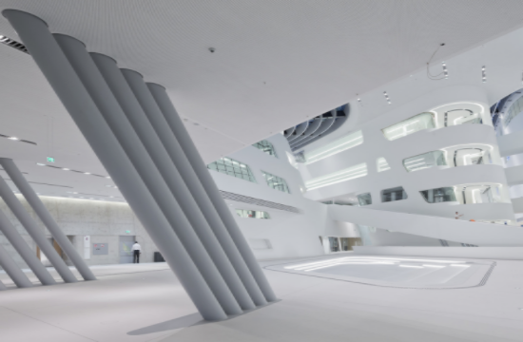

Slide 29
In the context of global environmental emergency, this Constructivist project could be translated into the proposition that the egalitarian aspects of city life consistently provide the best sociological and physical supports for resource conservation and carbon mitigation. Indeed, there is little hope of mitigating greenhouse emissions or adapting human habitats to the Anthropocene unless the movement to control global warming converges with the struggle to raise living standards and abolish world poverty. And in real life, beyond the IPCC’s simplistic scenarios, this means participating in the struggle for democratic control over urban space, capital flows, resource-sheds and large-scale means of production

Slide 30
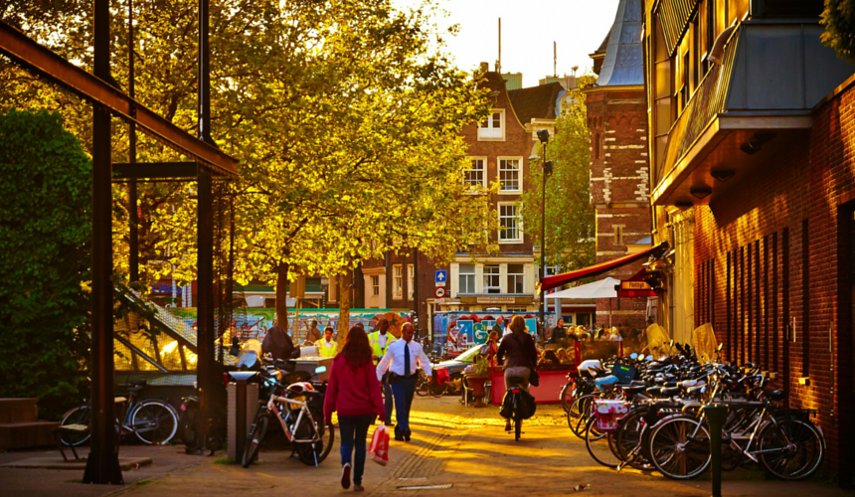

Slide 31
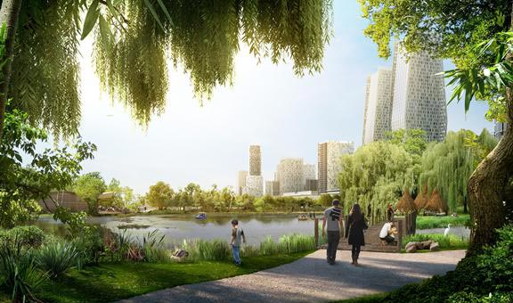

Slide 32
Tackling the challenge of sustainable urban design for the whole planet, and not just for a few privileged countries or social groups, requires a vast stage for the imagination… It presupposes a radical willingness to think beyond the horizon of neo-liberal capitalism toward a global revolution that reintegrates the labour of the informal working classes, as well as the rural poor, in the sustainable reconstruction of their built environments and livelihoods. Of course, this is an utterly unrealistic scenario, but one either embarks on a journey of hope, believing that collaborations between architects, engineers, ecologists and activists can play small, but essential roles in making an alter-monde more possible, or one submits to a future in which designers are just the hireling imagineers of elite, alternative existences

