Slide 1
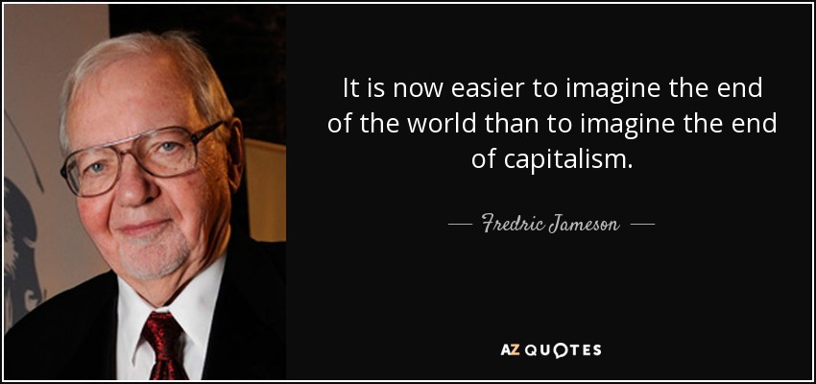

Slide 2
Why monetarism? Why are investment and the stock market getting more attention than an industrial production that seems on the point of disappearing anyway? How can you have profit without production in the first place? Where does all this excessive speculation come from? Do the new form of the city (including postmodern architecture) have anything to do with a mutation in the very dynamic of land values (ground rent)? Why should land speculation and the stock market come to the fore as dominant sectors in advanced societies, where ‘advanced’ certainly has something to do with technology but presumably ought to have something to do with production as well?
‘Culture and Finance Capital’, p. 136

Slide 3
[D]uring the long period of the Cold War and of Western Marxism – a period one really needs to date from 1917 – a complex analysis of ideology needed to be developed in order to unmask the persistent substitutions of incommensurate dimensions, the passing off of political arguments in the place of economic ones, the appeal to alleged traditions – freedom and democracy, God, Manichaeism, the values of the West and of the Judaeo-Christian or Roman-Christian heritage – as answers to new and unpredictable social experiments…
In those days, the theory of ideology constituted the better mousetrap: and every self-respecting theorist felt the obligation to invent a new one, to ephemeral acclaim and momentarily attracting a horde of curious spectators already ready to move on to the next model at a moment’s notice, even when that next model meant revamping the very name of ideology itself and substituting episteme, metaphysics, practices, or whatever.
‘Culture and Finance Capital’, p. 137

Slide 4
But today many of these complexities seem to have disappeared, and, faced with the Reagan-Kemp and Thatcher utopias of immense investments and increases in production to come, based on the deregulation and privatization and the obligatory opening of markets everywhere, the problems of ideological analysis seem enormously simplified, and the ideologies themselves far more transparent. Now that, following master thinkers like Hayek, it has become customary to identify political freedom with market freedom, the motivations behind ideology no longer seem to need an elaborate machinery of decoding and hermeneutic reinterpretation; and the guiding thread of all contemporary politics seems much easier to grasp: namely, that the rich want their taxes lowered.
‘Culture and Finance Capital’, p. 137

Slide 5
It was not so long ago that free trade and the ‘magic of the market’, in the exuberant phrase of the Financial Times commentator Martin Wolf, seemed to be bringing about the benign homogenisation of all human societies. As Louis Vuitton opened in Borneo and the Chinese turned into one of the biggest consumers of French wines, it appeared only a matter of time before free trade and consumer capitalism were followed by the rule of law, the enhanced use of critical reason, the expansion of individual freedom and the tolerance of diversity. Instead, the world at large – from the US to Indonesia – is undergoing a militant tribalisation. The new demagogues combine xenophobia with progressivist rhetoric about decent housing, efficient healthcare systems and better schools. Insisting on linguistic, religious, ethnic, and racial differences, they don’t just threaten free trade, or the globalist dream of achieving cosmopolitan unity through intensified commerce and digital communications. They seem to be deforming nothing less than the secular and egalitarian ideals of modernity.
Pankaj Mishra, ‘Democracy of the Aggrieved’

Slide 6
capitalism’s movement must be seen as discontinuous but expansive
if we position discontinuity not only in time but also in space, and if we add back in the historian’s perspective, which clearly enough needs to reckon in the national situations and the uniquely idiosyncratic developments within the national states, let alone within the greater regional groupings (Third versus First Worlds, for example), then the local teleologies of the capitalist process can be reconciled with its own spasmodic historical developments and mutations as those leap from geographical space to space

Slide 7
The internal stages of capitalist cyclicity:
1. trade which in one way or another, and often by way of the violence and brutality of primitive accumulation, brings into being a quantity of money for eventual capitalization
2.that money becomes capital, and is invested in agriculture and manufacture: it is territorialized, and transforms its associated area into a centre of production. But this second stage knows internal limits: those that weigh on production, distribution and consumption alike; a ‘falling rate of profit’ endemic to the second stage in general: ‘profits are still high, but it is a condition for their maintenance that they should not be invested in further expansion’
3. Third stage: Speculation, the withdrawal of profits from the home industries, the increasingly feverish search, not so much for new markets (these are also saturated) as for the new kind of profits available in financial transactions themselves and as such – these are the ways in which capitalism now reacts to and compensates for the closing of its productive moment.

Slide 8
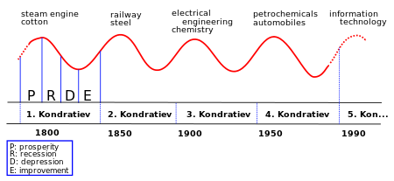

Slide 9
In the third stage, ‘Capital itself becomes free-floating. It separates from the “concrete context” of its productive geography. Money becomes in a second sense and to a second degree abstract (it always was abstract in the first and basic sense): as though somehow in the national moment money still had a content – it was cotton money, or wheat money, textile money, railway money and the like. Now, like the butterfly stirring within the chrysalis, it separates itself off from that concrete breeding ground and prepares to take flight. We know only too well… that the term is literal. We know that there exists such a thing as capital flight: the disinvestment, the pondered or hasty moving on to greener pastures and higher rates of investment return, and of cheaper labour. Now this free-floating capital, on its frantic search for more profitable investments… will begin to live its life in a new context; no longer in the factories and the spaces of extraction and production, but on the floor of the stock market, jostling for more intense profitability, but not as one industry competing with another branch, nor even one productive technology against another more advanced one in the same line of manufacturing, but rather in the form of speculation itself…’

Slide 10
‘As for my other contribution…I wanted to follow Lukács (and others) in seeing modernist reification in terms of analysis, decomposition, but above all of internal differentiation… [I]n the course of hypothesizing modernism in various contexts, I… found it interesting and productive to see this particular process in terms of “autonomization”, of the becoming independent and self-sufficient of what were formerly parts of a whole. It is something that can be observed in the chapters and sub-episodes of Ulysses, and also in the Proustian sentence. I wanted to establish a kinship here, not so much with the sciences… as rather with the labour process itself: and here the great phenomenon of Taylorization (contemporaneous with modernism) slowly imposes itself; a division of labour (theorized as long ago as Adam Smith) now becoming a method of mass production in its own right, by way of the separation of different states and their reorganization around principles of “efficiency” (to use the ideological word for it)’.

Slide 11
But now, in what some people like to call post-Fordism, this particular logic no longer seems to obtain; just as in the cultural sphere, forms of abstraction which in the modern period seemed ugly, dissonant, scandalous, indecent or repulsive, have also entered the mainstream of cultural consumption (in the largest sense, from advertising to commodity styling, from visual decoration to artistic production) and no longer shock anyone; rather our entire system of commodity production and consumption today is based on those older, once anti-social modernist, forms. Nor does the conventional notion of abstraction seem very appropriate in the postmodern context; and yet, as Arrighi teaches us, nothing is quite so abstract as the finance capital which underpins and sustains postmodernity as such.

Slide 12
From
C-M-C
(‘the simple circulation of commodities begins with a sale and ends with a purchase’)
to
M-C-M’
(the focus of the operation is no longer on the commodity but on money’)
‘the autonomization of the process of capital accumulation, which asserts its own logic over that of the production and consumption of goods as such, as well as over the individual entrepreneur and the individual worker’

Slide 13
The two ‘moments’ or ‘stages’ of deterritorialization:
‘one moment is a deterritorialization in which capital shifts to other and more profitable forms of production, often enough in new geographical regions. Another is the grimmer conjuncture, in which the capital of an entire centre or region abandons production altogether in order to seek maximization in those non-productive spaces, which… are those of speculation, the money market, and finance capital in general. Of course, here the word “deterritorialization” can celebrate its own kinds of ironies: for one of the privileged forms of speculation today is that of land and city space: the new postmodern informational or global cities (as they have been called) thus result very specifically from the ultimate deterritorialization, that of territory as such – the becoming abstract of land and the earth, the transformation of the very background of context of commodity exchange into a commodity in its own right. Land speculation is therefore one face of a process whose other one lies in the ultimate deterritorialization of globalization itself, where it would be a great mistake to imagine something like “the globe” as yet a new and larger space replacing the older national or imperial ones. Globalization is rather a kind of cyberspace, in which money capital has reached its ultimate dematerialization, as messages which pass instantaneously from one nodal point to another across the former globe, the former material world’

Slide 14
Architects seldom make the front pages of newspapers Patrik Schumacher recently managed it, though, getting himself on to the cover of the Evening Standard after a speech in which he advocated privatising all social housing and all public space – including Hyde Park – and espoused intensified gentrification of inner-city areas. His advocacy on behalf of plutocrats reached hilariously villainous levels when he said of second-home owners in London: ‘Even if they’re only here for a few weeks and throw some key parties, these are amazing multiplying events’.
This is ‘neoliberal’ rhetoric at its purest. Neoliberalism – a form of free-market fundamentalism that effectively came to power at the start of the 1980s with the election of such enthusiasts for Friedrich Hayek and Milton Friedman as Margaret Thatcher and Ronald Reagan – is an unusual concept, largely because it extends out of economics into philosophy and the way people see the world. As Thatcher once said, ‘economics is the method, the aim is to change the soul’… [O]ne of the best places to see this is in architecture’
Owen Hatherley, rev. of Douglas Spencer, The Architecture of Neoliberalism

Slide 15
For the neoliberal architects, resistance is futile; there is no alternative. Hayek argued that, in the social democratic era, human systems were so complex that to try to manage or plan them could only lead to totalitarianism. With Schumacher, this idea is translated into a ‘radical free-market urbanism’, where all controls on the flows of capital must be removed, and ‘the market will discover the most productive mix and arrangement of land uses, a distribution that garners synergies and maximises overall value’.
Owen Hatherley, rev. of Douglas Spencer, The Architecture of Neoliberalism

Slide 16
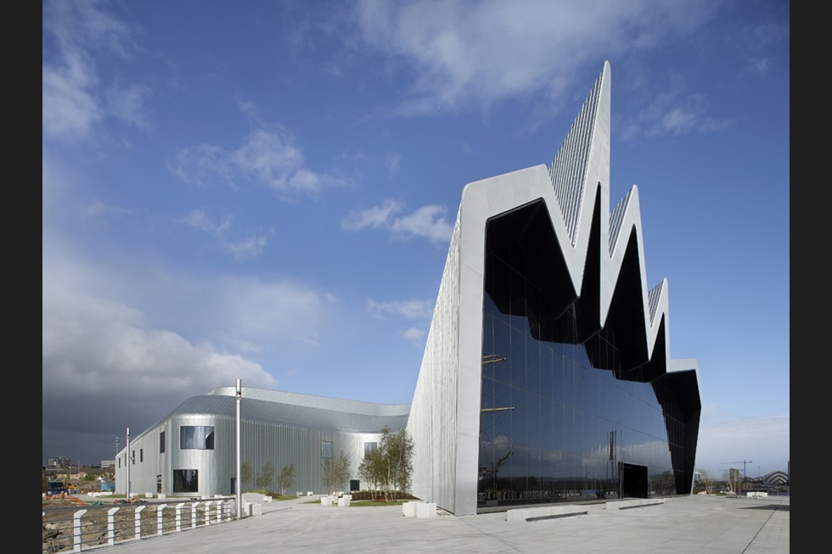

Slide 17
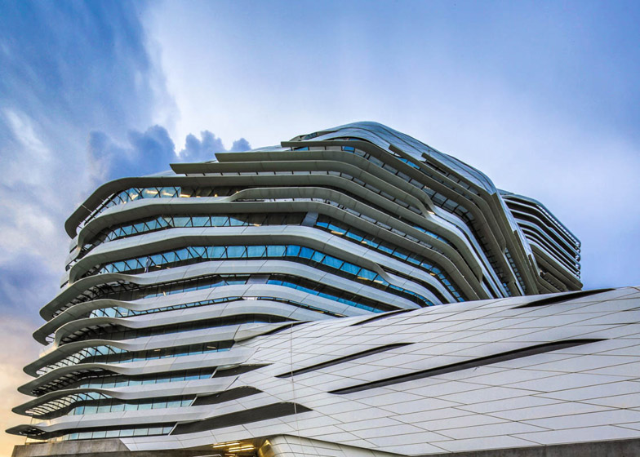

Slide 18
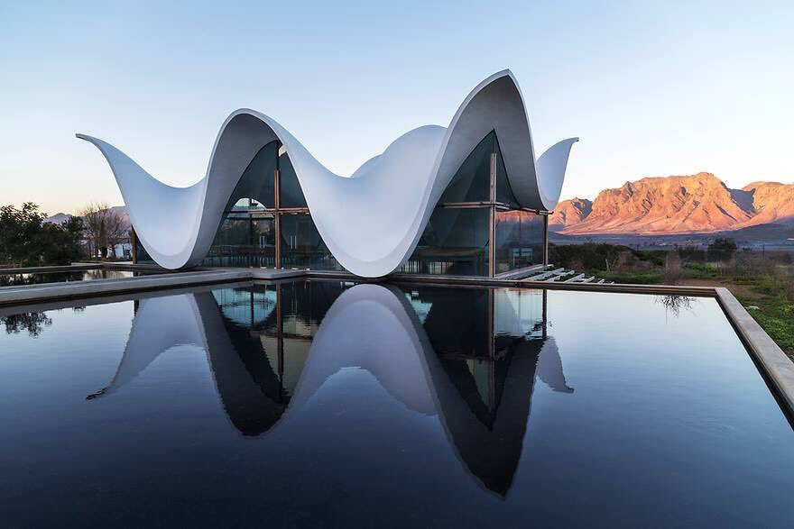

Slide 19
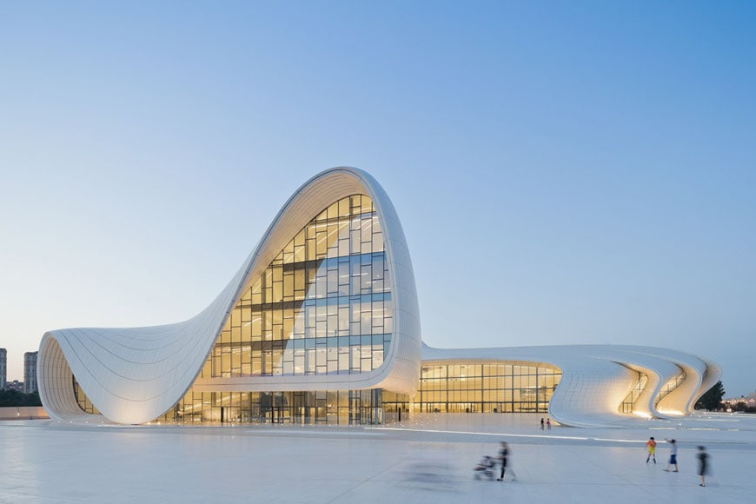

Slide 20
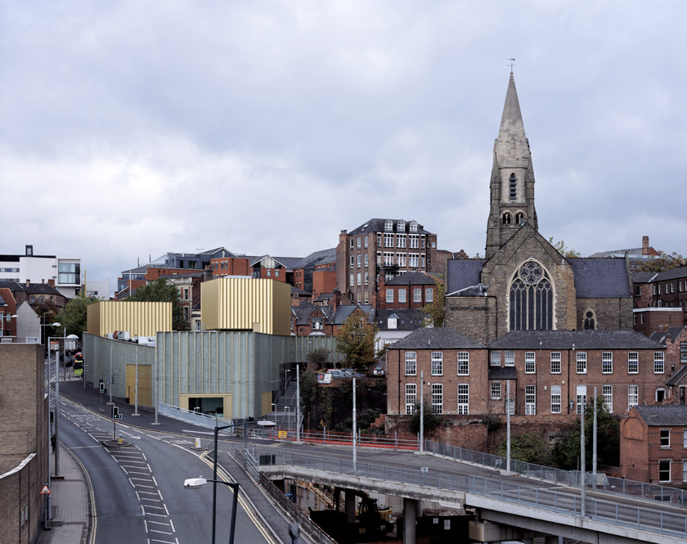

Slide 21
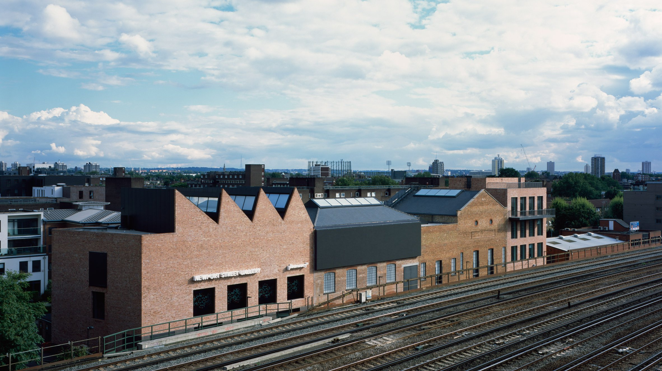

Slide 22
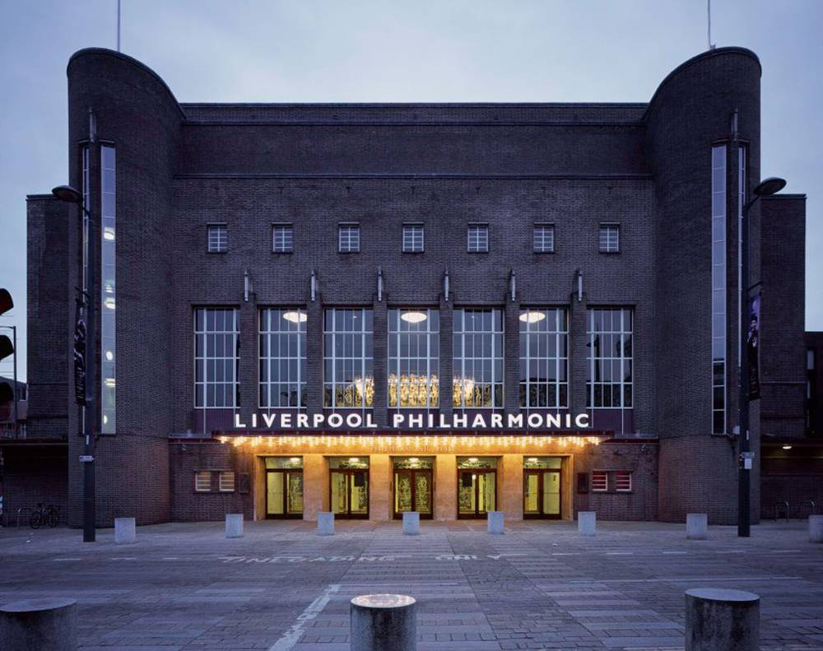

Slide 23
Norfolk Southern advertisement
https://www.youtube.com/watch?v=Y8pp_ijH4aU

Slide 24
Stan Brakhage ‘Mothlight’ (1963)
https://www.youtube.com/watch?v=S5P5vkegmvU

Slide 25
Kendrick Lamar ‘Humble’
https://www.youtube.com/watch?v=tvTRZJ-4EyI

Slide 26
Gil Scott-Heron ‘The Revolution will not be Televised’
https://www.youtube.com/watch?v=qGaoXAwl9kw

Slide 27
Derek Jarman The Last of England (1988)
https://www.youtube.com/watch?v=F7VqAK3WI3Y

