Slide 1
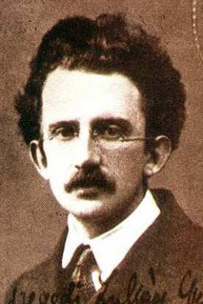

Georg Lukács/Naomi Klein

Slide 2
Georg Lukács
Our intention here is to base ourselves on Marx’s economic analyses and to proceed from there to a discussion of the problems growing out of the fetish character of commodities, both as an objective form and also as a subjective stance corresponding to it.

Slide 3
Reification is forgetting
This sees the matter from the standpoint of the consumer: it suggests the kind of guilt people are freed from if they are able not to remember the work that went into their toys and furnishings. Indeed, the point of having your own object world, and walls and muffled distance or relative silence all around you, is to forget all those innumerable others for a while; you don’t want to have to think about Third World women every time you pull yourself up to your word processor, or all the other lower-class people with their lower-class lives when you decide to use or consume your other luxury products: it would be like having voices inside your head; indeed, it ‘violates’ the intimate space of your privacy and your extended body. For a society that wants to forget about class, therefore, reification in this consumer-packaging sense is very functional indeed: consumerism as a culture involves much more than this, but this kind of ‘effacement’ is surely the indispensable precondition on which all the rest can be constructed
Fredric Jameson

Slide 4
‘For all reification is a forgetting: objects become purely thing-like the moment they are retained for us without the continued presence of their other aspects: when something of them has been forgotten’.
Theodor W. Adorno, letter to Walter Benjamin, 1930s.

Slide 5
The commodification of everything
These days you can buy almost anything. Sperm and eggs are advertised on the web. Speed dating services will provide you with several minutes-long dates in one night for the right price. Human organs are being bought and sold around the world. Universities are increasingly thinking of the education that they offer as a ‘product’ and their students as ‘consumers’. There are fewer and fewer realms of life in which the language of money does not speak powerfully’.

Slide 6
reification
The transformation of the commodity relation into a thing of ‘ghostly objectivity’ cannot therefore content itself with the reduction of all objects for the gratification of human needs to commodities. It stamps its imprint upon the whole consciousness of man; his qualities and abilities are no longer an organic part of his personality, they are things which he can ‘own’ or ‘dispose of’ like the various objects of the external world. And there is no natural form in which human relations can be cast, no way in which man can bring his physical and psychic ‘qualities’ into play without their being subjected increasingly to this reifying process.

Slide 7
https://www.youtube.com/watch?v=71KAO_bmc2o

Slide 8
‘Celebrating 20 years of Priceless’
https://www.youtube.com/watch?v=4gEAi195woA

Slide 9
Kant on ‘sexual community’
Sexual community… is the reciprocal use made by one person of the sexual organs and faculties of another… [M]arriage … is the union of two people of different sexes with a view to the mutual possession of each other’s sexual attributes for the duration of their lives.

Slide 10


Slide 11


Slide 12


Slide 13


Slide 14


Slide 15


Slide 16


Slide 17

‘This landscape requires its bodies to be placed… [C]onsider how many purchases must be made, how much work done, before a body is properly prepared to take its place in this room’
(W.F. Haug)

Slide 18


Slide 19
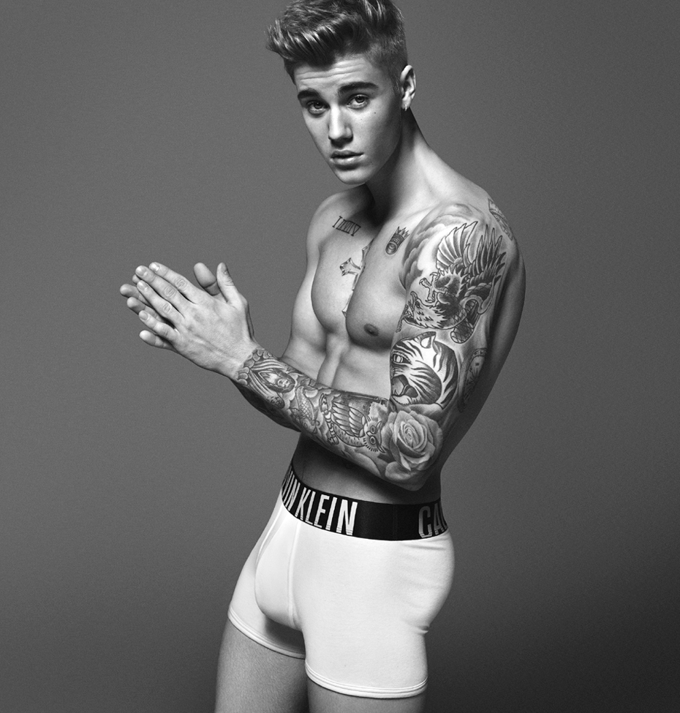


Slide 20

‘Natural Male Care Products’
‘Who fails here to call to mind our good friend, Dogberry, who informs neighbour Seacoal, that, “To be a well­favoured man is the gift of fortune; but reading and writing comes by Nature.”’

Slide 21
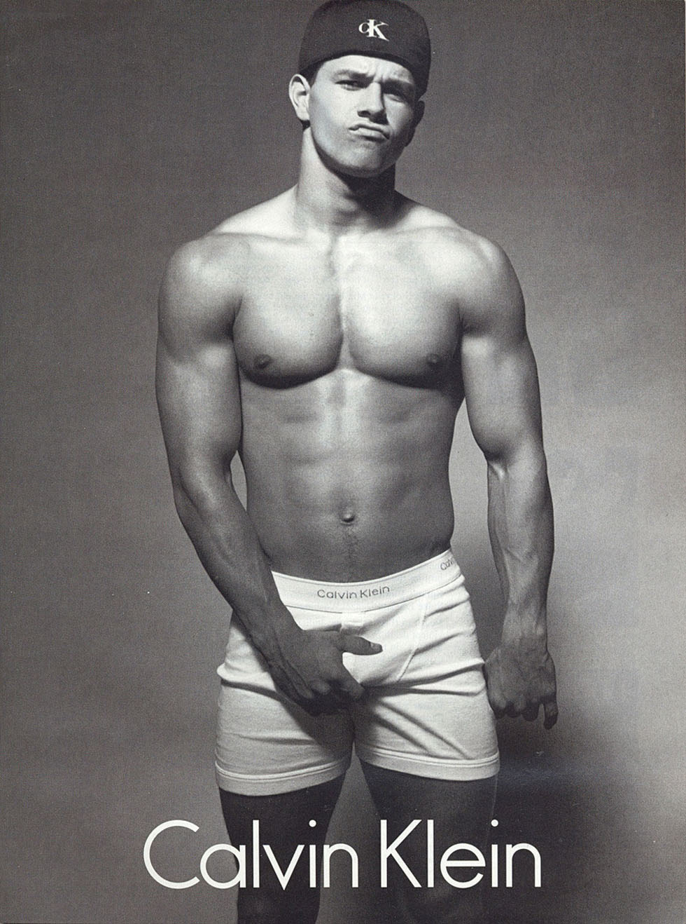

Slide 22

‘What kind of face is today’s woman wearing?’

Slide 23
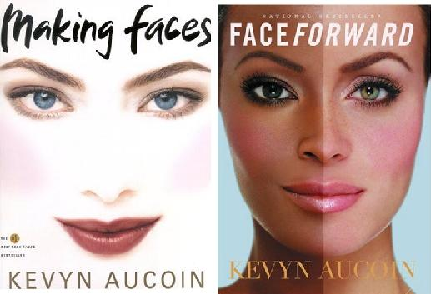

Slide 24
John Berger, Ways of Seeing (from Episode 2)
https://www.youtube.com/watch?v=ta-s_vzxWn8

Slide 25
Front Row Late: Mary Beard in Conversation with Emma Thompson
https://www.bbc.co.uk/iplayer/episode/b0bp1k6z/front-row-late-series-3-episode-6

Slide 26
Self-marketing/
‘Personal Branding’
Marketing is an essential tool in branding yourself. You must not simply blend in with everyone else in your thinking or approach for it will not set you apart from the rest. You must explore all of your options and display as much ingenuity as possible if you truly want to be recognized as an expert in your field. Marketing is a skill that takes persistence to sell your self as a bona fide professional that is appealing to an employer or customer

Slide 27


Slide 28
‘Could commodities themselves speak, they would say: Our use value may be a thing that interests men. It is no part of us as objects. What, however, does belong to us as objects, is our value. Our natural intercourse as commodities proves it. In the eyes of each other we are nothing but exchange values’.

Slide 29

MONEY TALKS

Slide 30
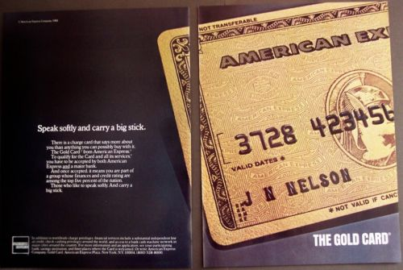
Reification is mystification
‘Speak softly and carry a big stick

Slide 31

‘People talk about technology, but Apple is a marketing company’
Apple’s brand is the key to its success. It’s got nothing to do with innovatine products like the iMarc or the iPod

Slide 32
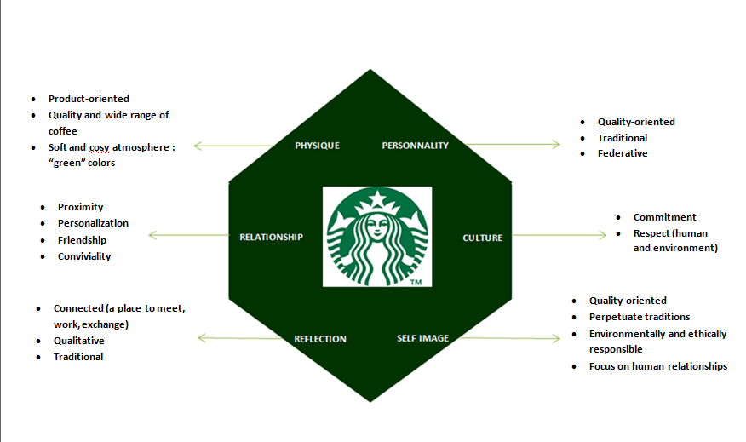

Slide 33
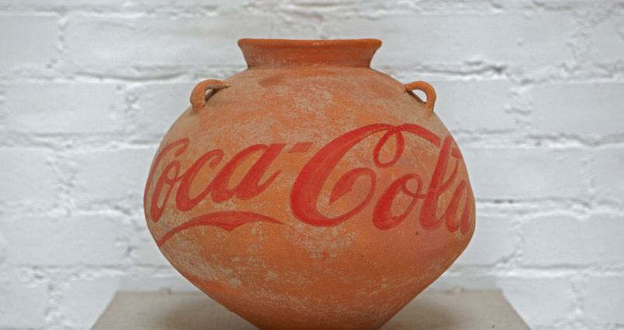
Ai Weiwei, neolithic vase with coca cola logo

