Slide 1
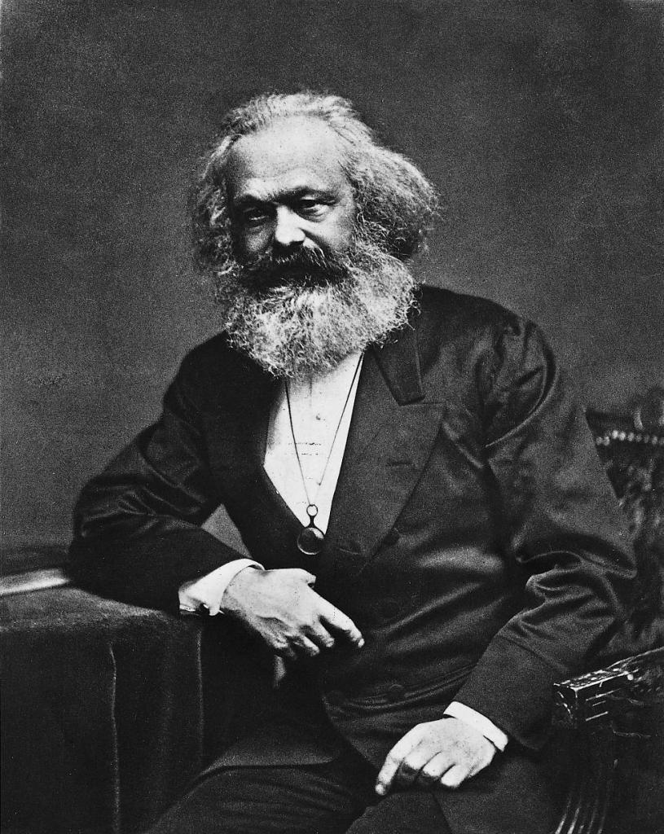
Karl Marx, Capital

Slide 2
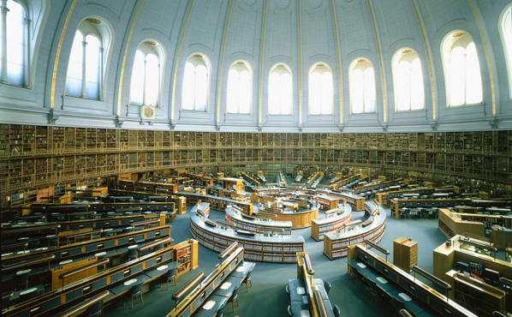
Reading Room, British Library, late 19th c.

Slide 3
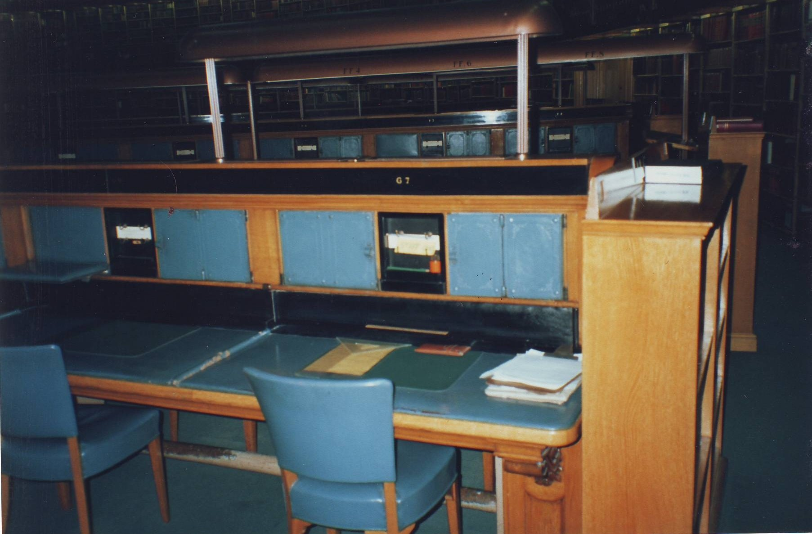
Karl Marx’s seat in the British Library

Slide 4
Key features of capitalism
Key features of capitalism as a mode of production:
Production for sale rather than direct use
More or less universal mediation of exchange (including the buying and selling of human labour-power) by money
Private ownership; production process and financial decision-making are in the hands of a particular social class (or its agents)
Competition between capitals
Existence of a market where labour power is bought and sold (‘free’ wage labour) – and of course where goods are exchanged

Slide 5
Opening sentences
The wealth of societies in which the capitalist mode of production prevails appears as an ‘immense collection of commodities’; the individual commodity appears as its elementary form. Our investigation therefore begins with the analysis of the commodity.

Slide 6

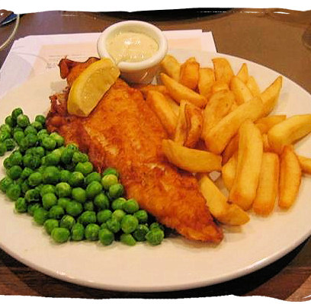
which is better?

Slide 7
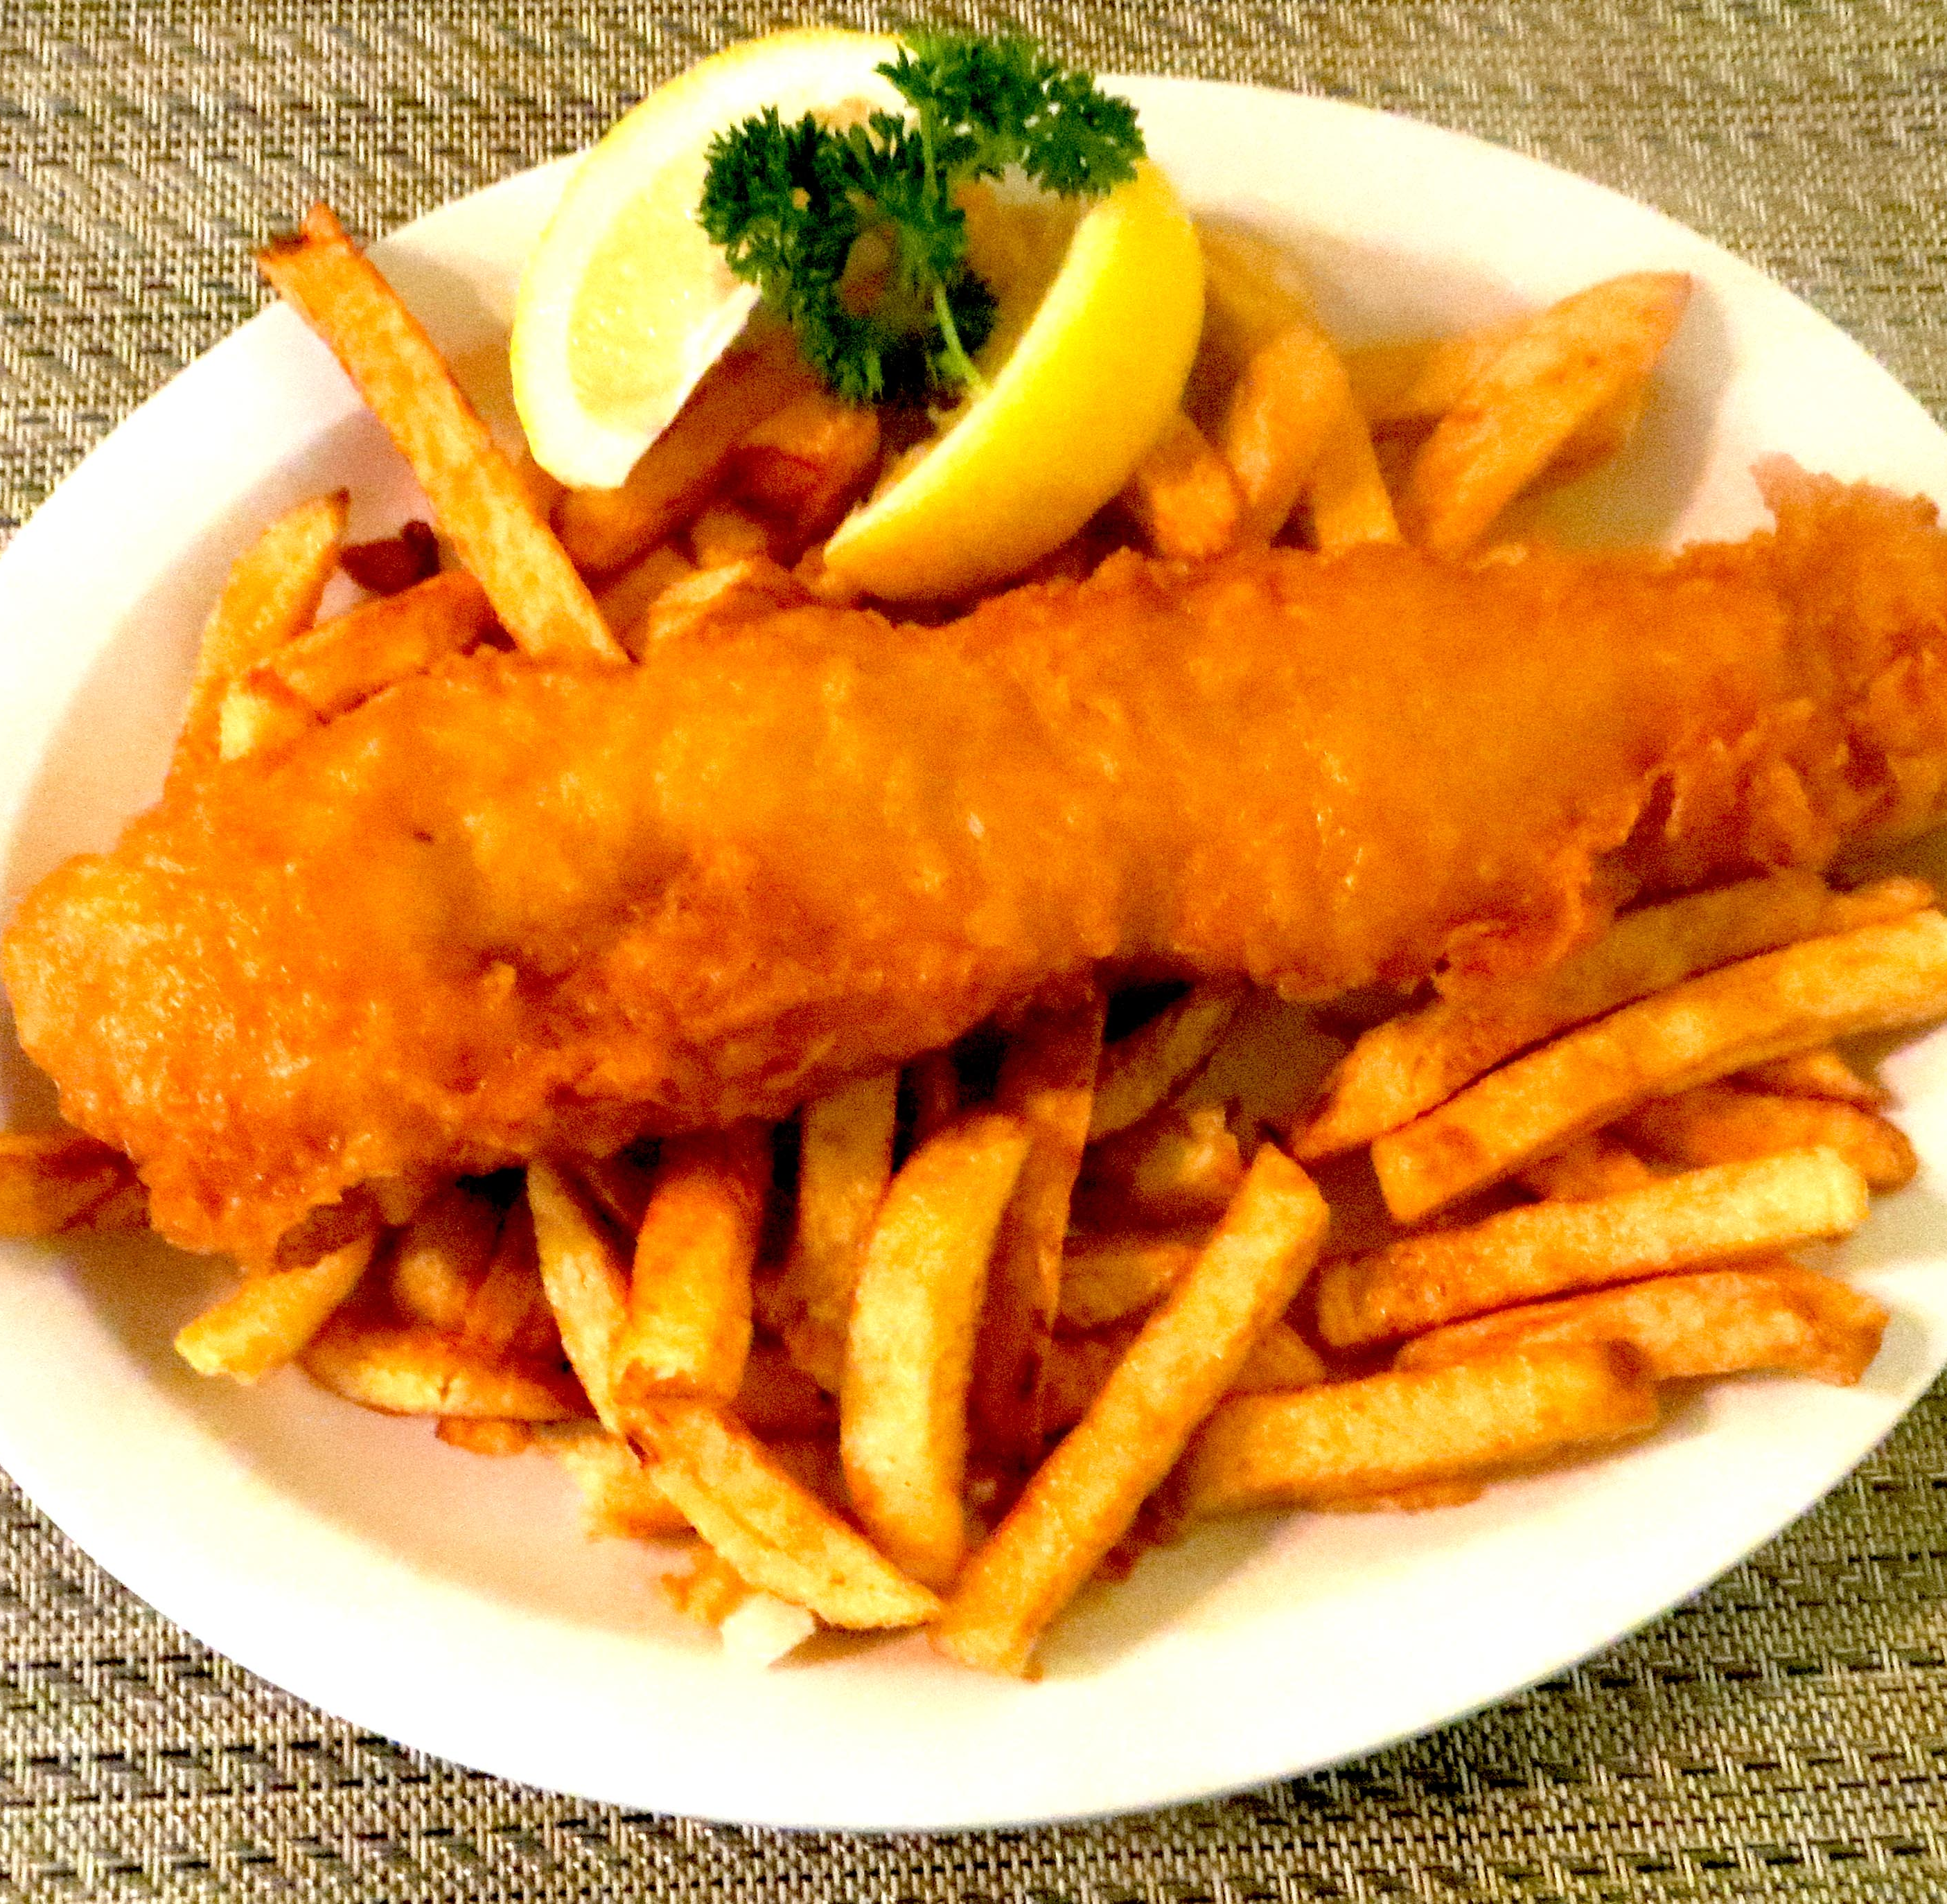
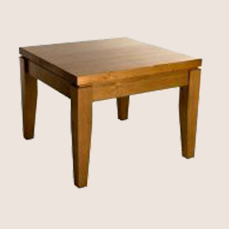
At the level of use values…?

Slide 8
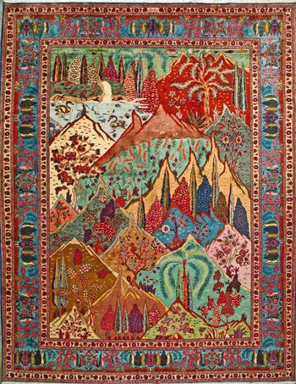

costs the same as…

Slide 9
Quantification of quality in exchange
if ‘x boot-polish, y silk, z gold, etc., must, as exchange-values, be mutually replaceable or of identical magnitude… [i]t follows… that, firstly, the valid exchange-values of a particular commodity express something equal, and secondly, exchange-value cannot be anything other than the mode of expression, the “form of appearance” [Erscheinungsform], of a content distinguishable from it’ (Capital, p. 127).

Slide 10
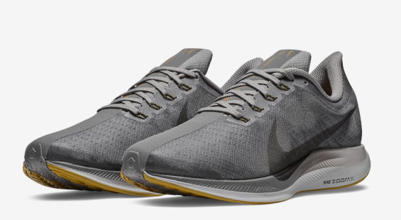
Buy, buy, buy

Slide 11
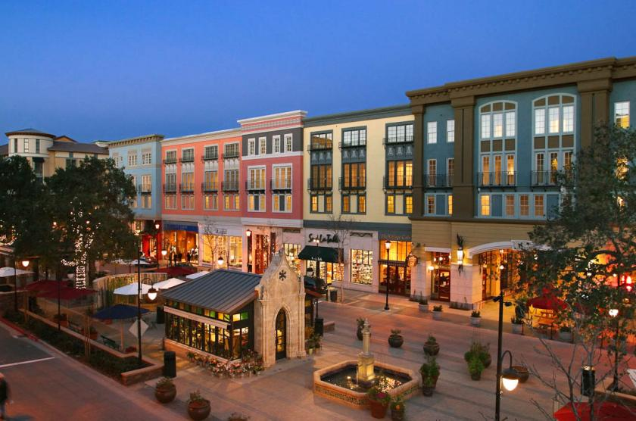
‘What exactly is a “lifestyle center”? Is it just a dressed up shopping mall?’

Slide 12
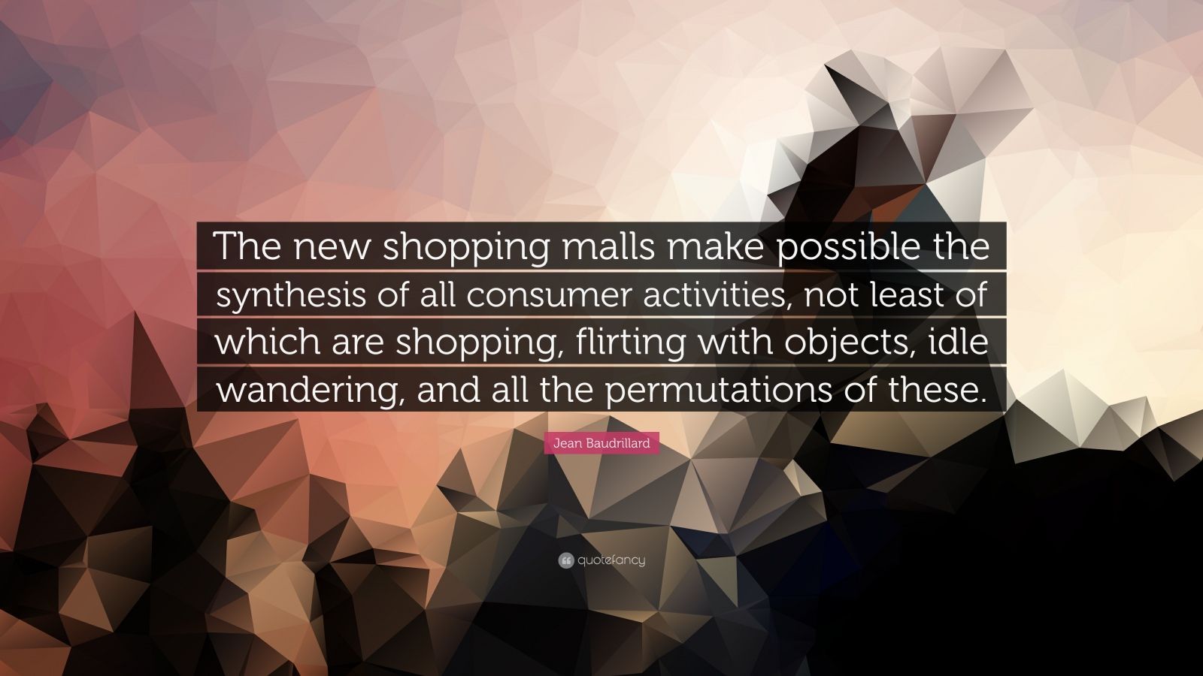

Slide 13
‘The mysterious character of the commodity-form consists therefore simply in the fact that the commodity reflects the social characteristics of men’s own labour as objective characteristics of the products of labour themselves, as the socio-natural properties of these things’ (Capital, pp. 164-65).

Slide 14

Paying cash for food at checkout

Slide 15

‘Cute happy couple paying for their food with a credit card’

Slide 16
‘The other definition of [fetishism] that has been important in recent years is the “effacement of the traces of production” from the object itself, from the commodity thereby produced. This sees the matter from the standpoint of the consumer: it suggests the kind of guilt people are freed from if they are able not to remember the work that went into their toys and furnishings. Indeed, the point of having your own object world, and walls and muffled distance or relative silence all around you, is to forget about all those innumerable others for a while; you don’t want to have to think about Third World women every time you pull yourself up to your word processor, or all the other lower-class people with their lower-class lives when you decide to use or consume your other luxury products: it would be like having voices inside your head; indeed, it “violates” the intimate space of your privacy and your extended body. For a society that wants to forget about class, therefore, [fetishism] in this consumer-packaging sense is very functional indeed: consumerism as a culture involves much more than this, but this kind of “effacement” is surely the indispensable precondition on which all the rest can be constructed’ (Fredric Jameson)

Slide 17
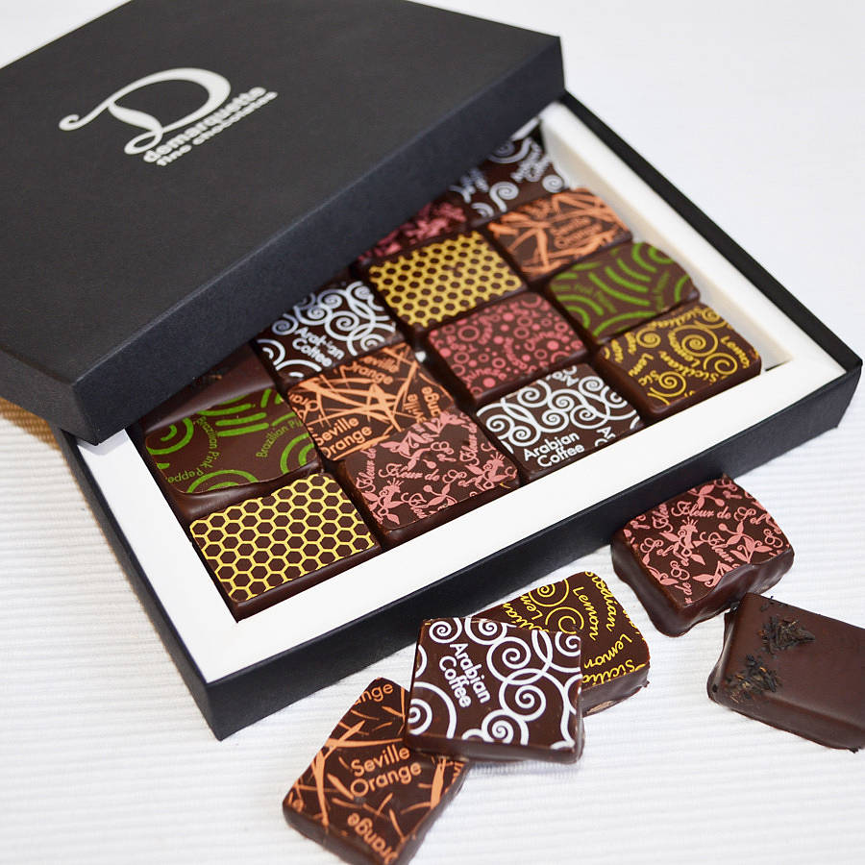

Left: luxury chocolate ganache gift box (£24.95) Right: chocolate is a bittersweet way of life in Ghana (earnings: £3 a day)

Slide 18

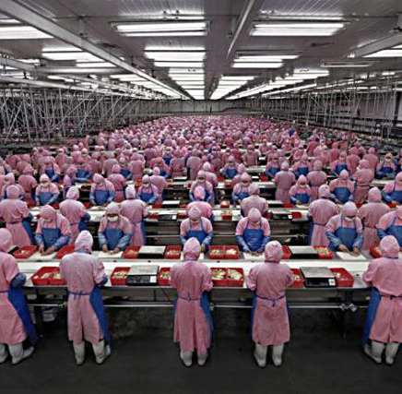
Right:‘each employee was given a biscuit and a cup of tea’

Slide 19
‘The belated scientific discovery that the products of labour, in so far as they are values, are merely the material expressions of the human labour expended to produce them, marks an epoch in the history of mankind’s development, but by no means banishes the semblance of objectivity possessed by the social characteristics of labour. Something which is only valid for this particular form of production, the production of commodities, namely the fact that the specific social character of private labours carried on independently of each other consists in their equality as human labour, and, in the product, assumes the form of the existence of value, appears to those caught up in the relations of commodity production (and this is true both before and after the above-mentioned scientific discovery) to be just as ultimately valid as the fact that the scientific dissection of their air into its component parts left the atmosphere itself unaltered in its physical configuration’ (p. 167)

Slide 20
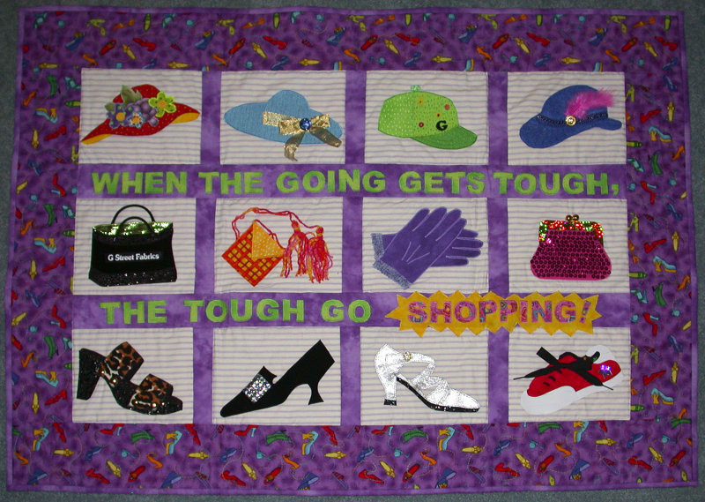

Slide 21
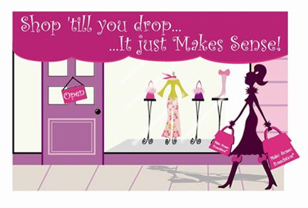

Slide 22
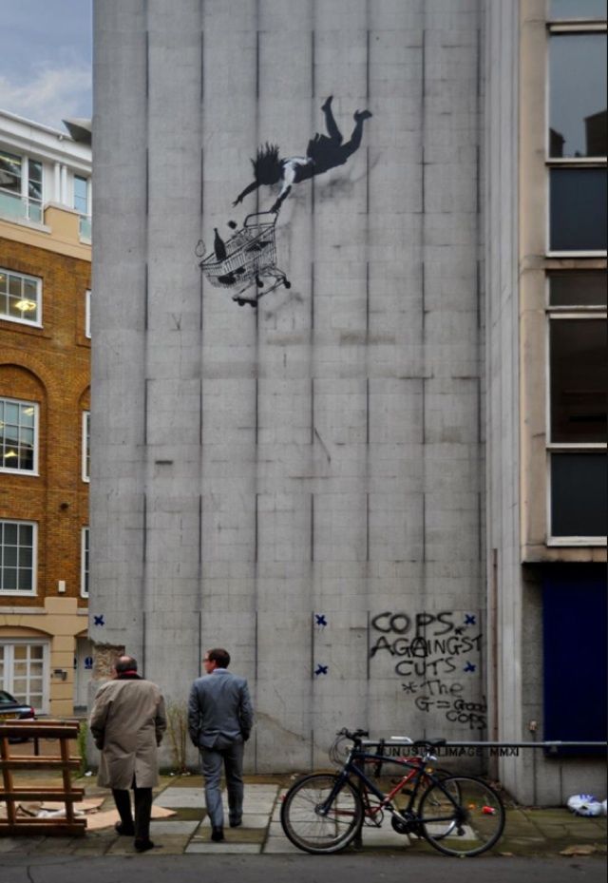
Banksy, ‘Shop till you drop’

Slide 23
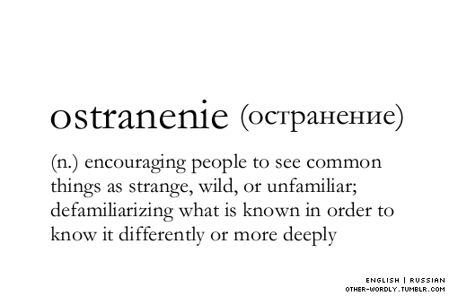

Slide 24

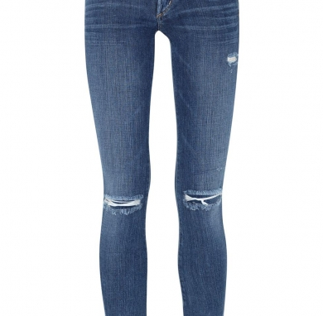
Left: Zara, Medium rise, ripped jean, £29 Right: Harvey Nichols, Citizens of Humanity, £290

Slide 25
‘If commodities could speak, they would say this: our use-value may interest men, but it does not belong to us as objects. What does belong to us, however, is our [exchange-] value. Our own intercourse as commodities proves it. We relate to each other as exchange-values. Now listen how those commodities speak through the mouth of the economist…’ (176-7)

Slide 26
‘To be a well-favoured man is the gift of fortune; but reading and writing comes by nature’
Dogberry to Seacoal in Much Ado About Nothing)
Why does Marx use this exchange?
‘well-favoured’ means good looking or something like that; ‘gift of fortune’ refers to social circumstance: so the sentence can be glossed along the lines of: ‘to be handsome is a matter of education or cultivation; but reading and writing comes by nature’

Slide 27
David Harvey
www.youtube.com/watch?v=gBazR59SZXk

Slide 28
‘For the owner, his commodity possesses on direct use-value. Otherwise, he would not bring it to market. It has use-value for others; but for himself its only direct use-value is as a bearer of exchange-value, and consequently, a means of exchange… All commodities are non-use-values for their owners, and use-values for their non-owners. Consequently, they must all change hands. But this changing of hands constitutes their exchange, and their exchange puts them in relation with each other as values and realizes them as values. Hence commodities must be realized as values before they can be realized as use-values.
On the other hand, they must stand the test as use-values before they can be realized as values…’ (179).

