Slide 1
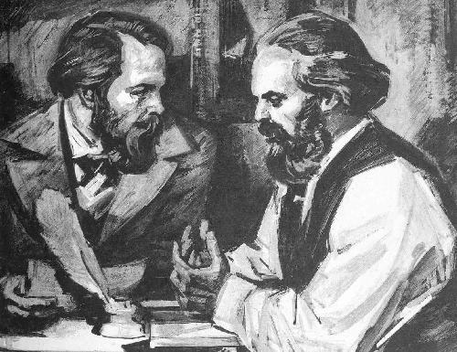

Slide 2
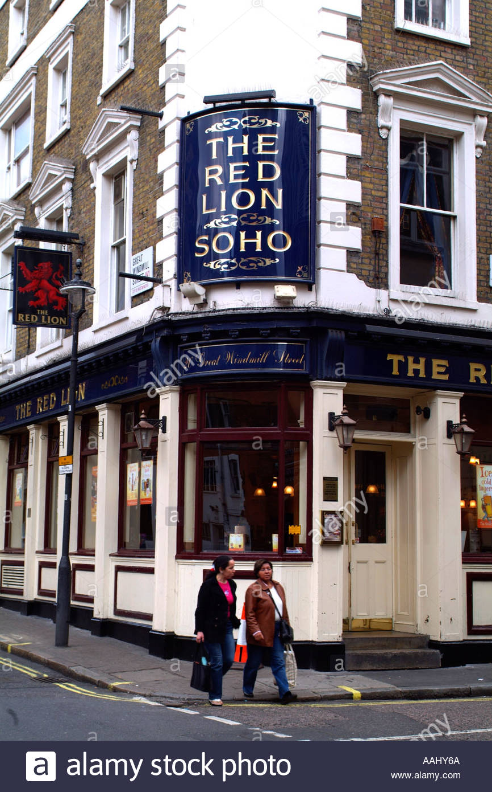

Slide 3
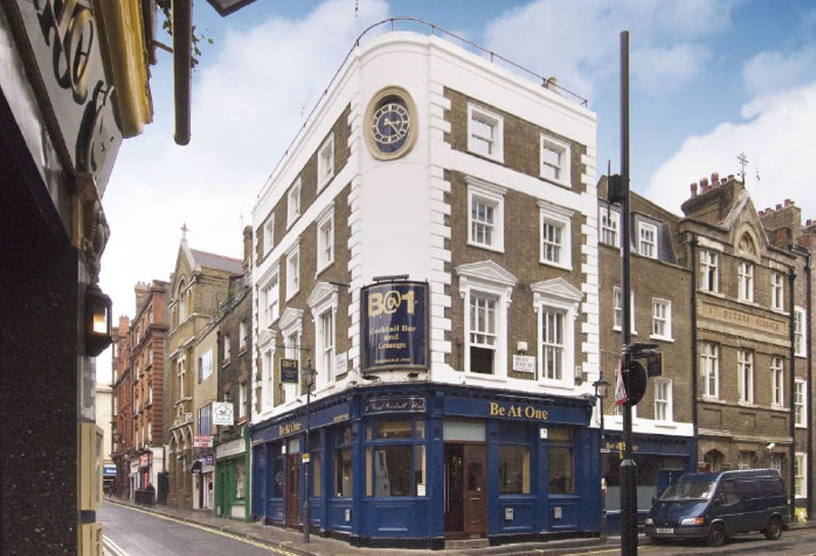

Slide 4
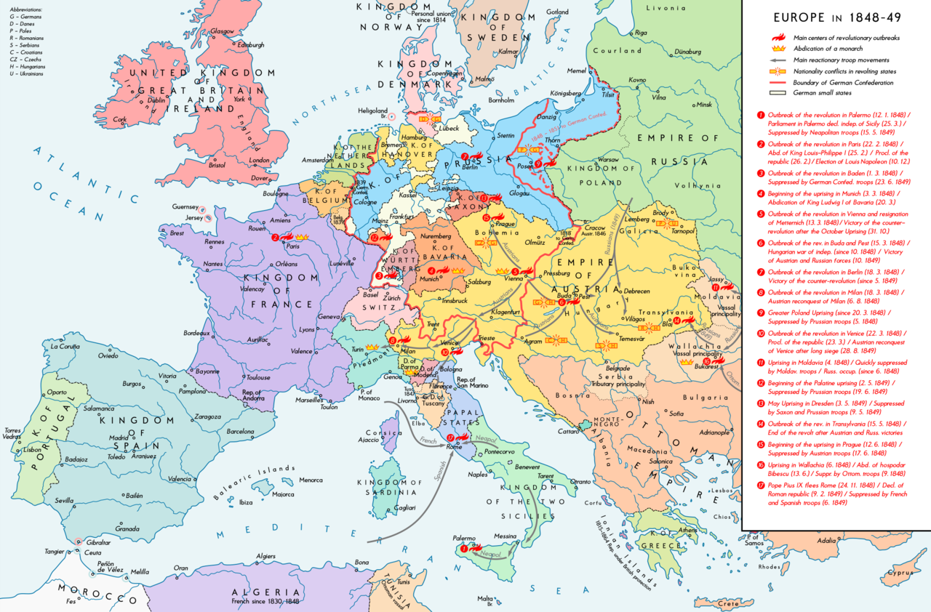

Slide 5
Manifesto of the Communist Party
A spectre is haunting Europe — the spectre of communism. All the powers of old Europe have entered into a holy alliance to exorcise this spectre: Pope and Tsar, Metternich and Guizot, French Radicals and German police-spies.
Where is the party in opposition that has not been decried as communistic by its opponents in power? Where is the opposition that has not hurled back the branding reproach of communism, against the more advanced opposition parties, as well as against its reactionary adversaries?
Two things result from this fact:
I. Communism is already acknowledged by all European powers to be itself a power.
II. It is high time that Communists should openly, in the face of the whole world, publish their views, their aims, their tendencies, and meet this nursery tale of the Spectre of Communism with a manifesto of the party itself.
To this end, Communists of various nationalities have assembled in London and sketched the following manifesto, to be published in the English, French, German, Italian, Flemish and Danish languages.

Slide 6
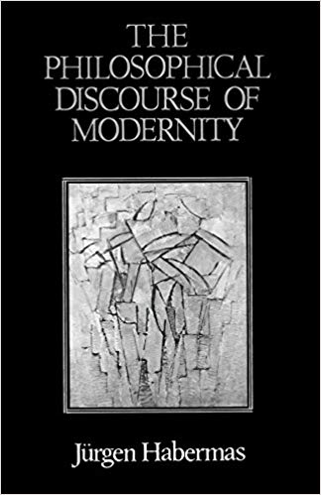

Slide 7
Capitalism is an historical formation
From the serfs of the Middle Ages sprang the chartered burghers of the earliest towns. From these burgesses the first elements of the bourgeoisie were developed.
The discovery of America, the rounding of the Cape, opened up fresh ground for the rising bourgeoisie.
Meantime the markets kept ever growing, the demand ever rising. Even manufacturer no longer sufficed. Thereupon, steam and machinery revolutionised industrial production.
We see, therefore, how the modern bourgeoisie is itself the product of a long course of development, of a series of revolutions in the modes of production and of exchange.
(Marx and Engels, Manifesto of the Communist Party)

Slide 8
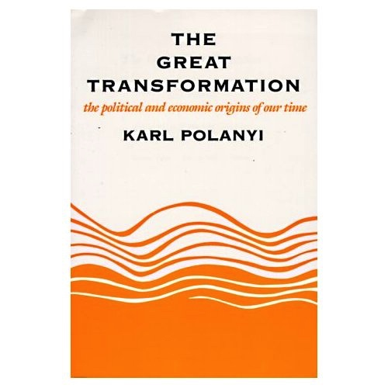

Slide 9
The bourgeoisie, historically, has played a most revolutionary part…
[W]herever it has got the upper hand, [it] has put an end to all feudal, patriarchal, idyllic relations. It has pitilessly torn asunder the motley feudal ties that bound man to his ‘natural superiors,’ and has left remaining no other nexus between man and man than naked self-interest, than callous ‘cash payment.’ It has drowned the most heavenly ecstasies of religious fervour, of chivalrous enthusiasm, of philistine sentimentalism, in the icy water of egotistical calculation. It has resolved personal worth into exchange value, and in place of the numberless indefeasible chartered freedoms, has set up that single, unconscionable freedom – Free Trade. In one word, for exploitation, veiled by religious and political illusions, it has substituted naked, shameless, direct, brutal exploitation.

Slide 10
Whereas in the Christian West the ‘new world’ had meant the still-to-come age of the world of the future, which was to dawn only on the last day… the secular concept of modernity expresses the conviction that the future has already begun: It is the epoch that lives for the future, that opens itself up to the novelty of the future
(Jürgen Habermas)

Slide 11
revolution
progress
enlightenment
emancipation
development
crisis
equality

Slide 12

Modernity and tradition
‘Curious mixes of ancient tradition and modernity co-mingle throughout Africa. In the town of Djibo in northern Burkina Faso, a Fulani family zips by on a motorcyle. The driver’s wife carries a toddler strapped to her back in a centuries-old African fashion’

Slide 13


Slide 14
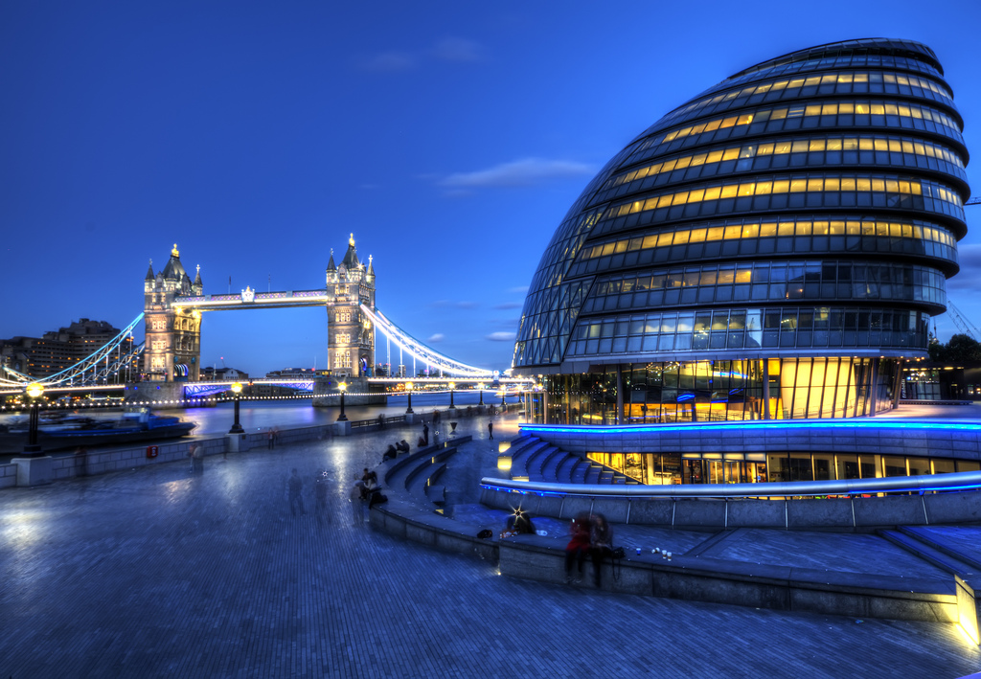

Slide 15
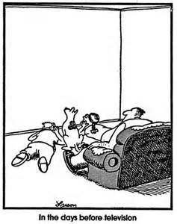
The Far Side (Gary Larson)

Slide 16
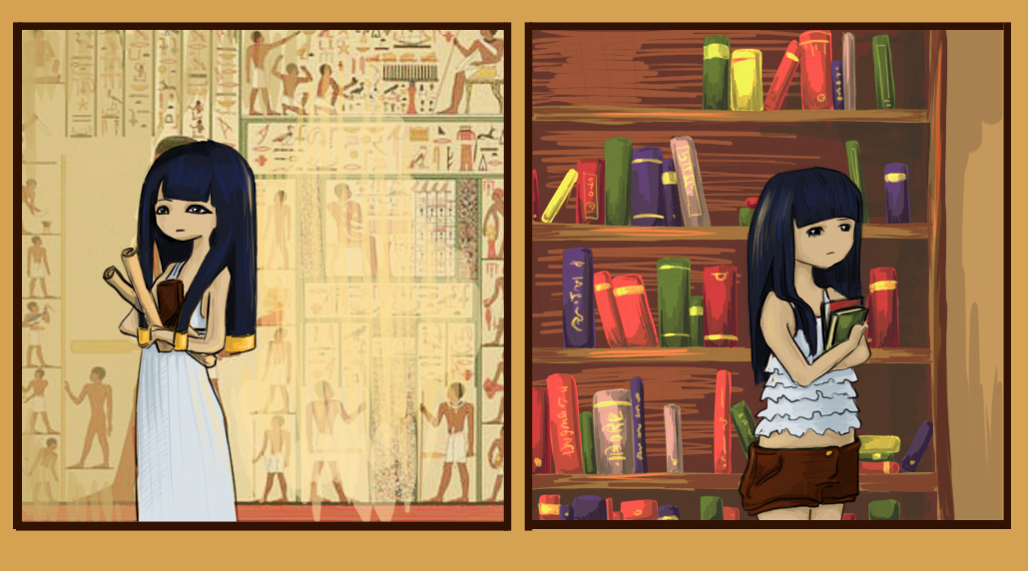
Egypt – Tradition and modernity (Dorea Potter)

Slide 17
Because the new… is distinguished from the old by the fact that it opens itself to the future, the epochal new beginning is rendered constant with each moment that gives birth to the new… [Hegel] dates the beginning of the present from the break that the Enlightenment and the French Revolution signified for the more thoughtful contemporaries at the close of the 18th and the start of the 19th century. With this ‘glorious sunrise’ we come, as the old Hegel still thought, ‘to the last stage in History, our world, our own time’. A present that understands itself from the horizon of the modern age as the actuality of the most recent period has to recapitulate the break brought about with the past as a continuous renewal
(Jürgen Habermas).

Slide 18
Walter Benjamin, ‘The Storyteller’. Illuminations, trans. Harry Zohn (New York: Schocken, 1989 [essay first published, 1936]): 83-109.
‘With the [First] World War a process began to become apparent which has not halted since then. Was it not noticeable at the end of the war that men returned from the battlefield grown silent – not richer, but poorer in communicable experience? What ten years later was poured out in the flood of war books was anything but experience that goes from mouth to mouth. And there was nothing remarkable about that. For never has experience been contradicted more thoroughly than strategic experience by tactical warfare, economic experience by inflation, bodily experience by mechanical warfare, moral experience by those in power. A generation that had gone to school on a horse-drawn streetcar now stood under the open sky in a countryside in which nothing remained unchanged but the clouds, and beneath those clouds, in a field of force of destructive torrents and explosions, was the tiny, fragile human body’ (84).

Slide 19
Eric Hobsbawm, “The Crisis of Today’s Ideologies”. New Left Review 192 (March/April 1992): 55-64.
‘The events of recent years have indeed been spectacular and world-changing – and also unexpected and unpredicted. Yet the revolutionary nature of the period we have been – and are still – living through goes far beyond those changes in global politics which are now making it impossible for cartographers to prepare atlases that will not be out of date in a matter of months. Never before in history has ordinary human life, and the societies in which it takes place, been so radically transformed in so short a time: not merely within a single lifetime, but within part of a lifetime’ (55)

Slide 20
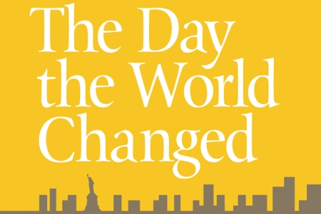

Slide 21
John Bellamy Foster, ‘The Epochal Crisis’ (2013).
‘It is an indication of the sheer enormity of the historical challenge confronting humanity in our time that the worst economic crisis since the Great Depression, sometimes now called the Second Great Depression, is overshadowed by the larger threat of planetary catastrophe, raising the question of the long-term survival of innumerable species – including our own…. I shall use the term “epochal crisis” here to refer to the convergence of economic and ecological contradictions in such a way that the material conditions of society as a whole are undermined, posing the question of a historical transition to a new mode of production. This can be distinguished from the ordinary developmental crises that punctuate the history of capitalism… An even more momentous epochal crisis than the one that produced the transition from feudalism to capitalism, I will argue, is occurring today, arising from the unlimited expansion of a capitalist system geared to a process of abstract wealth creation’.

Slide 22
‘I think it important to challenge the idea of a single and objective sense of time or space, against which we can measure the diversity of human conceptions and perceptions. I shall not argue for a total dissolution of the objective-subjective distinction, but insist, rather, that we recognize the multiplicity of the objective qualities which space and time can express, and the role of human practices in their construction’.
Harvey, p. 203

Slide 23
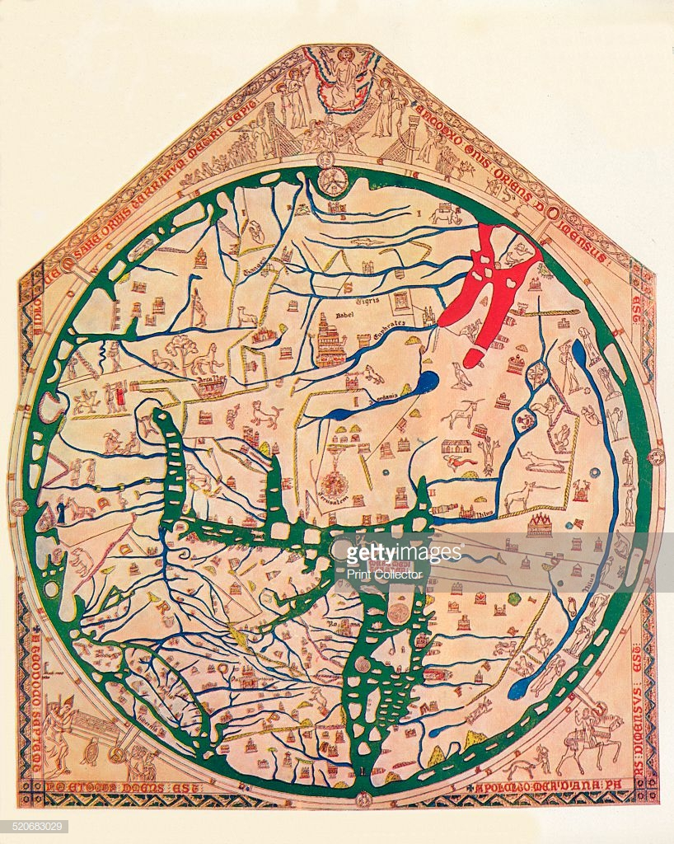
Mappa mundi (Hereford)

Slide 24
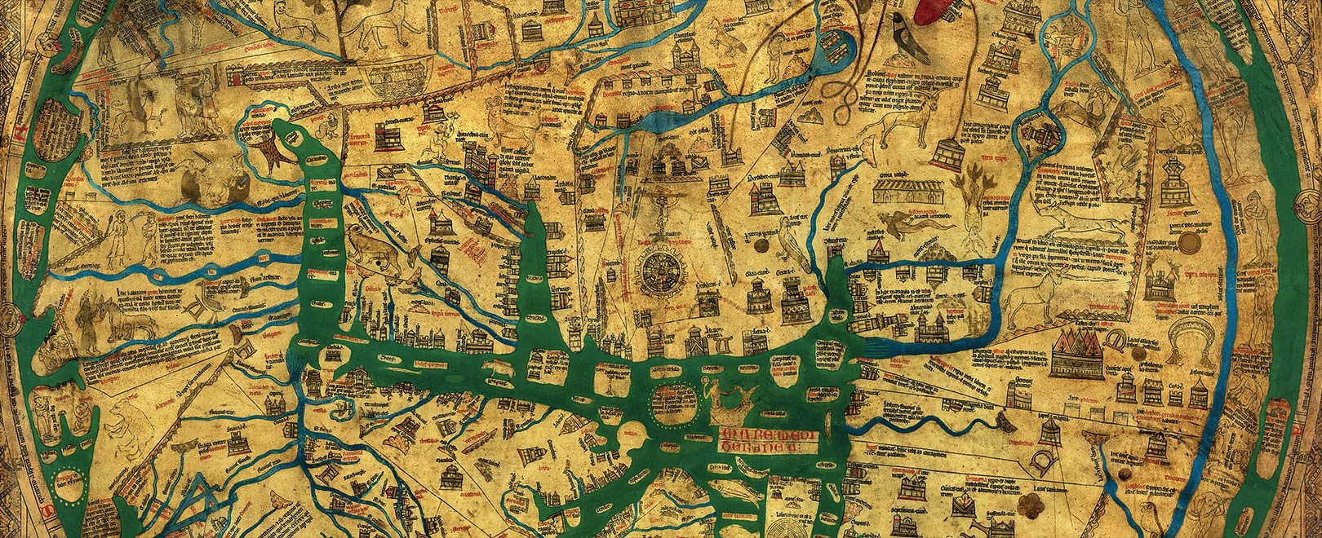
Detail from Mappa Mundi Hereford (showing Jerusalem at centre of map)

Slide 25
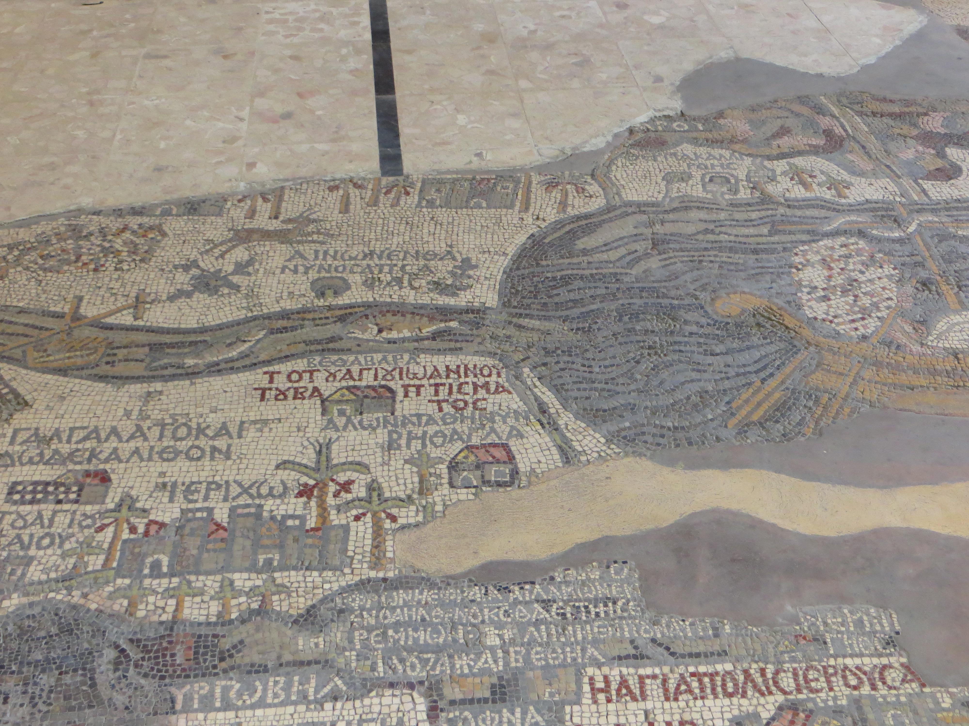

Slide 26
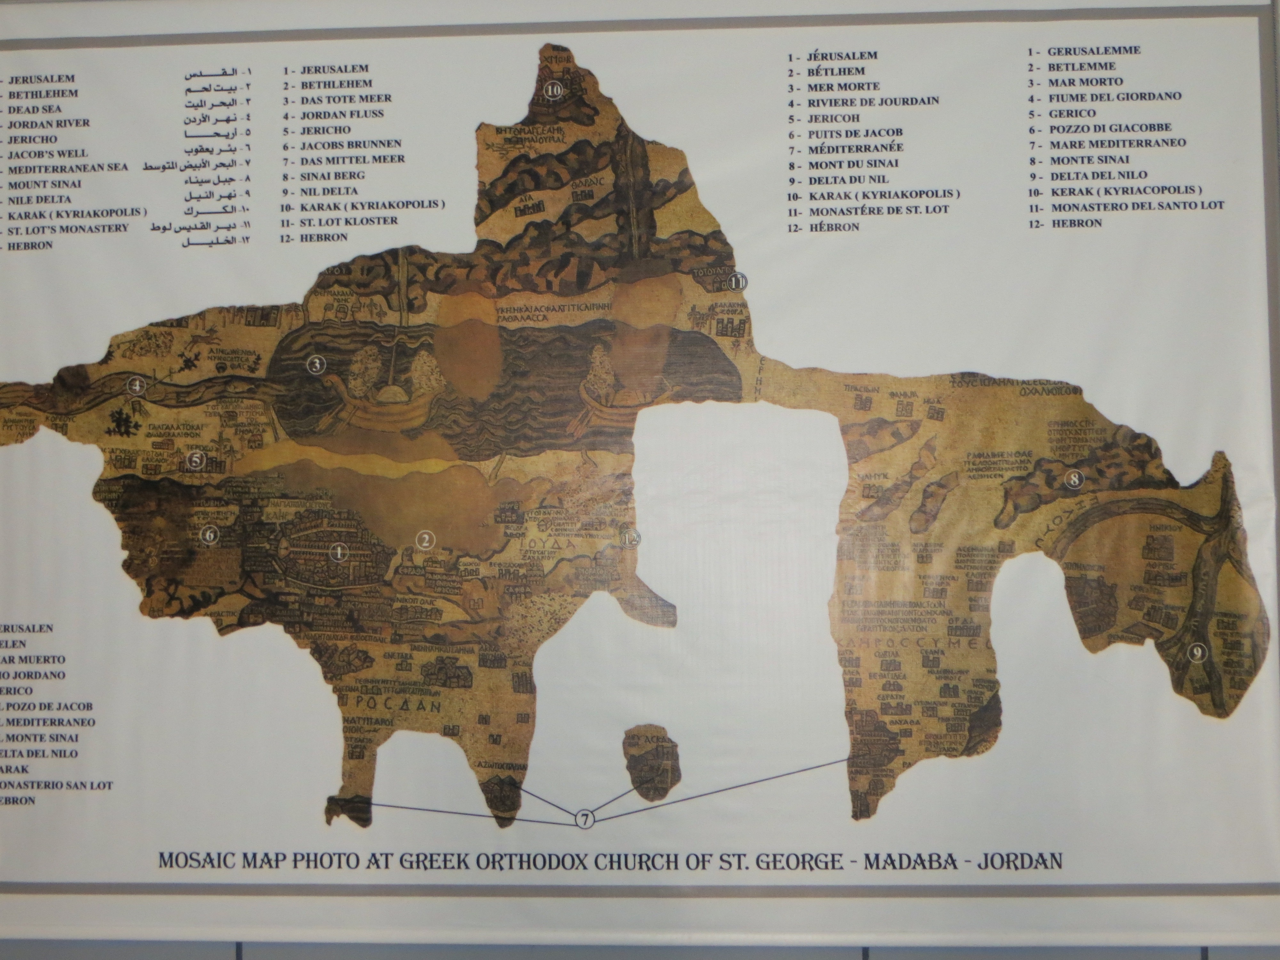
6th century map of Palestine (mosaic, Madaba, Jordan)

Slide 27
‘The conclusion we should draw is simply that neither time nor space can be assigned objective meanings independently of material processes, and that it is only through investigation of the latter that we can properly ground our concepts of the former’ (p. 204).
‘Since capitalism has been (and continues to be) a revolutionary mode of production in which the material practices and processes of social reproduction are always changing, it follows that the objective qualities as well as the meanings of space and time also change’ (p. 204).

Slide 28
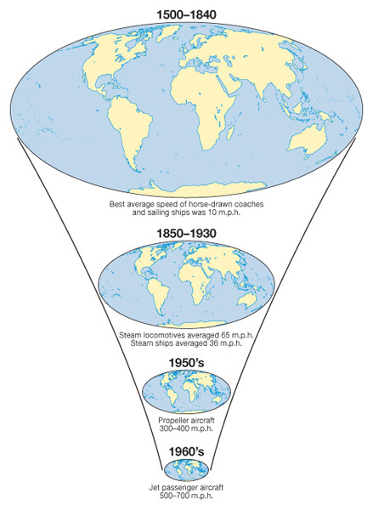

Slide 29
‘Spatial practices derive their efficacy in social life only through the structure of social relations within which they come into play. Under the social relations of capitalism, for example, the spatial practices portrayed in this grid become imbued with class meanings. To put it this way is not, however, to argue that spatial practices are derivative of capitalism. They take on their meanings under specific social relations of class, gender, community, ethnicity, or race and get ‘used up’ or ‘worked over’ in the course of social action’ (p. 223).

Slide 30
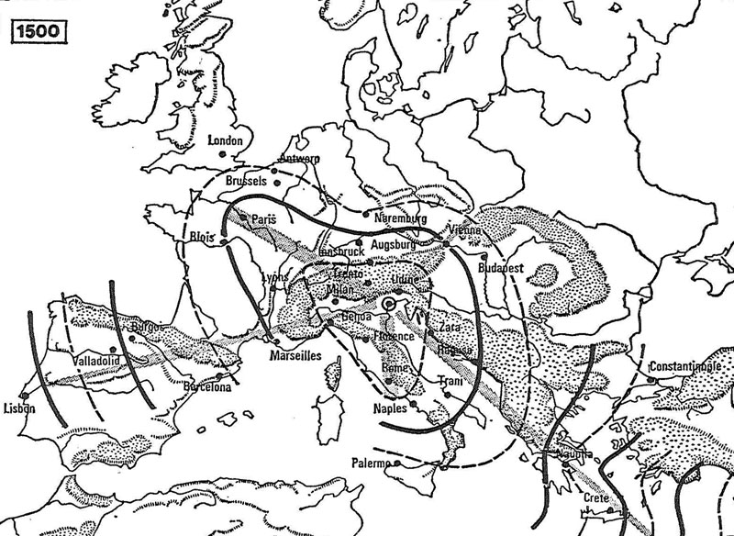
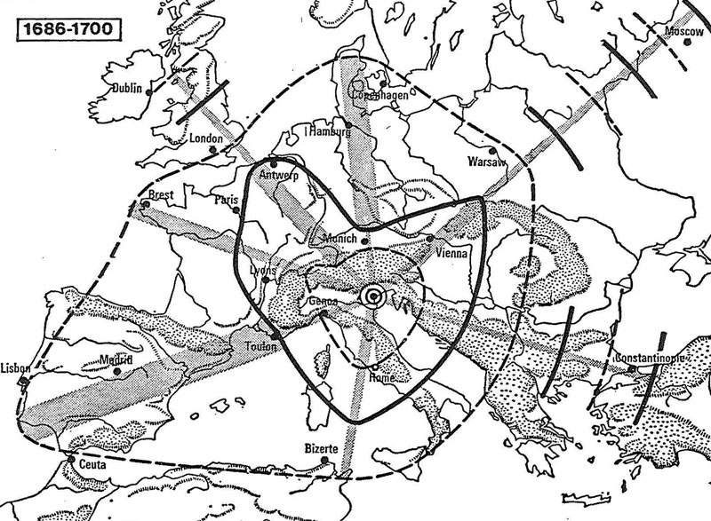
Speed at which news travelled to Venice, 1500 and 1700

Slide 31
‘The general argument I shall explore is that in money economies in general, and in capitalist society in particular, the intersecting command of money, time, and space forms a substantial nexus of social power that we cannot afford to ignore… [T]hose who define the material practices, forms, and meanings of money, time, or space fix certain basic rules of the social game… [I]deological and political hegemony in any society depends on an ability to control the material context of personal and social experience’ (pp. 226-27).
‘[P]rogressive monetization of relations in social life transforms the qualities of time and space’ (p. 228).

Slide 32
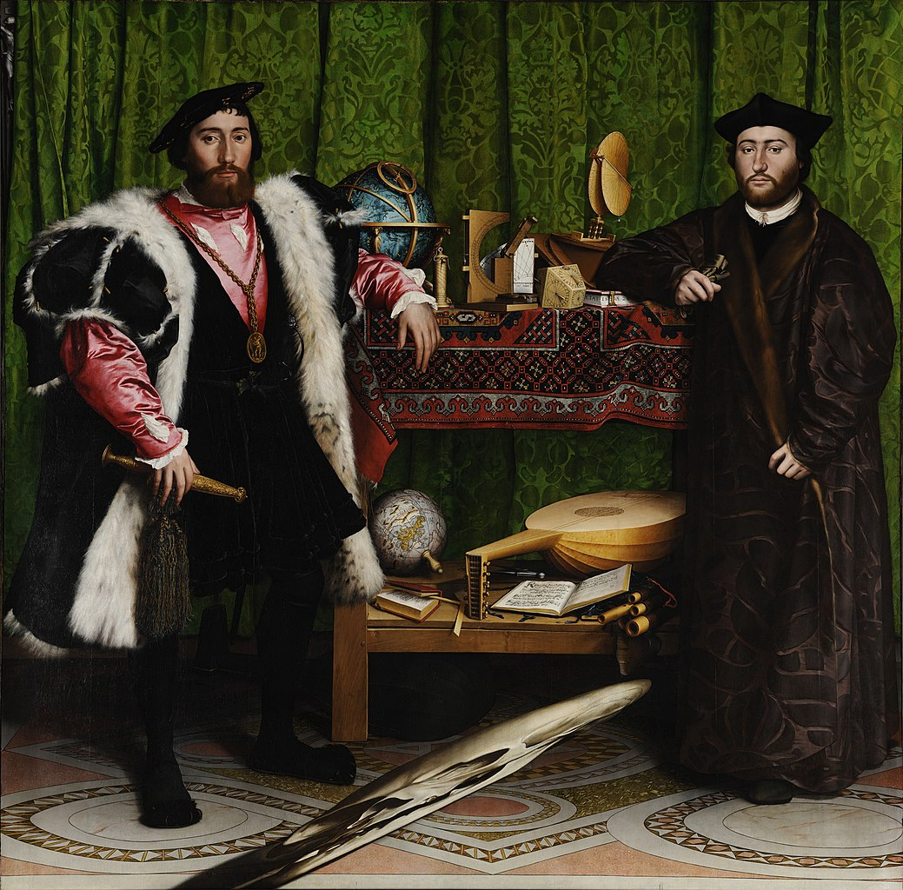

Slide 33
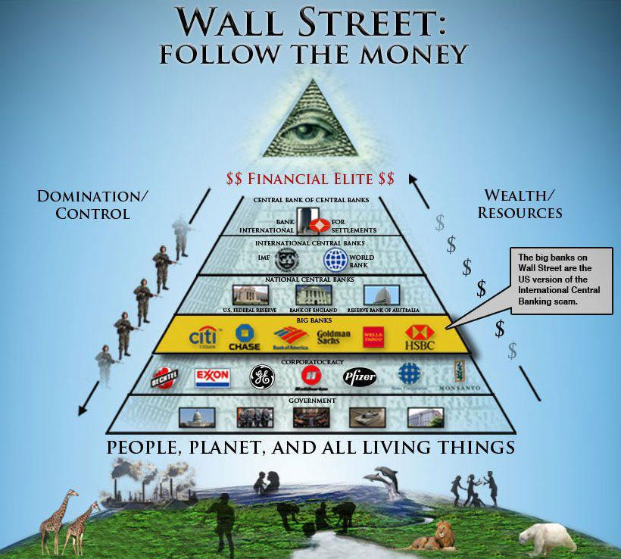

Slide 34
By ‘time-space compression’, ‘I mean to signal… processes that so revolutionize the objective qualities of space and time that we are forced to alter, sometimes in quite radical ways, how we represent the world to ourselves. I use the word “compression” because a strong case can be made that the history of capitalism has been characterized by speed-up in the pace of life, while so overcoming spatial barriers that the world sometimes seems to collapse inwards upon us. The time taken to traverse space… and the way we commonly represent that fact to ourselves… are useful indicators of the kind of phenomena I have in mind. As space appears to shrink to a “global village” of telecommunications and a “spaceship earth” of economic and ecological interdependencies – to use just two familiar and everyday images – and as time horizons shorten to the point where the present is all there is (the world of the schizophrenic), so we have to learn how to cope with an overwhelming sense of compression of our spatial and temporal worlds’ (p. 240).

