Slide 1
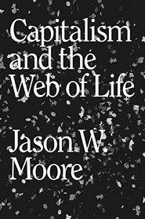
Jason W. Moore, Capitalism in the Web of Life (2015)

Slide 2
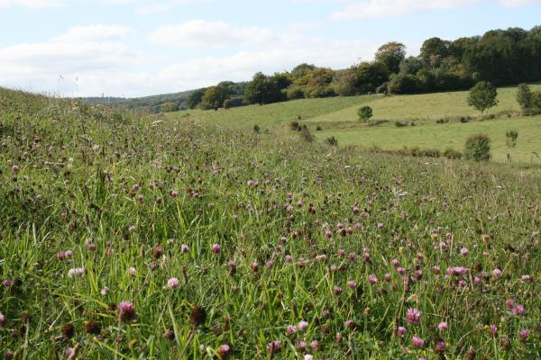
Raymond Williams, “We have mixed our labour with the earth, our forces with its forces too deeply to be able to draw back and separate either out”

Slide 3
“Although the distinction between humans and the rest of nature has a long history that predates capitalism, the construct of Nature/Society is thoroughly modern. The notion that social relations (humans without nature) can be analyzed separately from ecological relations (nature without humans) is the ontological counterpoint to the real and concrete separation of the direct producers from the means of production.” (19)

Slide 4
‘I do not believe “Society” and “Nature” exist, at least not in their dominant usage: humans without nature and nature without humans. Nor do I believe these are mere “social constructions.” They are, rather, abstractions at once violent and real. They are violent, in the sense that they abstract too much reality in the interests of conceptual clarity. And they are real, in the sense that Society and Nature are in fact operative forces, both in our knowledge structures and in capitalism’s actually existing relations of power and production.’ (27)

Slide 5
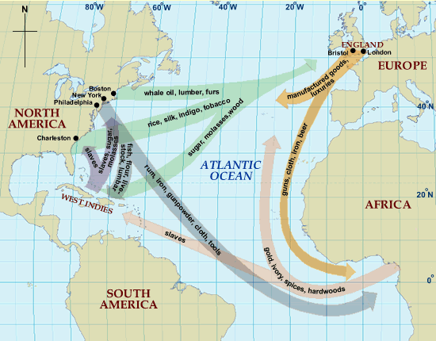

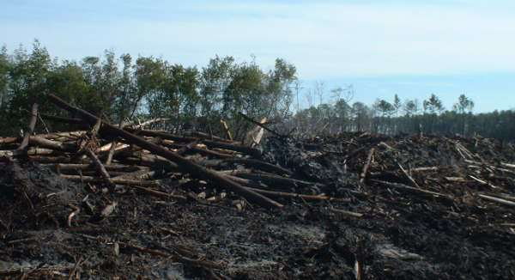
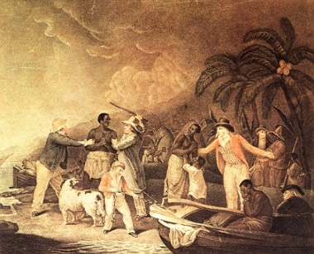
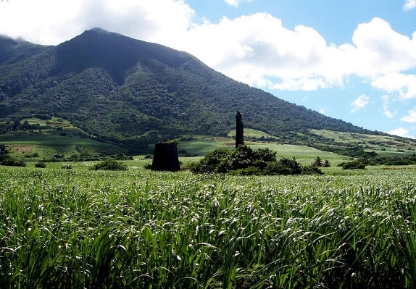

Slide 6







Wage labour / paid work (value)
Unpaid work (unvalued)

Slide 7
“For if the production of capital has been the strategic pivot of capitalism, to an even greater extent accumulation has unfolded through the appropriation of planetary work/energy. Such appropriation—of cheap resources, yes (“taps”), but also of cheap garbage (“sinks”)—does not produce capital as “value”; but it does produce the relations, spaces, and work/energy that make value possible. Capitalism does generalize commodity relations, but the actual extent of such generalization depends on an even greater generalization: the appropriation of unpaid work/energy.” (29)

Slide 8
[Moore’s] analysis rejects a critique based on alienation of labor and nature and the rift in the social metabolism. It paves over the contradiction between an alienated humanity and alienated nature and normalizes received ideology. Moore substitutes for Marx’s complex notion of a “rift in the interdependent process of social metabolism,” what he calls a “singular metabolism of power.” [. . .] The result [. . .] is an all-out denial of Marx’s conception of the “alienated mediation” of the social metabolism of humanity and nature under capitalism.
  John Bellamy Foster and Brett Clark, “Marxism and the Dialectics of Ecology” (Monthly Review, October, 2016: 10)

