Slide 1
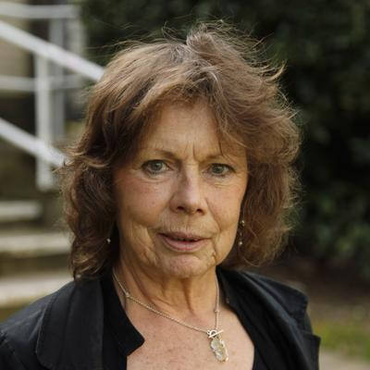
Kate Soper

Slide 2
The body is a cultural form and ‘site’ of ‘disciplinary power’
It is not only materially acculturated (for example, as it conforms to social norms and habitual practices of ‘femininity’ and ‘masculinity’), but also mediated by language: by metaphors (for instance, microbes as ‘invading’, egg as ‘waiting’ for sperm) and semantical grids (such binary oppositions as male/female, inner/outer) that organize and animate our perception and experience
Susan Bordo, Unbearable Weight: Feminism, Western Culture, and the Body

Slide 3
Corollary:
the prevailing configurations of power, no matter how dominant, are never seamless but are always spawning new forms of subjectivity, new contexts for resistance to and transformation of existing relations.

Slide 4
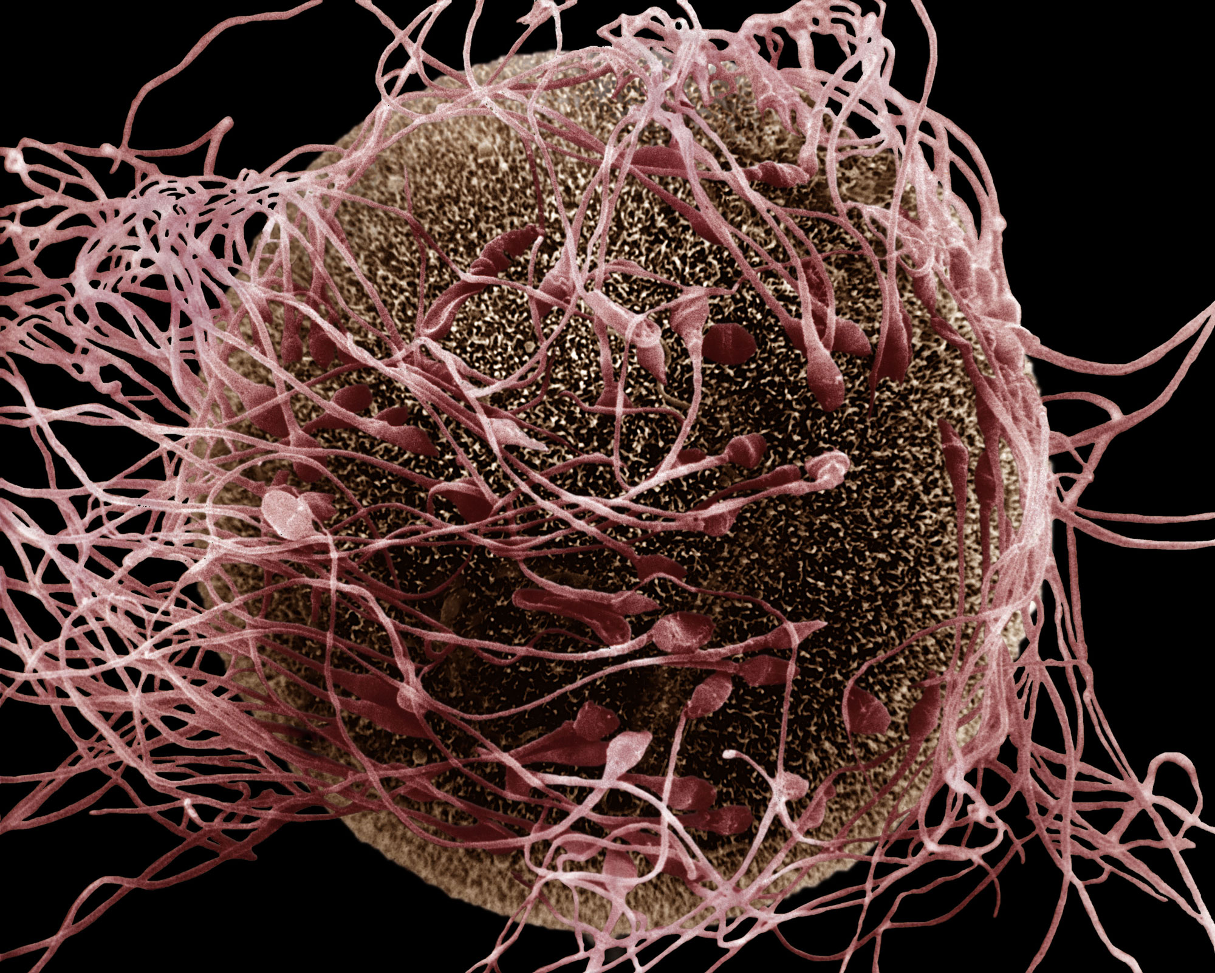
A scanning electron micrograph shows the moment of fertilisation involving a human egg and spermatozoa

Slide 5
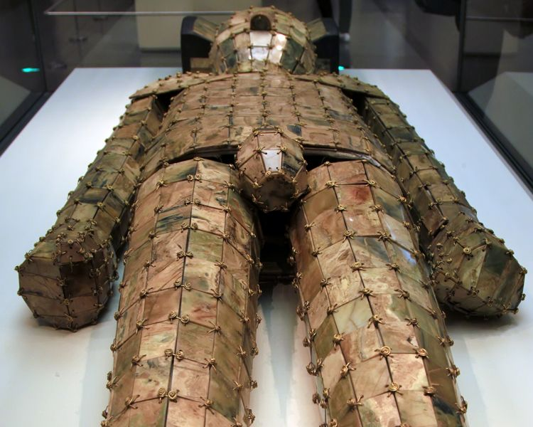
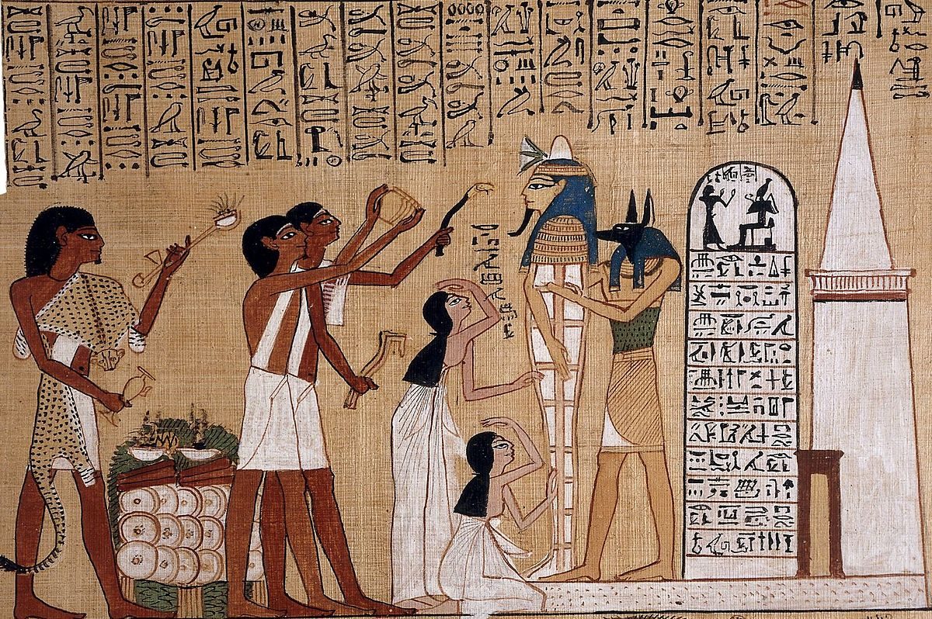
‘There is no life and no death without a relation to some frame’ (Judith Butler)

Slide 6
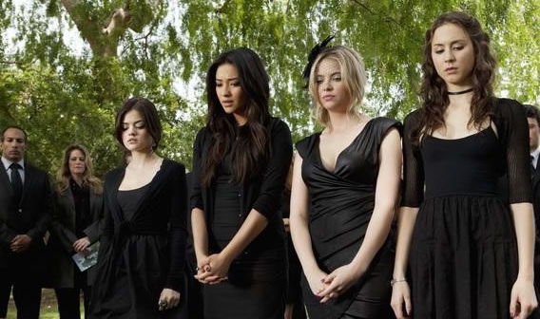
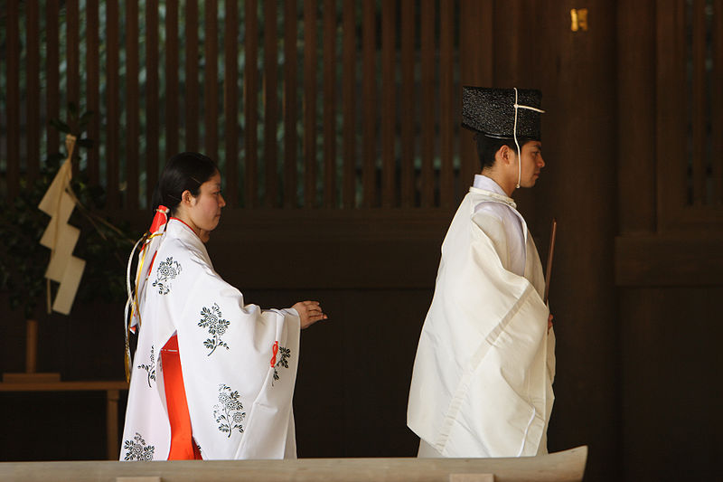
‘There is no life and no death without a relation to some frame’ (Judith Butler)

Slide 7
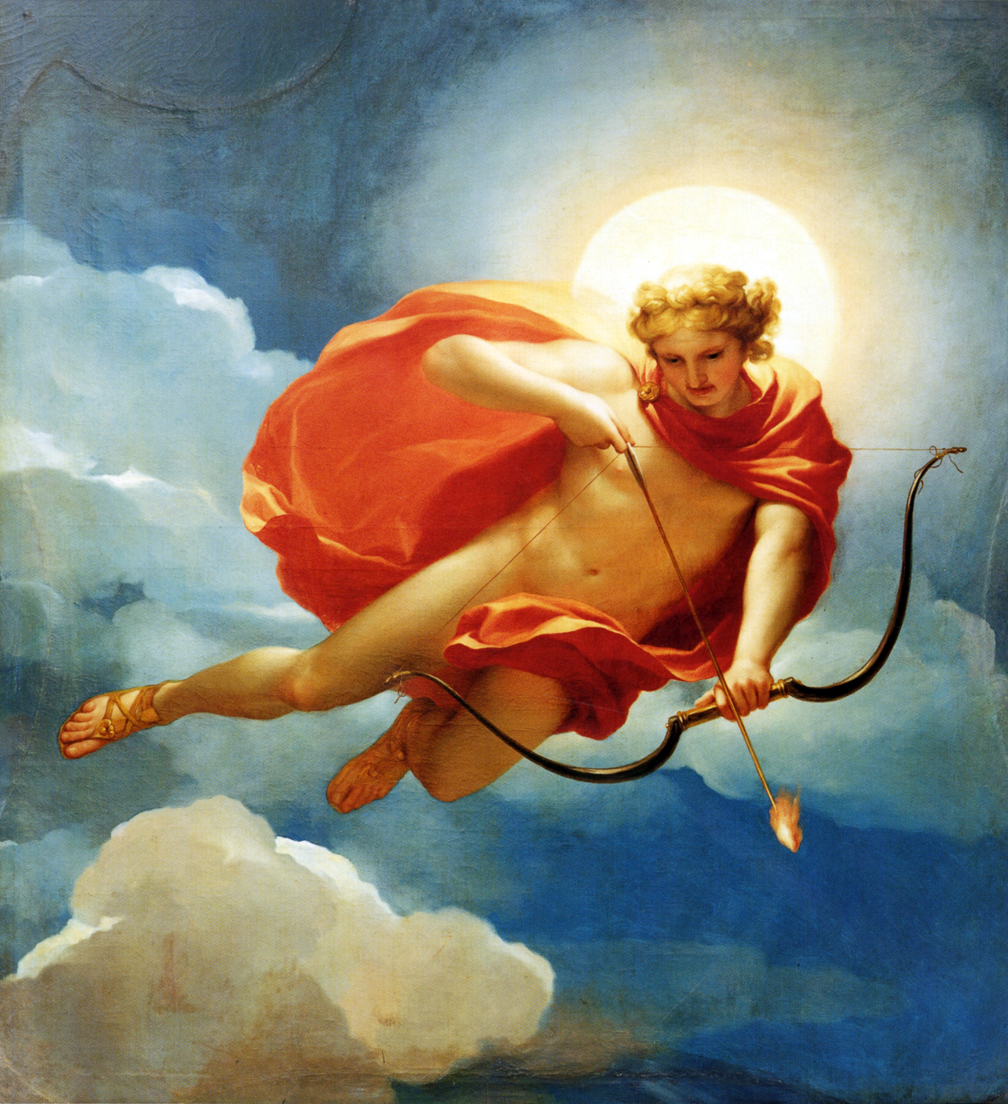
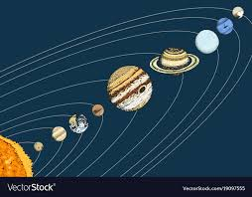
Are the worlds that we and the Greeks live in ‘under the sun’ the same?

Slide 8
‘We…have no direct, innocent, or unconstructed knowledge of our bodies; rather, we are always reading our bodies according to various interpretive schemes’ (Susan Bordo)
‘For many [feminist] scholars the commitment to cultural constructionism has gone far beyond notions that the biological body never presents itself to us in innocent or “natural” form but is always historically and politically “inscribed” and shaped… to the much more radical position that the very notion of the biological body is itself a fiction’ (Susan Bordo).

Slide 9
Constructionism: culture/nature
There is no ‘nature’ external to the cultural discourse that constructs it as such

Slide 10
‘Arguments of this stamp do not object to invocations of nature and biology simply on the grounds of the ideological use to which they have been put in authenticating certain norms of sexual conduct. They refuse to allow that there is any natural dimension at all to human subjectivity, bodily existence or sexual disposition. They are therefore at odds with all those critiques that have focused on the ways in which culture has been gender biased or repressive of bodily need or sexual desire. Contesting though they do the supposed naturality of current sexual practices and institutions, their extreme conventionalism on nature, strictly speaking, denies them any basis either for justifying this critique of existing practice, or for defending the more emancipatory quality of the alternatives they would institute in its place’ (Soper, 129-30)

Slide 11
‘[W]hile we shall always have to live with the consequences of our cultural transformations (or perish as a result of them), nature does not, or only very minimally, determine the modes in which we respond to its limits and potentials. It may “recommend” certain types of action, and it will always have its say in determining the effects of what we do, but it does not enforce a politics… [W]hile biology has dictated that we cannot reproduce ourselves through same-sex relations, it has not dictated the political persecution of those relations, nor, given the persistence and extent of the preference experienced for these, has it ever given us any basis for presenting them as abnormal. Nor, one might add, has it given us any grounds for persecuting homosexuality on the basis of its non-procreative function’ (Soper, 142).

Slide 12
‘Human beings, like all other living creatures, are determined by biology in the sense that they are embodied, mortal entities with specific genetic endowments, and possessed of a particular sexual anatomy and physiology. But relative to other animals, and in part in virtue of their specific biological evolution, they are biologically under-determined in respect of the ways in which they will experience and respond to these conditions’ (Soper, 125-6)

Slide 13
Nature in the ‘realist’ sense: ‘To speak of “nature” in this conception is to speak of those material structures and processes that are independent of human activity (in the sense that they are not a humanly created product), and whose forces and causal powers are the necessary condition of every human practice, and determine the possible forms it can take. Such a concept of nature as the permanent ground of environmental action is clearly indispensable to the coherence of ecological discourse about the “changing face of nature” and the need to revise the forms of its exploitation. But it is also essential to the coherence of any discourse about the culturally “constructed” body and its continually changing gender “significations”’ (Soper, 132-3)

Slide 14
‘...two rather differing ways in which culture may be said to “work” upon nature... those that involve the cultural processing of what is naturally produced and reproduced, and must necessarily exist in some form prior to that cultural work upon it, and those that make use of natural materials to inaugurate a product which previously did not exist. The body is in this sense not a “product” of culture but a creation of nature whose existence is the condition of any cultural “work” upon it, whereas an entity such as a watch comes into being only in and through its “construction”; and while watches are once and for all made as finished products, bodies are not, but remain continuously in the making, either as a consequence of what we deliberately contrive ourselves or as a result of involuntary processes (of ageing, disease, hormonal change, cell-renewal, etc.)’ (Soper, 135-6)

Slide 15
‘What I am trying to highlight here is the conceptual poverty of the constructivist refusal to discriminate properly between those forms of being (bodies, geographical terrain) that are culturally transmuted and those kinds of things (telephones, aeroplanes) that are indeed culturally “constructed” and have a natural existence only in the realist sense that they are constructed out of natural materials (though often highly processed ones). The distinction here is not between forms or entities that have or have not been culturally affected, but between those forms or entities that are natural in the sense that we have no choice but to experience them in some form prior to whatever form we impose upon them, and those that we literally bring into being. Bodies and landscape may be said to be culturally formed in the double sense that they are experienced through the mediation of cultural discourse and representation. But they are not artefacts of culture, and it is no more appropriate to think of bodies and sexualities as the “construct” of cultural practice and discourse than it is to think of the landscape as “constructed” out of agricultural practices or as the discursively constituted effect of Romantic poetry’ (Soper 136-7)

