Slide 1
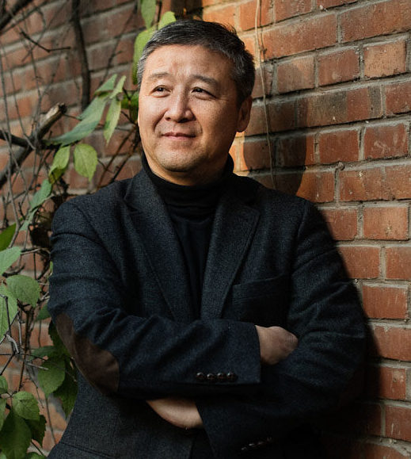
Wang Hui

Slide 2
Unthinking Eurocentrism

Slide 3
The term ‘Eurocentrism’ denotes a world-view which, implicitly or explicitly, posits European history and values as ‘normal’ or modal (and usually as superior to others), thereby helping to produce and justify Europe’s dominant position within the global capitalist world system. At the heart of Eurocentrism lies a binary way of thinking that constructs a white, progressive, modern and civilised European identity and juxtaposes it to a black/indigenous, undeveloped, traditional, or barbarian Other. Most prominently, the concepts of modernity, progress and universal history have been identified as inherently ‘European’ in their provenance. The standard account, as presented in encyclopaedias and conventional histories, captures modernity in terms of a self-contained European process of moral and economic progress.

Slide 4
‘The West’ is an historical, not a geographical construct. By ‘western’ we mean… a society that is developed, industrialized, urbanized, capitalist, secular, and modern…Nowadays, any society which shares these characteristics, wherever it exists on a geographical map, can be said to belong to ‘the West’. The meaning of this term is therefore virtually identical to that of the word ‘modern’.
Stuart Hall

Slide 5
For the first time in all human experience the world revolution of Westernization brought together, in inescapably intimate and virtually instant interaction, all the peoples of the world, regardless of their prior cultural evolution or their capacity – or incapacity – for peaceful coexistence. Within a brief time, essentially within half a century, they were thrust into a common harness, against their will, by a small minority commonly called “The West” – the peoples of Western Europe and their descendants in North America. As a result, the human condition in the present and the future can only be understood within the framework of the Westernized world.
Theodore von Laue, The World Revolution of Westernization (1987)

Slide 6
This massive confluence of the world’s peoples, infinitely exceeding in intensity all previous interdependence and transforming the world’s ecosystem on which human life depends, was started by irresistible force, by guns, supported by a vast and complex array of cultural skills, adding up to an overwhelming political presence that excelled also in the arts of peace. In creating an interdependent world through conquest, colonization, and expanded opportunities for all, that Western minority imposed its own accomplishments as a universal standard to which all others, however reluctantly, had to submit
(von Laue).

Slide 7
‘The Europeans’ exploited the world’s resources, hitherto mostly dormant, for their own gain; they enlisted the prowess and resilience of people around the world to make themselves masters. The will to power and the capacity for taking advantage of all opportunities for their own aggrandizement… sprang from Europe, from the hothouse competition among the Europeans themselves. In expanding around the world and enlarging their base from Europe into ‘the West’, they foisted their singular qualities on the unwilling and unprepared majority of humanity, dynamically transforming the entire world in their own image and establishing a hierarchy of prestige defined by the success of imitation.

Slide 8
Western civilization emerged in the eighth and ninth centuries and developed its distinctive characteristics in the following centuries. It did not begin to modernize until the seventeenth and eighteenth centuries. The West was the West long before it was modern. The central characteristics of the West, those which distinguish it from other civilizations, antedate the modernization of the West.
(Samuel Huntington, The Clash of Civilizations and the Remaking of World Order (1998)

Slide 9
Huntington reifies civilizations into culturally homogenous and spatially mappable entities, insists on drawing impassable boundaries between them, and proposes a fortress EuroAmerica to defend Western civilization against the intrusion of… unassimilable Others. What is remarkable about his views is his disavowal of the involvement of the “West” in other civilization areas… [Huntington erases] the legacies of colonialism, [insisting] that whatever has happened in other societies has happened as a consequence of their indigenous values and cultures.
(Arif Dirlik)

Slide 10
From the standpoint of the Eurocentric thinker, ‘the European West is not only the world of material wealth and power, including military might; it is also the site of the triumph of the scientific spirit, rationality, and practical efficiency, just as it is the world of tolerance, diversity of opinions, respect for human rights and democracy, concern for equality – at least the equality of rights and opportunities – and social justice. It is the best of the worlds that have been known up until this time’.
Amin adds that the first of the theses elaborated here – that concerning the material wealth and power of the ‘West’ – is, in the Eurocentric imagination, ‘reinforced by the corollary thesis that other societies... have nothing better to offer on any of the levels mentioned (wealth, democracy, or even social justice). On the contrary, these societies can only progress to the extent that they imitate the West... Consequently, it becomes impossible to contemplate any other future for the world than its progressive Europeanization... The progressive Westernization of the world is nothing more than the expression of the triumph of the humanist universalism invented by Europe’.
(Samir Amin, Eurocentrism)

Slide 11
For nearly six centuries now western Europe and its diaspora have been disturbing the peace of the world. Enlightened, through their Renaissance, by the learning of the ancient Mediterranean; armed with the gun, the making of whose powder they had learned from Chinese firecrackers; equipping their ships with lateen sails, astrolabes and nautical compasses, all invented by the Chinese and transmitted to them by Arabs; fortified in aggressive spirit by an arrogant, messianic Christianity of both the popish and Protestant varieties; and motivated by the lure of enriching plunder, white hordes have sallied forth from their western European homelands to explore, assault, loot, occupy, rule and exploit the rest of the world. And even now, the fury of their expansionist assault upon the rest of us has not abated.
Chinweizu, The West and the Rest of Us (1975)

Slide 12
Europe pioneered industrial capitalism, her demands upon the resources of the world increased tremendously. In addition to obtaining spices for her tables and manpower for her mines and plantations in the Americas, Europe set out to seize for her factories the mineral and agricultural resources of all the world. Her need to take African manpower to the Americas declined. She needed instead to put African labor to work in Africa, digging up for her the riches of African mines. The trading companies that had for centuries bought and sold on Africa’s coast were found inadequate for seizing and carting off the raw materials of the African hinterland. Europe now felt a need to export her power into Africa’s interior to reorganize the farms, mines and markets for Europe’s greater profit. Her adventurers banded together, obtained charters from their national governments, and came to seize the African markets from the African middlemen with whom for centuries Europe had been content to trade.
(Chinweizu)

Slide 13
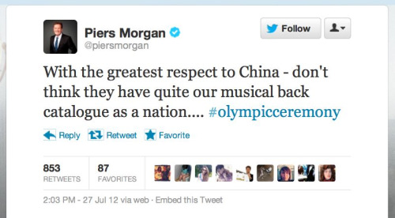
Unthinking Eurocentrism

Slide 14
‘In the introduction (导论), I seized upon an imbricated opposition of tianli (heavenly principles) and gongli (the axiomatic) to understand the modern worldview and core knowledge system. Then I employed these to link vast and complex political, economic, cultural, and social questions. As [Hans- Georg] Gadamer has said, “No matter how much dispute surrounds the period of its emergence or origin, the concept of modernity is first explicitly defined as a scientific and methodological fresh concept. It took shape initially as part of Galileo’s (伽里略) field of study, and then the first to establish the idea in philosophy was Descartes (笛卡尔).” The concept of the modern had a decisive influence not only in philosophy but in all disciplines. The Enlightenment movement believed that the particular character of scientific epistemology transcended all cultural traditions, religious backgrounds, political systems, and ethical structures and was a universally sanctioned principle. According to [Alasdair] MacIntyre (麦釒泰尓), “the Enlightenment design is incarnated politically in the central manifestoes of the American and French Revolutions. Among philosophers, Hume (休慔), Diderot (狄德罗), Bentham (边沁), and Kant (康 徳) et al. expounded on these principles theoretically.” Under what historical conditions did this worldview and intellectual genealogy take hegemonic form? What are its internal features? When you ponder these larger issues, the science question becomes a complex question of the scientific worldview’.

Slide 15
‘There is one thread running throughout The Rise of Modern Chinese Thought and that is the interaction between knowledge and system, as for instance, between tianli and the local bureaucracy (郡县制), gongli and modern nationalism and its related systems, and so on. What I have done is not a history of ideas. If there is one sentence that epitomizes my method, it is this: I strove to liberate the object of my study from its position as an object and to make it bolster my reflections and exploration. In research, the object of study is structured point of view, which I employ to investigate our limitations’.

Slide 16
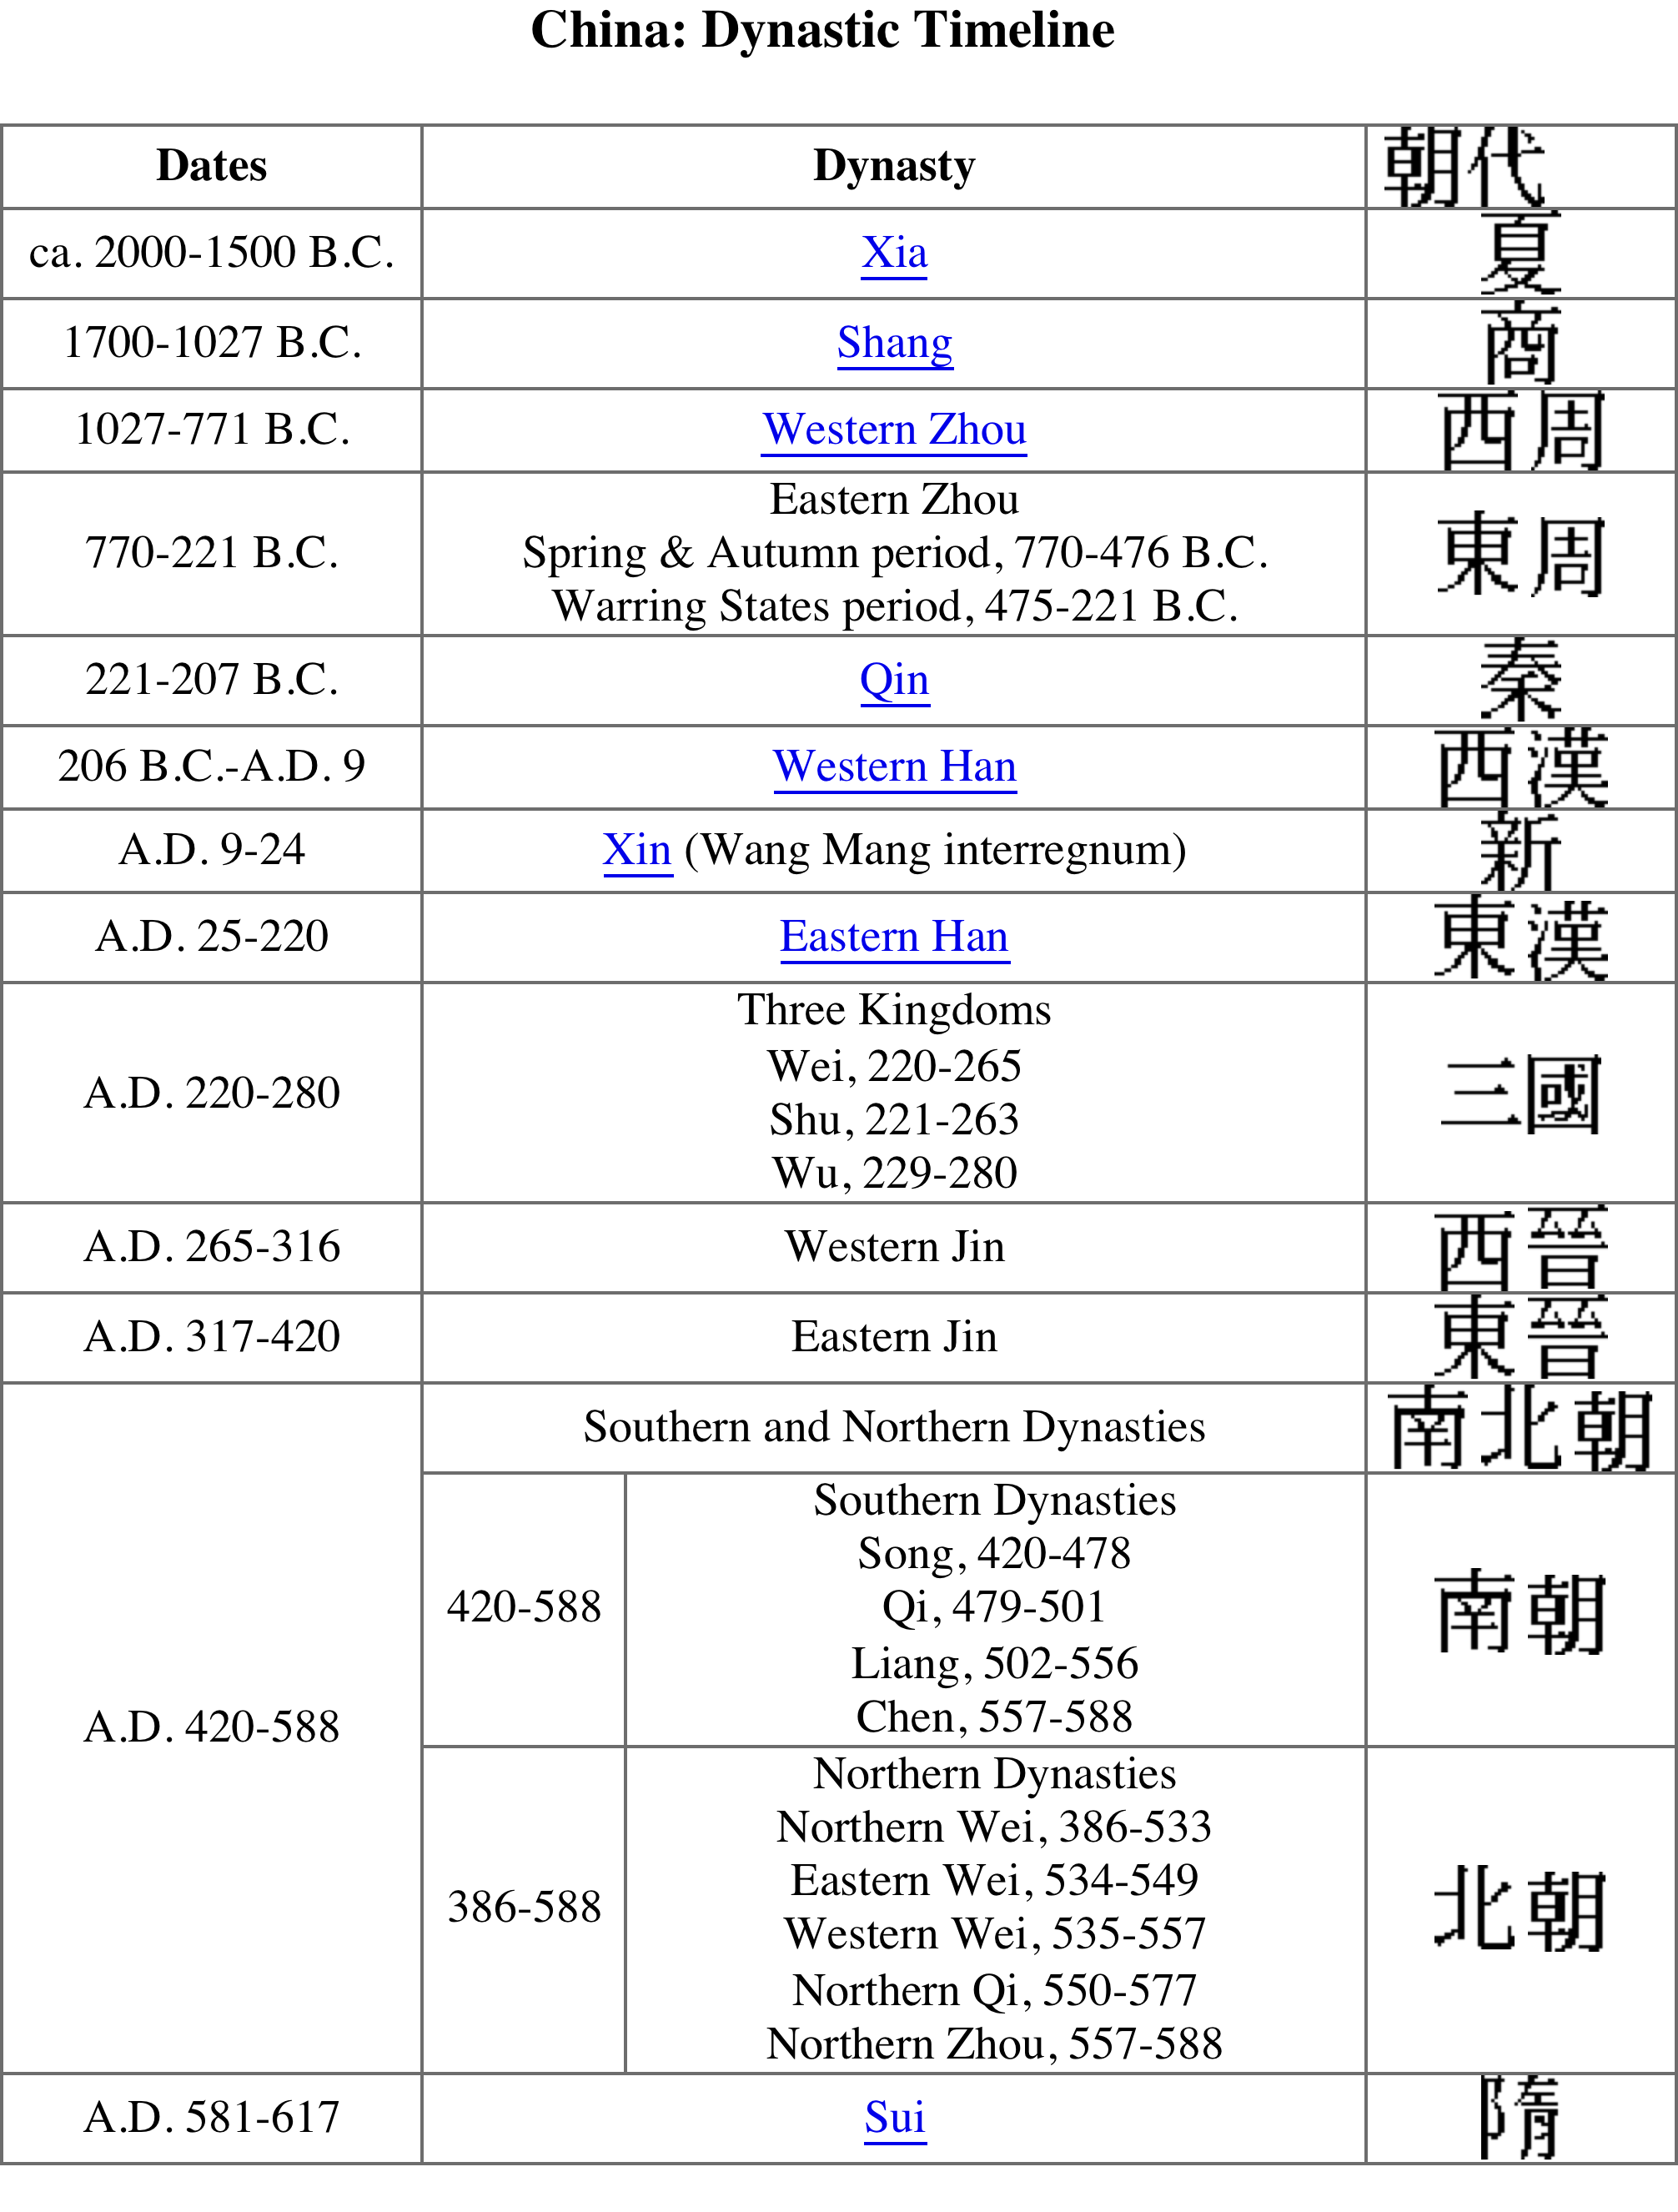

Slide 17
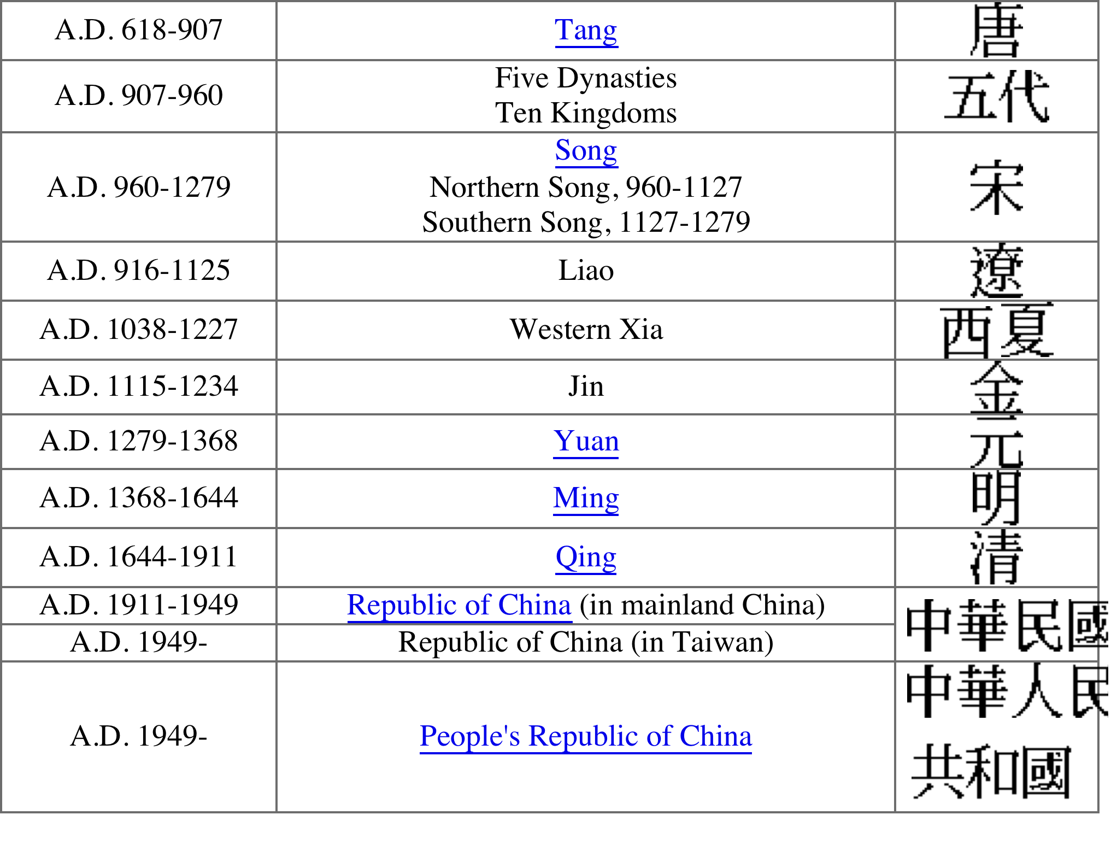

Slide 18
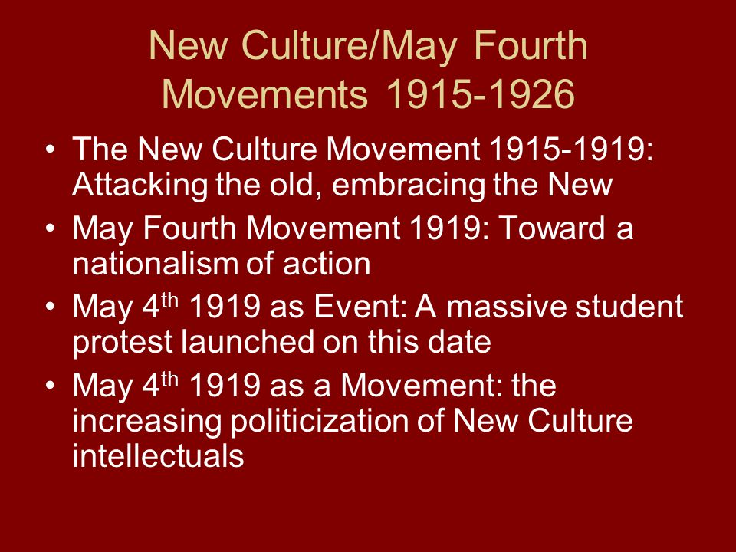

Slide 19
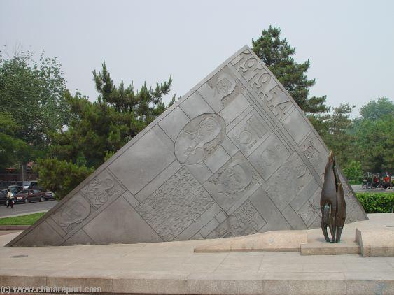

Slide 20
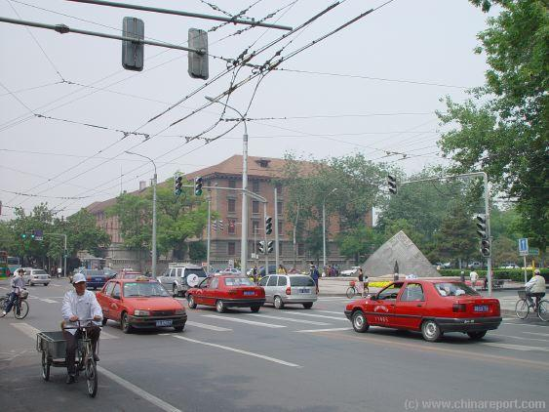

Slide 21
‘There are two important disadvantages with methods of philosophical history. One is that it uses Western philosophy’s categories and concepts to try to understand Chinese structures of thought, so in the comparative structure itself there is a distortion of Chinese thought. Second, there is an overemphasis on the continuities of the history of ideas and the relationship between its key categories, while it is relatively rare to find an analysis of the historical conditions under which these concepts, categories, and basic propositions have been structured. The social historical method is highly concerned with thought and modes of production, sociopolitical relations; this is its most powerful aspect. But in this sort of research it is easy to meet with two profound difficulties. The first is that social history methodology is at base an outcome of a specific modern worldview, which means that from its methodological vantage point it is not possible to provide a genuine depiction of the significance of the social change or evolution itself; second, when the method of social history is used to establish the relationship between thought and society, and it is easy when the social history method establishes the relationship between thought and society. It is easy to lapse into a determinist structure in which the function of ideas as a constructive power is overlooked’.

Slide 22
‘we cannot simply understand the historical development of ancient society by using nineteenth- and twentieth-century principles of classification…In early Confucianism, economics, military, education, and so on were all considered as organic components of “rites and music.” It was only in relation to the category of rites and music that their significance could be revealed. No matter whether it was the well-field [land-distribution] system or the school, no matter if it was managing political affairs or ways of behaving, we have no way of understanding the “historical significance” of these things if we depart from the framework of rites and music. If we say that the category of economics in modern society includes politics, law, ethics, and other kinds of meaning, and cannot be understood as a simplistic notion, so the category of rites and music also includes every aspect of politics, economics, law, ethics, and so on within itself, and cannot be defined according to categories of rites, morality, and ethics in modern knowledge’.

Slide 23
‘I am not saying that we should abandon the discussion of social history or veer sharply off into a purely conceptual historical method or completely spurn the spirit of our own times. Instead, it is to demand that we liberate our research object from the status of object, which would enable a methodological vision that allows us to investigate ourselves and our times and provide a new angle on conditions of knowledge’.
‘when we liberate the object from its object status, can we still really describe so-called “modernity”? My objective in proceeding with this sort of vast structural description of “modernity” is not to fix the significance of modernity temporally but to undermine the self-description of this modernity and to inspire our thinking on the rise of Chinese modern thought as such’.

Slide 24
A friend once asked me, Why is it that when you are analyzing Chinese questions you do not use tianxia, an indigenous or “Confucian” concept, and hold onto the word empire? First off, only after my critique of nineteenth century political economy and the twentieth-century binary of “empire and nation,” and only after I teased out the significance of this term in the Chinese language, did I use the concept of “empire.” During the nationalist wave at the end of the nineteenth century, the word empire was already a part of Chinese thought and had a conceptual genealogy. From then on it became a category of Chinese thought through the processes of conceptual translation. We cannot consider this concept or word as extrinsic to Chinese thought. Second, the term tianxia has a foundation not limited to Confucianism but related to the natural universe in Chinese thought and the world of rites and music, dated to antiquity. We can also find similar expressions in other civilizations, such as in Christian and Islamic representations of universalisms similar to the concept of tianxia. At this level, to consider tanxia as representative of the uniqueness of China might not be the product of profound reflection… The category of empire, on the other hand, is a precise description of the entity of political economy, which is not the same as tianxia. Tianxia is a form of self-expression based on a kind of universalism.

Slide 25
‘My research provides historical insight into questions such as What is China? What is modernity in China? and What is the historical significance of Chinese thought? My writing includes two questions that are intimately related to modernity: (1) What is Chinese identity? This question reflects on tendencies of social division inherent in modernity, it is also an exploration of the historical dialectic of diversity and identity; and (2) How do we understand modern social relations and their developmental trends, not only the concentration of power in modernism, but also what in Chinese thought overcomes this trend?’

