Slide 1
The Conquest of Granada, 1670-1671
John Dryden

Slide 2
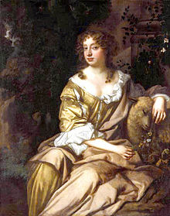
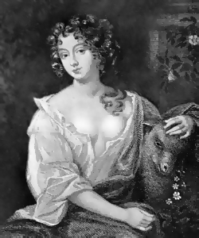
Nell Gwynne (1650-1687). Almahide

Slide 3
Rebecca Marshall, 1660-1683. Lyndaraxa
She was primarily known for her portrayal of tempestuous, passionate women, usually in tragedies. For example, she played the queen of Sicily in John Dryden's Secret Love (1667), Lyndaraxa in both parts of Dryden's The Conquest of Granada (1670–71), Fulvia in William Joyner's The Roman Empress (1670), and Calphurnia in Shakespeare's Julius Caesar (c.1672). The roles usually offset those played by another actress of the same company, Elizabeth Bowtell. Numerous rival pairs were written so the company could take advantage of the contrast between Marshall's fiery characters and Bowtell's sweet ones (demonstrating how contemporary playwrights deliberately created roles to match the strengths of individual company players). For example, Marshall played Olivia against Bowtell's Fidelia in William Wycherley's The Plain Dealer (1676), and she played Roxana against Bowtell's Statira in Nathaniel Lee's The Rival Queens (1677).

Slide 4
Elizabeth Boutell, (1648/9–1714/15). Benzayda
Mrs Bowtell was a talented actress, popular with audiences and dramatists alike. Dryden wrote several roles for her, aside from Sabina in Secret Love: Donna Theodosia in An Evening's Love (1668); Benzayda in The Conquest of Granada (1670/1671); Melantha in Marriage a-la-mode (1671); Laura in The Assignation (1672); and Cleopatra in All for Love (1677). William Wycherley gave her two of his greatest female roles, Margery Pinchwife in The Country Wife (1675) and Fidelia in The Plain Dealer (1676).
Whether deserved or not, Mrs Bowtell had a reputation for promiscuity. One lampoon called her 'chestnut-maned Boutell, whom all the Town fucks' (Wilson, Court Satires, 206). Edmund Curll, in his memoir of Thomas Betterton, noted that 'besides what she saved by Playing, the Generosity of some happy Lovers enabled her to quit the Stage before she grew old' (Curll, 21). Her stage roles also capitalized on her sexual appeal. In Thomas Duffett's play, The Spanish Rogue (London, 1674), her character is told she should 'know, you'r beauty can Command so large a pow'r ore any heart' (ibid., 16). Curll says 'she was low of Stature, had very agreeable Features, a good Complexion, but a Childish Look. Her Voice was weak, tho' very mellow; she generally acted the young Innocent Lady whom all the Heroes are mad in Love with' (ibid., 21).

Slide 5
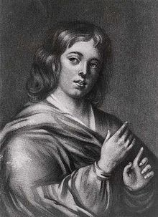
Edward Kynaston (c.1643-1712), Boabdelin
His roles at Vere Street and the new theatre in Bridges Street, Covent Garden, where the company moved in 1663, included Roseilli and Caraffa in John Ford's Love's Sacrifice, the idealistic Acacis in John Dryden's and Robert Howard's Indian Queen, the flawed leader Mahomet Boabdelin in both parts of Dryden's The Conquest of Granada, and the excessively honourable Guymor in his The Indian Emperor, and the title role in Orrery's The Black Prince. He also managed young comedic leads such as Peregrine in Jonson's Volpone, Valentine in William Wycherley's Love in a Wood, and probably Volscius in the duke of Buckingham's The Rehearsal.

Slide 6
Charles Hart, (bap. 1625, d. 1683). Almanzor
While still in his teens Charles Hart became an apprentice actor with the King's Men. Wright says in Historia histrionica that: “Hart and Clun, were bred up Boys at the Blackfriers; and Acted Womens Parts, Hart was [Richard] Robinson's Boy or Apprentice: He Acted the Dutchess in the Tragedy of the Cardinal, which was the first Part that gave him Reputation (Wright, 3). James Shirley's The Cardinal was licensed for production by the King's Men in 1641, when Hart was fifteen years old, a typical age for a Caroline apprentice actor. Hart is probably also the ‘Charles’ who is listed as playing Euphrasia, another female role, in a manuscript cast list for a production of Philaster by the King's Men about 1640.
Although Hart never married, in the mid-1660s he carried on an affair with Nell Gwyn, the popular actress with whom he co-starred in numerous productions.

Slide 7
Charles Hart, (bap. 1625, d. 1683). Almanzor
Throughout the 1660s and 1670s Hart maintained his reputation as one of the finest actors in the King's Company. He often played kings, princes, and other roles requiring a dignified presence, but he was also a quite capable comedian. Some of his later roles included Alexander in Lee's The Rival Queens, Mark Antony in Dryden's All for Love, and Horner in Wycherley's The Country Wife.
The prompter John Downes, after listing some of Hart's tragic roles, wrote that:
“if he Acted in any one of these but once in a Fortnight, the House was fill'd as at a New Play, especially Alexander, he Acting that with such Grandeur and Agreeable Majesty, That one of the Court was pleas'd to Honour him with this Commendation; That Hart might Teach any King on Earth how to Comport himself” (Downes, 16).
Thomas Rymer praised Hart's ability to breathe life into even inferior material, writing that 'to the most wretched of Characters he gives a lustre and brilliance which dazzles the sight, that the deformities in the Poetry cannot be perceiv'd' (Rymer, 5).

Slide 8
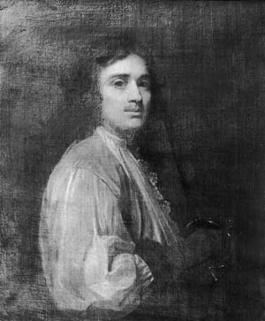
Michael Mohun, (c. 1616–1684). Abdelmelech
Mohun and his fellows formed the nucleus of the King's Company, one of the two chief Restoration troupes, and with which Mohun remained as a leading player—notably in partnership with the actor Charles Hart—until the foundation of the United Company in 1682.
Mohun's range was wide: he acted in both comedy and tragedy from the old repertory and the new. In the years immediately following the Restoration he had a line in dynamic, witty deceivers, with chief roles in Jonson's famous comedies: the title role in Volpone, Face in The Alchemist, and Truewit in Epicoene. In the same vein he took over Iago in Othello after Walter Clun's murder in 1664.
Montezuma in The Indian Emperor (Dryden), King Edward in The Black Prince (Orrery), Bellamy in An Evening's Love (Dryden), Maximin in Tyrranic Love (Dryden), Abdelmelech in The Conquest of Granada (2 parts, Dryden), Rodophil in Marriage à la mode (Dryden), Pinchwife in The Country Wife (Wycherley), the Old Emperor in Aureng-Zebe (Dryden), Ventidius in All for Love (Dryden)

Slide 9
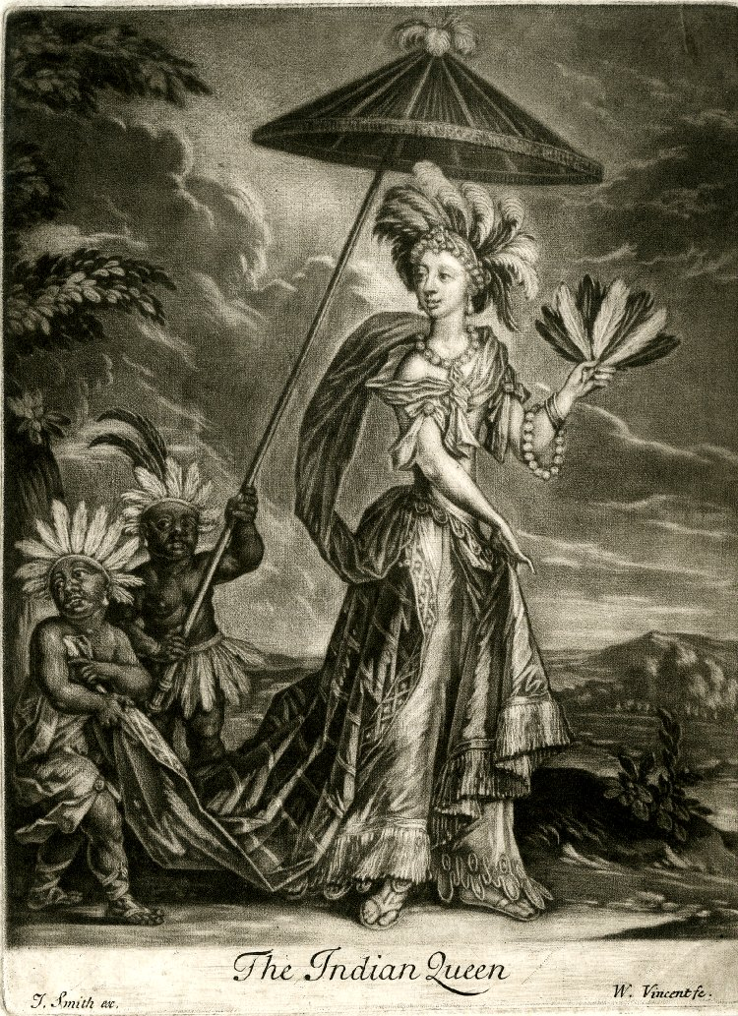
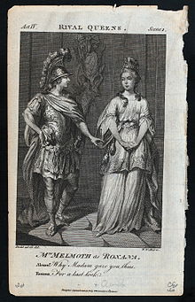

Slide 10
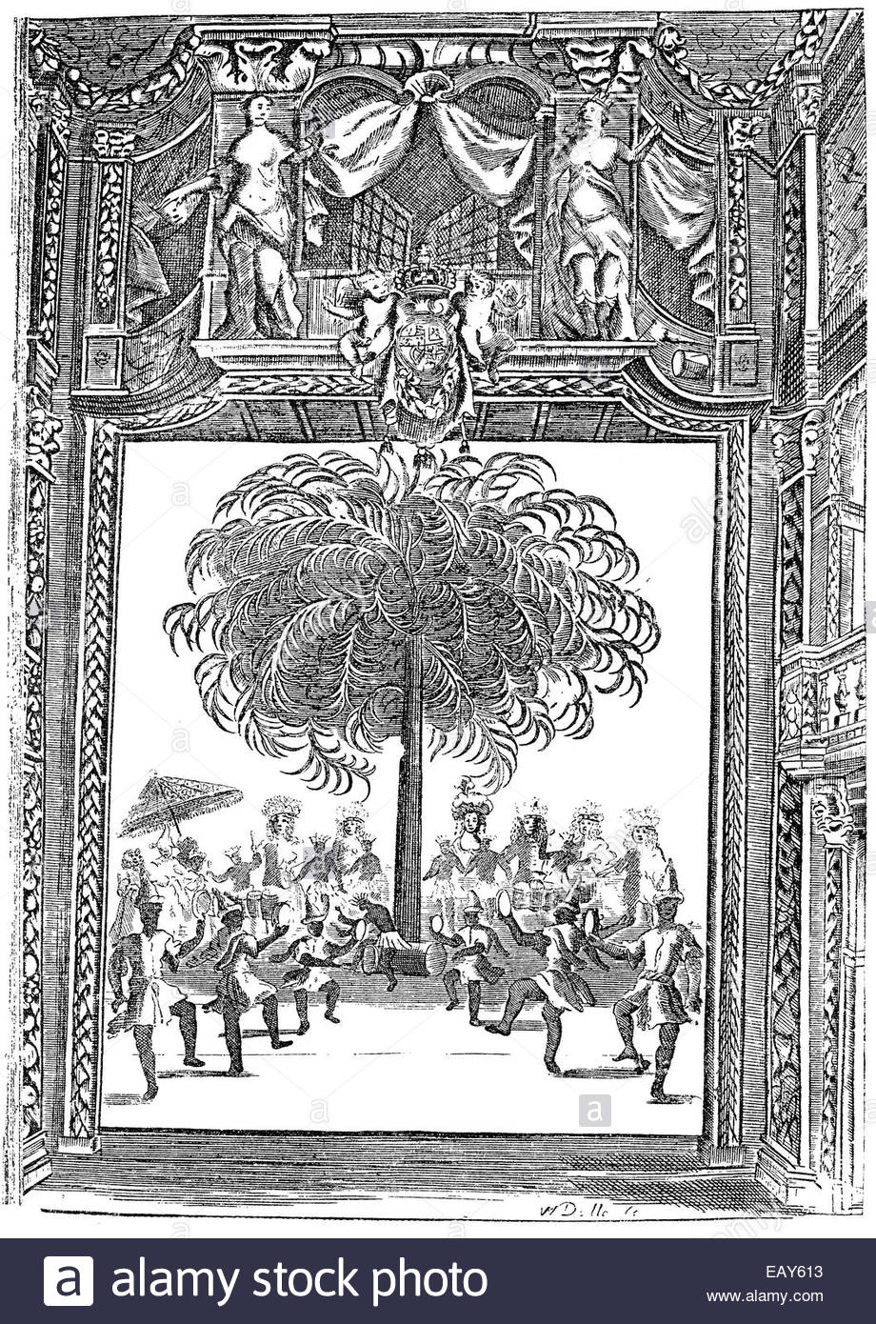
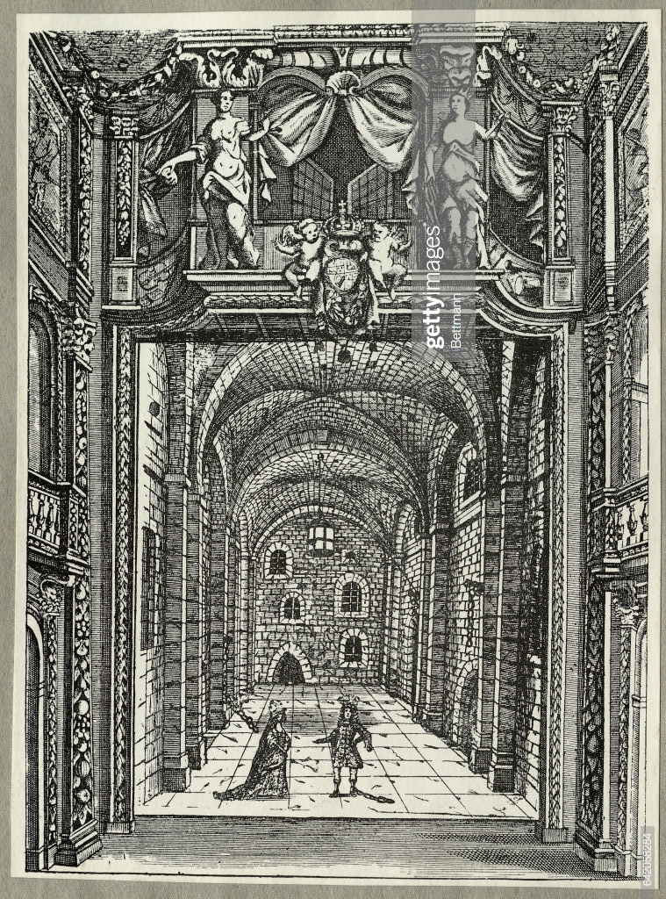
Notes:
Elkaniah Settle’s The Empress of Morocco (1673) (with ‘sculptures’)

Slide 11
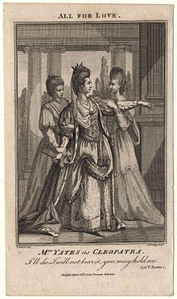
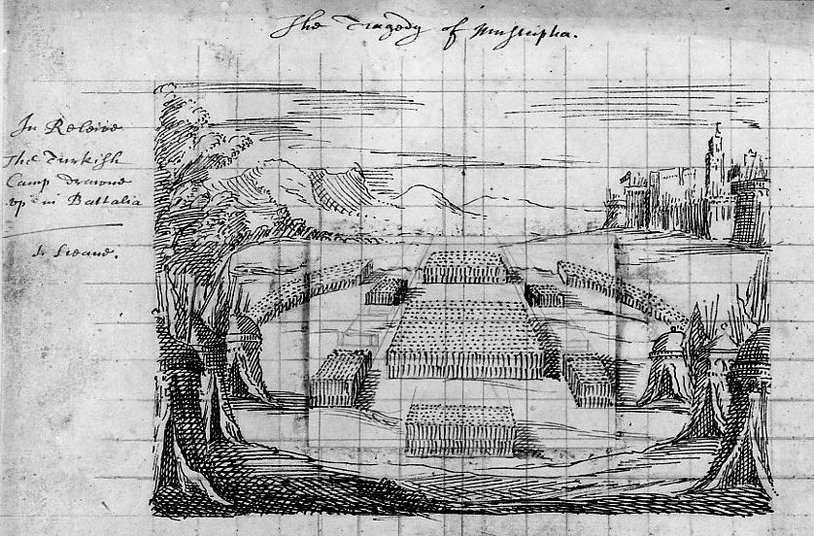
Orrery, Mustapha (1665)

