Slide 1
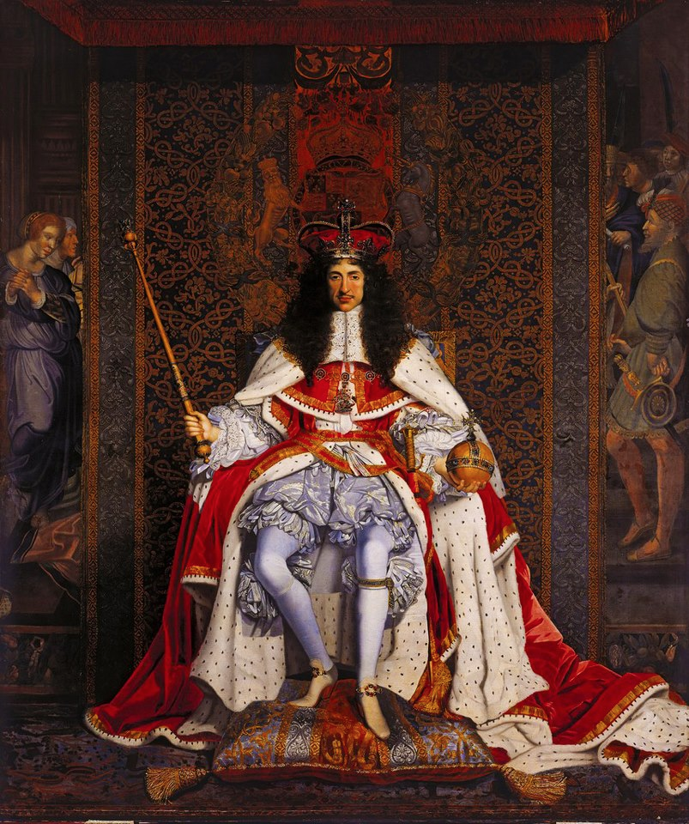
THEATRICALITY – RESTORATION STYLE

Slide 2
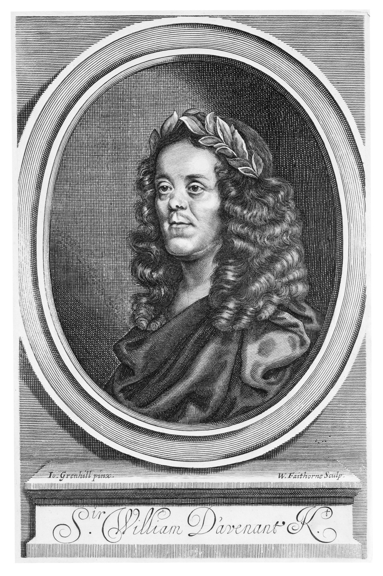
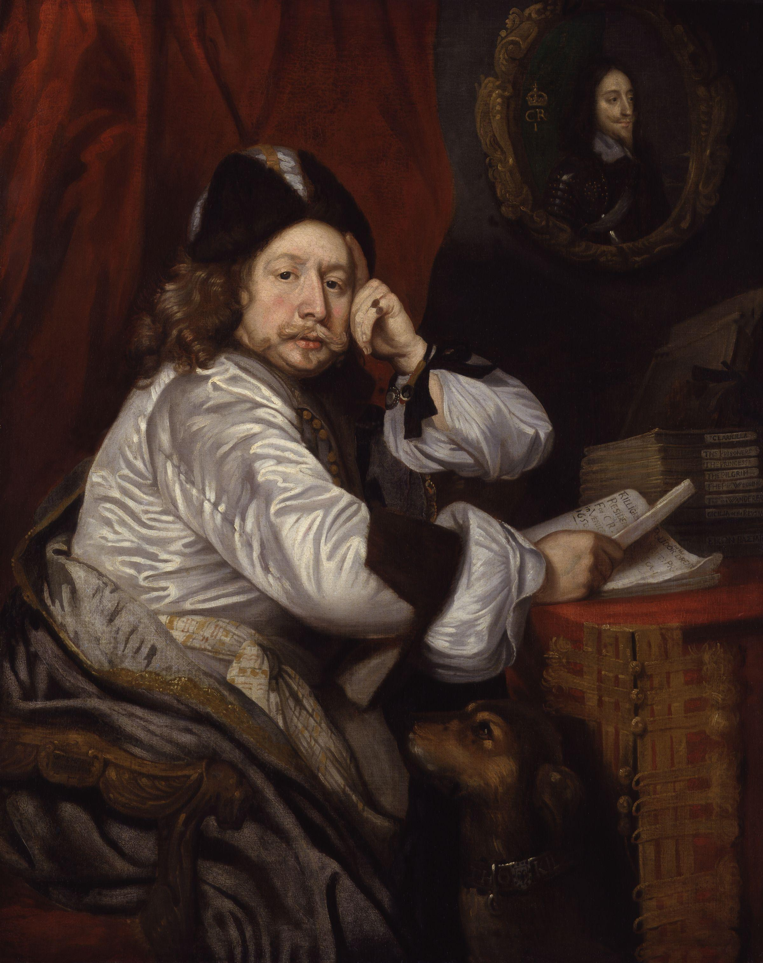
REOPENING THE THEATRES
Thomas Killigrew (1650)
William Davenant (1673)

Slide 3
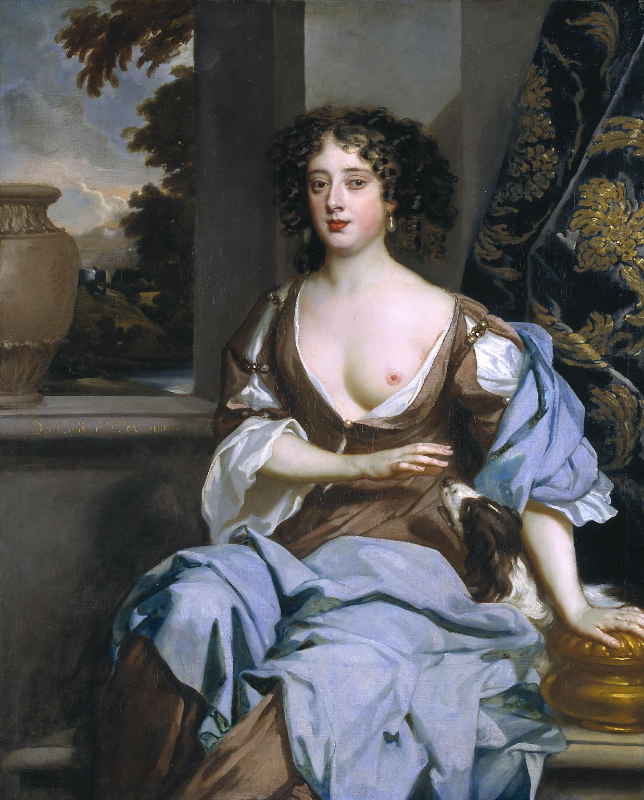
THE AGE OF FIRST ACTRESSES
Margaret Hughes,
by Peter Lely (c. 1673)

Slide 4
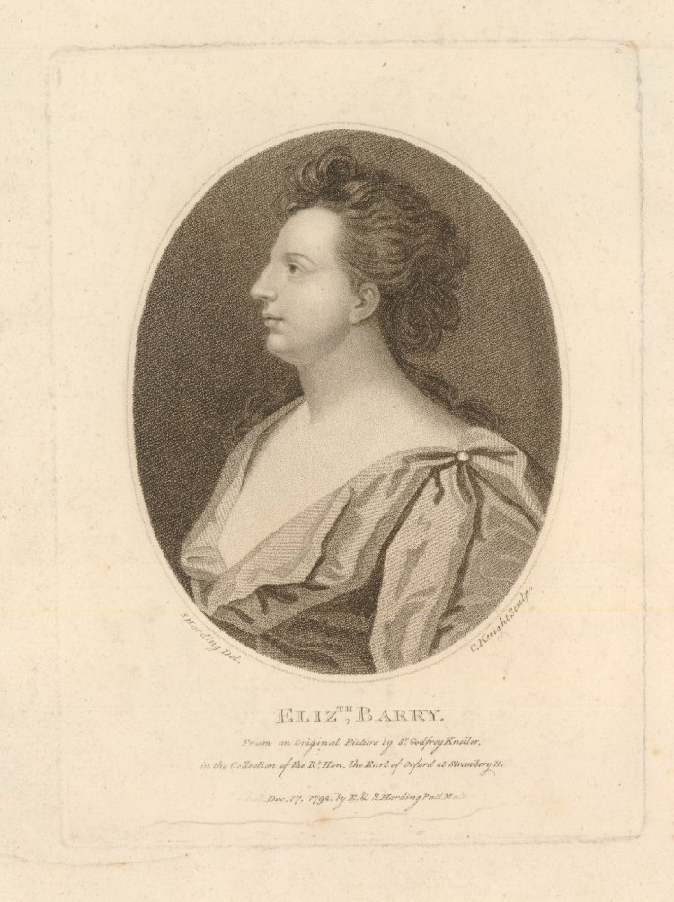
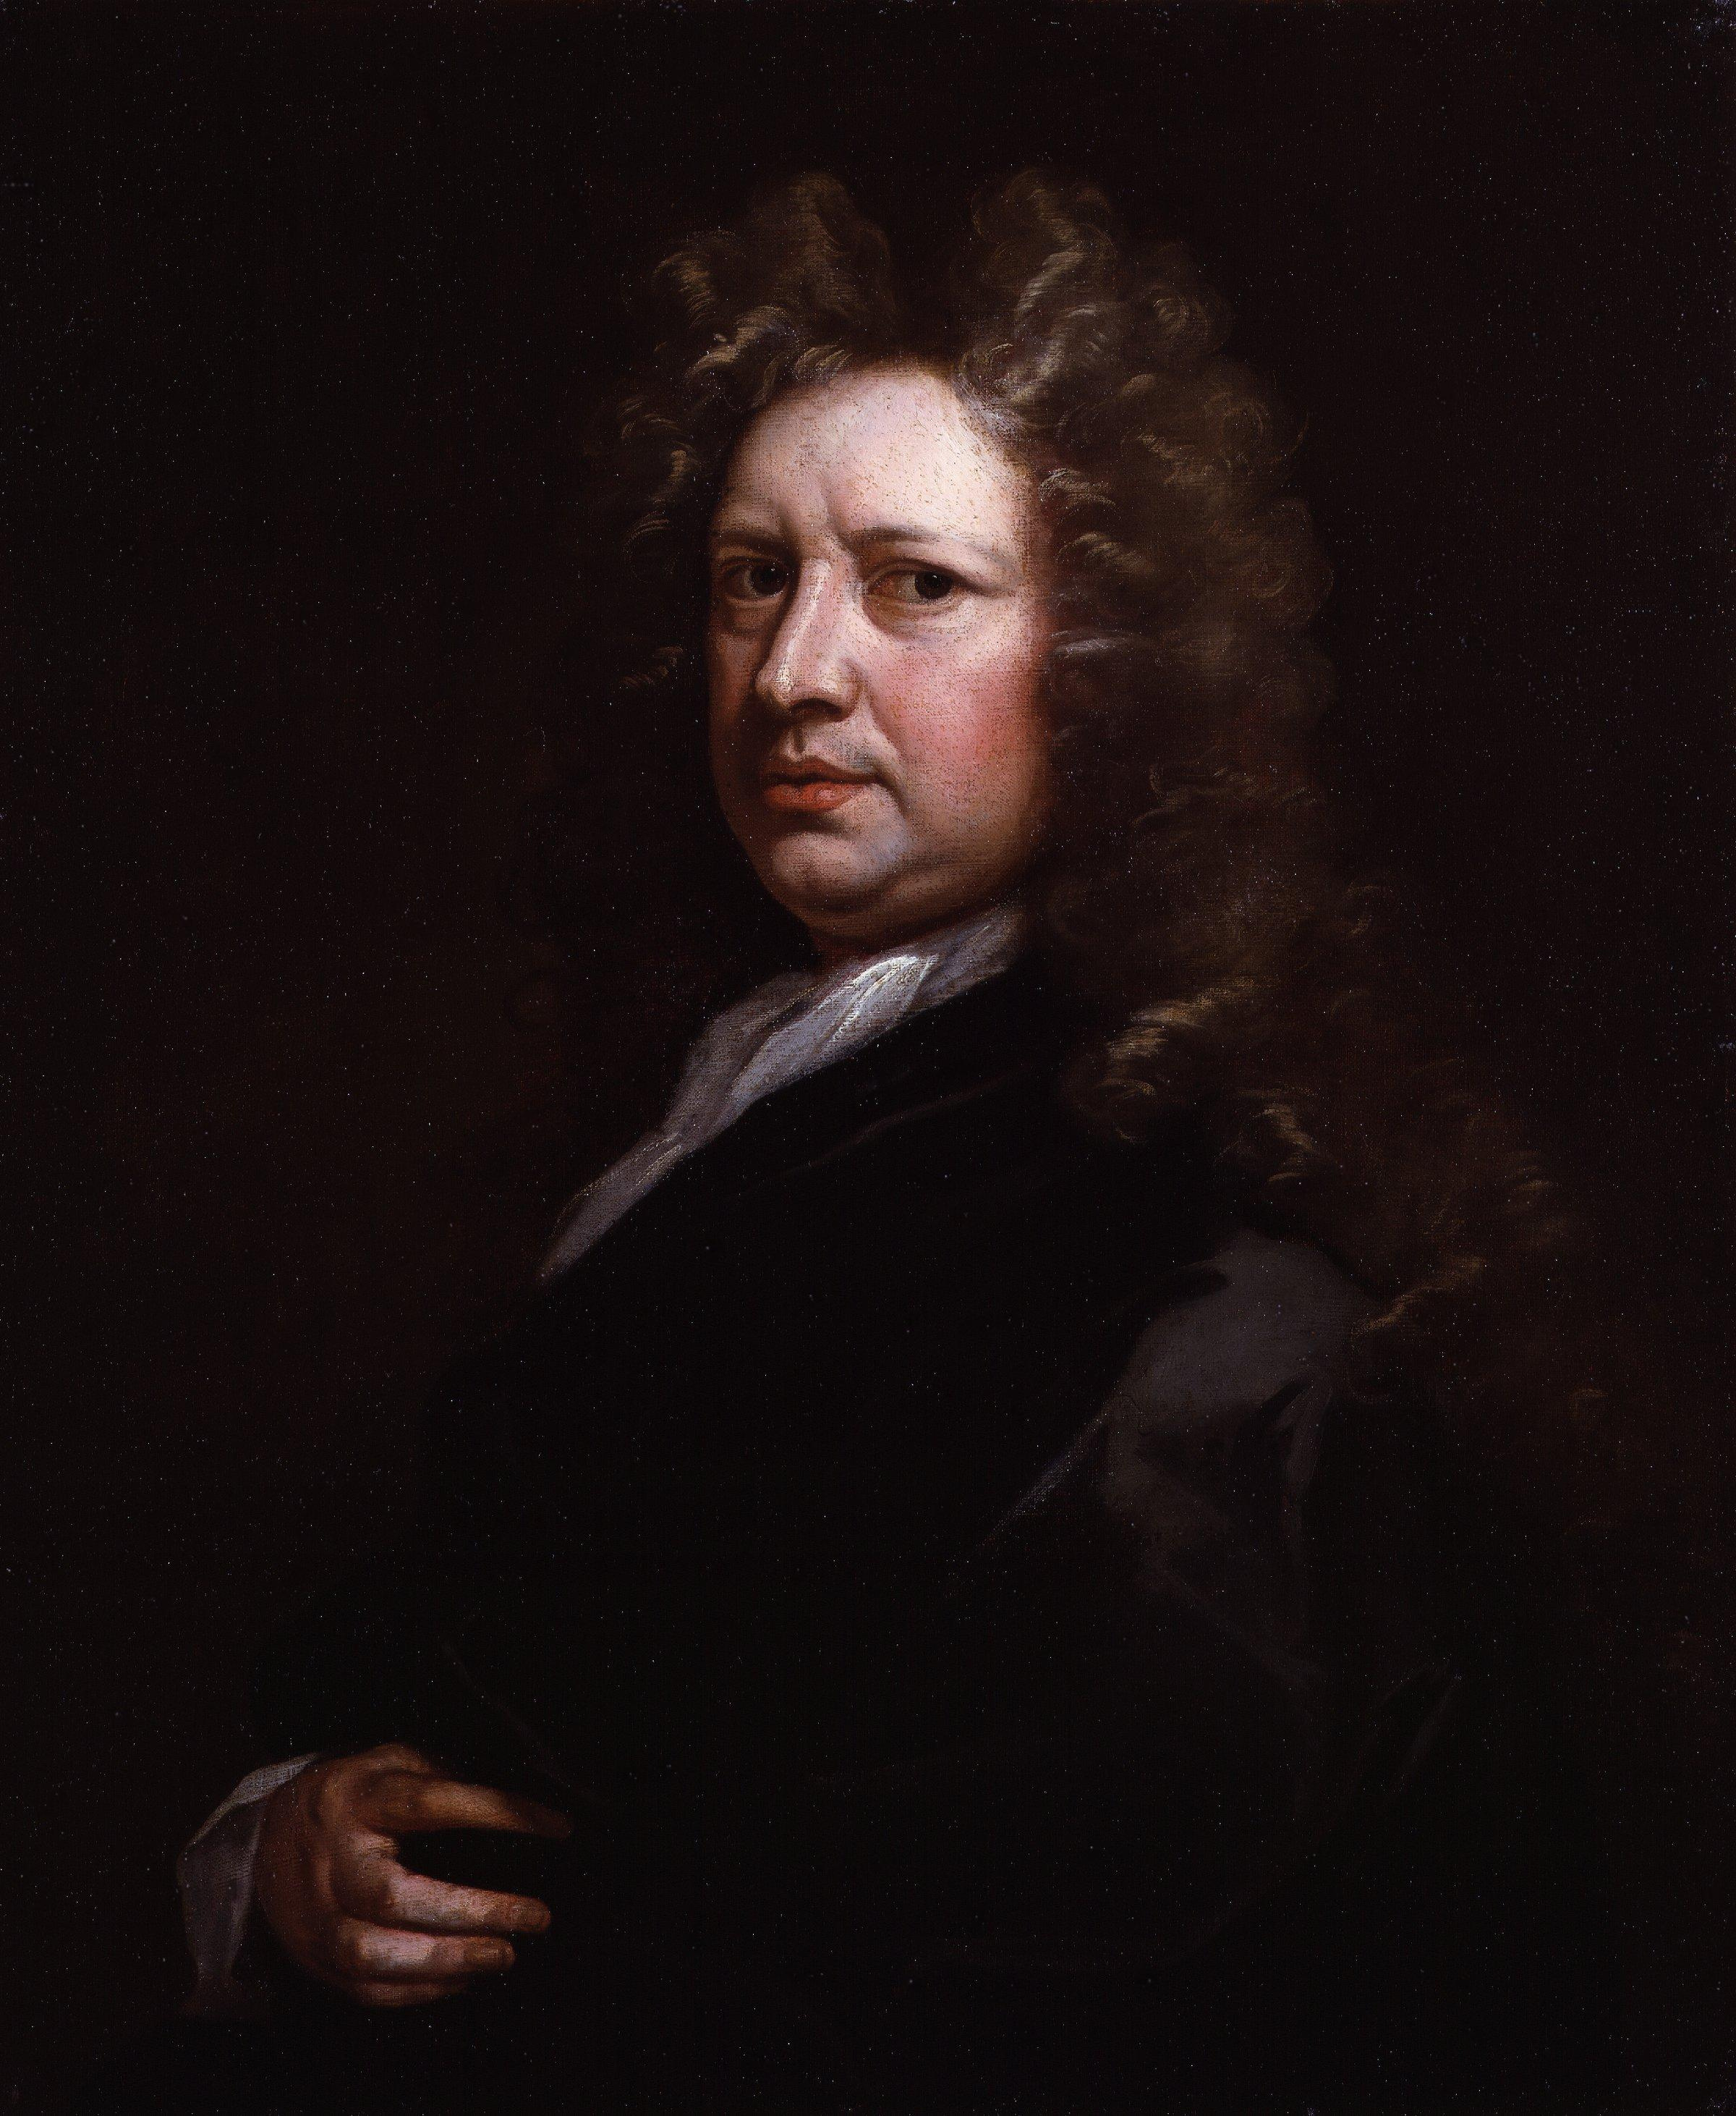
THE FIRST AGE OF CELEBRITY
Elizabeth Barry
Thomas Betterton

Slide 5
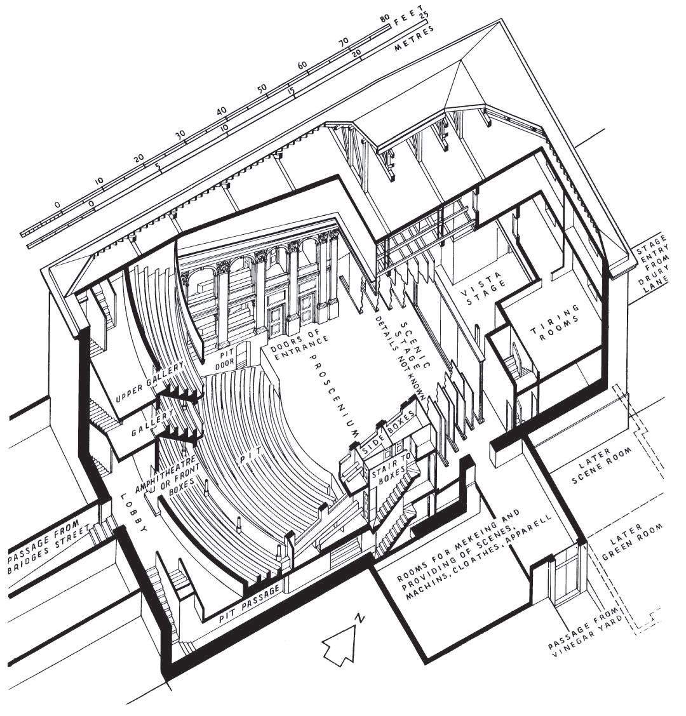
A NEW KIND OF THEATRE
Richard Leacroft’s reconstruction of Drury Lane Theatre, 1674

Slide 6
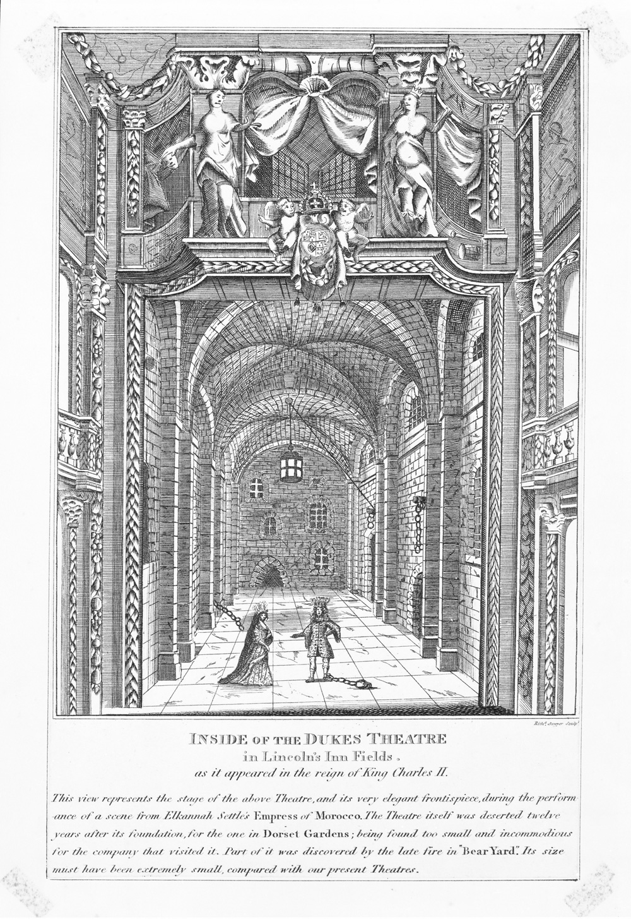
A NEW KIND OF THEATRE
Interior of Lincoln’s Inn Fields Theatre, c. 1660s

Slide 7
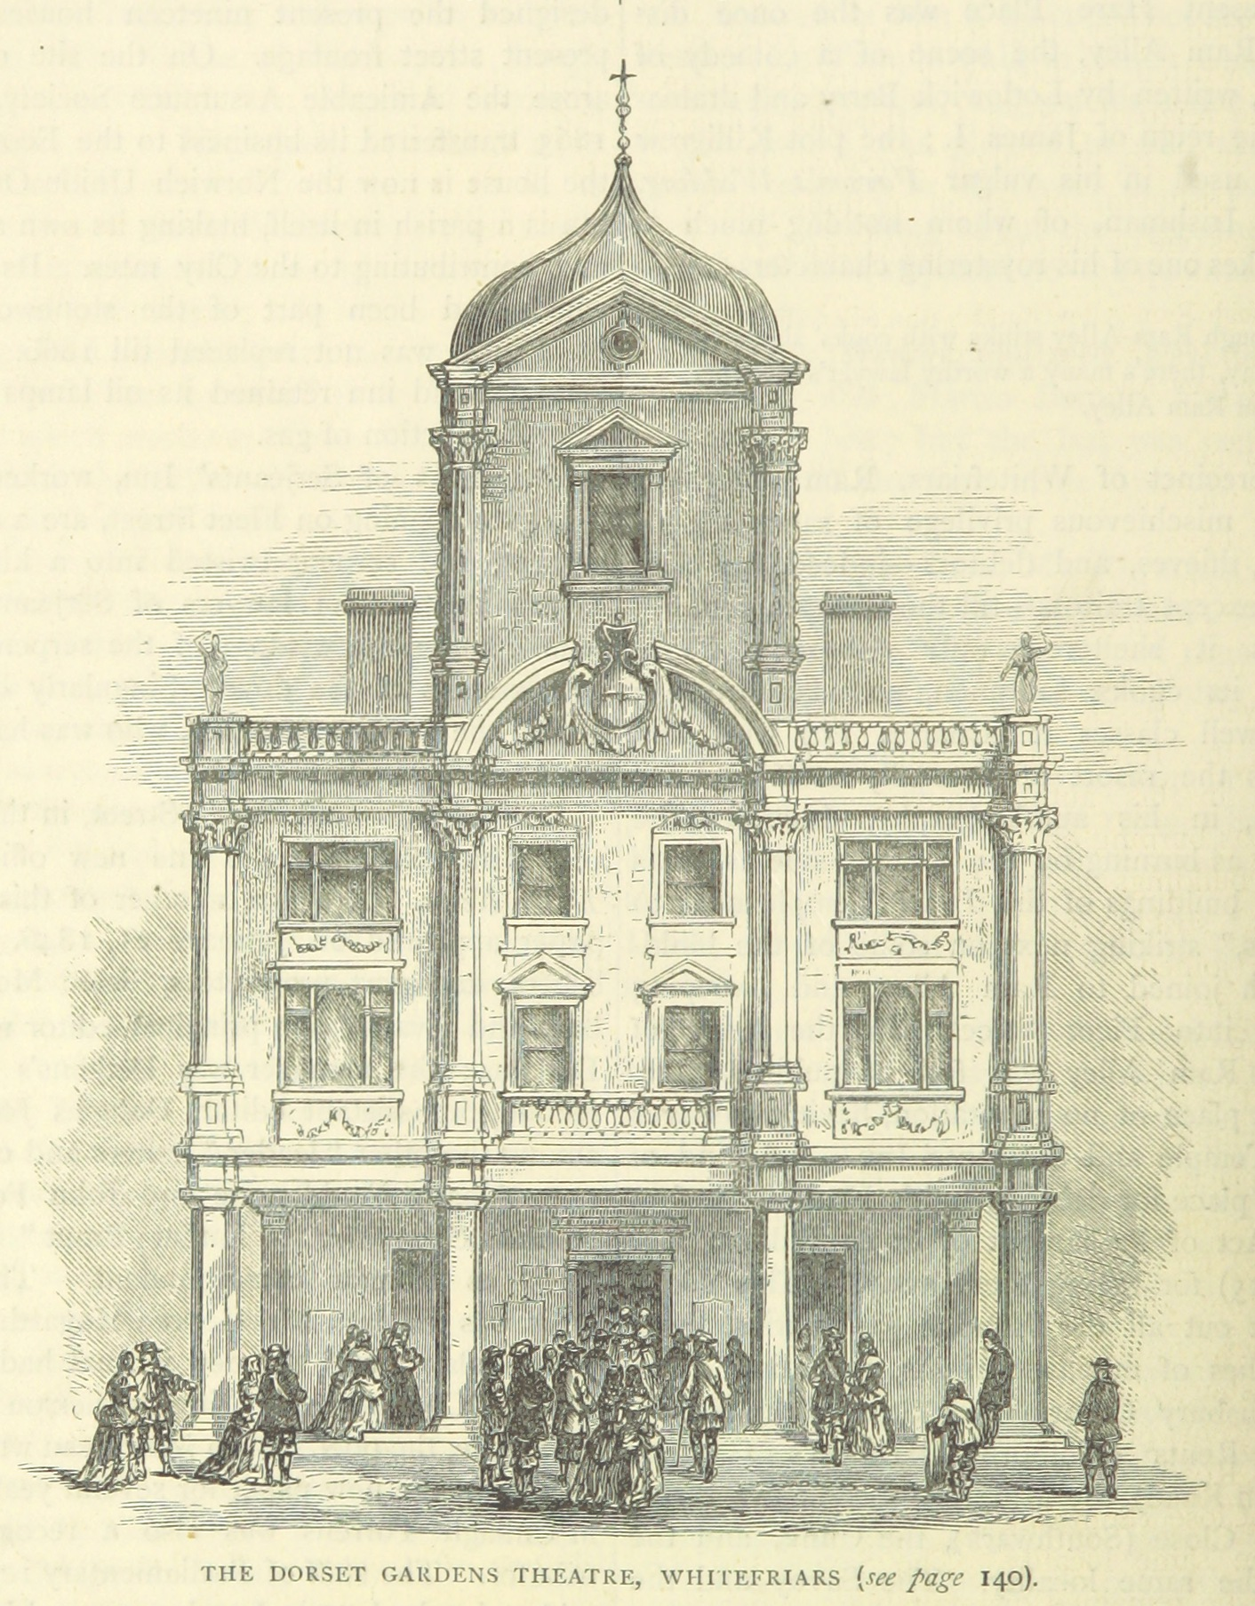
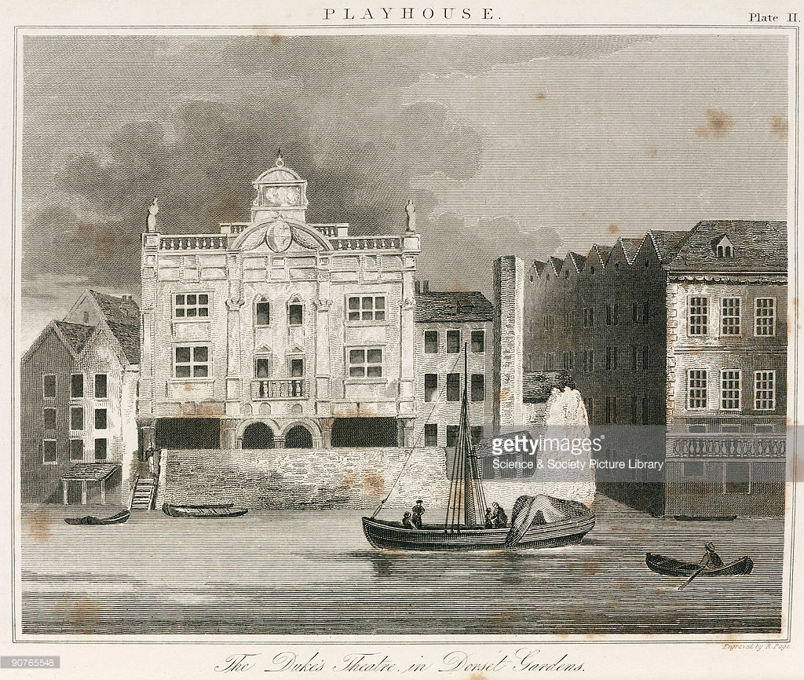
A NEW KIND OF THEATRE
Dorset Garden Theatre, c. 1680

Slide 8
A NEW KIND OF THEATRE
https://youtu.be/ZRDniz5dyeY?t=7m38s

Slide 9
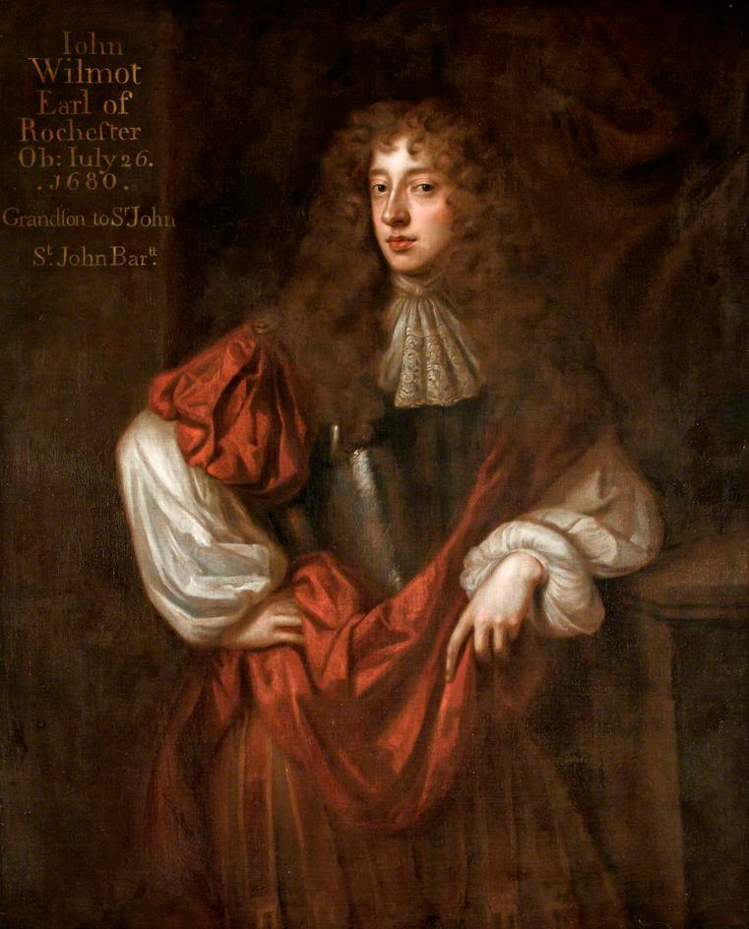
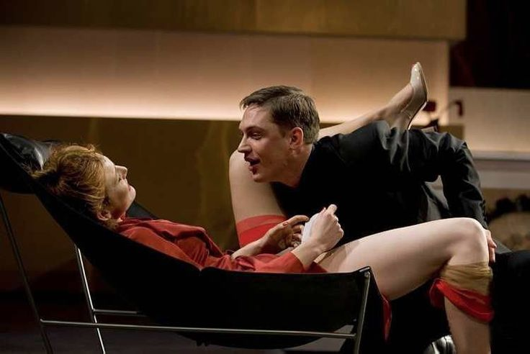
LIBERTINE (n.)
A person who follows his or her own inclinations; one who is not restricted by convention or tradition.
A person (typically a man) who is not restrained by morality, esp. with regard to sexual relations; a person of dissolute or promiscuous habits.

