Slide 1
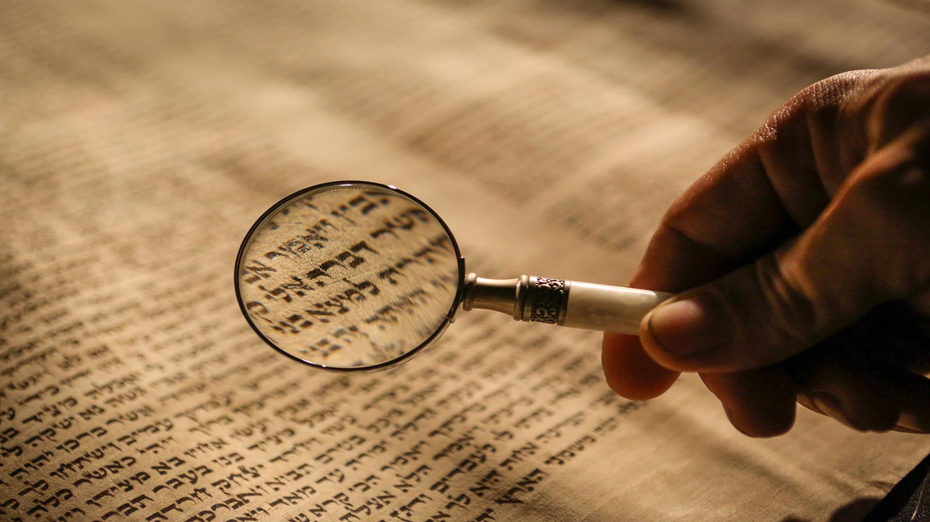
EN126 History and Textuality
Week four: Method
Dr. Stuart Middleton

Slide 2
Re-cap: What is History?
History and Textuality unit one: ‘What is History?’
Answered in terms of the distinctive features of history as it was formed into an academic ‘discipline’ over the nineteenth century:
Week 2: Archives
History is the branch of academic inquiry that produces knowledge through research in the archives
Week 3: Evidence
History produces knowledge of the past by reading texts as evidence of the past, for a particular understanding of the past

Slide 3
Today’s lecture: method
‘Method’ (working definition): the means by which knowledge of the past is produced and said to be true.
Comprising:
The way we understand the relationship between evidence and the thing of which it is taken to be evidence
The terms in which we establish or validate the truth of an historical statement.

Slide 4
Today’s lecture: method
Romantic history; and the idea of history in A Tale of Two Cities
History as a ‘science’ in the later nineteenth century
History as inter-disciplinary method (Braudel)
Historical method and the interpretation of meaning (Darnton)

Slide 5
Today’s lecture: method
Romantic history; and the idea of history in A Tale of Two Cities
History as a ‘science’ in the later nineteenth century
History as inter-disciplinary method (Braudel)
Historical method and the interpretation of meaning (Darnton)

Slide 6
Time in Romantic historiography
Enlightenment history traces trans-historical schemes of development; Romantic thinkers view societies and cultures as historically-unique, possessing their own distinctive value
Modernity itself as an historical rupture
  thus Friedrich Perthes (German publisher), 1818: ‘[I]n the three generations alive today our own age has combined what cannot be combined. No sense of continuity informs the tremendous contrast inherent in the years 1750, 1789 and 1815. To people alive now, they simply do not appear as a sequence of events.’
Quoted in Tim Blanning, The Romantic Revolution
(New York, 2011), pp.ix-x

Slide 7
History and the historical novel
“The perfect historian is he in whose work the character and spirit of an age is exhibited in miniature. He relates no fact, he attributes no expression to his characters, which is not authenticated by sufficient testimony. But, by judicious selection, rejection, and arrangement, he gives to truth those attractions which have been usurped by fiction.”
Macaulay, ‘History’ (1828)
Thomas Babington Macaulay

Slide 8
History and the historical novel
“Perfectly and absolutely true it cannot be: for, to be perfectly and absolutely true, it ought to record ALL the slightest particulars of the slightest transactions […] The omission of any circumstance, however, insignificant, would be a defect. […]
[…] No picture, then, and no history, can present us with the whole truth: but those are the best pictures and the best histories which exhibit such parts of the truth as most nearly produce the effect of the whole.”
Macaulay, ‘History’ (1828)
Thomas Babington Macaulay

Slide 9
History as death and resurrection
Jules Michelet: “[A]s I breathed their dust, I saw them rise up. They rose from the sepulchre […] as in the Last Judgement of Michelangelo or in the Dance of Death. This frenzied dance […] I have tried to reproduce in [my] work.”
Thomas Carlyle, The French Revolution: A History (1837) – key source for Dickens
  Carlyle rejects conception of history as chronological series of events, or what he called ‘tombstone information’ (essay on ‘Boswell’s Life of Johnson’)
  instead, the past as living experience which the historian (or historical writer) revives
Resurrection in A Tale of Two Cities:
  as commentary on the novel’s ‘bringing back to life’ of the past
  as repair of the radical historical discontinuity that the revolution sought to accomplish.
Quoted in Carolyn Steedman, Dust, p.27

Slide 10
Resurrection in A Tale of Two Cities: Mr. Cruncher
“Father,” said Young Jerry, as they walked along, […] “what’s a Resurrection-Man?”
[…]
“Hem! Well,” returned Mr Cruncher, going on again, and lifting off his hat to give his spikes [of hair] free play, “he’s a tradesman.”
“What’s his goods, father?” asked the brisk Young Jerry.
“His goods,” said Mr Cruncher, after turning it over in his mind, “is a branch of Scientific goods.”
“Persons’ bodies, ain’t it, father?” asked the lively boy.
“I believe it is somethink of that sort,” said Mr Cruncher.
“Oh, father, I should so like to be a Resurrection-Man when I’m quite growed up!”
Dickens, A Tale of Two Cities, p.170

Slide 11
Resurrection in A Tale of Two Cities: Mr. Cruncher
”That there Roger Cly, master,” said Mr Cruncher, with a taciturn and iron-bound visage. “So you put him in his coffin?”
“I did.”
“Who took him out of it?”
Barsad leaned back in his chair, and stammered, “What do you mean?”
“I mean,” said Mr Cruncher, “that he warn’t never in it. No! Not he! I’ll have my head took off, if he was ever in it.”
The spy looked round at the two gentlemen; they both looked in unspeakable astonishment at Jerry.
“I tell you,” said Jerry, “that you buried paving-stones and earth in that there coffin. Don’t go and tell me that you buried Cly. It was a take in. Me and two more knows it.”
Dickens, A Tale of Two Cities, pp.315-16

Slide 12
Today’s lecture: method
Romantic history; and the idea of history in A Tale of Two Cities
History as a ‘science’ in the later nineteenth century
History as inter-disciplinary method (Braudel)
Historical method and the interpretation of meaning (Darnton)

Slide 13
History as discipline and ‘science’: Ranke
Charles Kingsley appointed Regius Professor of Modern History at Cambridge, 1861 – but met with opposition (e.g. medieval historian Edward Freeman), on grounds of history’s status as ‘science’ based on rigorous source criticism
Leopold von Ranke (1795-1886) – critical examination of source material (principally state documents), seeking ‘wie es eigentlich gewesen’
Leopold von Ranke

Slide 14
History as discipline and ‘science’: Lord Acton
“The test of solidity is not the quantity read, but the mode in which the knowledge has been collected and used. Method, not genius, or eloquence, or erudition, makes the historian.”
“Contributors will understand that […] our Waterloo must satisfy French and English, German and Dutch alike; that nobody can tell, without examining the list of authors, where the Bishop of Oxford laid down his pen, and whether Fairbairn or Gasquet, Liebermann or Harrison took it up.”
‘Mr. Goldwin Smith’s Irish History’, Ramber 6 (1862)
John Dalberg-Acton (Lord Acton)
‘Prospectus’ to the Cambridge Modern History (1902)

Slide 15
Today’s lecture: method
Romantic history; and the idea of history in A Tale of Two Cities
History as a ‘science’ in the later nineteenth century
History as inter-disciplinary method (Braudel)
Historical method and the interpretation of meaning (Darnton)

Slide 16
Resistance to quasi-Rankean political history
Lucien Febvre & Marc Bloch – founders of ‘Annales’ school:
  focus on analytical, problem-oriented inquiry
  use of research & analytical techniques from other disciplines, esp. social & human sciences
E.g. Bloch, The Royal Touch (1924) – study of the problem of collective belief, drawing on psychology and (esp. Durkheimian) sociology
Weakened sense of history as a distinctive ‘method’; instead willingness to draw upon methods of neighbouring disciplines, particularly the social and ‘human’ sciences

Slide 17
Braudel: history and time
The Mediterranean and the Mediterranean World in the Age of Philip II (1949). Three levels of time:
‘events’
structures
geo-history
“My feeling is that the sea itself, the one we see and love, is the greatest document of its past existence.”
[…]
“… ‘l’histoire événmentielle’, that is, the history of events: surface disturbances, crests of foam that the tides of history carry on their strong backs.”
Braudel, The Mediterranean, trans. Sîan Reynolds, p.17; p.21

Slide 18
Today’s lecture: method
Romantic history; and the idea of history in A Tale of Two Cities
History as a ‘science’ in the later nineteenth century
History as inter-disciplinary method (Braudel)
Historical method and the interpretation of meaning (Darnton)

Slide 19
The fragmentation of historical ‘method’?
Influence of structural linguistics: languages share a densely-interrelated common structure, not necessarily having any fixed relation to the world of objects
Claude Levi-Strauss (French anthropologist), The Elementary Structures of Kinship (1949) – kinship structures share common structural elements, despite apparent diversity
Michel Foucault (denied being a ‘structuralist’), The Order of Things (1966) – study of how knowledge has been produced, structured & categorised since the Renaissance, & esp. since the eighteenth century. Rejection of method, in order to make ‘method’ itself an object of inquiry (and critique)

Slide 20
'Thick description’ and cultural history
Clifford Geertz (US anthropologist), The Interpretation of Cultures (1973) –
cultures as systems of meaning, which the anthropologist does not observe but interprets
‘thick description’ – investigation of the meanings of texts and practices in a particular culture, derived from the knowledge & assumptions shared by people in that culture
[W]hat we call our data are really our own constructions of other people’s constructions of what they and their compatriots are up to. […] Right down at the factual base, the hard rock, insofar as there is any, of the whole enterprise, we are already explicating: and worse, explicating explications. Winks upon winks upon winks.
Clifford Geertz, The Interpretation of Cultures (1973, repr. 2017), p.10

Slide 21
'Thick description’ and cultural history
Clifford Geertz (US anthropologist), The Interpretation of Cultures (1973) –
cultures as systems of meaning, which the anthropologist does not observe but interprets
‘thick description’ – investigation of the meanings of texts and practices in a particular culture, derived from the knowledge & assumptions shared by people in that culture
[W]hat we call our data are really our own constructions of other people’s constructions of what they and their compatriots are up to. […] Right down at the factual base, the hard rock, insofar as there is any, of the whole enterprise, we are already explicating: and worse, explicating explications. Winks upon winks upon winks.
Clifford Geertz, The Interpretation of Cultures (1973, repr. 2017), p.10

Slide 22
Robert Darnton, ‘The City as Text’?
Robert Darnton (cultural historian of C18 France; taught with Geertz at Princeton)
‘The City as Text’ – the city (Montpellier) doesn’t have a fixed, determinate ‘reality’, but rather is a dense agglomeration of signs that contemporaries interpret, and which we (re-?) interpret
But – ‘the city as text’, as Darnton claims; or the text as text about the city (which continues to exist outside the text)?
Darnton: ‘Eighteenth-century Montpellier was essentially an administrative center and a marketplace, the third largest city after Toulouse and Nîmes in the vast province of Languedoc. Its population grew rapidly to about thirty-one thousand in 1789 …’
Darnton, ‘A Bourgeois Puts His World in Order’,
in The Great Cat Massacre, p.114

