Slide 1
EN126 History & Textuality
Week 9:
Historical Materialisms

Slide 2
Re-cap – Unit 2: What is Literary History?
Week 7: Narrative
Ian Watt and Marilyn Butler – two (or more?) ways of historicising a novel
Week 8: Historical Formalisms
Ian Hacking: the categories and concepts in which we think are products of particular times and places in history – but can also take on a kind of reality in those times and places
Gallagher & Greenblatt (‘new historicism’): reading the past in a certain way, through small or forgotten ‘anecdotes’, can challenge grand narratives of historical explanation and enable us to feel ‘the touch of the real’

Slide 3
‘The touch of the real’
“Sr: Your Baily or Steward proper is a black guard sort of fellow to the Workmen and if you dont discharge him You may Look to Your House being sett on fire if Stones will not Burn You damned Son of a hoare You shall have Your throat cutt from Ear to Ear except You Lay L50 under the Second tree of Staple Nashes from his house at the front of the Great Gates near the Rabbit Warrin on Wesdy Morn next …”
Quoted in Gallagher & Greenblatt, ‘Counter-history and the Anecdote’ in Practicing New Historicism (2000), 55

Slide 4
Today’s lecture
Background: historical materialism in the works of Marx and Engels
Historical materialism as an approach to literary history
  a. Lukács, The Historical Novel
  b. Williams, ‘Dominant, Residual, and Emergent’
An historical-materialist approach to reading Frankenstein

Slide 5
Today’s lecture
Background: historical materialism in the works of Marx and Engels
Historical materialism as an approach to literary history
  a. Lukács, The Historical Novel
  b. Williams, ‘Dominant, Residual, and Emergent’
An historical-materialist approach to reading Frankenstein

Slide 6
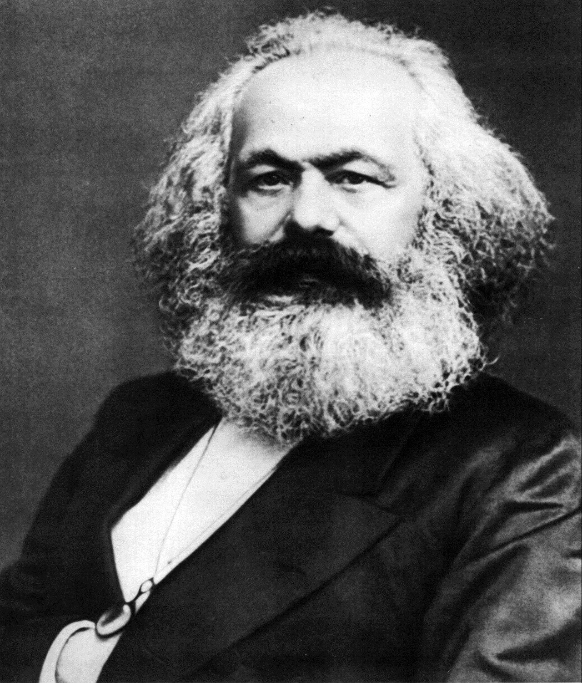
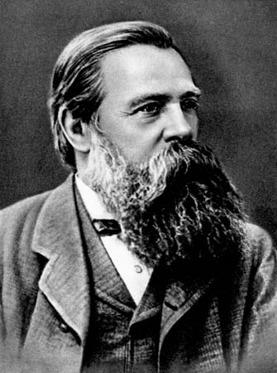
Marx and Engels
Karl Marx
(1818-1883)
Friedrich Engels
(1820-1895)

Slide 7
Hegel and Hegelianism
The world as self-alienated Geist (spirit, idea); history as the process through which this self-alienation is overcome, and the world reconciled with reason – culminating in the modern state
Hegel remains the dominant figure in German philosophy after his death in 1831
Marx & Engels profoundly influenced by Hegel and members of a group of thinkers called the ‘young Hegelians’; but decisively break with Hegelianism mid-1840s
Georg Wilhelm Friedrich Hegel
(1770-1831)

Slide 8
The German Ideology (written 1845-6; pub. 1932)
The premises from which we begin are not arbitrary ones, not dogmas, but real premises from which abstraction can only be made in the imagination. They are the real individuals, their activity and the material conditions under which they live, both those which they find already existing and those produced by their activity. These premises can thus be verified in a purely empirical way.
The first premise of all human history is, of course, the existence of living human individuals. Thus the first fact to be established is the physical organisation of these individuals and their consequent relation to the rest of nature. […] The writing of history must always set out from these natural bases and their modification in the course of history through the action of men.
K. Marx & F. Engels, The German Ideology (1845-6),
Part I: Feuerbach. Opposition of the Materialist and Idealist Outlook

Slide 9
The German Ideology (written 1845-6; pub. 1932)
This conception of history depends on our ability to expound the real process of production, starting out from the material production of life itself, and to comprehend the form of intercourse connected with this and created by this mode of production […] as the basis of all history[.]
K. Marx & F. Engels, The German Ideology (1845-6),
Part I: Feuerbach. Opposition of the Materialist and Idealist Outlook

Slide 10
The German Ideology (written 1845-6; pub. 1932)
Stages in the ‘modification’ (or development) of material forces, through division of labour and forms of property:
Tribal: centred on the family, with enslaved people in a subordinate position in the division of labour
Ancient: communal property in the city, with slavery (as a form of property)
Feudal: a small nobility owns land which is worked by serfs and peasants; also very small-scale artisanal craft production
Feudal society is succeeded by ‘bourgeois’ or capitalist society, in which capital is the most important productive force; and then by socialist or communist society, in which the means of production are held in common
K. Marx & F. Engels, The German Ideology (1845-6),
Part I: Feuerbach. Opposition of the Materialist and Idealist Outlook

Slide 11
Productive forces and relations
Historical materialism identifies as the motive force of history the developing alignment of, and tensions between, productive forces and productive relations
Productive forces: the resources with which production is undertaken, including raw materials, technologies, labour
Productive relations: primarily relations of control, i.e. control of the process of production and its output. At most times in history Marx & Engels claim there are two principal classes: those who control the means of production, and those who are controlled by them. In a ‘bourgeois’ or capitalist society these are (respectively) the bourgeoisie and the proletariat

Slide 12
Preface to A Contribution to the Critique of Political Economy (1859)
In the social production of their existence, men inevitably enter into definite relations, which are independent of their will, namely relations of production appropriate to a given stage in the development of their material forces of production. The totality of these relations of production constitutes the economic structure of society, the real foundation, on which arises a legal and political superstructure and to which correspond definite forms of social consciousness. The mode of production of material life conditions the general process of social, political and intellectual life. It is not the consciousness of men that determines their existence, but their social existence that determines their consciousness. …

Slide 13
Preface to A Contribution to the Critique of Political Economy (1859)
… At a certain stage of development, the material productive forces of society come into conflict with the existing relations of production or—this merely expresses the same thing in legal terms—with the property relations within the framework of which they have operated hitherto. From forms of development of the productive forces these relations turn into their fetters. Then begins an era of social revolution. The changes in the economic foundation lead sooner or later to the transformation of the whole immense superstructure.

Slide 15
Today’s lecture
Background: historical materialism in the works of Marx and Engels
Historical materialism as an approach to literary history
  a. Lukács, The Historical Novel
  b. Williams, ‘Dominant, Residual, and Emergent’
An historical-materialist approach to reading Frankenstein

Slide 16
Georg Lukács
Hungarian philosopher and Communist Party activist
Joins Communist Party December 1918 during ‘Autumn Rose Revolution’ in Hungary; 1919 minister in short-lived Hungarian Soviet Republic
1923 History and Class Consciousness – a seminal work of Marxist philosophy
Exiled in Austria & Germany during 1920s, then 1930s in Moscow as official at the Marx-Engels Institute
Georg Lukács (1885-1971)

Slide 17
Context for Lukács 1937
From 1936 a series of show trials & political purges underway, beginning with senior figures within the Bolshevik regime and extending throughout the Party and the country
From 1934: promulgation of ‘socialist realism’ as official literary doctrine of the USSR

Slide 18
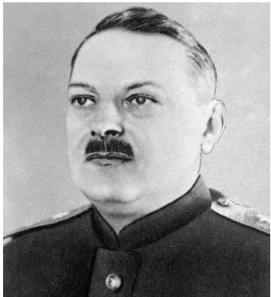
Andrey Zhdanov on ‘socialist realism’, 1934
‘Comrade Stalin has called our writers engineers of human souls. What does this mean? […]
In the first place, it means knowing life so as to be able to depict it truthfully in works of art, not to depict it in a dead, scholastic way, not simply as “objective reality,” but to depict reality in its revolutionary development.
In addition to this, the truthfulness […] should be combined with the ideological remoulding and education of the toiling people in the spirit of socialism. This method […] is what we call the method of socialist realism.’
Andrey Zhdanov
(Secretary of the Central Committee
of the Soviet Communist Party)
Soviet Writers’ Congress 1934: The Debate on Socialist Realism and Modernism (London, 1935; repr. 1977), p.21

Slide 19
Lukács on the historical novel
How does Lukács’s account of the emergence of the historical novel in our reading for this week exemplify an historical-materialist approach to literary history?
1. He presents the classical historical novel (pioneered by Walter Scott) as an ideological product of the aftermath of a bourgeois revolution
2. He also suggests that Scott’s novels depict the processes of historical change in a way that is congruent with historical materialism

Slide 20
Lukács on the historical novel
The Historical Novel, ch.1, §1: ‘Social and Historical Conditions for the Rise of the Historical Novel’
The properly historical novel emerges amid an ideological reconstruction that follows the French Revolution and the revolutionary wars – the key point of which was that history suddenly became a ‘mass experience’, partly as a by-product of the emergence of ‘national sensibility’ on the same mass scale. (pp.24-5)
Hence the concrete possibilities for men to comprehend their own existence as something historically conditioned, for them to see in history something which deeply affects their daily lives and immediately concerns them.
Lukács, The Historical Novel, p.24

Slide 21
Lukács on the historical novel
The Historical Novel, ch.1, §2: ‘Sir Walter Scott’
These ideological developments are registered most clearly in the novels of Walter Scott – specifically in his typical focus upon a mediocre hero in place of the great historical figures whom we might expect to be the main characters of an historical novel or drama.
These mediocre heroes are caught between opposing social forces and, by mediating between them, embody the ‘middle course’ by which Scott’s novels affirm the existence of historical progress while sympathizing with those who bear its costs (e.g. the clans).
Thus for Lukács the historical novel is more than merely a novel that’s set in the past: it depicts and elucidates the process of historical development, by showing the necessary and inextricable connection between the action and the characters and the time in which they live.

Slide 22
Lukács on A Tale of Two Cities
Even with a writer of Dickens’s rank the weaknesses of his petty bourgeois humanism and idealism are more obvious and intrusive in his historical novel on the French Revolution (Tale of Two Cities) than in his social novels. […] Dickens, by giving pre-eminence to the purely moral aspects of causes and effects, weakens the connection between the problems of the characters’ lives and the events of the French Revolution. The latter becomes a romantic background. The turbulence of the times is used as a pretext for revealing human-moral qualities. But neither the fate of Manette and his daughter, nor of Darnay-Evremonde, and least of all Sidney Carton, grows organically out of the age and its social events.
Lukács, The Historical Novel, p.243

Slide 23
Today’s lecture
Background: historical materialism in the works of Marx and Engels
Historical materialism as an approach to literary history
  a. Lukács, The Historical Novel
  b. Williams, ‘Dominant, Residual, and Emergent’
An historical-materialist approach to reading Frankenstein

Slide 24
Raymond Williams
Welsh literary critic and theorist
Joined Communist Party as a student at Cambridge (1939-40), but let his membership lapse and didn’t rejoin after WW2
During 1950s attempted to develop a democratic theory of culture that wasn’t dependent on the innovation or authority of a minority of cultural arbiters
‘Structure of feeling’ – unspoken attitudes and conventions shared within a culture that set the terms for artistic creation
Raymond Williams, 1950s

Slide 25
Raymond Williams
Marxism and Literature (1977) - part of a wider interest, among Marxist and ‘Left’ intellectuals, in culture as a site of political action and struggle, based partly on the work of Italian Marxist leader and philosopher Antonio Gramsci (1891-1937)
In particular, preoccupation with how dominant or ‘hegemonic’
(– Gramsci) cultures set limits to the possibilities of thought and action
Williams’s ‘Dominant, Residual, and Emergent’ – an engagement with cultural domination as a political issue, and with the complexities of cultural development as a political-historical issue

Slide 26
Raymond Williams
Residual – elements of culture that have survived from the past, but are still active (and thus not merely ‘archaic’)
e.g.: religion; idea of ‘rural community’; the monarchy
can also be ‘incorporated’ by the dominant culture
Emergent – elements of culture that are new and in opposition to the dominant culture
Harder to identify, partly because the dominant culture will attempt to incorporate emergent cultural formations in order to nullify their oppositional force (e.g. English radical popular press, working-class culture → commercial culture)
How can this incorporation be resisted? And in order to resist it, how do we identify the social bases of emergent cultural forms?

Slide 27
Today’s lecture
Background: historical materialism in the works of Marx and Engels
Historical materialism as an approach to literary history
  a. Lukács, The Historical Novel
  b. Williams, ‘Dominant, Residual, and Emergent’
An historical-materialist approach to reading Frankenstein

Slide 28
Historical materialism and Frankenstein
Franco Moretti, ‘The Dialectic of Fear’ (New Left Review 1982) – Victor Frankenstein’s creation of the creature stands for the bourgeoisie’s creation of the proletariat; and their relationship (of mutual need and destruction) mirrors that of capital and labour under early industrial capitalism.
But other questions to consider:
1. when is Frankenstein set, and is it an historical novel as Lukács defines one?
2. do you agree with Lukács’s judgement of A Tale of Two Cities?
3. What, in Williams’s terms, is ‘dominant, emergent, and residual’ in Frankenstein?

