Slide 1

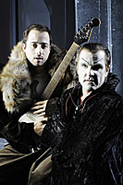
Johann Wolfgang Goethe’s Faust I and II: (re)-Germanicizing the Legend?
Week 3: Dr James Hodkinson, Dept. of German Studies

Slide 2
Boundaries and the Audacity of Faust
One thing that many literary Faust figures have in common:
Audacious in daring to challenge boundaries set by religious, moral and intellectual systems
Often written by author’s with radical visions in these areas (true of Goethe).
Of course, Faust’s transgressions are punished – though is he beyond redemption?
Today, we shall be seeing how the myth moved between England and Germany 1580-1800 and Goethe’s new context for Faust

Slide 3
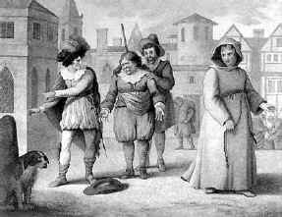
Faust in ‘Dialogue’ between
England in Germany
The German Faustbuch or Historia (published by J. Spiess in 1587) – a free translation into English followed in the early 1590’s
Christopher Marlowe’s play followed (written early 1590’s)
A network of folk traditions in 16th century England and Germany (England’s response)
  puppet theatre
  Englische Komödianten in Germany, late 16-century 17th century, including, probably, Marlowe’s play in some form.

Slide 4
The Impact of Christopher Marlowe
A sustained staging of Faust, with sustained poetic language and a ‘chorus’
Faust’s serious intellectual concerns, not merely a burlesque figure: more than a womanizer, an indulger, a confidence trickster and an alchemical meddler
Student of logic, medicine, law, divinity, though he does turn to the black arts for a life ‘in all voluptuousness’ (I, 3)
Still a temporally bound Faust - 24 years (‘ever moving spheres of heaven’) (V, 2)
Still a Christian framework of sin, punishment (redemption?)

Slide 5
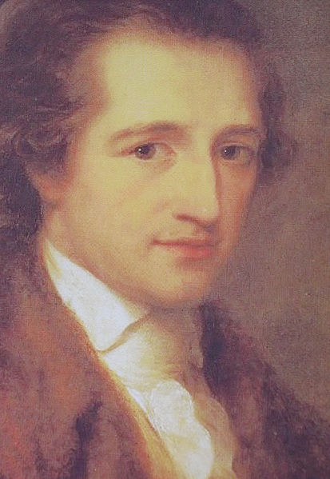
Johann Wolfgang von Goethe
A long and rich life (1749-1832). A student of law, who later became Director of the Court theatre in Weimar
Journeys though Italy – rediscovery of the ‘Classical world’: classical aesthetics, eroticism
Not anti- religious but NOT a conventional Christian, if it all (also not a literal pagan). Critical of Christian moralities
Never married – a robust love life that remained undiminished with age – lived unmarried with several women.
An omnivorous reader, a lyrical poet, playwright, novelist, essayist, scientist and man of letters. Many contemporary debates woven into his epic, two-part Faust.
A humanist, an educationalist.

Slide 6
Goethe’s Faust in German
Bequest to German language and culture:
‘Die Gretchenfrage’
‘...des Pudels Kern’
‘Hab’ nun ach! Philosophie!’
Schubert’s Lied ‘Gretchen am Spinnrad’ (covered by ‘Rammstein’) http://www.listeningarts.com/music/art_song/oxy116/gretchen.htmntist
The image German mad scientist – the obsession with the essential – in the anglophone world

Slide 7
18th Century Germany: a New Context for Faust
German nationhood and culture
The Enlightenment and its impact on Germany: reason, critique, progress and perfectibility
The Storm and Stress literary movement
Appeal of the Faust figure: A German Faust needed (though not for some coarse form of nationalism)
Goethe’s Urfaust (1772-1775): an early draft, considered a work in its own right.
Faust I (1797-1805). Faust II (1825-1831).
A closet drama – though many a famous staging has occurred, particularly in the 20th century.

Slide 8
Goethe’s Faust I and II
Faust I
Prelude in the theatre - Heaven and the wager
Faust’s academic deliberations and magic
The Poodle and the Faustian pact
Gretchen, the seduction, pregnancy, her mother’s death
The dual between Faust and Gretchen’s brother
The infanticide and Gretchen’s condemnation (?)
Faust II
Allegorical journey through history and myth (much classical antiquity): a sense of non linearity
Multiple ‘voices’, polyphonic choral effects from classical and modern figures
Highlights include Act III (Helen of Troy) – more than mere sensuality, a journey of classical education – verse form exchange
Act V: Faust’s ‘end’: What is this?

Slide 9
Group work: Tasks
Using the text of Faust I, find evidence to help you answer these questions:
1. What is the nature of the Faustian pact (‘Study’, 42-54)? How does this differ from other literary versions of the legend?
2. What does Faust want and how do his needs change, if at all?
3. With regard to Gretchen (and Helena), how are women portrayed in Goethe’s play?
4. Have a look at Faust II, Act V ‘Entombment’. How does Faust ‘end’ (331-336)? How does this compare with Gretchen’s end in Faust I (‘Dungeon’, 128-133)? What is Goethe’s ethical stance in this play? What is his view of Christianity? And is this, as the play itself claims, a tragedy?
5. What value is placed upon intellect and education – and how does this relate to the more ‘sensual’ aspects of experience?
6. What is the purpose of the ‘Prelude in the Theatre’?

Slide 10
What you might wish to ‘take away’ from Goethe’s Faust
A new Faust for a young Germany? Yes, though universal ideals of culture and learning
An Enlightenment Faust: he begins as a medieval figure, though he is ‘educated’ in several senses of the word
Experience, failure and progress and individual striving
A new (post –Christian?) world view. Ethics, sin and redemption beyond forms of religion?

