Slide 1
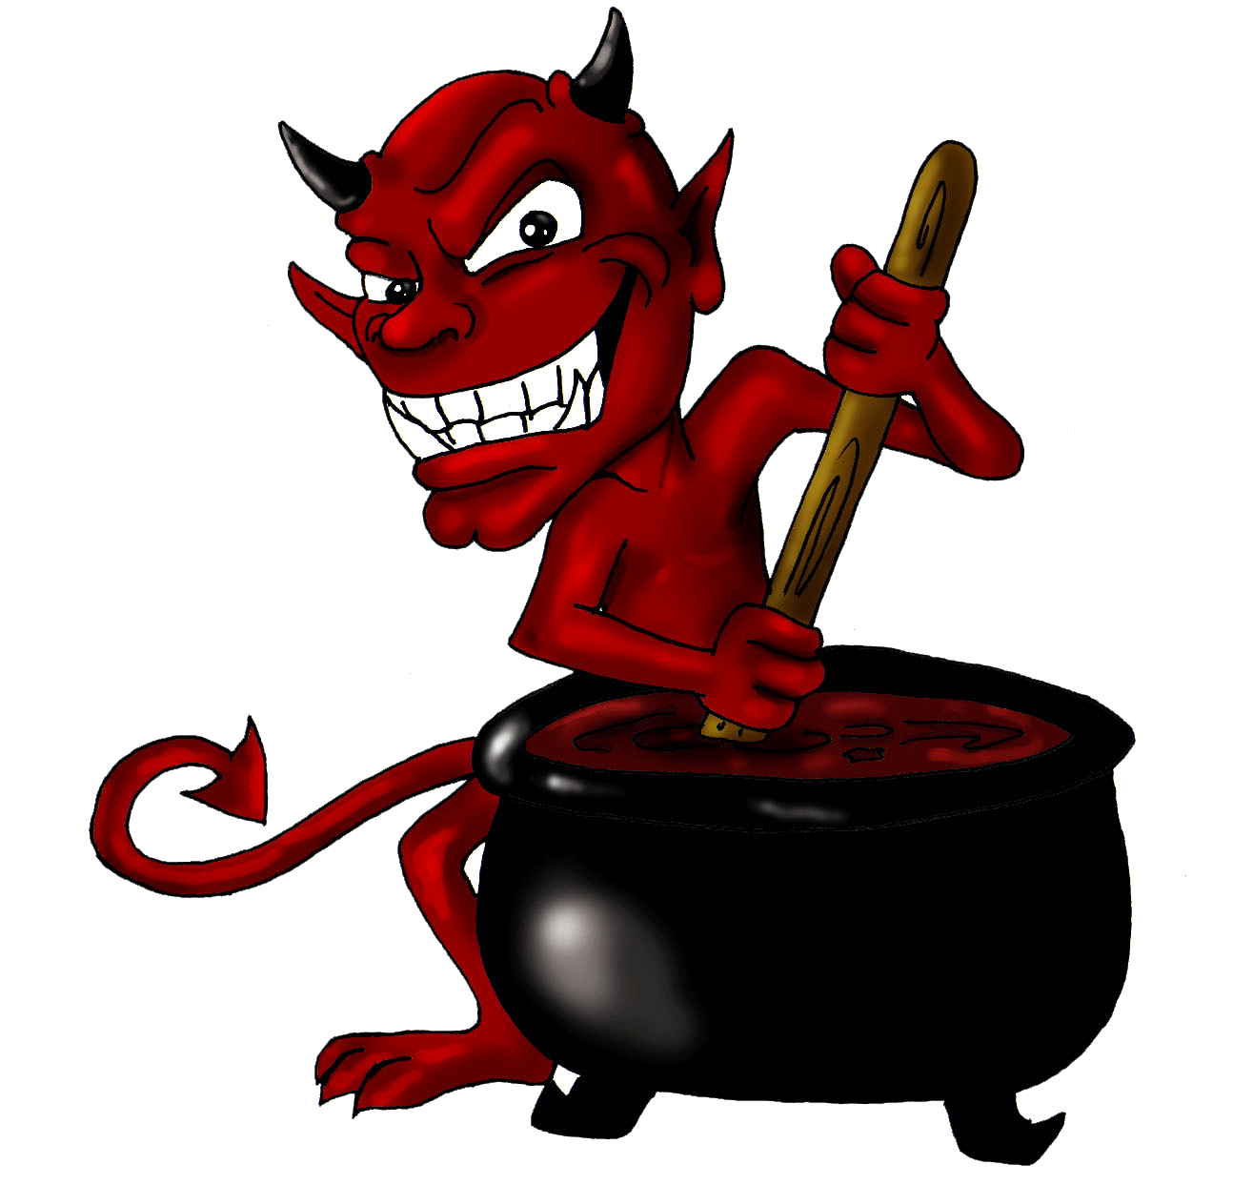
Some cats they know how to fight Some cats run I'm a thousand generations ahead of them Cool as they come See all my suits are Calvin Klein My lucky number: 69 I got all the things I need It's the nature of my breed I'm independent Smooth and confident Always in command With a graceful element A taste for compliment Do you know who I am? Look up, look down, watch out, the tiger's on the town tonight I'm a deadly handsome man Look up, look down, watch out, the tiger's on the town tonight I'm the lion in the lamb Everywhere I go I make a scene The ladies love to stroke me, yeah Pimped out and lazy in my limousine Oh, come on here sweetie Everything I say - like Socrates Most people love to quote me My real name is Mephistopheles But you can call me baby
The Devil's Song
Marcy Playground

Slide 2
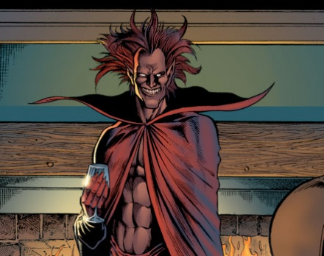
'Mephisto' in Marvel Comics
Mephisto is a prominent character within the Marvel comics. A ruler of what he calls Hell or Hades, but this actually does not refer to the Biblical Hell or the Olympian Hades.
He is known to impersonate the Blblical Satan.
Exploits people for fun.
He is particularly interested and fascinated by Earth's super-beings. He exploits and tries to tempt the earth-bound Surfer with physical power and pleasure.
An all-round MANIPULATOR and CONTROLLER of other characters so as to gain power for himself.

Slide 3
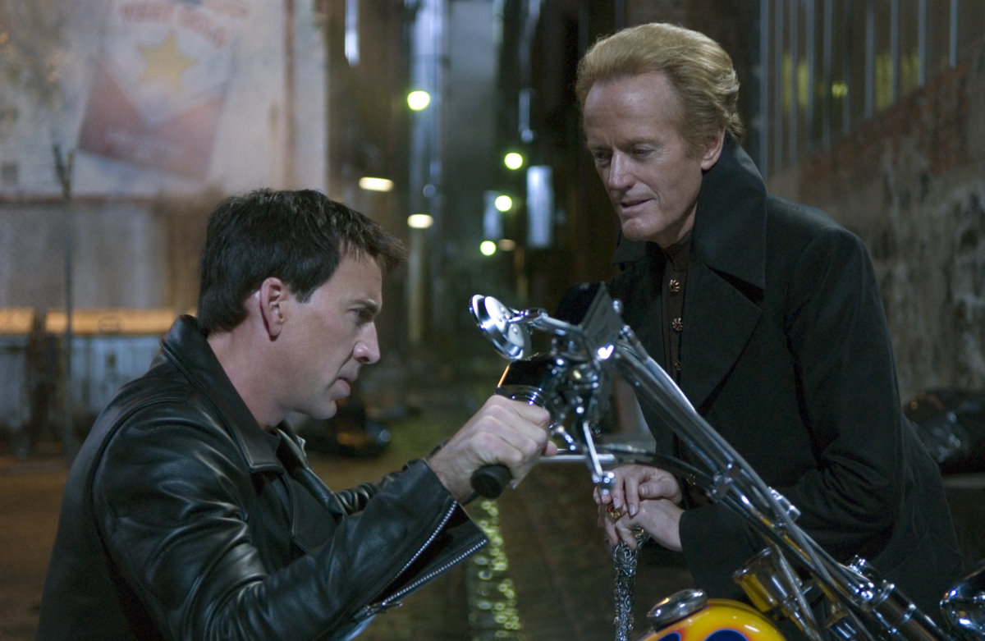
Notably, in 'One More Day' (2007 Spiderman crossover series), Mephisto took advantage of Spider-Man's desperation to save his Aunt May's life, after she was shot: in exchange for her restored health, Spider-Man had to sacrifice his marriage to Mary Jane Watson, as the demon would revel in the elimination of a sacred and holy bond of love, and Spider-Man's innate suffering (despite losing memory of the event). The couple agreed, and Mephisto altered time such that the Parkers never exchanged wedding vows. As part of the deal, Mephisto removed the knowledge of Spider-Man's secret identity from the world.
He has also particularly coveted the Silver Surfer's pure spirit. Mephisto tried to tempt the newly Earth-bound Surfer with power and physical pleasure, but the Surfer resisted. Undeterred by this failure, Mephisto has repeatedly threatened the Surfer, the Ghost Rider, and Daredevil amongst others, and has captured the souls of the likes of the Fantastic Four.
(Peter Fonda as Mephisto [Mephistopheles], with Nicholas Cage)
http://marvel.com/universe/Mephisto

Slide 4
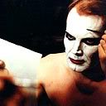
Mephisto-The Movie
Mephisto is the 1981 film adaptation of Klaus Mann's novel, Mephisto.
The film adapts the story of Faust by having the main character Hendrik Höfgen abandon his conscience and continue to act and ingratiate himself with the Nazi Party so as to keep and improve his job and social position.
The plot's bitter irony is that the protagonist's most fond dream is to play Mephisto - but in order to achieve this dream he in effect sells his soul, and realises too late that in reality he is Faustus; it is the Nazi leader having a major role in the film who is the true Mephisto. This was also modeled on Goering.
Both the film and Mann's 1936 novel mirror the career of Mann's brother-in-law, Gustaf Gründgens, who is considered by many to have supported the Nazi Party and abandoned his previous political views for personal gain rather than conscience. (Playing Mephisto was indeed the peak of Gründgens' career, though in reality this was long after the fall of the Nazis.)
The film offers a more realistic exploration of a flawed but recognisably human character.
(Klaus Maria Brandauer as Hendrick Höfgen)
The film is dark and satirical. Its use of the Nazi Party, one of 20th centuries most famous dictatorships, is extremely effective. It raises big moral and cultural questions; but to a personal level, as everyone has desire of personal advancement and success. The use of politics and the fact that we are able to relate the devil within a politician, and Faustus within an ordinary human being (especially in today's society where there is so much political corruption and intrigue), shows that perhaps there is a Mephistopheles and a Faustus in everyone of us-and it shows it in a not so comic way.

Slide 5
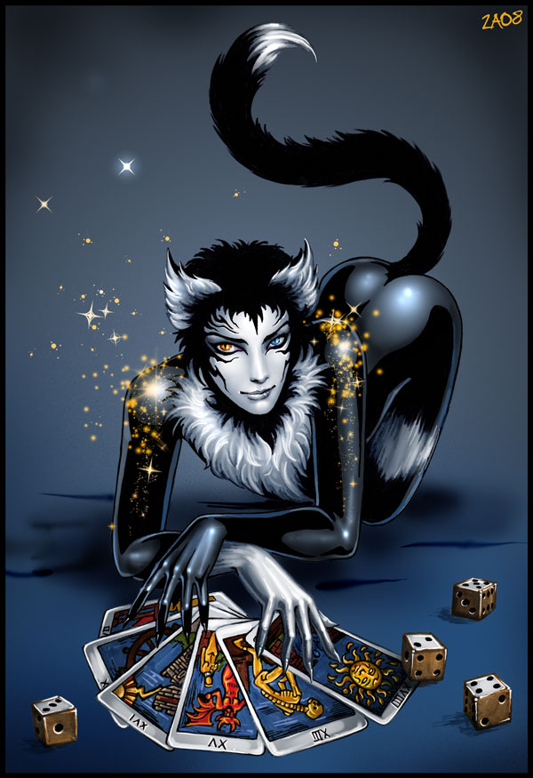
Mr.Mistoffelees
'Please listen to me and don't scoff. All his Inventions are off his own bat. There's no such Cat in the metropolis; He holds all the patent monopolies For performing suprising illusions And creating eccentric confusions. At prestidigitation And at legerdemain He'll defy examination And deceive you again. The greatest magicians have something to learn From Mr. Mistoffelees' Conjuring Turn.'
From T.S Eliot's Old Possum's Book of Practical Cats Practical Cats
In the musical, Cats, Mr.Mestoffelles is a principal character, where the role is demanding.-both dance and singing ability wise. Although Mr.Mistoffelees is not an 'evil' character, he is attributed a lot of power and sigificance. All the other cats look up to him.
Does this character actually have more in common with Faust than the Devil? Could we perhaps say that Faust and Mephistopheles are not that different?

Slide 6
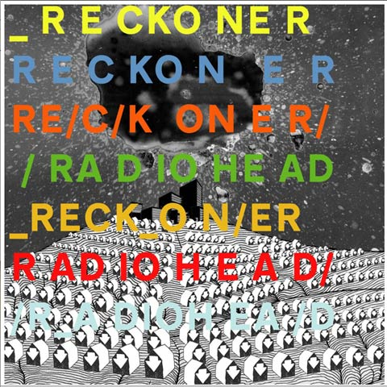
‘Videotape’ - Radiohead
http://www.youtube.com/watch?v=Qvv-LpTBWVk
When I'm at the pearly gates This'll be on my videotape My videotape My videotape Mephistopheles is just beneath And he's reaching up to grab me This is one for the good days And I have it all here in Red, blue, green Red, blue, green You are my centre when I spin away Out of control on videotape On videotape On videotape On videotape This is my way of saying goodbye Because I can't do it face to face So I'm talking to you before No matter what happens now I won't be afraid Because I know Today has been the most perfect day I have ever seen
Reckoner contains tracks that allude to the Faust myth (quite cryptically!) – but Videotape is the only one that alludes to the character of Mephistopheles directly. This song is very open to interpretation – but our take on this is that Mephistopheles is used in this song as a sort of exposition of man as a sinner, dealing with man’s internal, personal demons: it is told from the perspective of a Faustian figure. Mephistopheles is seen “reaching up to grab” the narrator – the tone of this song can be interpreted as apologetic, so Mephistopheles can be seen as an instigator of irresistible temptations, or as a symbol of the narrator’s inevitable descent into Hell. The “most perfect day” the narrator “has ever seen” can relate to the bargain between Faust and Mephistopheles (Faust’s soul would belong to Mephistopheles if he states that he would like a moment of complete satisfaction to last forever) in Goethe’s Faust. We can see, then, that the narrator is destined to fall, as he makes such a statement.

Slide 7
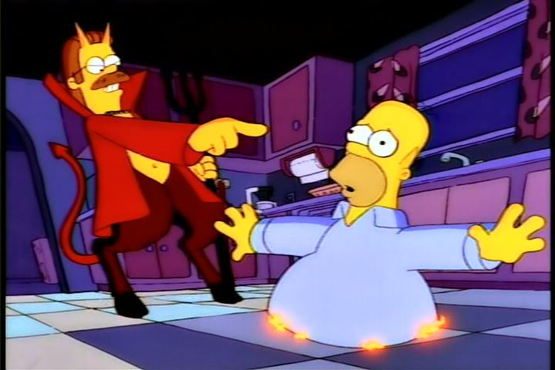
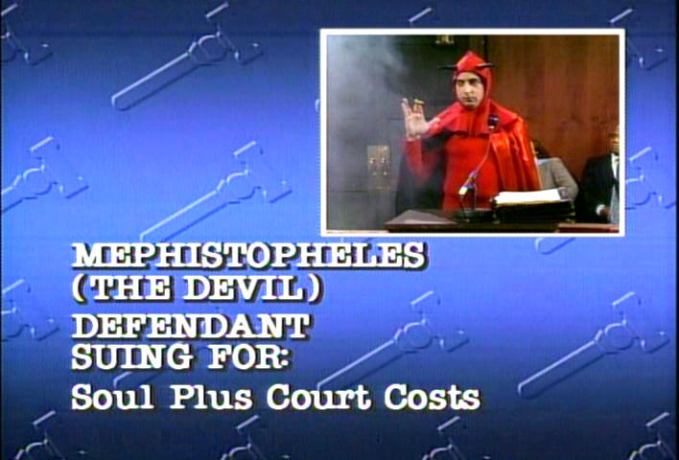
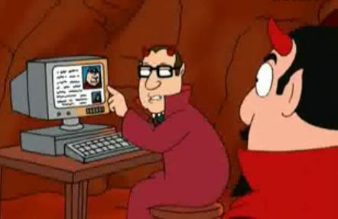
Mephistopheles in satire
(Family Guy):
Peter: [making a birthday wish] I'd sell my soul to be famous. [Cutaway to Hell. The Devil gets a message instantly] Devil: Oop, I got a live one. Peter Griffin. Assistant: Ooh, sorry, chief. Seems he already sold his soul in 1976 for Bee Gees tickets, and again in 1981 for half a mallomar. Devil: Aw, heck, where's a lawyer when I need one? [behind him, several hundred men holding pitchforks raise their hands]
http://www.youtube.com/watch?v=X3ZcZ2h4Ths
http://www.morethings.com/fan/saturday_night_live/jon_lovitz/mephistopheles_photo_gallery-01.htm

Slide 8
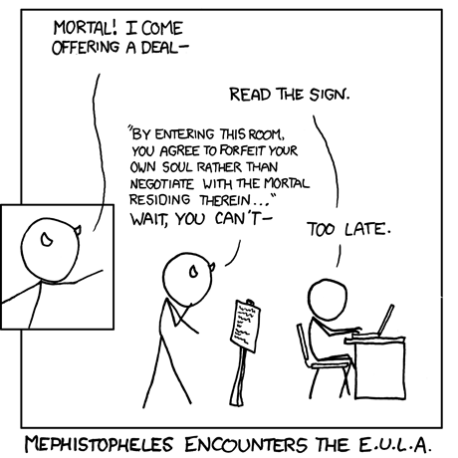
In popular satire, the devil is not necessarily named as Mephistopheles, but is depicted as a cartoonish, exaggerated devil making pacts with characters that audiences are familiar with (such as Flanders-devil in The Simpsons or The Devil in Family Guy). The devil is also depicted as someone that is somehow thwarted by mundane aspects of today’s society, such as court/legal cases (xkcd webcomic, Saturday Night Live). They are often shown as stereotypical images of the devil, with red clothing/capes and horns, making them instantly recognisable. Each example also uses colloquial, everyday language, making them almost identifiable with audience.
Devils dwarfed by aspects of a contemporary capitalist society – cynical look at contemporary life as we recognise the things that would once have been considered as sins?
Recognition of the devil not as a literal presence, but rather used as device to illustrate man’s evils/flaws/stupidity (the latter referring particularly to the likes of The Simpsons, Family Guy, Pinky and the Brain), or man’s internal demons
Maybe even a comment on how complacent/arrogant society might have become? Idea of being able to argue way out of anything: trivialising the Devil and his powers.

Slide 9
Post-Christian Mephistopheles
Starting with the Enlightenment there was a move towards rationalism when the idea of the Devil was seen more as a symbol of an internal struggle, rather than a literal metaphysical struggle, as in the time of the Faustbook. Goethe “always vehemently denied the literal existence of the Christian devil.”
So nowadays, it’s more external than internal as it deals with our own personal demons. There is more concentration on the self but the character of the devil is as good a representation of this as any.
In some adaptations, such as David Mamet’s play the Mephistopheles figure is a banker-a human being.

Slide 10
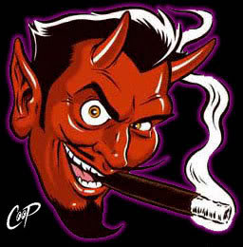
Post-Christian Mephistopheles
Whether mocked or taken seriously, it is still a commonly recognised figure. It can now represent the generalised struggle and problems of evil as opposed to a specific metaphysical presence.

Slide 11
Watch this space: New Faust movie currently in production, with Moritz Bleibtreu cast as Mephisto… http://www.dreadcentral.com/news/33088/moritz-bleibtreu-set-play-faust-remake http://www.imdb.com/title/tt1494712/

