Slide 1
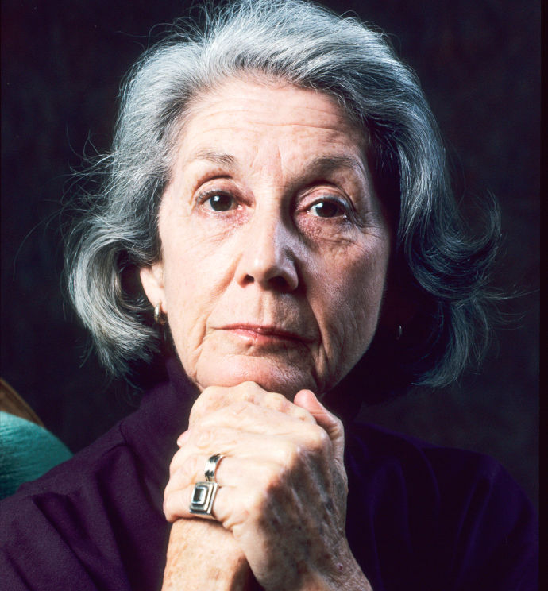

Slide 2
‘If you want to know the facts of the retreat from Moscow in 1815, you may read a history book; if you want to know what war is like, and how people of a certain time and background dealt with it as their personal situation, you must read War and Peace’.
(Nadine Gordimer, The Black Interpreters)

Slide 3
The truth of Gordimer’s work does not arise from any metaphysical powers attributed to the writer as a person. It issues from what readers perceive as the imaginative integrity and the veracity of the world represented in the art, which in return, is offered to the world for scrutiny and appraisal. This is to be found in abundance in everything Gordimer has written. Her work… is the product of artistic and ethical deliberation. It is shaped by a form of creativity which, when we encounter it, emboldens us to enlarge our freedom so that no one is excluded from it… [T]o read Gordimer is to be transported into worlds seemingly familiar but always profoundly unconventional which beckon us to meet the challenges they pose. Within the spaces established by her fiction and her essays she crystallises and brings into regard the life, thoughts, feelings, sensations and otherwise imperceptible impulses concealed below the surfaces of everyday life. Reading her is to experience again, and from different perspectives, what it means to have lived in South Africa [since 1948]… Her writing is charged with the great and subtle forces of our age. At the same time, her texts resonate with what lies beyond the present future. Her work therefore makes readable the outlines of our future. Right from the beginning her writing does not await our liberation but enacts it.
It is for this reason that… [J.M.] Coetzee, citing the Russian writer Anna Akhmatova, referred to her as ‘a visitor from the future’ (Andries Oliphant).

Slide 4
https://www.youtube.com/watch?v=M6f8p8OydHA

Slide 5
‘If Gordimer has, as she has commented on more than one occasion, written one novel throughout her life, she has done so through a twofold process, the private life accreting public overtones, the public situation inhabiting private conditions’.
John Cooke, The Novels of Nadine Gordimer: Private Lives/Public Landscapes

Slide 6
In 1994, the struggle, the final process of decolonisation was achieved after decades when the end receded again and again. In April 1994 South Africans of all colours went to the polls and voted into power their own government, for the first time. There are now no overlords and underlings in the eyes of the law. What this means to our millions is something beyond price or reckoning that we know we shall have to work at and put into practice, just as we worked for liberation. We know we have to perform what Flaubert called ‘the most difficult and the least glamorous of all tasks: transition’. This is the reality of freedom. This is the great matter.
I am a small matter; but for myself there is something immediate, extraordinary, of strong personal meaning. The other world is no longer the world. My country is the world, whole, a synthesis. I am no longer a colonial. I many now speak of ‘my people’.

Slide 7
An interregnum (plural interregna or interregnums) is a period of discontinuity or ‘gap’ in a government, organization, or social order.
Antonio Gramsci:
La crisi consiste appunto nel fatto che il vecchio muore e il nuovo non può nascere: in questo interregno si verificano i fenomeni morbosi piú svariati.
Translation: The crisis consists precisely in the fact that the old is dying and the new cannot be born; in this interregnum a great variety of morbid symptoms appear.

Slide 8
‘[I]nstead of crimes by the black and poor, shading into primitive accumulation by gang capitalists (as in Russia or Serbia)…in the foreground of the plot there is a bourgeois murder in which a young white architect…kills one of his friends with a gun. This brings white-identifying readers into the circle of violence, not as victims, vengeance seekers, or moral and legal theorists, but as perpetrators and affectional accomplices. It brings them face to face with a new staple of white South African life, the house gun, which is now seen in a new light, turning the suburban outrage over violent crime back on itself without invoking a politically more overt – but also more easily distanced – image of white gunplay…[The House Gun] is an exercise in white conscientisation, in paying back the wages of whiteness’.
(Alex O’Brien, Against Normalization: Writing Radical Democracy in South Africa)

Slide 9
Few of the doctor’s patients connected her with one of the cases of violence they might have read about. There were so many in a region of the country where the political ambition of a leader had led to killings that had become vendettas, fomented by him, a daily tally of deaths was routine as a weather report; elsewhere, taxi drivers shot one another in rivalry over who would choose to ride with them, quarrels in discotheques were settled by the final curse-word of guns. State violence under the old, past regime had habituated its victims to it. People had forgotten there was any other way.
(The House Gun, pp. 49-50)

Slide 10
There had been so much cruelty enacted in the name of that State they had lived in, so many fatal beatings, mortal interrogations, a dying man driven across a thousand kilometres naked in a police van; common-law criminals singing through the night before the morning of execution, hangings taking place in Pretoria while a second slice of bread pops up from the toaster – the penalty unknown individuals paid was not in question compared with state crime. (The House Gun, p. 126)

Slide 11
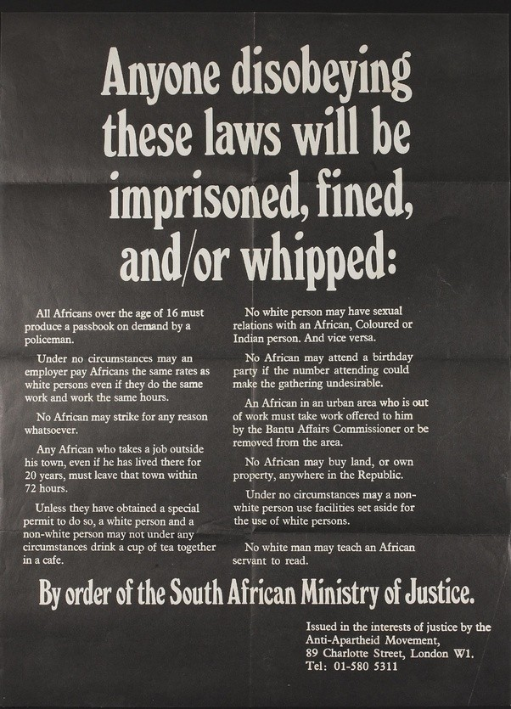

Slide 12
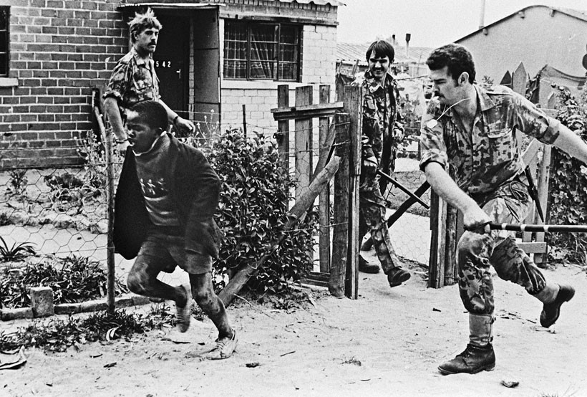

Slide 13
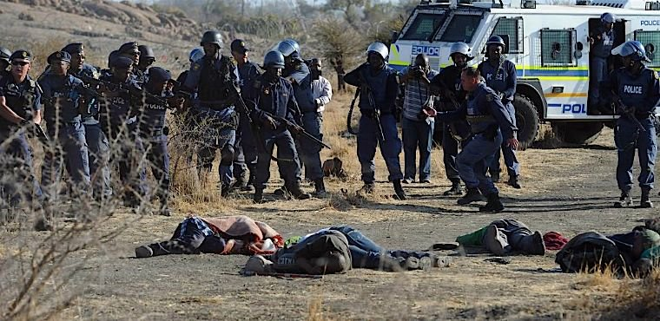

Slide 14
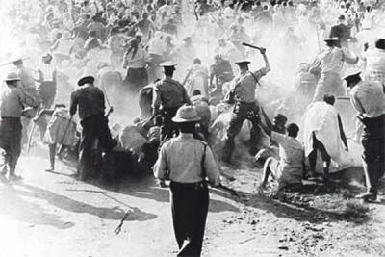

Slide 15
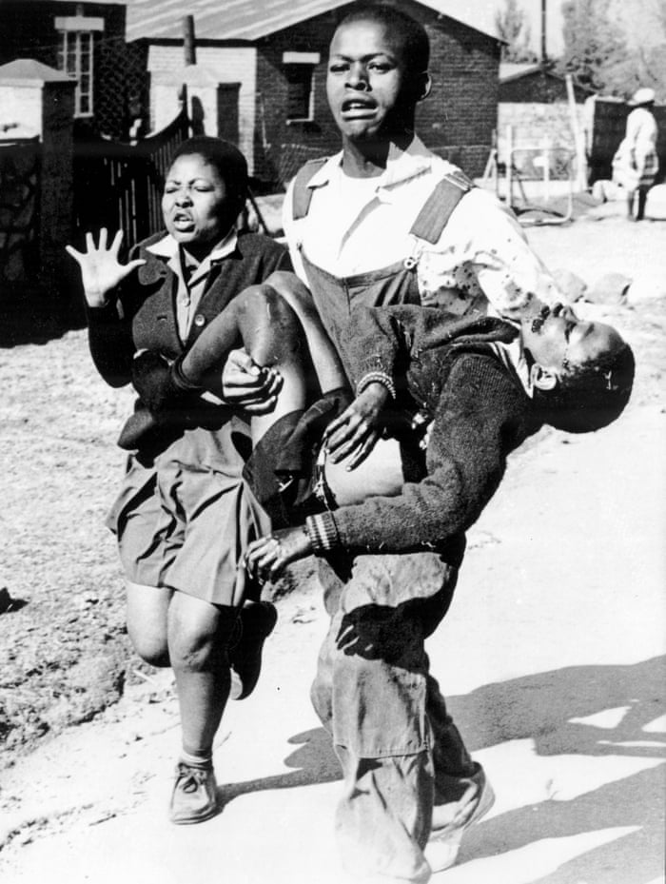

Slide 16
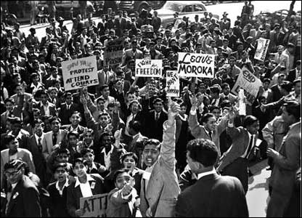

Slide 17
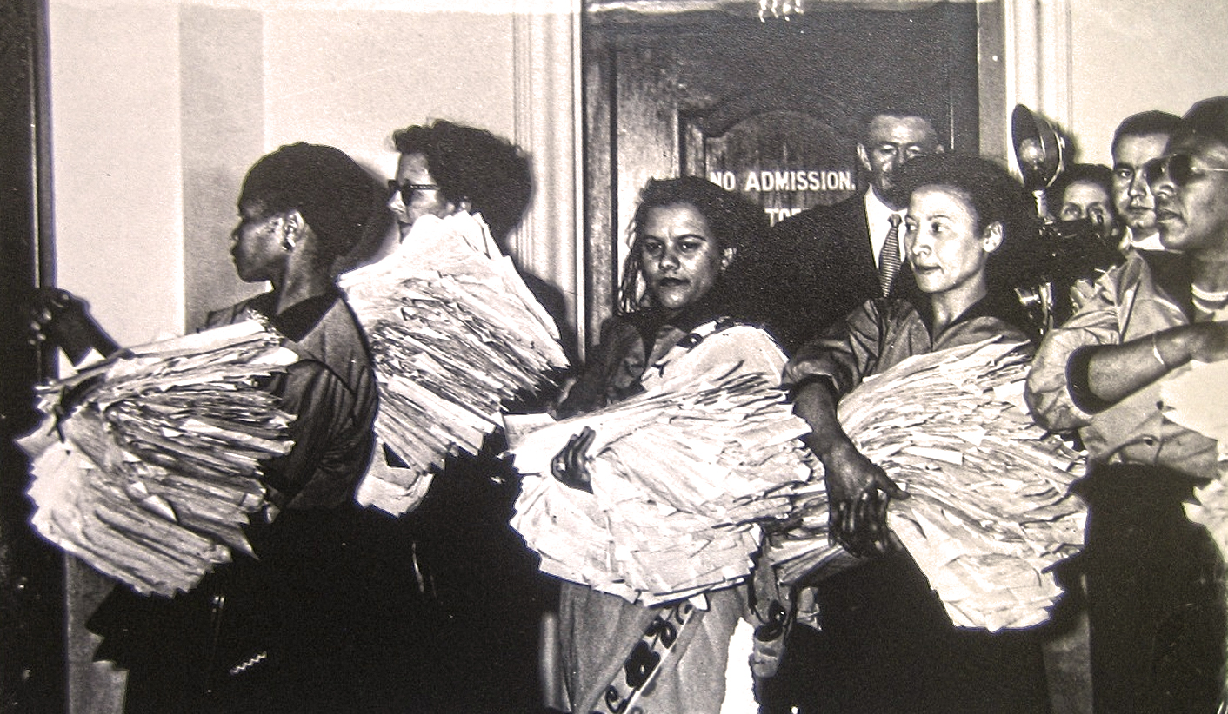

Slide 18
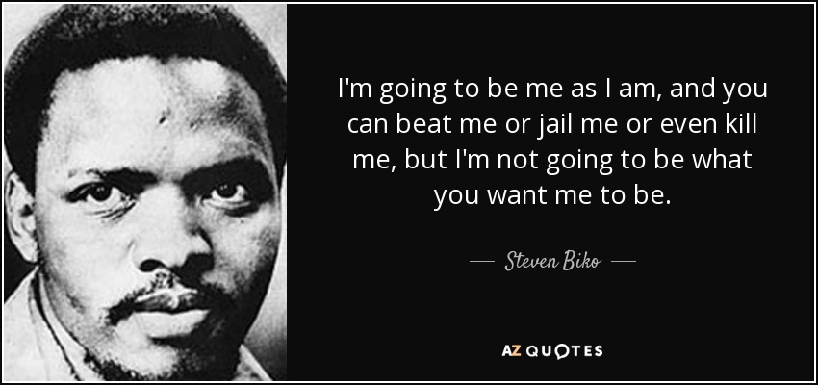

Slide 19


Slide 20
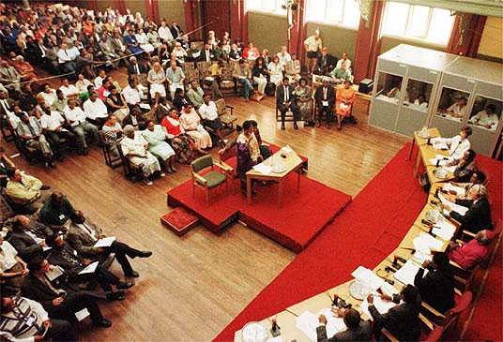

Slide 21
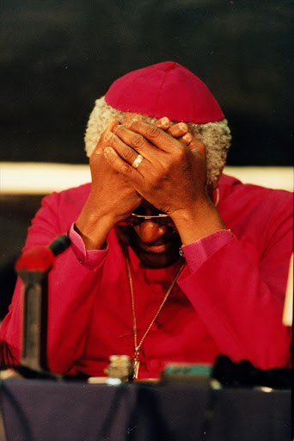

Slide 22
The Lindgards were not racist, if racist means having revulsion against skin of a different colour, believing or wanting to believe that anyone who is not your own colour or religion or nationality is intellectually and morally inferior [….] Yet neither had joined movements, protested, marched in open display, spoken out in defence of these convictions. They thought of themselves as simply not that kind of person; as if it were a matter of immutable determination, such as one’s blood group, and not failed courage.
(The House Gun, p. 86)

Slide 23
He/she. He strides over and switches off the television. And expels a violent breath. So long as nobody moved, nobody uttered, the word and the act within the word could not enter here. Now with the touch of a switch and the gush of a breath a new calendar is opened. The old Gregorian cannot register this day. It does not exist in that means of measure.
(The House Gun, p. 5)

Slide 24
There is a labyrinth of violence not counter to the city but a form of communication within the city itself They no longer were unaware of it, behind security gates. It claimed them […] Violence: a reading of its varying density could be taken if a device like that which measures air pollution were to register this daily
(The House Gun, p. 141)

Slide 25
https://www.youtube.com/watch?v=KI3eGU_wmHg

Slide 26
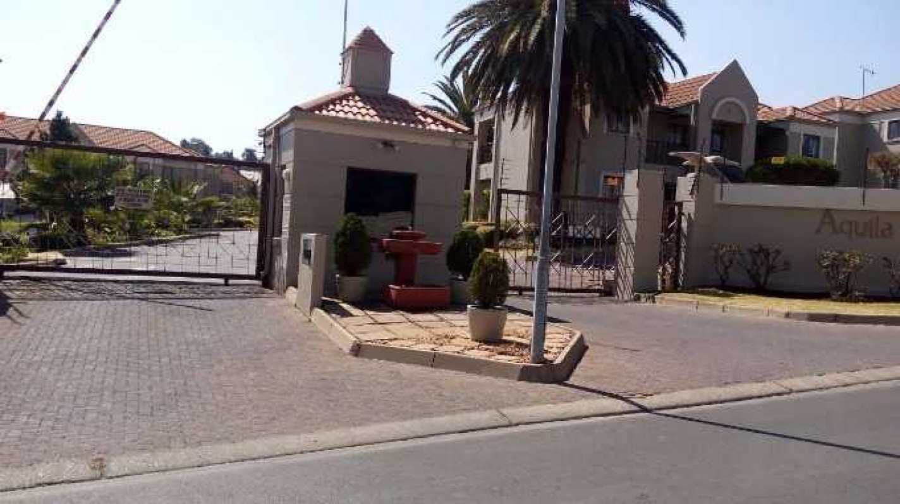

Slide 27
The truth of all this was that he and his wife belonged, now, to the other side of privilege. Neither whiteness, nor observance of the teachings of Father and Son, nor the pious respectability of liberalism, nor money, that had kept them in safety – that other form of segregation – could change their status. In its way, that status was definitive as the forced removals of the old regime; no chance of remaining where they had been, surviving in themselves as they were.
(The House Gun, p. 127)

Slide 28
‘Without rejection of all that is humane, in the times only just become the past a human being could not have endured the inhumanity of the old regime’s assault upon body and mind, its beatings and interrogations, maimings and assassinations, or his own need to plant bombs in the cities and kill in guerrilla ambushes. Is that what this text is saying to Harald? What happens, afterwards, to this rejection of all that is human that has been learnt through so much pain, so lacerating and passionate a desperation, a deliberate cultivation of cruel unfeeling, whether to endure blows inflicted upon oneself, or to inflict them on others? Is that what is living on beyond its time, blindly roving; not only the hut burnings and assassinations of atavistic political rivalry in one part of the country, but also the hijackers who take life as well as the keys of the vehicle, the taxi drivers who kill rivals for the patronage of fares, and gives licence to a young man to pick up a gun that’s to hand and shoot in the head a lover (lover of a lover, in God’s name, who can say) – a young man who was not even subject to the fearsome necessities of that revolution, neither suffering blows inflicted upon himself, nor inflicting suffering upon others, as with the connivance of his parents he never was thrust further into conflict than the training camps where his target was a dummy. Violence desecrates freedom, that’s what the text is saying. That is what the country is doing to itself; he knows himself as part of it, not as a claim that what his white son has done can be excused in a collective phenomenon, an aberration passed on by those in whom it mutated out of suffering, but because violence is the common hell of all who are associated with it’. (The House Gun, pp. 142-3)

Slide 29
Because of the old conditioning, phantom coming up from somewhere again, there is awareness that the position that was entrenched from the earliest days of their being is reversed: one of those kept-apart strangers from the Other Side has come across and they are dependent on him. The black man will act, speak for them. They have become those who cannot speak, act, for themselves (The House Gun, pp. 88-9).

Slide 30
Damaged intersubjectivity
‘Wrong life cannot be lived rightly’
(Adorno)
Can we ‘raise the…question whether after Auschwitz you can go on living’. A situation in which ‘mere survival calls for the coldness, the basic principle… without which there could have been no Auschwitz’
(Adorno).

Slide 31
‘She, to whom everything was permissible, would not hesitate to abuse him for what she actually regarded as of no account. In confidence in the freedom of experience, of emotions, she professed and practised, he had done what he never should have – told her of the incident, no, be honest, it was more than that: the time with Jespersen. Given her a weapon to whirl above his head, hold at his throat, and when she saw in him the reaction she wanted, whip away as a big joke’ (The House Gun, p. 152).
‘Love you will find only where you can show yourself weak without provoking strength’ (Adorno).

Slide 32
‘He, she – twitch of a smile, he got himself up with languor directed at her and went to life the nearest receiver. Who, she half-heard him say, half-listening to the commentary following the images, Who’ (The House Gun, pp. 3-4).
‘The place of the narration is outside both characters, yet rather than simply expressing antithesis between Harald and Claudia, it seems also to inhabit both of their minds and reverberate between them’
(Stephen Clingman ‘Surviving Murder: Oscillation and Triangulation in The House Gun’ )

Slide 33
‘We have here a degree of separation between characters in space and time, yet with something more like a wave motion, or flow, or oscillation of communication between them…The implication is that Harald and Claudia are in this situation together, must make sense of the impossible together: that awareness is distributed, collective, and collaborative, even when different. Oscillation becomes a less sharp, in its essence a more forgiving, mode of representation; for Gordimer’s work it becomes a different version of perception and – in its deepest sense – communication in South Africa’.
(Stephen Clingman, ‘Surviving Murder: Oscillation and Triangulation in Nadine Gordimer’s The House Gun’

Slide 34
‘The moment when you put your hand out to do it – the man in the madhouse was right, I don’t remember that moment but I reconstruct it, I’ve had to; I’ve found out that you think it’s a discovery, it’s something that’s come to you that has never been known before. But it’s always been there, it’s been discovered again and again, forever. Again and again, what Odysseus did, and what Homer, whoever he was, knew. Violence is a repetition we don’t seem able to break; oh look at them, my brothers – Bra, they have the right to claim me, we crowd of feasters on our own carrion in this place made secure for us alone – I look at them when we’re in the yard for our exercise, and they tramp and they lope round and round, round and round. I haven’t come to the end of the book, I don’t know how Odysseus reconstructed what he did, what way he found for himself. Put out your eyes. Turn the gun on your own head.
Or throw away the gun in the garden. That was a choice made. Can you break the repetition just by not perpetrating violence on yourself. I have this life, in here. I didn’t give it for his. I’ll even get out of here with it, some year or other. The murderer has not been murdered. My luck, this was abolished in my time. But I have to find a way. Carl’s death and Natalie’s child, I think of one, then the other, then the one, then the other. They become one, for me. It does not matter whether or not anyone else will understand: Carl, Natalie/Nastasya and me, the three of us. I’ve had to find a way to bring death and life together’. (The House Gun, pp. 293-4)

Slide 35
Khulu’s message to Duncan:
UNGEKE UDLIWE UMZWANGEDWA SISEKHONA (pp. 249-50)
Translated as ‘something like, you will never be alone because we are alone without you’.
Literally: ‘Never were you eaten by sorrow, we are still here’.

Slide 36
O’Brien reads the ‘translation’ as follows: ‘the moving and elegant double negative “alone without you”… goes further than the literal sisekhona [‘we are still here’] toward asserting the commitment of Khulu’s friendship and his sadness. How does Duncan get to this translation? He must be translating the tone and context of Khulu’s text, putting into it the scene of friendship in the house, the courtroom, and the jail, literalizing presence as this presence, here, now, there, then, filling it with their history. The text of the translation is performative: if Khulu is still present (sisekhona) after the murder, all during the trial, after the verdict, during Duncan’s prison term (as he is), then he must be “alone without you”; he has performed that other feeling of aloneness by his very presence. The other phrase, ungeke udliwe umzwangedwa (‘never were you eaten by sorrow’) is also echoed rather than copied in Duncan’s version, ‘you will never be alone’. Apart from the optative change of tense to the future, the English ‘alone’ becomes a pivoting term describing a feeling common to both Khulu and Duncan, whereas the Zulu attributes sorrow, personal and private grief to Duncan and presence to Khulu. Duncan has come to terms with the distinction by overriding it: sameness replaces difference as the achievement of friendship, the asymmetrical Zulu flowing into the zeugma of the English sentence. His translation is an interpretation and a claim, capping Khulu’s gesture with a more intense response’. (The House Gun, pp. 249-50)

Slide 37
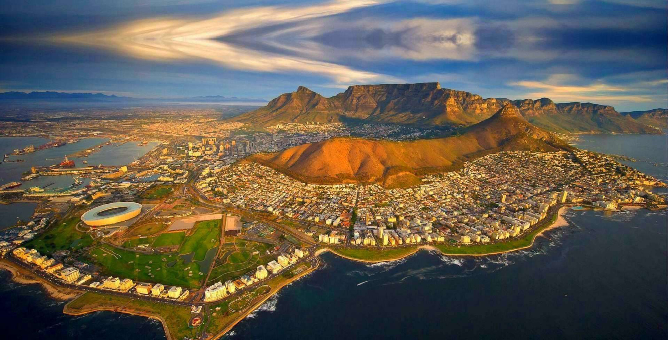

Slide 38
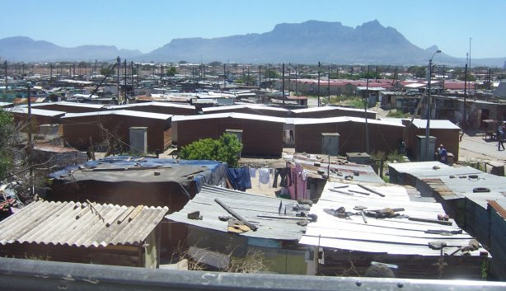

Slide 39
‘Motsamai was like his chambers, well-appointed. There was immense self-confidence in his combining the signs of success in a prestigious profession – the intercom instruction to his secretary to hold calls, the group photographs with distinguished Gray’s Inn colleagues in London, the library of law books with slips of paper standing up from their pages, marking frequent reference, the presentation plaque on the tray of desk-top accoutrements – with the wisp of bear just under the point of his chin that asserted a specific, traditional African style, another order of dignity and distinction… A new form of national sophistication. In his elegant grey suit, here is a man who has mastered everything, all contradictions that were imposed upon him by the past’.
(The House Gun, pp. 39-40)

