Slide 1

Studies in Postcolonial Literature

Slide 2

Dionne Brand:
“a significant postcolonial author”
“one of the most significant Caribbean writers today”
“one of Canada’s most important writers”
“a distinctive voice in Black Studies”

Slide 3
Postcolonial Studies
emerges as a distinct field of academic specialization in the 1970s; institutionally consolidated by the 1990s
Intellectual antecedents pre-date this; foundational to what would become ‘postcolonial studies’ is the work of anti-colonial writers, thinkers, and activists of the early to mid-twentieth century (e.g., C. L R. James, Aime Cesaire, Frantz Fanon, Amilcar Cabral, Leopold Senghor)
from the late 1970s onwards, the use of ‘postcolonial’ begins to evolve from a strictly historical meaning to become an ideological concept
Key canonical texts in the field: Edward Said, Orientalism (1978), Gayatri Spivak , “Can the Subaltern Speak”(1988), Homi Bhabha, The Location of Culture (1991)

Slide 4
Postcolonial studies as a response to end of the post-war economic boom and long downturn that begins in the 1970s
Emerges in the context of the various problems and pitfalls encountered by many Third World nationalist movements and independence projects in the 1970s
new imperialist offensives, particularly by the U.S.

Slide 5
Pablo Mukherjee:
“I take ‘postcolonial’ not as the sign of a clean historical break between the era of modern Euro-north American colonial domination and that of Asian, African, Latin American and Oceanic national self-determination; but rather as a historical condition of intensified and sustained exploitation of the majority of humans and non-humans of the former colonies by a cartel composed of their own and ‘core’ metropolitan European/north American elites. That is to say, the ‘post’ in postcolonial marks not an end of colonialism, but an end of a particular mode of colonialism which then shifts its gears and evolves to another stage (obviously triggering a concomitant shift in the global struggles against it). The [interests of the] globalized ruling classes of this postcolonialism [. . .] are often embodied in gigantic transnational corporations and the labyrinthine world of speculative financial transactions.” (Postcolonial Environments, 5-6)

Slide 6
Postcolonial Studies in Crisis:
“The shadow the 2003 US invasion of Iraq casts on the twenty-first century makes it more absurd than ever to speak of ours as a postcolonial world. On the other hand, the signs of galloping US imperialism make the agenda of postcolonial studies more necessary than ever” (Ania Loomba et al. Postcolonial Studies and Beyond, 1).
Neil Lazarus: “[the editors are] correct to insist that the ‘urgent’ task facing those in [postcolonial studies] today, in the wake of the invasion, occupation and, evidently, the long-term destabilization of Iraq, is to take central cognisance of the unremitting actuality and indeed the intensification of imperialist social relations in the times and spaces of the postcolonial world” (The Postcolonial Unconscious, 17).

Slide 7
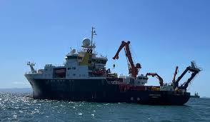
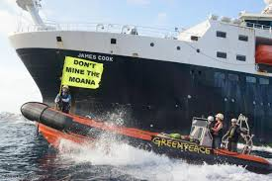

Slide 8
James Hita, Māori activist and Pacific lead for Greenpeace International’s deep sea mining campaign:
“While political tensions flare over whether to allow deep sea mining to start, commercial interests are pressing ahead at sea like it's a done deal. As if sending a ship to enable further destruction of our ecosystems wasn’t offensive enough, sending one named after the most notorious colonizer of the Pacific is a cruel insult. For too long, Pacific peoples have been excluded from decisions that impact our territories and waters. If governments don't stop this industry from starting, the darkest days of history will repeat. We reject a future with deep sea mining”.

Slide 9


Slide 10
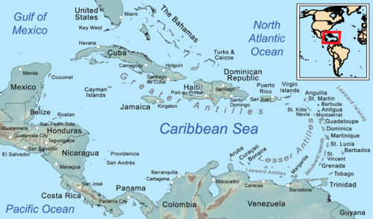

Slide 11
“This crisis pervades the intellectual climate. Brian Meeks suggests that perhaps we are in a stage of ‘terminal meltdown,’ David Scott argues that ‘there is scarcely a postcolonial society that is not in fundamental crisis,’ and Selwyn Ryan opines that the ‘tensions between economic distress and democratic governance’ engender regional political instability. In the contemporary period, ‘crisis’ is a much overworked label. As a political term it is a sign of instability, of chaos, of disorder, and broken social bonds. Clearly the Caribbean nation-states constructed from 1938 onward are in crisis.”
Anthony Bogues, “Politics, Nation and PostColony: Caribbean Inflections,” Small Axe 6.1 (2002): 6.

Slide 12
Aaron Kamugisha: The contemporary Caribbean “is in a state of tragedy and crisis, destroyed and corrupted by a postcolonial malaise wedded to neocolonialism” (1).
“antiworker states seduced and secured by client politics and a lurking ruthless authoritarianism” (1).
with “the effect of climate change so severe and political-economic marginality so acute, [. . .] it is not apocalyptic to wonder if the Caribbean will survive as we know it into the second half of the current century” (59).
Kamugisha, Beyond Coloniality (2019)

Slide 13
Norman Girvan: “When you combine acute climate change-related stress of this kind with (a) the acute economic stress arising out of erosion of trade preferences and the failure to develop a new “insertion” into the global economy, (b) fiscal stress due to unsustainable debt burdens and the impact of the global economic crisis; and (c) the seeming incapacity of governments to control the impact of transnational crime; one must wonder if we are not in fact experiencing an overlapping and interconnected series of challenges which in their totality, challenge the assumptions underlying the ‘national statehood’ dispensation of the region. Suppose, in other words, that we are not dealing simply with a series of ‘natural disasters’, but rather with a deeper, more systemic threat to the viability of our societies as functional entities in any meaningful sense of the word.” (“Are Caribbean Countries Facing Existential Threats” 2010)

Slide 14


