Slide 1

Caribbean Futurisms

Slide 2

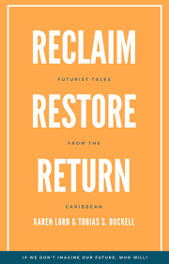

Slide 3
Lord: “Caribbean futurism – not a genre tag like the Afrofuturism of Wakanda and Beyonce, but a practical, results-oriented collaboration of literature, science and policy. [. . .] Caribbean futurism, where policy, science and technology, and the arts work together in a long game towards a better future for the region and the world.” (2, 4)

Slide 4

Nicola Hunte: “Caribbean futurism re-imagines futures and offers healing through imaginative redress. It claims agency in imagining the future for the region with narratives that project current social concerns through various speculative frames. This agency tends to be expressed in three main ways: collective action/communal links in the face of crisis; the use of technology to generate hope; and the presence of love and/or compassion.” (“Afrodiasporic Speculative Fiction” in The New Routledge Companion to Science Fiction” (2024), 168)

Slide 5


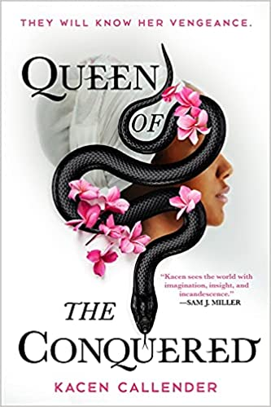
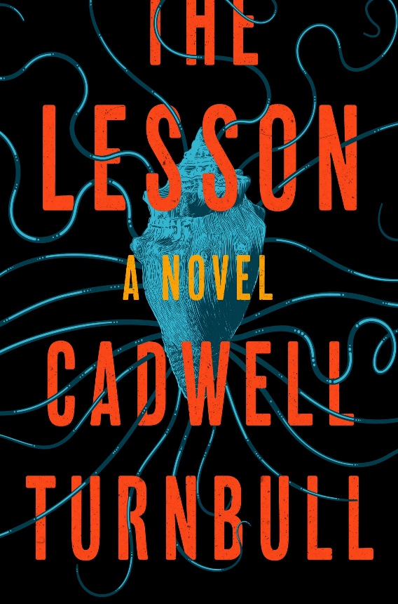

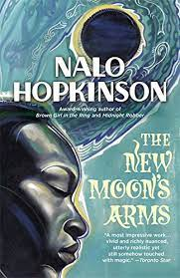
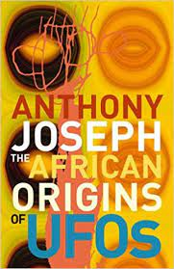
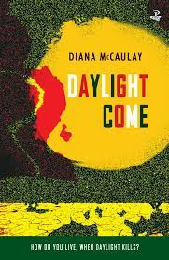
“We arrive backwards even as we voyage forward” (Wilson Harris, “Quetzalcoatl and the Smoking Mirror”).

Slide 6
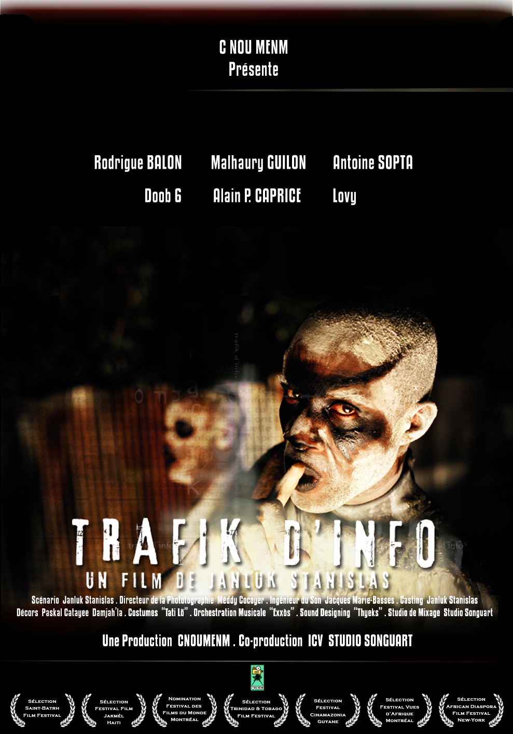
https://fourthree.boilerroom.tv/film/watch-caribbeans-first-sci-fi-film-trafik-dinfo-2005-exclusively-43

Slide 7
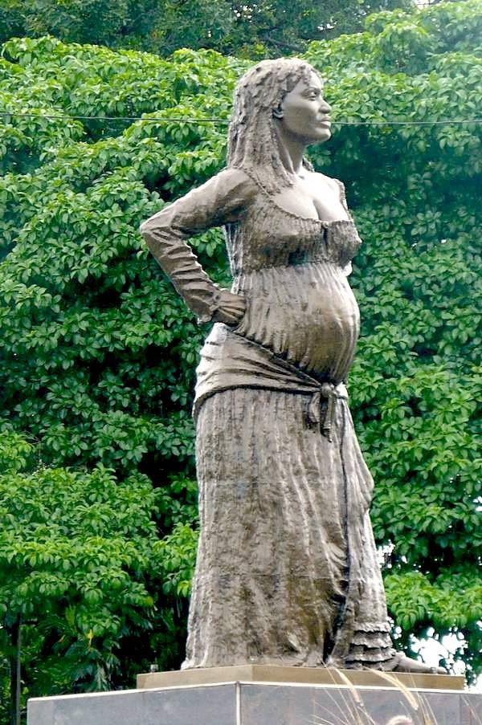
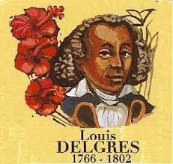

Slide 8
Brathwaite on catastrophe:
“My position on catastrophe [. . .] is, I’m so conscious of the enormity of slavery and the Middle Passage and I see that as an ongoing catastrophe. So whatever happens in the world after that, like tsunamis in the Far East and India and Indonesia, and 9/11, and now New Orleans, to me these are all aspects of that same original explosion, which I try constantly to understand.”
Joyelle McSweeney, ‘Poetics, Revelations, and Catastrophes: An Interview With Kamau Brathwaite’, Rain Taxi Online Edition, Autumn (2005). http://www.raintaxi.com/poetics-revelations-and-catastrophes-an-interview-with-kamau-brathwaite/

Slide 9
“Afrofuturism therefore stages a series of enigmatic returns to the constitutive trauma of slavery in the light of science fiction. [. . .] [S]lavery functioned as an apocalypse experienced as equivalent to alien abduction” (Kodwo Eshun, “Further Considerations of Afrofuturism,” CR: The New Centennial Review 3, no. 2 (2003): 301)
“The ships landed long ago: they already laid waste whole societies, abducted and genetically altered swathes of citizenry. . . . Africa and America—and so by extension Europe and Asia—are already in their various ways Alien Nation.” (Mark Sinker, “Loving the Alien”, 1992)

Slide 10
Andrea Shaw Nevins: Mark Dery proposes that African Americans—and I would include all New World Africans—“in a very real sense, are the descendants of alien abductees; they inhabit a sci-fi nightmare in which unseen but no less impassable force fields of intolerance frustrate their movements: official histories undo what has been done; and technology is too often brought to bear on black bodies.” As examples of this kind of technology, Dery cites “branding” and “forced sterilization.” One of the best-known accounts of such an abduction is found in The Interesting Narrative of the Life of Olaudah Equiano (1789).” (Working Juju, 103)

Slide 11
The Interesting Narrative of the Life of Olaudah Equiano
“The first object which saluted my eyes when I arrived on the coast, was the sea, and a slave ship, which was then riding at anchor, and waiting for its cargo. These filled me with astonishment, which was soon converted into terror, when I was carried on board. I was immediately handled and tossed up to see if I were sound, by some of the crew; and I was now persuaded that I had gotten into a world of bad spirits, and that they were going to kill me. Their complexions, too, differing so much from ours, their long hair, and the language they spoke (which was very different from any I had ever head), united to confirm me in this belief. Indeed, such were the horrors of my views and fears at the moment, that, if ten thousand worlds had been my own, I would have freely parted with them all to have exchanged my condition with that of the meanest slave in my own county. When I looked round the ship too, and saw a large furnace of copper boiling, and a multitude of black people of every description chained together, every one of their countenances expressing dejection and sorrow, I no longer doubted of my fate; and, quite overpowered with horror and anguish, I fell motionless on the deck and fainted.”

Slide 12
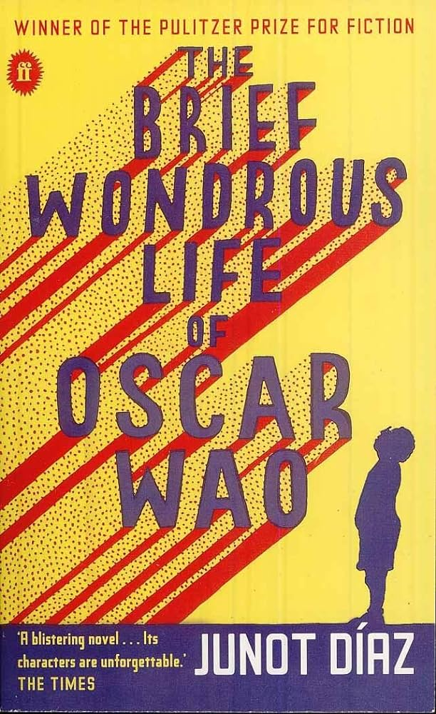
“Who more sci-fi than us?” Junot Díaz, The Brief Wonderous Life of Oscar Wao (2008)

Slide 13
Lord: “A focus on reclaiming sets the revolutionary tone of the anthology. Take control of the technology and processes that govern and regulate your daily life. Hold fast to your oceans and lands, and all the wealth they contain, for your generation and the generations to come. [. . .] There is no true hospitality without ownership. Offering a welcome into a home that is not yours makes you a servant, not a host.” (5)

Slide 14
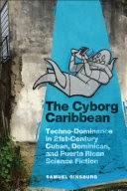
Samuel Ginsburg: “the line between real life and science fiction in the Caribbean continues to be blurred. The last decade has seen numerous examples of real-life narratives of technological attacks and resistance from the Caribbean and its diasporas. In 2013, a team of Dominican hackers from Yonkers, New York, was caught participating in an international ATM heist that stole $45 million worldwide. In 2017, the possibility of covert attacks on diplomats using weaponized supersonic devices starting the previous year caused the U.S. Embassy in Havana to recall all nonessential personnel, though a Central Intelligence Agency (CIA) assessment in 2022 has ruled out the theory that the mysterious “Havana syndrome” was the result of a coordinated, hostile attack. Since 2018, the aftermath of devastating hurricanes have opened the door for digital currency investors to flock to Puerto Rico with the hopes of creating a “crypto utopia” on the island. The genre of science fiction allows Caribbean writers and artists to negotiate the past, navigate the pre-sent, and speculate on the future of techno-domination.” (The Cyborg Caribbean 5)

Slide 15
Odilius Vlak (2017):
“It is the genres of science fiction and fantasy that have the resources to contend with our reality. . . . It is impossible that we as Caribbean writers remain apathetic in front of a reality that dominates us: one must fight fire with fire. It is not enough to imitate, but instead one must take the fundamental principles of genre literature . . . and extrapolate them to our history, myths, folklore, urban legends, and, obviously, our future.)”

Slide 16


Slide 17
Ryan Cecil Jobson: “The survival of the Caribbean hangs in the balance [. . .]. Our criticism can no longer take for granted the existence of the Caribbean as a habitable geography. While Dipesh Chakrabarty regards this as an occasion to collapse an artificial distinction between human and natural history in service of a “new universal history of humans that flashes up in the moment of the danger that is climate change,” his appeal too easily effaces the uneven political geographies borne out of histories of racial bondage. This new universalism poses a unique predicament for the Caribbean. The survival of the species may well be secured after the onset of Caribbean extinction. Beyond its status as the proverbial canary in the climatological coal mine, the Caribbean is a measure of the limits of liberal universalism and the category of the human it purports to defend. Will the survival of humanity once again rest on the backs of the innumerable Caribbean dead? Or will the changing climate occasion a turn to the Caribbean as a staging ground for a radical humanism unencumbered by the colonial logic of sovereignty”. ("States of crisis, flags of convenience: An introduction." Small Axe: A Caribbean Journal of Criticism 24.2 (2020): 67-77)

Slide 18
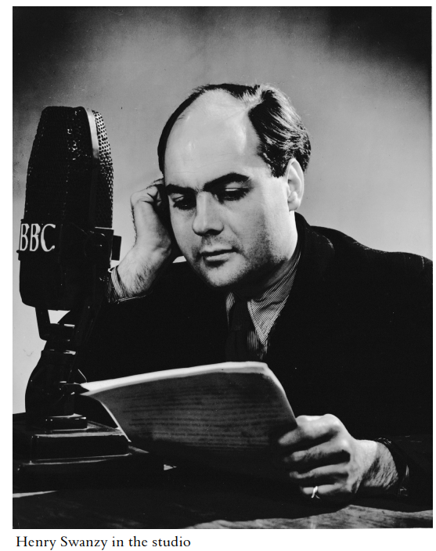

Slide 19
Henry Swanzy’s diaries, 23rd April, 1954:
“Two more macabre Voices. Gordon [Woolford] reads “The Red Penny,” by Naomi Gibbins, a murder by razor, and Pauline [Henriques] “The Sign” by Lloyd Clarke, a haunting. Both contain racial undertones. Something is going sour with the programme, it was better in the old days, with clumsy peasant stories, honest to God protest? Yet perhaps these were a mask too, acceptable to the latter-day Imperialist…”

Slide 20
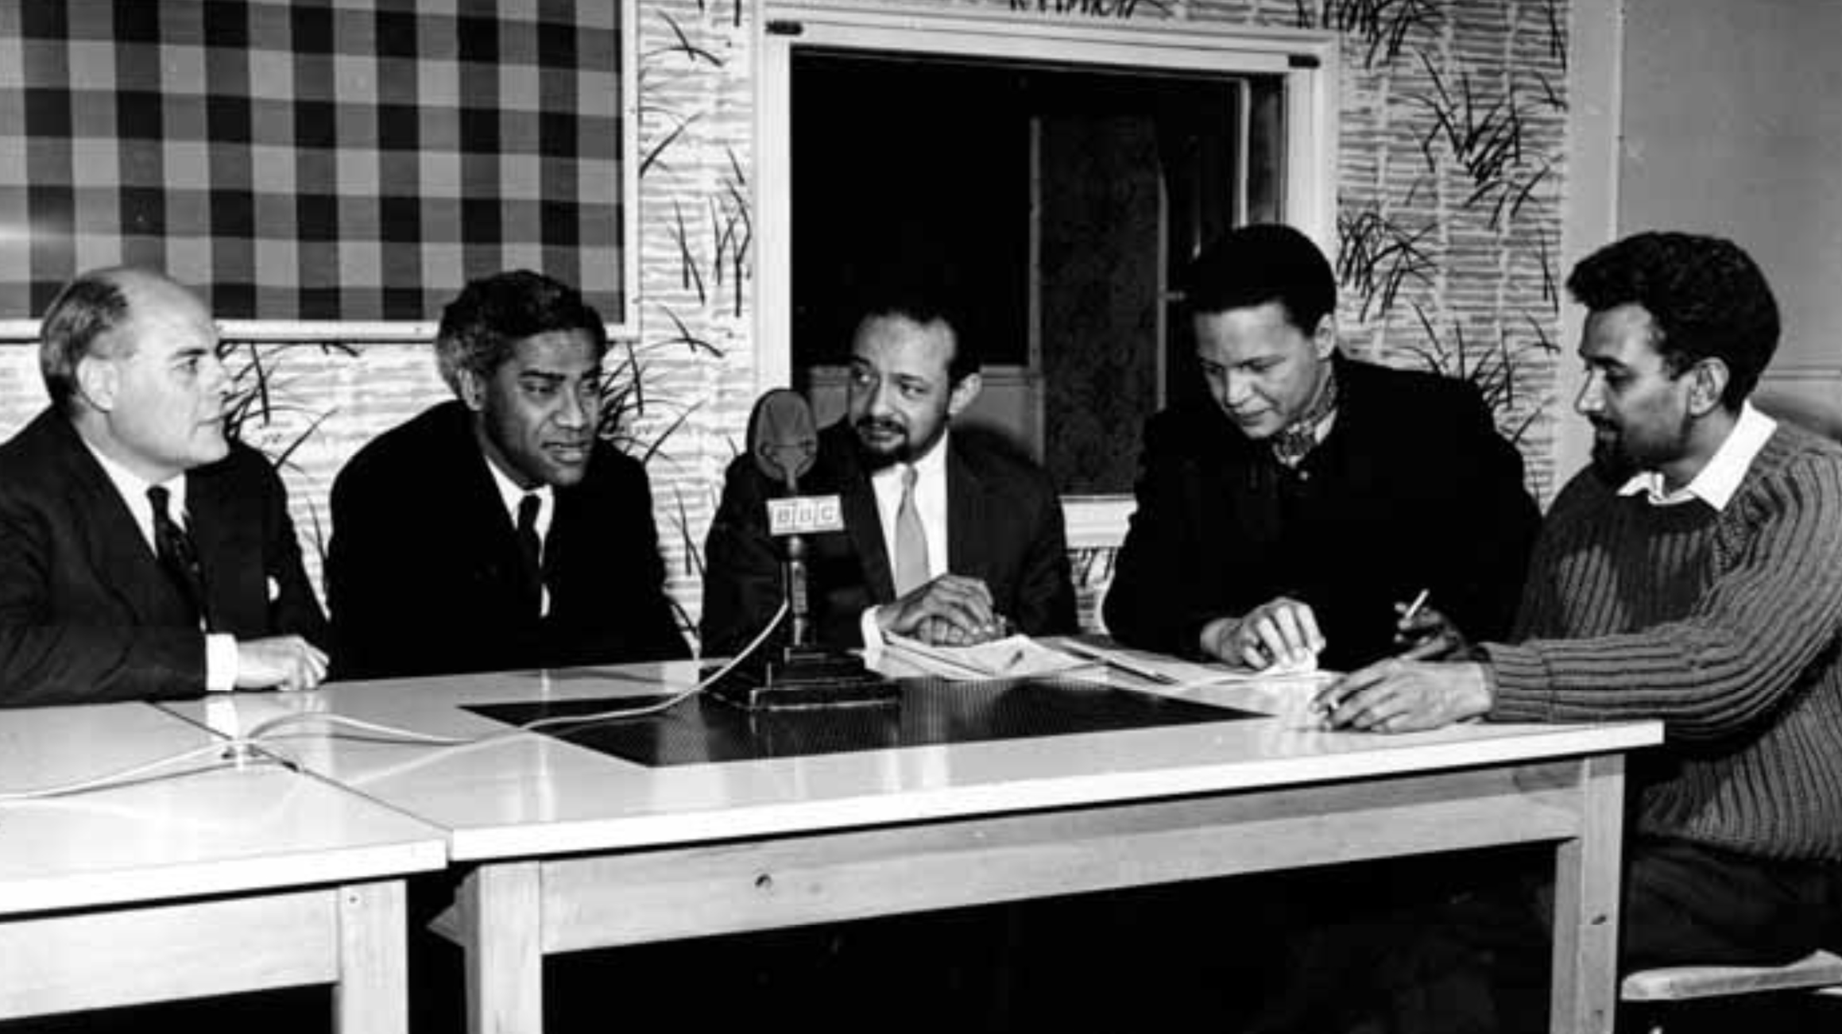
BBC Caribbean Voices radio programme

Slide 21
Kris Manjapra: The official abolition of slavery in the British West Indies in 1833 is “conventionally said to mark the culmination of an age of abolition, the rise of the liberal era, and the origin point of universal freedom in the nineteenth century” (2018: 361).
During this so-called age of abolition, “new forms of forced and coerced labour arose on a global scale, and the plantation as an exploitative, racial, political-ecological complex began to expand and travel the face of earth. Just when the institution of slavery was said to die away under liberalism, the plantation complex attained new life. The turning point of 1833, with the official end of slavery in the British Empire, saw the rise of new kingdoms of sugar, coffee, cotton, and rubber across the Americas, Africa, and Asia. It saw the spread of plantation asylums ruled by the lash and worked by the chain gang.” ("Plantation dispossessions: The global travel of agricultural racial capitalism." American capitalism: New histories. Columbia University Press, 2018, 361)

Slide 22
Immanuel Wallerstein: capitalism and the rise of centrist liberalism
the economic, social, and political crises confronting capitalism in the late 18th/early 19th c., including American, Haitian, and French revolutions
produced two new social truths: 1) continual social transformation ("modernization") would be a normal constant and 2) rule by sovereign forces of lineage elites would be replaced by forms of popular and democratic government
three ideologies/political formations arose in response: conservativism, centrist liberalism, and radicalism (Marxism)

Slide 23
The triumph of centrist liberalism
“The more equality was proclaimed as a moral principle, the more obstacles — juridical, political, economic, and cultural — were instituted to prevent its realization. The concept, citizen, forced the crystallization and rigidification — both intellectual and legal — of a long list of binary distinctions that then came to form the cultural underpinnings of the capitalist world-economy in the nineteenth and twentieth centuries: bourgeois and proletarian, man and woman, adult and minor, breadwinner and housewife, majority and minority, White and Black, European and non-European, educated and ignorant, skilled and unskilled, specialist and amateur, scientist and layman, high culture and low culture, heterosexual and homosexual, normal and abnormal, able-bodied and disabled, and of course the ur-category which all of these others imply — civilized and barbarian.”
Wallerstein, The Modern World-System IV: Centrist Liberalism Triumphant, 1789- 1914, p. 146

Slide 24
Kris Manjapra and Ulbe Bosma: “the intellectual life of the plantation complex served as the disavowed substrate that conditioned the emergence of liberal discourses of freedom – continually haunting liberalism and putting it into ongoing crisis” ("Metaphorical Overtures of Freedom and the Plantation Complex." Capitalism: A Journal of History and Economics 3.1 (2022): 196).

Slide 25
Stephen Shapiro: “Of all the cultural forms emerging throughout this long secular trend, it was the form of long-fiction categorized as the novel that best housed and managed these tensions for centrist liberalism”
it also enacted a sense of unique private interiority, particularly as an object consumed in various states of intimate undress and positions of vulnerable isolation. This production of a liberal self flowered through disciplinary techniques of behavioral, emotional, and sexual normalization manifested through binary divisions. “Un-noveling Lovecraft Country” https://post45.org/2021/11/un-noveling-lovecraft-country/#footnote_8_16801

Slide 26
Shapiro: “The novel-form became so dominant that it managed to effectively wipe out swathes of alternatives in what was a heterogeneous cultural ecology, allowing some to exist only on the margins as para-literature or experimental writing. Indeed, what we often call genre writing is best understood not through reference to a typology of figurations and plot devices, but as works that are devalued, while by far eclipsing the literary novel's commercial success, because they do not respect the structure provided by the novel for liberalism's governmentality.”

Slide 27
Shapiro: the “problematic of horror [. . .] is liberalism’s various attempts to maintain the separation between the citizen subject and the objects of social death, be these women, children, non-whites, and so on”.
The tortured and bleeding body is highlighted in horror “because liberalism’s binaries depend on forms of embodied exclusions, where to ‘have’ a body is to be disempowered (as plebeian and proletarian, gendered non-male, ethno-racialised non-European, and so on). (“The World-System of Global Gothic, Horror and Weird” in The Edinburgh Companion to Globalgothic, p. 42)

Slide 28
