Slide 1
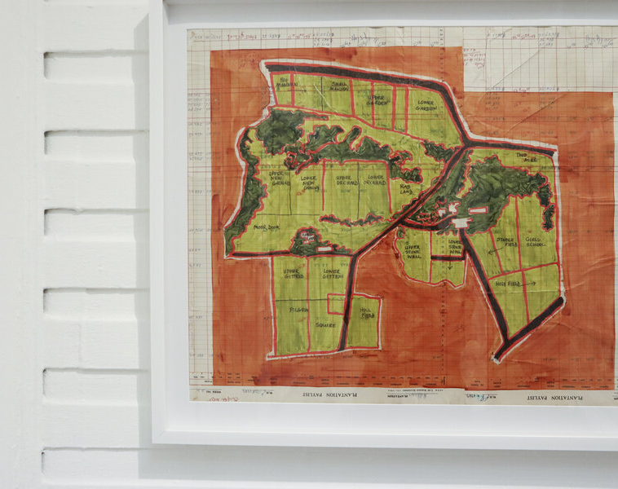
Week 2: Plot and Plantation:
Representing Caribbean History and Literature
Olive Senior, “Meditation on Yellow” (1994)
Diana McCaulay, “Bridge Over the Yallahs River” (2022)

Slide 2
David Scott: “One way of describing one central discursive dimension of a Caribbean Black radical intellectual tradition is to say that it is constructed around a moral-political critique of the colonialist historiography (formal and informal) according to which the colonial vector of value flowed from metropole to colony. The colonial presumption, of course, is that it was Europe that made the colonies, that bestowed upon them their material and civilizational worth. Obviously, this is a self-serving story, one that enables Europe to see itself as above reproach, to absolve itself of moral-political culpability, accountability, and responsibility for the moral evil of slavery’s plunder. As I see it, a central plank of the historiographical revisionism of the Caribbean Black radical tradition is to mock and puncture and undermine this conceit and to argue that, to the contrary, it was the exploited labor from the colonies that produced the values of the metropoles.”
"Between Revolution and Repair: How Europe Underdeveloped Africa in a Caribbean Intellectual Tradition." Small Axe 27.3 (2023): 73

Slide 3
Scott: “New World slavery, Caribbean radicals argue, was not only a leading dimension of modern capitalist development. More significantly, it was historically structured into the capitalist world in such a way as to constitute a systemically asymmetrical relationship between the dominant European centers of capital investment and accumulation and expansion, on the one hand, and, on the other, the colonial peripheries of resource extraction and labor exploitation. The colonial metropole and the colonial periphery, in other words, were systemically constituted in a dialectically inverse relationship between enrichment and impoverishment. The magnificent splendor of Europe enabled by the profits of slavery was one side of an internally interconnected formation, the other side of which was the immiseration of plantation societies.”

Slide 4
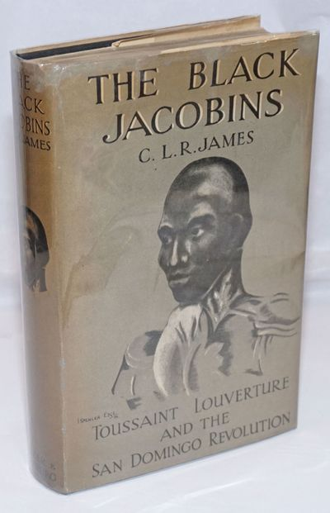
C. L. R. James, Preface to The Black Jacobins (1938):
“In 1789, the French West Indian colony of San Domingo supplied two-thirds of the overseas trade of France and was the greatest individual market for the European slave-trade. It was an integral part of the economic life of the age, the greatest colony in the world, the pride of France, and the envy of every other imperialist nation. The whole structure rested on the labour of half-a-million slaves.”

Slide 5
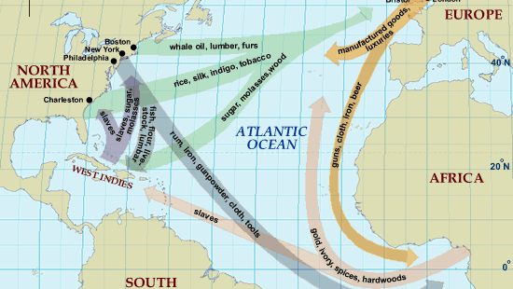

Slide 6
Caribbean peoples are “the first modernised peoples in world history. They were modernised by enslavement and forced transportation; by ‘seasoning’ and coercion on time-conscious export-oriented enterprises; by the reshuffling, redefinition and reduction of gender-based roles; by racial and status-based oppression; and by the need to reconstitute and maintain cultural forms of their own under implacable pressure. These were people wrenched from societies of a different sort, then thrust into remarkably industrial settings for their time and for their appearance, and kept under circumstances of extreme repression. Caribbean cultures had to develop under these unusual and, indeed, terrible conditions.”
Sidney Mintz, Goodbye, Columbus: Second Thoughts on the Caribbean Region at Mid- millennium. Centre for Caribbean Studies, Warwick University, 1993.

Slide 7
Torn from the vine from another world
to tame the wildness of the juice, assigned
with bill and hoe to field or factory, chained
by the voracious hunger of the sugar cane
the world’s rapacious appetite for sweetness
Olive Senior, “Cane Gang” in Shell (Toronto: Insomniac Press, 2007), 51.

Slide 8
Raymond Williams: “Sociology can describe social conditions more accurately, at the level of ordinary measurement. A political program can offer more precise remedies, at the level of ordinary action. Literature can attempt to follow these modes, but at its most important its process is different and yet still inescapably social: a whole way of seeing that is communicable to others, and a dramatization of values that becomes an action.”
The English Novel from Dickens to Lawrence (London: The Hogarth Press, 1970), 58-59.

Slide 9
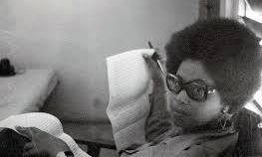
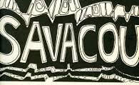
Sylvia Wynter
“Novel and History, Plot and Plantation.” Savacou 5 (1971): 95-102.

Slide 10
“Generally speaking, the plantation is understood to represent Euclidean grids of monoculture, defined as a European social hierarchy and as the commodity cultivation of nonsustainable crops such as sugar and tobacco for external markets. The provision grounds, with their diverse intercropping of indigenous and African cultivars, are understood as the often unseen—but no less integral—voluntary cultivation of subsistence foods such as yams, cassava, and sweet potatoes that represent edible staples and the economically viable roots of the internal markets.” (Elizabeth DeLoughrey, “Yam, Roots, and Rot”, Small Axe (2011): 58

Slide 11
Sylvia Wynter, Plot and Plantation:
“If the history of Caribbean society is that of a dual relation between plantation and plot, the two poles of which originate in a single historical process, the ambivalence between the two has been and is the distinguishing characteristic of the Caribbean response” (99)
“our societies were both cause and effect of the emergence of the market economy; an emergence which marked a change of such world historical magnitude, that we are all, without exception, still "enchanted", imprisoned, deformed and schizophrenic in its bewitched reality.” (95)

Slide 12
“History, then, these things that happen, is, in the plantation context, itself, fiction; a fiction written, dominated, controlled by forces external to itself. It is clear then, that it is only when the society, or elements of the society rise up in rebellion against its external authors and manipulators that our prolonged fiction becomes temporary fact.” (Wynter, 95)
Shake Keane: “the unreality of colonial life”

Slide 13
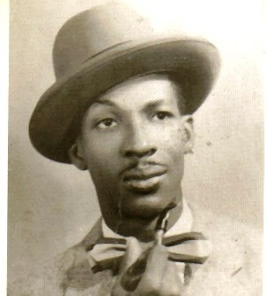
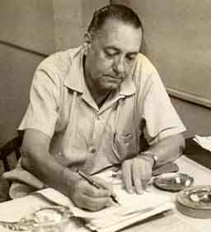
Jacques-Stéphen Alexis Alejo Carpentier

Slide 14
Wynter: “the planters gave the slaves plots of land on which to grow food to feed themselves in order to maximize profits” (99).
“around the growing of yam, of food for survival,” the enslaved “created on the plot a folk culture – the basis of a social order [. . .]. This folk culture became a source of cultural guerrilla resistance to the plantation system” (99-100).

Slide 15
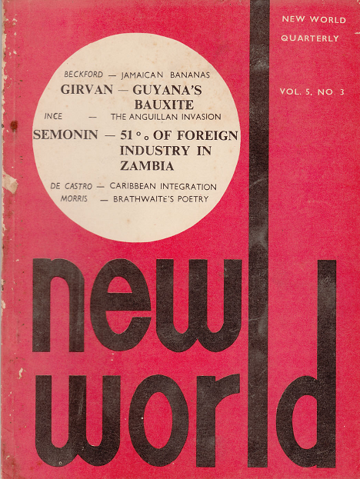
Emergence of the ‘New World Group’ in the 1960s
Key thinkers included Lloyd Best, George Beckford, and Kari Levitt

Slide 16
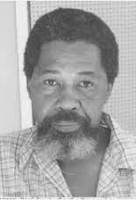
George Beckford: plantations as “total economic institutions”

Slide 17
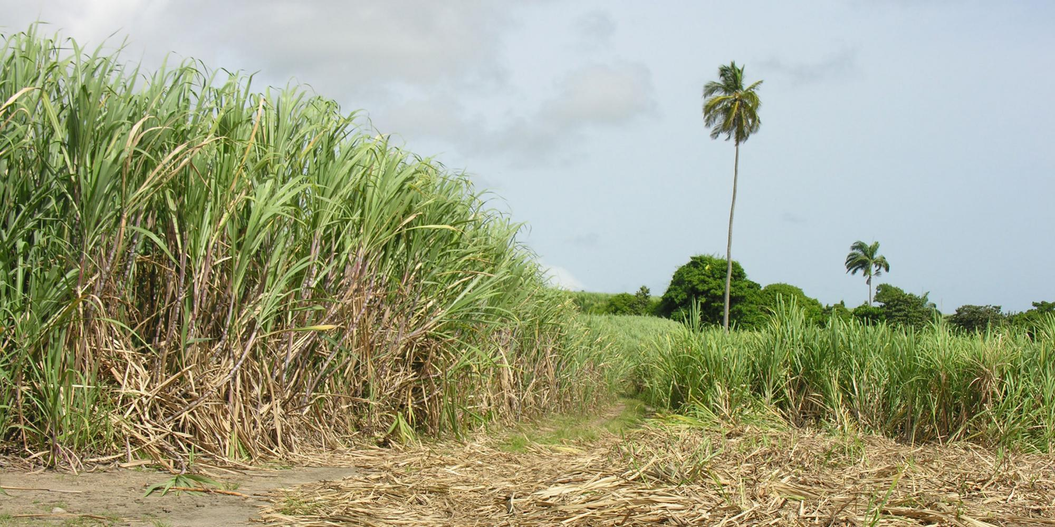
[The plantation] is an “instrument of political colonization” a “system of agricultural production and a social institution as well”… In the colonial setting, then the plantation is created by metropolitan capital to serve the requirements of metropolitan enterprise. It is a monopolizing institution: the plantation hoards all the best land and deploys it in the production of cash crops; the plantation also smothers the forms of production that threaten to sap its potential labour supply, causing a monoculture wherever the plantation is in operation … the plantation has been the principal shaping force of Caribbean life, past and present, on every island where it was successfully adopted as the mode of production and the apparatus of rule.
Ian Gregory Strachan, Paradise and Plantation (University of Virginia Press, 2002) p.6

Slide 18
Strachan: [comparing the plantation economy to the tourist economy] “Like sugar, coffee, or banana production, tourism is an “export industry”, in as much as the Caribbean “product” is marketed and sold to consumers in the North Atlantic.” (8)
“In a number of crucial ways, tourism has grown out of and sustains the plantation economy. The plantations laid the economic, political, cultural and social groundwork that has enabled tourism to function so effectively in the Caribbean. As an institution of colonization, the plantation established a political and economic dependency on the metropolitan centres that tourism merely extends.” (pp. 8-9)

Slide 19

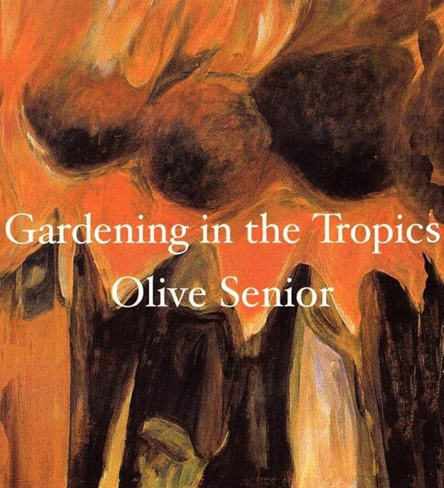

Slide 20
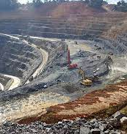
Inter-American Commission on Human Rights: Thematic hearing on “Impact of Extractive Industries on Human Rights and Climate Change in the Caribbean,” October 26, 2021
“A number of Caribbean economies rely on the large-scale extraction of natural bodies—including hydrocarbons (gas and petroleum), metals and minerals (e.g. gold, bauxite, alumina), forest, fishery and agricultural products—primarily for exportation. Small- and medium-scale extraction, particularly gold mining, also plays a major role in some states. In the past few years, there has been an alarming expansion in the nature and intensity of extractive activities in the region. This includes an increase in fossil fuel prospecting and extraction and an expansion of mining activities in ecologically sensitive areas and lands traditionally occupied by Indigenous Peoples and Afro-descendants.”

Slide 21
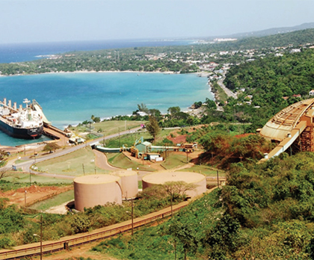
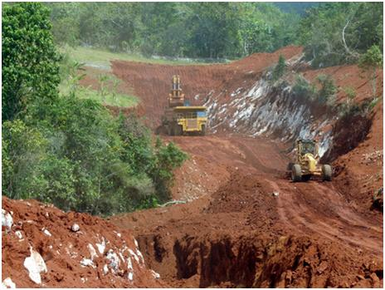
Bauxite mining in Jamaica

Slide 22
Ester Figueroa:
“Bauxite mining has for over sixty years been the greatest destroyer of rural Jamaican communities and Jamaican agriculture. Representatives of Jamaican governments past and present routinely claim to support Jamaican agriculture, lament our high level of agricultural imports, and say we must, ‘Grow what we eat and eat what we grow,’ while promoting the expansion of the very same industry that destroys local agriculture, tears apart, sickens and impoverishes self-sufficient rural communities, leading to out migration, environmental devastation, scarred landscapes, wastelands and toxic ‘mud lakes.’ What is lost is the heart and soul of Jamaica. People who are strong, independent, and knowledgeable, who can grow their own food and feed Jamaica. What is lost is fertile soil, forests, trees, endemic species, water, cooler temperatures.”
https://jamaicans.com/bauxite-mining-continues-to-threaten-jamaican-farmers-and-cockpit-country/

Slide 23
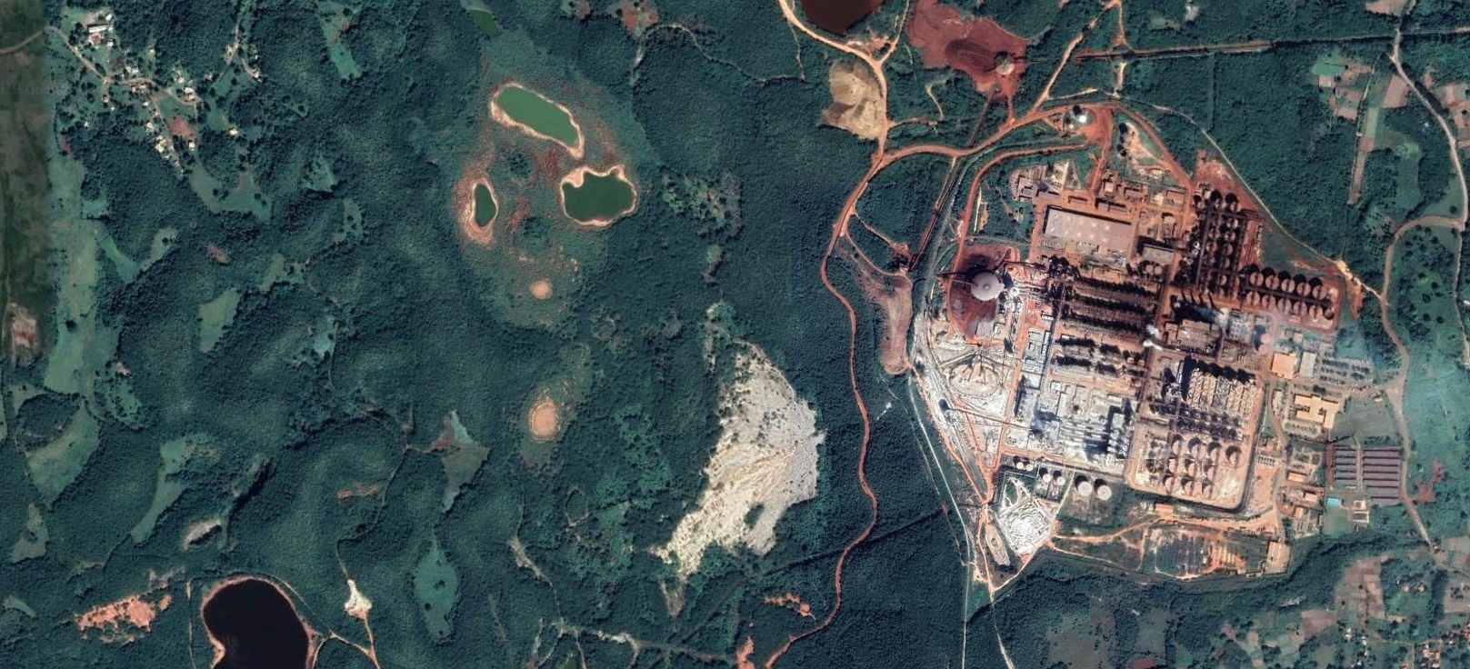
JISCO’s aluminium refinery near Nain, Jamaica, seen via satellite

Slide 24
Three years after Chinese state-owned mining giant Jiuquan Iron and Steel Company (JISCO) acquired the largest bauxite to alumina refinery in Jamaica, residents want the company to relocate and to better compensate them for the plant’s adverse health effects.
More than 30 residents in Upper and Lower Warminster in the southwest parish of St. Elizabeth say mining activities have compromised air quality, leaving households with spiraling health care costs. Clean water is now less accessible and some small-scale farmers say they have abandoned production as they dig deeper in their pockets to put food on the table.
“When the dust blow, if you have an air-tank, it wash off from the zinc on the housetop in the tank…it hurt the children them. It hurt your belly… we either have to throw it away or use it to wash, we cannot drink it.”
To rectify these water woes, JISCO/Alpart apparently sends one to two trucks of water to the community monthly. But residents say that too is problematic.
“The [dust] blow and…wash into the parish tank and we have to drink the water because we have no other source.”
Some residents also point out that pollution caused by the plant has complicated existing illnesses. Asthmatic 65-year old Keith Peters (not his real name) said that over the last two years, he’s developed a lung infection due to the pollution from the plant.
“When this thing blow, they take so long to send you to [the] doctor that the asthma, it develop on me then it start to almost lock me off. I waited too long and by the time I went to the hospital, my lungs were infected.
https://dialogochino.net/en/extractive-industries/25227-aluminium-refinery-sickens-jamaicans/

Slide 25



Slide 26
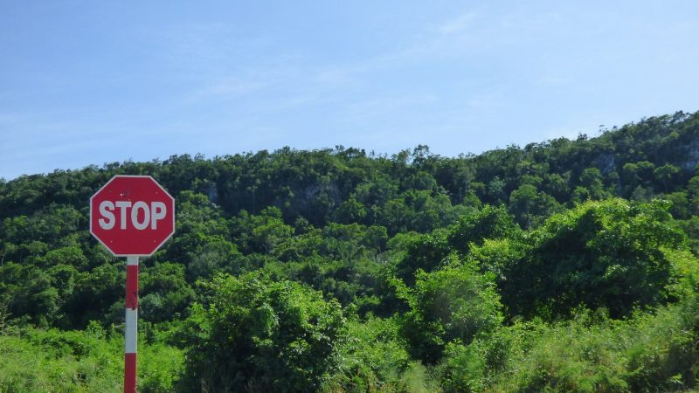
Puerto Bueno forest

Slide 27
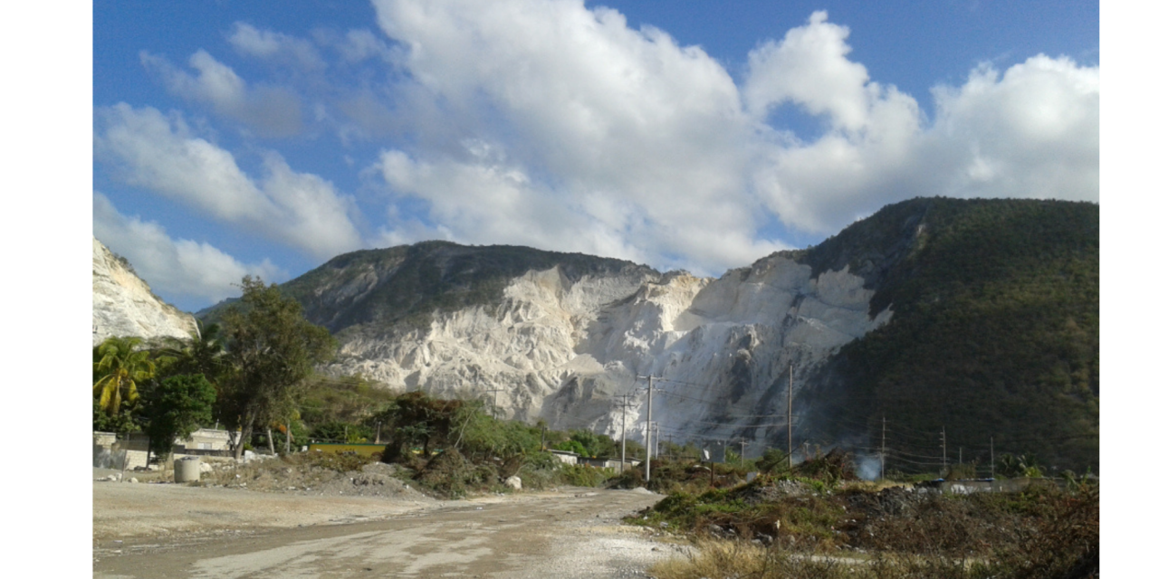

Slide 28
https://twitter.com/Jaybritz/status/1328143553529323521?ref_src=twsrc%5Etfw%7Ctwcamp%5Etweetembed%7Ctwterm%5E1328336522924462081%7Ctwgr%5E37731a8357870776e3fa1483a9badec5818de1d9%7Ctwcon%5Es3_&ref_url=https%3A%2F%2Fglobalvoices.org%2F2020%2F11%2F24%2Fin-jamaica-backlash-over-limestone-quarry-in-puerto-bueno-ecological-area-sparks-youth-online-activism%2F

Slide 29
Fanon: “If the building of a bridge does not enrich the awareness of those who work on it, then that bridge ought not to be built and the citizens can go on swimming across the river or going by boat. The bridge should not be ‘parachuted down’ from above; it should not be imposed by a deus ex machina upon the social scene; on the contrary it should come from the muscles and the brains of the citizens. Certainly, there may well be need of engineers and architects, sometimes completely foreign engineers and architects; but the local party leaders should be always present, so that the new techniques can make their way into the cerebral desert of the citizen, so that the bridge in whole and in part can be taken up and conceived, and the responsibility for it assumed by the citizen. In this way, and in this way only, everything is possible.” (Wretched of the Earth, 200-01)

