Slide 1
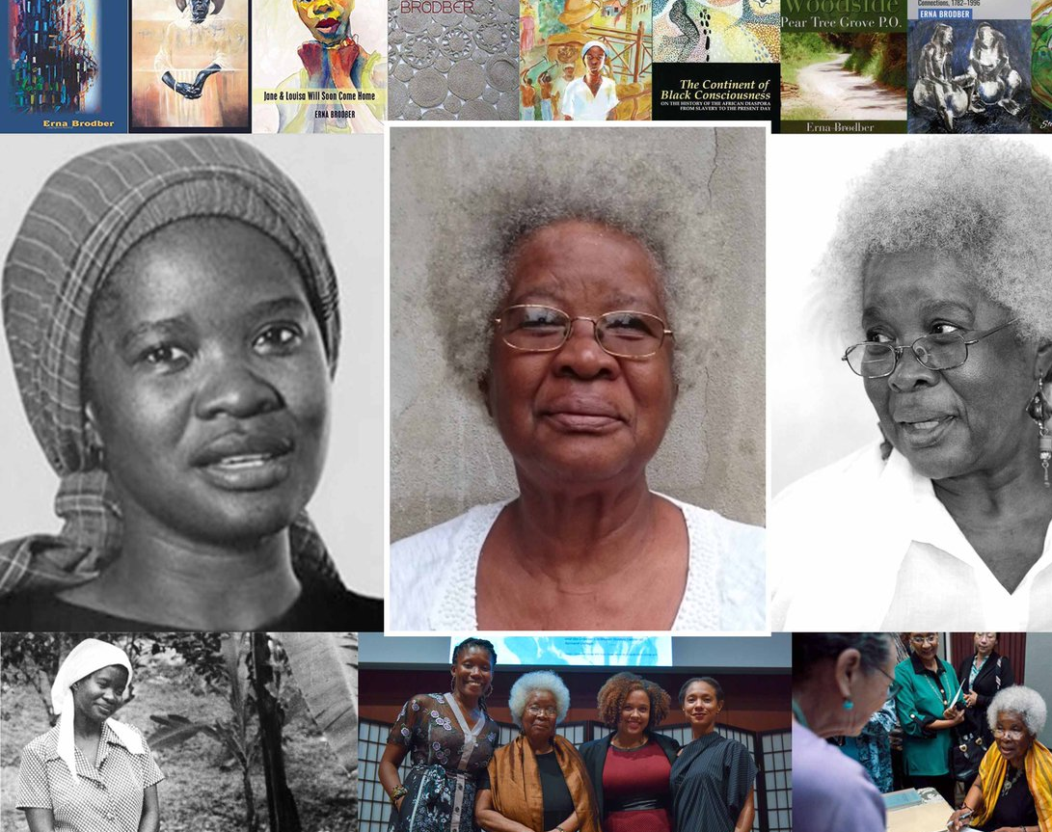
Erna Brodber
Myal (1988)

Slide 2
Brodber’s novels:
Jane and Louisa Will Soon Come Home (1980)
Myal (1988)
Louisiana (1994)
The Rainmaker’s Mistake (2007)
Nothing’s Mat (2014)
Born 1940 in Woodside, Jamaica
Attended University of West Indies; in the 1960s, she won a Ford Foundation pre-doctoral scholarship, enabling her to study at the University of Washington
while studying in the United States, Brodber “encountered two powerful forces she had not previously been exposed to: the Black Power and Women’s Liberation movements. Coupled with her early familial indoctrination to the importance of community, these social concerns formed a background for her interest in social research and seeking out those who possess untold stories” (Lichtenstein, 2013).

Slide 3
1983: established the “Blackspace” project, a centre for the study of Africa and the Diaspora which aims to provide a “refuge for working, thinking, politically and culturally engaged creative black people”
Blackspace provides “an informal summer programme devoted to educating the younger children in the community” and has also produced such publications as The People of My Jamaican Village, 1817-1948 (1999), which was later expanded into the more detailed 2004 work Woodside, Pear Tree Grove P.O. (John, 2012: 74)
Brodber describes The People of My Jamaican Village as being “specially written for the people who live in Woodside and whose responses provided the base data. It is my hope that linking the present inhabitants of Woodside with their enslaved ancestors who lived and worked on the Neilson’s Woodside coffee plantation in the early nineteenth century, as this work does, will give us, the new generation, a sense that we are part of a process from slavery to freedom and will lend us a greater measure of responsibility” (The People of My Jamaican Village, 1817-1948. Jamaica: Blackspace, 1999), p. 22.

Slide 4
Jane and Louisa was “to serve as a case study of the dissociative personality for [Brodber’s] social work students”; the novel is “a therapeutic exercise, [. . .] with the therapeutic tool being the process of ‘going back’ to the past” (Evelyn O’Callaghan, “Re-discovering the Natives of My Person,” Jamaica Journal 16.3 (1983): 61).
The Rainmaker’s Mistake: “impossible to follow and yet beautiful to read” (Mary Hanna, in a review)
Jean-Pierre Durix: “probably no one else in the West Indies, apart from Wilson Harris, has revolutionized the art of fiction as much as Erna Brodber” (“Review”, AFRAM Newsletter 14 (1982): 77)

Slide 5
“It sometimes bothers me that my children and grandchildren cannot decipher what I write, but I have to confess that some of the difficulties they face are native to the design of my fiction. From teenage I have seen myself as serving my community. My fiction has been my tool, so I usually spend a great deal of energy and time working on the theories and working on the ways I insert them into my novels. Our politicians continually, and rightly so, certainly in my formative years, talked about, but in their own theorizing seemed not to understand, how many divisive elements were embedded in our social structure, resulting in our deep alienation from each other, factors that blunted our thrust toward social change. Our first move, in my view, then, should be tackling alienation.”
Brodber, "Me and My Head-Hurting Fiction." Small Axe 16.3 39 (2012): 119-125.

Slide 6
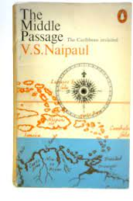

Edward Baugh, “The West Indian Writer and His Quarrel with History” (1977): Caribbean authors typically exhibit “a certain uneasiness, preoccupation, agony concerning history and the idea of history” (61).
V. S. Naipaul, The Middle Passage (1962): “History is built around achievement and creation; and nothing was created in the West Indies” (29).

Slide 7
Édouard Glissant, Le discour antillais / Caribbean Discourse (1981)
in a context where a community has had a “nonhistory” imposed upon it – where the accumulation of a people’s experiences is not regarded as part of an historical continuum – history “as far as it is a discipline and claims to clarify the reality lived by this people, will suffer from a serious epistemological deficiency” (61)
it is not enough to attend only to the records of the (colonial) archive; a “creative approach” is necessary (61)
literature is required to furnish a “prophetic vision of the past” (64)
“Because the collective memory was too often wiped out, the Caribbean writer must ‘dig deep’ into this memory, following the latent signs that he has picked up in the everyday world. [. . .] Because the Caribbean notion of time was fixed in the void of an imposed nonhistory, the writer must contribute to reconstituting its tormented chronology.” (65)
“To renew acquaintance with one’s history is a poetic endeavour” (Preface, Monsieur Toussaint: A Play, 2005: 9-10).

Slide 8
Glissant, Caribbean Discourse: "Realism, the theory and technique of literal or “total” representation, is not inscribed in the cultural reflex of African or American peoples. I am often irritated by reading books that give an account of the miserable reality of our countries, and it is because I then have the impression of being faced with a substitute, a wretched one, for Balzac or for Zola. Western realism is not a ‘flat’ or shallow technique but becomes so when it is uncritically adopted by our writers. The misery of our lands is not only present, obvious. It contains a historical dimension (of not obvious history) that realism alone cannot account for. (105)

Slide 9
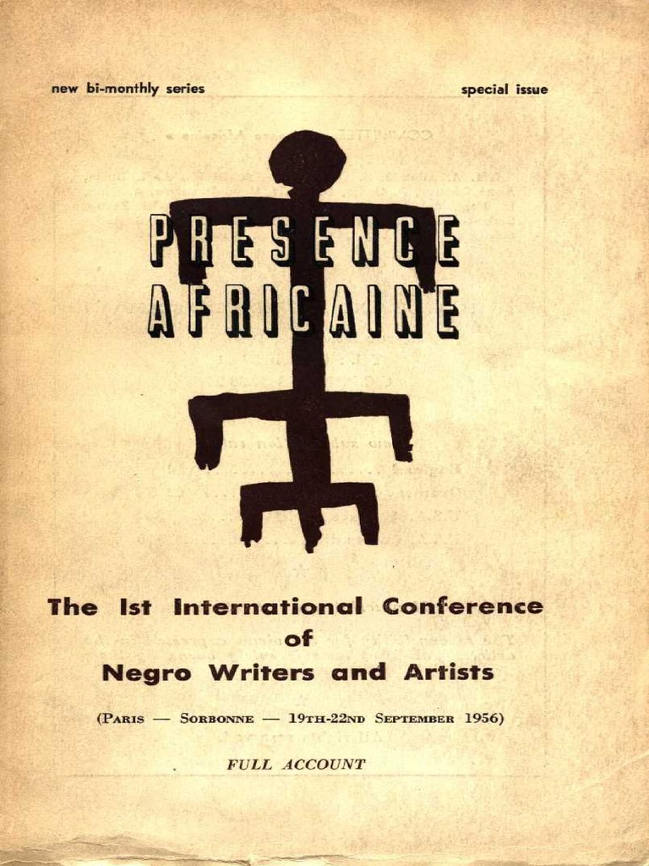
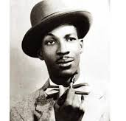
Jacques-Stéphen Alexis:
“Haitian art, like that of its African cousins, is profoundly realistic, notwithstanding that it is indissolubly linked to the myth, the symbol; the stylised, the heraldic, even the hieratic” (267).
the “dynamic integration of the Marvellous in realism” is typical of situations in which “modern life with its stern rates of production, with its concentration of great masses of men into industrial armies” overlaps with a life lived “in contact with Nature” (268).
“Creating realism meant that the Haitian artists were setting about speaking the same language as their people. The Marvellous Realism of the Haitians is thus an integral part of Social Realism” (270). 1956. “Of the Marvellous Realism of the Haitians.” Présence Africaine, 8-10: 249-75.

Slide 10
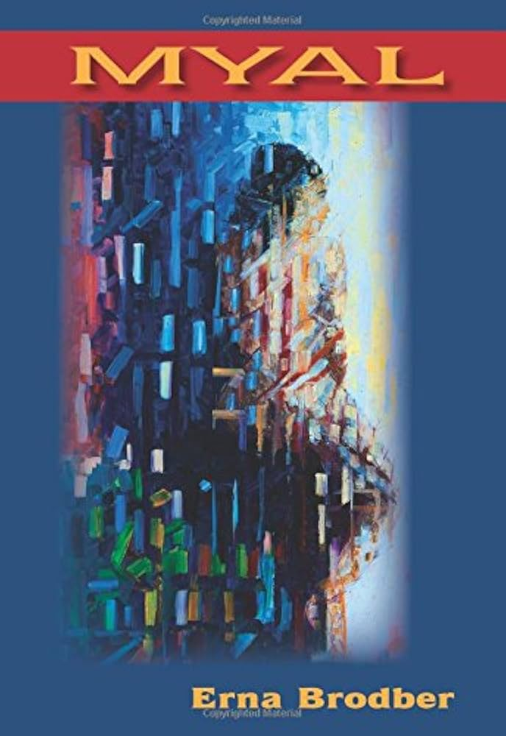
Ella experiences psychic dislocation and a traumatic breakdown prior to her reintegration into a local “community of healers who draw on knowledge and rituals outside of conventional Western cosmology” (O’Callaghan, “Writing States of Independence,” Kunapipi, 2012: 67).

Slide 11
“Myalism emerged in eighteenth-century Jamaica as a Pan-African religious movement designed to protect slaves against European ‘sorcery’. A syncretic and hybrid religious form, Myalism combined characteristics of Central African religious thought with Baptist practices.” (Andrea Davis in The Encyclopedia of Caribbean Religions: Volume 1, ed. Patrick Taylor et al., p. 534)
“…the many similarities between Obeah [. . .] and Myalism. Their practioners’ skill in herbalism, the healing aspects of both practices, their preparation of fetishes and other objects for the purpose of influencing behaviour, assuring protection, and reaching one’s goals. [. . .] [In Myalism] the ecstatic trance allows for the possibility of a direct interaction between ancestral spirits and the living, who in turn become the spirits’ vehicles for prophecy, healing, advice, and revenge for those who harmed them while alive” (Fernández Olmos, Margarite and Lizabeth Paravisini-Gebert, Creole Religions of the Caribbean: An Introduction from Vodou and Santería to Obeah and Espiritismo (New York: New York UP, 2003), pp. 143-44

Slide 12
Reverend Simpson: “Separating people from themselves, separating man from his labour. [. . .] Spirit thieves!”
“It is not by chance that there exists in Haiti the myth of the zombie, that is, of the living dead, the man whose mind and soul have been stolen and who has been left only with the ability to work . . . The history of colonization is the process of man’s general zombification. It is also the quest for a revistalizing salt capable of restoring to man the use of his imagination and culture” (René Depestre, Change, 1971, p. 20)

Slide 13
“In the Haitian context, the zombie - whether docile or rebellious - is a figure whose roots in the experience of brutal enslavement and exploitation are readily discernible. It bears the marks of extreme human deprivation, as well as, arguably, those of extreme ecological deprivation and of human alienation from the natural environment, now re-shaped by colonial monocultures.” (Kerstin Oloff, “Greening the Zombie”, Green Letters, 16 (2012): 34)

Slide 14




Slide 15


Slide 16
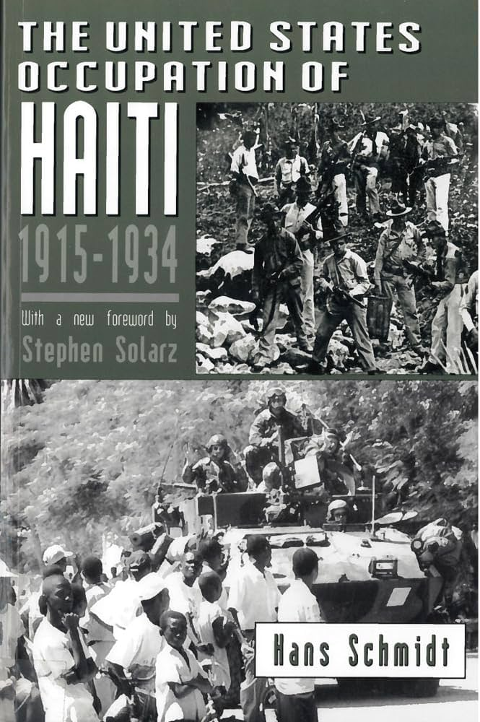
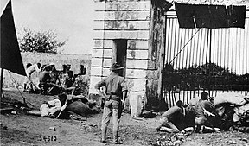

Slide 17
“If the history of Caribbean society is that of a dual relation between plantation and plot, the two poles of which originate in a single historical process, the ambivalence between the two has been and is the distinguishing characteristic of the Caribbean response” (99)
“around the growing of yam, of food for survival,” the enslaved “created on the plot a folk culture – the basis of a social order [. . .]. This folk culture became a source of cultural guerrilla resistance to the plantation system” (99-100).

Slide 18
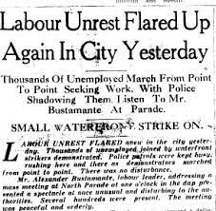
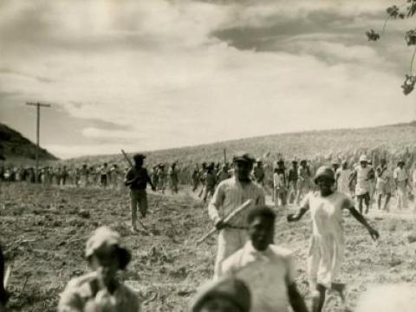

Slide 19
Carolyn Cooper: Brodber’s work as characterized by “an interpenetration of scribal and oral literary forms: a modernist, stream-of-consciousness narrative voice holds easy dialogue with the traditional teller of tales, the transmitter of anansi story, proverb, folk song and dance”
Cooper, “Afro-Jamaican Folk Elements in Brodber’s Jane and Louisa Will Soon Come Home” (Out of the Kumbla: Caribbean Women and Literature, eds. Carole Boyce Davies and Elaine Savory Fido (1990), p. 279).

