Slide 1
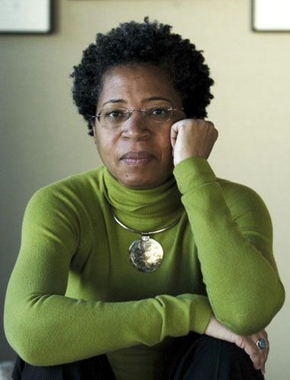

Week 4: Embodied Apocalypses

Slide 2
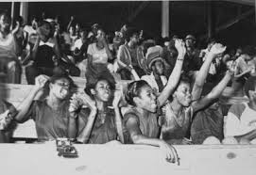
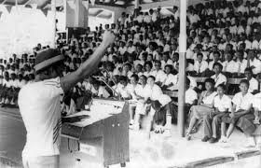
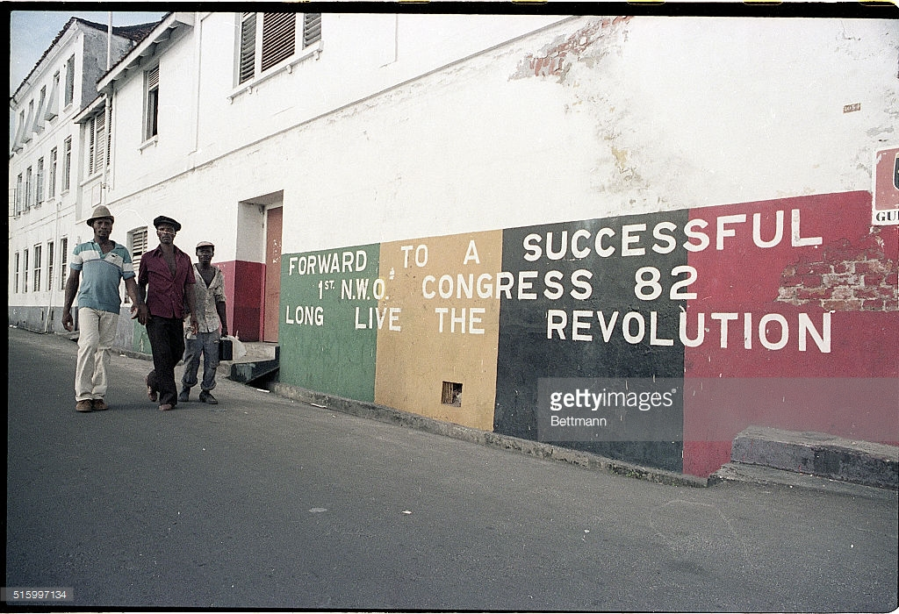
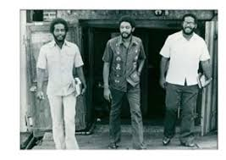
The Grenada Revolution, 1979-1983

Slide 3
The promise of the revolution
Brand (who travelled to Grenada in February 1983):
I had just seen the end of the fighting in Zimbabwe. The Sandinistas were in power in Nicaragua, and Bishop was in Grenada. The wings of the American eagle hadn’t clamped themselves over so much of the world as they have today . . . I felt that it was quite possible for a whole population to have a vision of equality, to see the possibility of living without being dominated by . . . patronizing and patriarchal governments. (qtd in Birbalsingh, Frontiers of Caribbean Literature, p. 126)

Slide 4
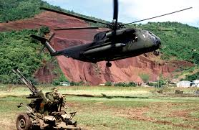
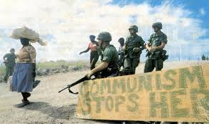
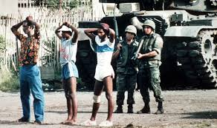

Slide 5
Brand, Chronicles of the Hostile Sun (1984): “the dream is dead / in these antilles

Slide 6
Ronald Cummings: “It would be no exaggeration to pronounce Dionne Brand one of the most significant Caribbean writers today.” https://smallaxe.net/sxsalon/discussions/bales-have-been-piling-years
Christina Sharpe: “The Caribbean is not the location of the writing poet (by which I mean she does not write from the Caribbean; she left Trinidad at seventeen years of age) nor is the Caribbean, usually, the place of the poetic consciousness of the poems. It is more precise to say that the Caribbean is deeply important for Brand as place and aperture, location and schema.” (“Introduction” Nomenclature: New and Collected Poems, Dionne Brand, xxiv)

Slide 7
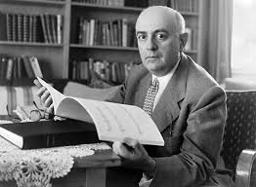


Slide 8
Theodor Adorno:
“Universal history must be construed and denied. After the catastrophes that have happened, and in view of the catastrophes to come, it would be cynical to say that a plan for a better world is manifested in history and unites it. Not to be denied for that reason, however, is the unity that cements the discontinuous, chaotically splintered moments and phases of history – the unity of the control over nature, progressing to rule over men, and finally to that over men’s inner nature. No universal history leads from savagery to humanitarianism, but there is one leading from the slingshot to the megaton bomb.”
“The world spirit [. . .] would have to be defined as permanent catastrophe.”
(Negative Dialectics, trans. E. B. Ashton. New York: Continuum, 1973, p. 320)

Slide 9


Public Enemy, “Countdown to Armageddon”, from It Takes a Nation of Millions to Hold Us Back (1988)
“Armageddon been in effect. Go get a late pass. Step! / This time around, the revolution will not be televised. Step!”

Slide 10
Brathwaite on catastrophe:
“My position on catastrophe [. . .] is, I’m so conscious of the enormity of slavery and the Middle Passage and I see that as an ongoing catastrophe. So whatever happens in the world after that, like tsunamis in the Far East and India and Indonesia, and 9/11, and now New Orleans, to me these are all aspects of that same original explosion, which I try constantly to understand.”
Joyelle McSweeney, ‘Poetics, Revelations, and Catastrophes: An Interview With Kamau Brathwaite’, Rain Taxi Online Edition, Autumn (2005). http://www.raintaxi.com/poetics- revelations-and-catastrophes-an-interview-with-kamau-brathwaite/

Slide 11
Antonio Gramsci: “The starting-point of critical elaboration is the consciousness of what one really is, and is ‘knowing thyself’ as a product of the historical process to date, which has deposited in you an infinity of traces, without leaving an inventory … therefore it is imperative at the outset to compile an inventory”’ (Prison Notebooks, 25).
Edward Said in Orientalism: “in many ways my study of Orientalism has been an attempt to inventory the traces upon me, the Oriental subject, of the culture whose domination has been so powerful a factor in the life of all Orientals” (25).

Slide 12
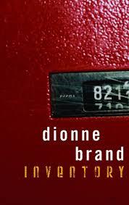
We believed in nothing

Slide 13
after work we succumbed
headlong in effusive rooms
to the science-fiction tales of democracy
and to their songs,
come gather ’round people for the times
say it loud and when you talk about destruction
count me out deep in my heart I do believe
oh lord won’t you buy me make me wanna holler
that’s fine, got drunk, got high,
said we were already living in another time
they waited, watched,
evacuated all our good lyrics
of the goodness, of the science, the delicious
being of more than, well more,
so hard now to separate what was them
from what we were

Slide 14
the unremitting malls of all desires
to have seen Che
Guevara as an old man on television,
Angela’s unbreakable voice has made jails extinct,
to die in this compassion,
to have never heard “Redemption Song,” so hoarse, at all
not willing another empire but history’s pulse
measured with another hand,

Slide 15
homicides of Indians
we arrived spectacular, tendering
our own bodies into dreamery,
as meat, as mask, as burden
the prison couture of orange-clad criminals

Slide 16
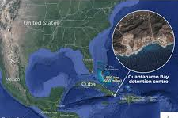
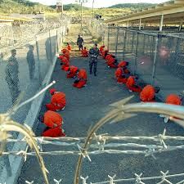
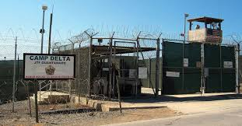

Slide 17
the black-and-white american movies
buried themselves in our chests,
glacial, liquid, acidic as love
the way to Wyoming, the sunset in Cheyenne,
the surreptitious cook fires, the uneasy
sleep of cowboys, the cactus, the tumbleweed,
the blankets, the homicides of Indians,

Slide 18
Diana Brydon: Brand’s “intimate inventory” traces “how the ghosts of slavery and those of capitalist ideologies have become intertwined in [our] very subjectivities and bodies” (“Dionne Brand's Global Intimacies: Practising Affective Citizenship.” University of Toronto Quarterly, 76.3 (2007): 996).
“the news was advertisement for movies / the movies were the real killings”
“screens lacerate our intimacies”

Slide 19
Christina Sharpe: “‘We believed in nothing.’ So starts Inventory I. With this first line, Brand is not summoning nihilism, and this is not despair. Rather, “we believed in nothing” articulates one of the major ideas in the poem; that what is now a past belief that planted itself in the body, in chests, lungs, hearts, minds, and limbs, is the nothing of the idea of America (the U.S.), the nothing of capitalism and the financialization of “each square metre of air” and sea and land. The nothings are the deadly myths of freedom, with their particular innocence, and its perfection that take root in the chest—and crack it open with violence.” (“Introduction,” Dionne Brand, Nomenclature: New and Collected Poems, xxxviii)

Slide 20
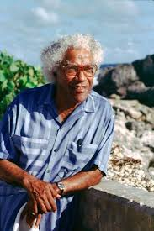
George Lamming, “The Education of Feeling”
the “serious revolutionary writer must always try to make that which is only seen and felt as possible into a moment of living reality” (20)
the “central and seminal value of the creative imagination” is that it “offers an experience through which feeling is educated. Through which feeling is deepened. Through which feeling can increase its capacity to accommodate a great variety of knowledge” (20)
“making feeling think” (20)

Slide 21
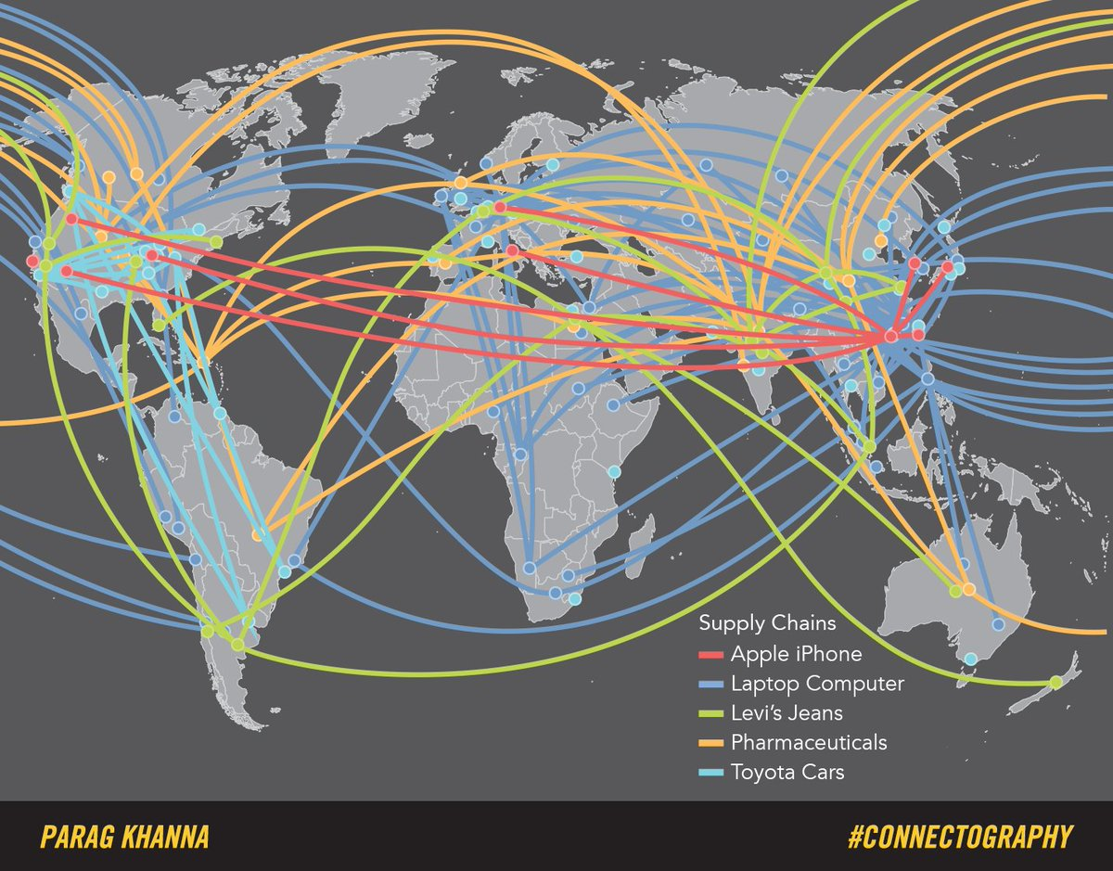

Slide 22
Christine Okoth: “[In Part III] the speaker now dons the guise of an omniscient thirdperson narrator, watching a woman watching a television screen. Distance is the overarching formal logic. The woman, who is neither poet nor activist, observes an unfolding archive of global death. She is singularly committed to the task of looking, as though she were offering evidence of her suitability as a more neutral interlocutor than the poet herself or a lyric I. Unlike the latter, the third person is here positioned as less likely to yield to the demands of literary form. She lives to ‘keep watch at the window / of the television’ in order to assess an already existing form, rather than shaping the forms of death’s documentary presentation herself.” (“The extractive form of contemporary Black writing: Dionne Brand and Yaa Gyasi,” Textual Practice, 35:3 (2001): 382)

Slide 23
Okoth: “But just as third-person narration fails to shield from the demands of literary form, the television fails to shield the poem’s observer from culpability in the violence she bears witness to. The screen of the modern television is constructed out of the same components as the screens of other electronic devices, such as mobile phones, tablets, and computers. That is to say, it contains some variation on the mineral composite coltan, which makes its way into the poem’s sphere of reference halfway through Part III (‘all that koltan from Kahuzi-Biega, the landslides, / to carry nothing’). Both the television and the mode of prosaic narration perform a formal and thematic neutrality that, all the while, implicates the poem in the violence it only intends to record.” (382-83)

Slide 24
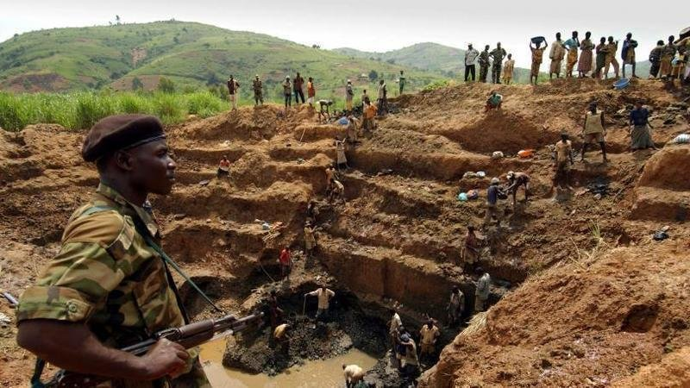

Slide 25
Brand: “It was a signal that someone was dragging Maurice and Jackie and Vincent to their deaths at that moment. What happens if you stand in a moment like this? Your own body must die, too, I suppose. Even if you do not know. Aren’t we all implicated in each other? In any moment like this we must die, too. I was that body draping the cliff.” (A Map to the Door of No Return, 166)

Slide 26
Brydon: “Brand’s Inventory rearticulates local, national, and global citizenship through [a] kind of dissonant, non-identitarian, ‘comprehensive and planetarity humanism’. [. . .] I find [this] in the assertion of Brand’s persona in Inventory when she insists: ‘I say this big world is the story, I don’t have any other’ (84). [. . .]. In Brand’s work such a re-visioned humanism in relation to planetary space involves a reimagined citizenship, as a mode of belonging and acting in the world. Her full, rather than provisional, human citizenship resists colonial, liberal, and neo-liberal frames for constructing human responsibilities to public and private worlds. As such, it encompasses a renewed attention to history and to the present.” (999-1000)

Slide 27
Kathryn Yusoff, A Billion Black Anthropocenes or None: “coloniality and anti-Blackness are materially inscribed into the Anthropocene.”
“Coloniality cuts across both flesh and earth in the economies of valuation it established [. . .]. The color line of the colonized was not merely a consequence of these structures of colonial power or a marginal effect of those structures; it was/is a means to operationalize extraction (therefore race should be considered as foundational rather than as periphery to the production of those structures and of global space). Richard Eden, in the popular 1555 publication Decades of the New World, compares the people of the “New World” to a blank piece of “white paper” on which you can “paynte and wryte” whatever you wish. “The Preface to the Reader” describes the people of these lands as inanimate objects, blank slates waiting to be civilized by the Europeans. [. . .] As land is made into tabula rasa for European inscription of its militant maps, so too do Indigenes and Africans become rendered as a writ or ledger of flesh scribed in colonial grammars.” (42)

Slide 28
Achille Mbembe, Critique of Black Reason:
“Blackness does not exist as such. It is constantly produced. To produce Blackness is to produce a social link of subjection and a body of extraction, that is, a body entirely exposed to the will of the master, a body from which great effort is made to extract maximum profit.” (19)
“The process of transforming people of African origin into Blacks, that is, into bodies of extraction and subjects of race, largely obeys the triple logic of ossification, poisoning, and calcification. Not only is the Black Man the prototype of a poisoned, burnt subject. He is a being whose life is made of ashes. The noun ‘Black’ is in this way the name given to the product of a process that transforms people of African origin into living ore from which metal is extracted.” (40)

