Slide 1
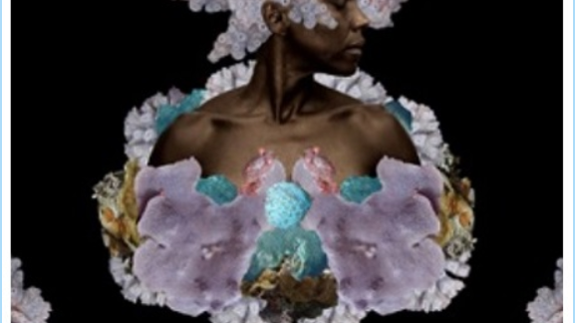
Nalo Hopkinson, The Salt Roads (2003)

Slide 2
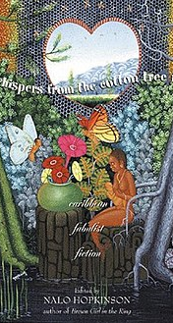
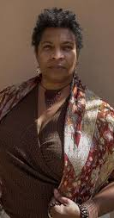
Brown Girl in the Ring (1998)
Midnight Robber (2000)
The Salt Roads (2003)
The New Moon's Arms (2007)
The Chaos (2012) (Young adult fiction)
Sister Mine (2013)
Blackheart Man (2024)

Slide 3


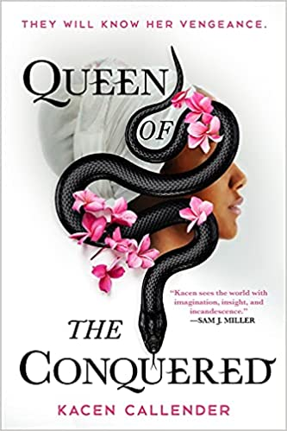
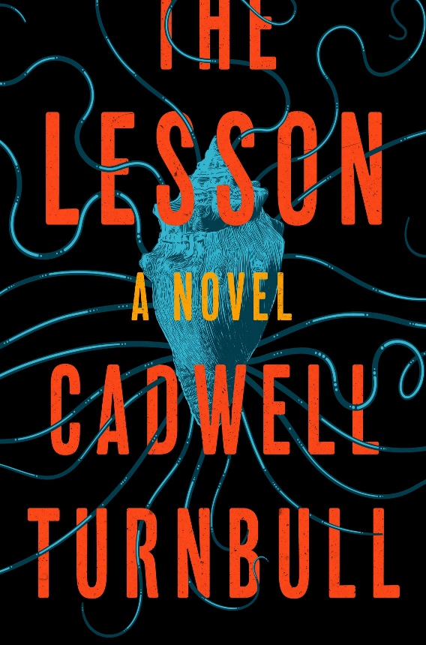
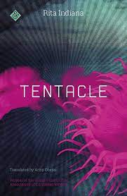
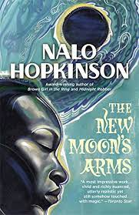
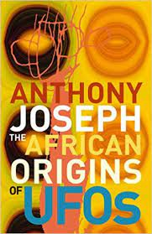
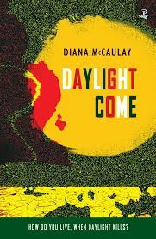

Slide 4
“Afrofuturism therefore stages a series of enigmatic returns to the constitutive trauma of slavery in the light of science fiction. [. . .] [S]lavery functioned as an apocalypse experienced as equivalent to alien abduction” (Kodwo Eshun, “Further Considerations of Afrofuturism,” CR: The New Centennial Review 3, no. 2 (2003): 301)
“The ships landed long ago: they already laid waste whole societies, abducted and genetically altered swathes of citizenry. . . . Africa and America—and so by extension Europe and Asia—are already in their various ways Alien Nation.” (Mark Sinker, “Loving the Alien”, 1992)
“extraterrestriality as a hyperbolic trope to explore the historical terms, the everyday implications of forcibly imposed dislocation, and the constitution of Black Atlantic subjectivities.” [But it can also be] “characterized as a programme for recovering the histories of counter-futures created in a century hostile to Afrodiasporic projection” (Eshun, 299, 301).

Slide 5
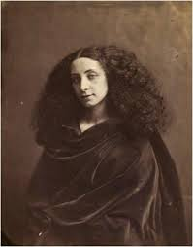
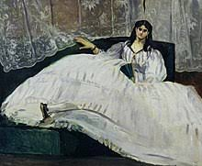
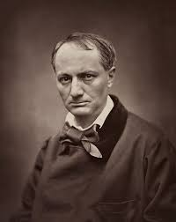

Slide 6
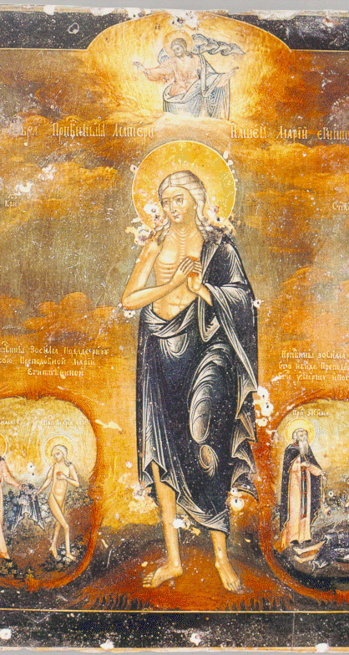
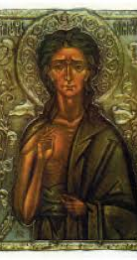
“How are we going to pay our way to Uncle Lev’s?”
“the way we know best [. . .], on our backs” (389)

Slide 7



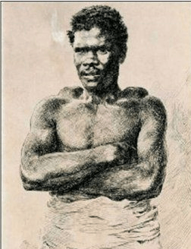
François Mackandal (c. 1730 – c. 1758)

Slide 8
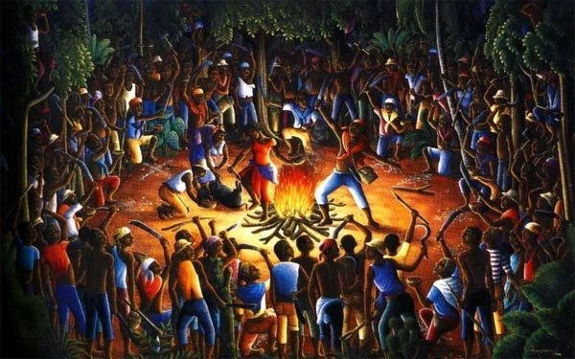

Slide 9
Mer; Jeanne / Lemer; Thais / Meritet
‘mer’ = ‘mère’ (Fr. ‘mother’) and ‘mer’ (Fr. ‘the sea’).

Slide 10
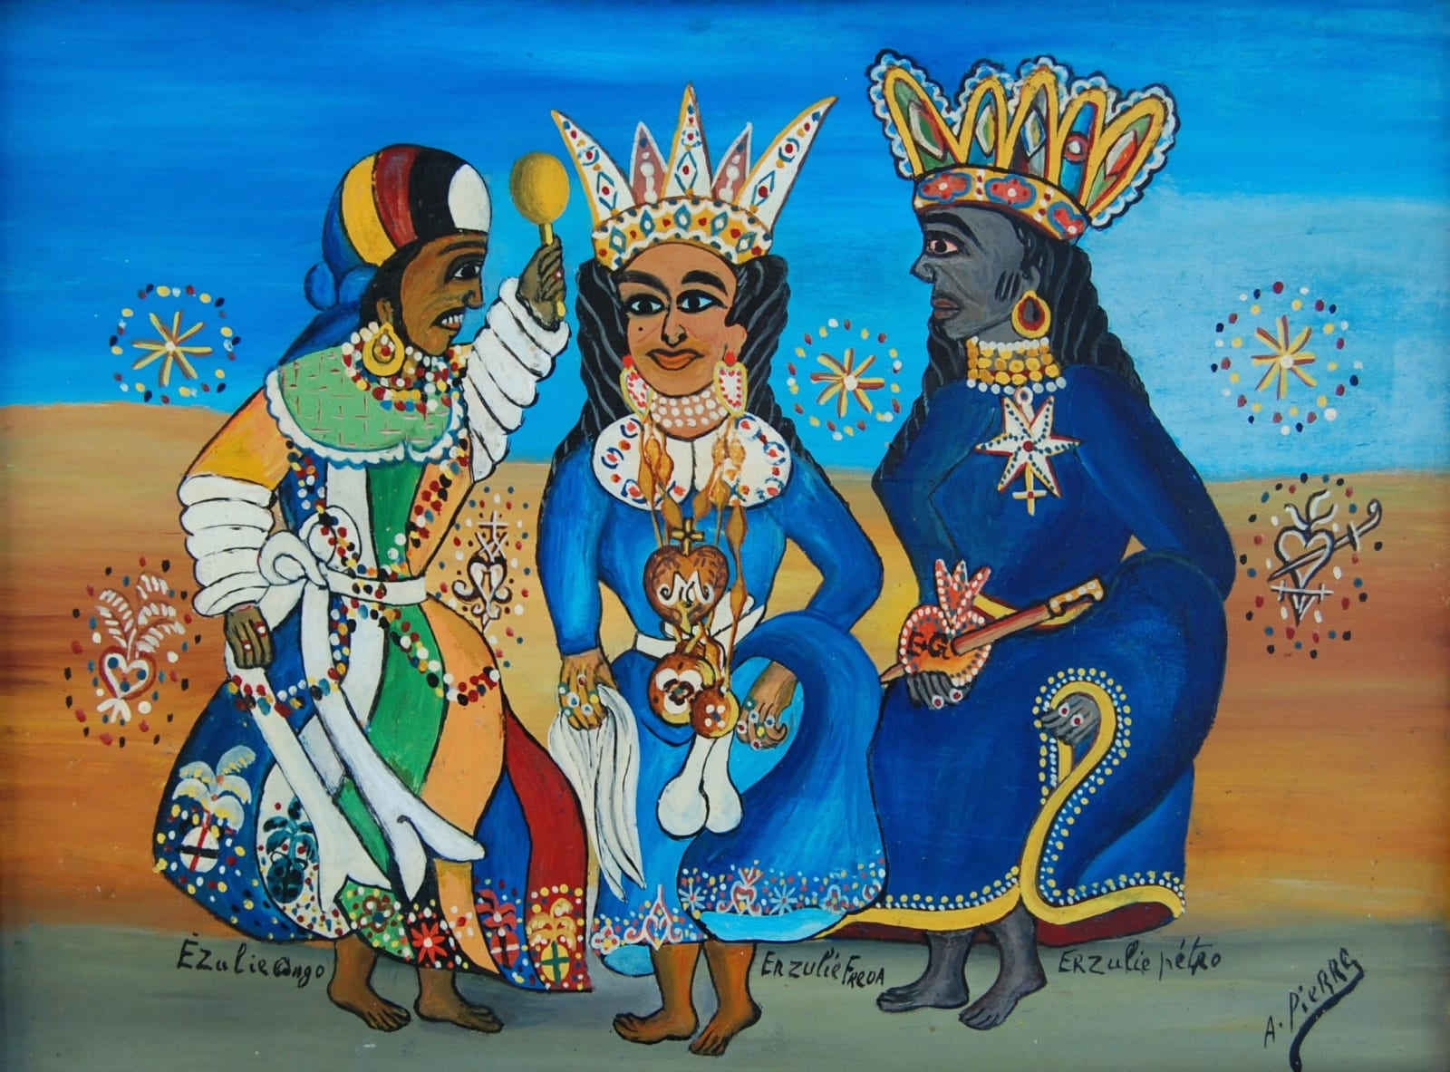

Slide 11
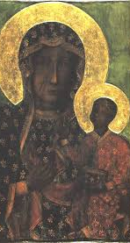
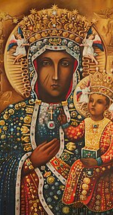
“Ezili is not (only) singular but also plural—not just one lwa but the name given to a pantheon of spirits. Embodying the divine forces of love, sexuality, pleasure, femininity, maternity, creativity, and fertility, her paths include Ezili Fréda, the luxurious mulatta who loves perfume, music, flowers, sweets, and laughter but always leaves in tears; the fierce protector Ezili Danto, the (often single) mother syncretized with the Black Madonna of Czestochowa, who appeared during the 1791 ceremony at Boïs Cayman that began the Haitian Revolution; and Lasyrenn, a mermaid who swims in lakes and rivers where she invites female passersby to join her and initiates them into mystical (erotic?) knowledge.” (Omise’eke Natasha Tinsley. “Songs for Ezili: Vodou Epistemologies of (Trans) Gender” Feminist Studies, 37 (2011): 421)

Slide 12
“I can see into the fractals of their eyes. My own face gazes back at me from those infinite reflections, and it is all their faces.
They are me.
“Frèda,” the coquette names herself, toying with misty pink lace that looks strong enough to strangle.
“Lasirèn,” bubbles the sea woman in Pidgin, cradling whole continents on her bosom.
“Danto,” weeps the sad one, mourning for her losses. Her hard fists flex in anger. [. . .]. They are me, these women.” (304)

Slide 13
“Back away, back away, watery one, cunted one. This horse is mine, not for you. He’s mine.
What? What is that on Makandal’s head? What are you?”
“Makandal wouldn’t listen to Mer my horse, but in the many flowing strands of the Ginen’s story, I could see a thing I could do.”

Slide 14
Margarite Fernández Olmos and Lizabeth Paravisini-Gebert:
“In group ceremonies, devotees congregate at an ounfo (hounfort or temple), where the oungan (houngan or priest) leads the celebrants in ceremonies that revolve around song, sacred drumming, dance, prayer, spirit possession, food preparation, and the ritual sacrifice of animals. The lwa communicate with individuals and the congregation through spirit possession, a trancelike state in which the devotee is “mounted” by the spirit and becomes the lwa’s vehicle. As the incarnation of the lwa, the “horse” communicates with the congregation through words and stylized dances, offering advice, becoming a conduit for healing, and relishing the opportunity to be among its devotees.” (Creole Religions of the Caribbean, 131)

Slide 15
Maya Deren:
“It is towards the achievement of this—towards the forcing open of the door to the source—that the entire structure of Voudoun is directed. The serviteur must be induced to surrender his ego, that the archetype become manifest. In the growing control accomplished by the ordeals and instructions of initiation, and in the prospective vigilance of houngan and societé, he is reassured that the personal price need not be unpredictable or excessive. In the principle of collective participation is the guarantee that the burden shall, in turn, be distributed and shared.” (Divine Horsemen, 250-51)

Slide 16
Alessandra Benedicty-Kokken: “Possession is a form of self-narration that enables individuals who experience extreme duress to inscribe agency into a life that is constantly being undermined through transformative acts and events such as slavery, servitude, poverty, exile, refugee status, and/or general disenfranchisement. . . . a deictic tool, a means of finding a narrative structure that can contain, and even “tell” extreme suffering. (Spirit Possession in French, Haitian, and Vodou Thought: An Intellectual History 19)

Slide 17
The classic historical novel vs. Hopkinson’s speculative historical novel
“The classic historical novel, inaugurated by Waverley, is an affirmation of human progress, in and through the conflicts that divide societies and the individuals within them.” (Perry Anderson, “From Progress to Catastrophe,” London Review of Books, 33.15 (2011).

Slide 18
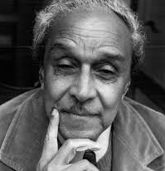
Wilson Harris: “For the subject which is being approached exists in a void and therefore one needs to participate in it, I believe, with an art of fiction, an imaginative fluidity that is as close as one can possibly come to existing now, with immediacy, in a form that has already been broken in the past. It is here that one starts to concede, and enter upon those alternative realities (‘phenomenal legacy’) which may lead to a new scale of illumination of the meaning of ‘community’” (Harris, “The Phenomenal Legacy”, in Explorations, p. 45)

Slide 19
[T]he substance of this adventure, involving men of all races, past and present conditions, has begun to acquire a residual pattern of illuminating correspondences. El Dorado, City of Gold, City of God, grotesque, unique coincidence, another window within upon the Universe [. . .]; in terms of the novel the distribution of a frail moment of illuminating adjustments within a long succession and grotesque series of adventures, past and present, capable now of discovering themselves and continuing to discover themselves so that in one sense one relives and reverses the ‘given’ conditions of the past, freeing oneself from catastrophic idolatry and blindness to one’s own historical and philosophical conceptions and misconceptions which may bind one within a statuesque present or a false future. (Harris, Tradition, the Writer and Society, 35-36)

Slide 20
Starmer: “That’s where I’m going to put my focus, rather than what will end up being very, very long, endless discussions about reparations on the past. This is about stance, really, looking forward rather than looking backwards. Slavery is abhorrent … there’s no question about that. But I think from my point of view and taking the approach I’ve just taken, I’d rather roll up my sleeves and work with them on the current future-facing challenges than spend a lot of time on the past.”

Slide 21
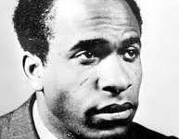
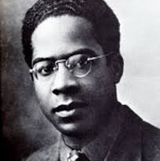
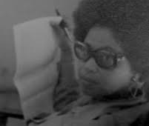
Rethinking the Human:
Thinkers like Frantz Fanon, Aimé Césaire, George Lamming, and Sylvia Wynter “created an epistemological revolution and rupture with conventional radical theory”, at the heart of which was “the question of the human” (Anthony Bogues, “Constructing Radical Caribbean Thought”, Bim https://www.bimmag.org/stories/sylvia-wynter-constructing-radical-caribbean-thought 34).

Slide 22
Fanon, Wretched of the Earth: “For Europe, for ourselves and for humanity, comrades, we must turn over a new leaf, we must work out new concepts, and try to set afoot a new man.”
Césaire, Discourse on Colonialism: “at the very time when it most often mouths the word, the West has never been further from being able to live a true humanism-a humanism made to the measure of the world.”
Wynter, “Unsettling the Coloniality of Being”: the necessity of abolishing the “ongoing collective production of our present ethnoclass mode of being human, Man: above all, its overrepresentation of its well-being as that of the human species as a whole, rather than as it is verdically: that of the Western and westernized (or conversely) global middle classes”.
Wynter, “Black Metamorphosis”: “It is the natives, all the wretched of the earth, who, breaking out of their reservation, are now called upon to reinvent the very concept of the human, through a restructuring of the world system created by the discovery and conquest of the New World by the West” (249-50).

Slide 23
Audre Lorde, “Uses of the Erotic”:
“There are many kinds of power, used and unused, acknowledged or otherwise. The erotic is a resource within each of us that lies in a deeply female and spiritual plane, firmly rooted in the power of our unexpressed or unrecognized feeling. In order to perpetuate itself, every oppression must corrupt or distort those various sources of power within the culture of the oppressed that can provide energy for change.”

Slide 24
Lorde: “The principal horror of any system which deﬁnes the good in terms of proﬁt rather than in terms of human need, or which deﬁnes human need to the exclusion of the psychic and emotional components of that need – the principal horror of such a system, is that it robs our work of its erotic value, its erotic power and life appeal.”

