Slide 1
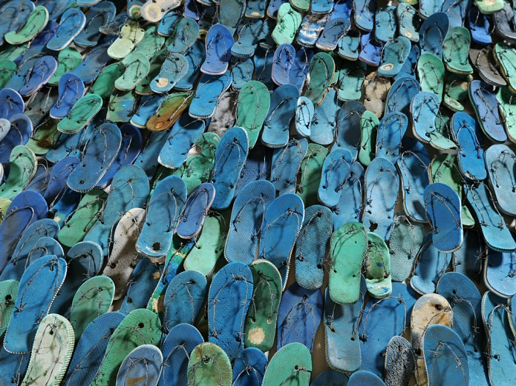
Nicole Dennis-Benn, Here Comes the Sun

Slide 2

“At 17, I moved to the United States from Jamaica, where I had felt as if I were the only lesbian in a country in which police turn a blind eye to mob violence against gays and sex between men is punishable by law. When I arrived in New York City and had the opportunity to date women, I was still glancing over my shoulders.”
(New York Times)

Slide 3
“It was born out of love for my country. I returned to Jamaica after being away for a long time and realized that I had a lot of unresolved feelings. I resented the reasons why I felt I needed to leave the island in the first place. The best way I know how to express myself is in storytelling; so I began to write down my thoughts during my visit, which ended up being the outline for Here Comes the Sun.” (Los Angeles Review of Books)
“I wanted visibility for women in our culture, specifically working-class women. Most feel invisible, pushed to the margins of society and silenced. Even with rape, incest, and violence against women remaining prevalent in Jamaica, the focus tends to be on other issues. I wanted to delve into the lives of these three women as a way to parallel the exploitation of the land with the exploitation of the female body — Margot being both the slave and the captain of this ship.”

Slide 4
Neoliberalism in the Caribbean
“Damn politicians. This country has gone to the dogs. Did you know that we owe the World Bank billions of dollars” (Here Comes the Sun, 50).
“The men were mid-discussion when she stood up—something about the monkeys in Parliament who are allowing P. J. Patterson to run the country into ruins since his win last year, and making sure Seaga takes the ’97 election in three years” (138).
“The date––though currently June 1, 1994” (225).

Slide 5
The climate crisis and ecological breakdown
“Mr. Levy’s Wholesale and Dino’s are the only two businesses left since the seafood shacks closed down. The construction and the drought have not only driven the fishermen out of work, but out of River Bank, leaving behind a community with not much to live off besides the highly taxed groceries each month at Mr. Levy’s” (19)

Slide 6
The war against women and feminized bodies
Verónica Gago: “I want to propose that it has been the feminist thought of authors such as Silvia Federici, Raquel Gutiérrez Aguilar, and Rita Segato, who have brought back the interpretative key of war for thinking about contemporary violence. [. . .] Reviving the term of war for talking about the “state of permanent warfare” against certain bodies and certain territories has allowed for popularizing Federici’s thesis regarding the extent to which the devaluation of life and of labor driven by the phase of contemporary globalization shapes a neoliberal violence that has not been subsumed in devices of subjective pacification nor is it only understood in the register of societies of control” (“Is Politics Possible Today?” Crisis and Critique 9.2 (2022): 95).

Slide 7
Neoliberalism as a response to stagnation in the global economy in the 1970s
Key features of this downturn include:
• declining rates of profit for businesses;
• overaccumulation of capital and lack of opportunities for productive investment;
• rising production / labour costs, linked to, e.g., increasing worker militancy; rising cost of raw materials and energy (the ‘oil shock’ of 1973)

Slide 8
Key features of the neoliberal response:
• the increasing deregulation of markets (the triumph of global ‘free trade’)
• financialization
• new rounds of primitive accumulation / ‘accumulation by dispossession’, including new imperialist offensives
•the use of institutions such as the IMF and the World Bank (and of initiatives such as Structural Adjustment Programmes, or SAPs) to force countries to open their borders to the free flow of capital and goods, and to prioritize the production and export of certain primary commodities; this in return for development loans (at usurious rates of interest)

Slide 9
Neoliberalism in the Caribbean
A response to the crises in global capitalism that began in the early 1970s, and implemented by the main global powers and the multilateral financial institutions they govern, most importantly the World Bank and the International Monetary Fund (IMF), neoliberal globalization rests on economic deregulation, financialization, and privatization, in the name of the ‘free market’ and ‘free trade.’ From the 1970s ‘Third World’ nations were encouraged to take out loans from foreign governments, private banks, and international institutions. With the debt crisis of 1982 many indebted countries were forced to carry out Structural Adjustment Programs (SAPs) in return for loan assistance from the World Bank or IMF. SAPs involve devaluation of currency; an orientation on exports and foreign capital investment; liberalization of financial markets; and cuts in government spending, subsidies, and wages.
  Helen Scott, Caribbean Women Writers and Globalization, p. 2

Slide 10
Structural Adjustment Programmes (SAPs) required countries to slash government spending and to pursue export-led growth by, for example, substituting agro-exports for staple foods and prioritizing the extraction of raw materials
Tourism was often prescribed to many Caribbean countries by the IMF/World Bank
It was presented as an opportunity to earn hard currency to help pay down debts incurred as a result of IMF loans etc.

Slide 11
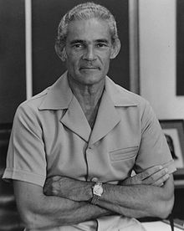
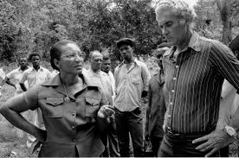
Michael Manley, People’s National Party (PNP), comes to power in 1972

Slide 12
Michael Manley’s People’s National Party (PNP) vs. the Jamaica Labour Party (JLP)
PNP’s Fierce rivalry with the (right-wing) Jamaican Labour Party (JLP). Both parties had ‘clientelistic’ relations with gangs in Kingston, who organized support for the parties in return for favourable treatment
“In a series of sustained and increasingly heinous attacks, armed and trained gunmen, largely from the Opposition JLP, were able to undermine the rule of law and bring Jamaica to the brink of civil war. It is true that the PNP, with its significant mass base in the city, did indeed join battle, but [. . .] the brunt of the offensive was against PNP strongholds, with the twin purposes of demoralizing the hardcore democratic socialist support and discrediting Manley’s ability to govern” (Brian Meeks, Narratives of Resistance, 125)

Slide 13
Jamaican economy in crisis; Manley was forced to go to the IMF for a loan. The loan conditions became increasingly stringent.
“In May 1978 the new Extended Fund Facility was implemented and the real economic contraction began. Between 1978 and 1980, under the aegis of the IMF programme, the Cost of Living Index increased by some 40 percent; real wages declined by 20 to 30 percent and unemployment again began to increase.” (Brian Meeks, Narratives of Resistance 124)

Slide 14
Tony Weis: “By 1984 growth had stalled, unemployment was rising and the payments imbalances that had compelled Jamaica into the IMF’s embrace were getting worse not better. Early failures only intensified the prescription, as growing trade deficits and debt service costs brought more loans and more conditionalities from the IMF, the World Bank and the Inter-American Development Bank (IDB) – the infamous ‘borrowing treadmill’ that was so pivotal in the emerging hegemony of the ‘Washington Consensus’ in the 1980s. As Jamaican policy-making effectively moved from Kingston to Washington, the social commitments of the 1970s were largely undone.”
("Restructuring and redundancy: the impacts and illogic of neoliberal agricultural reforms in Jamaica." Journal of Agrarian Change 4.4 (2004): 461-491).

Slide 15
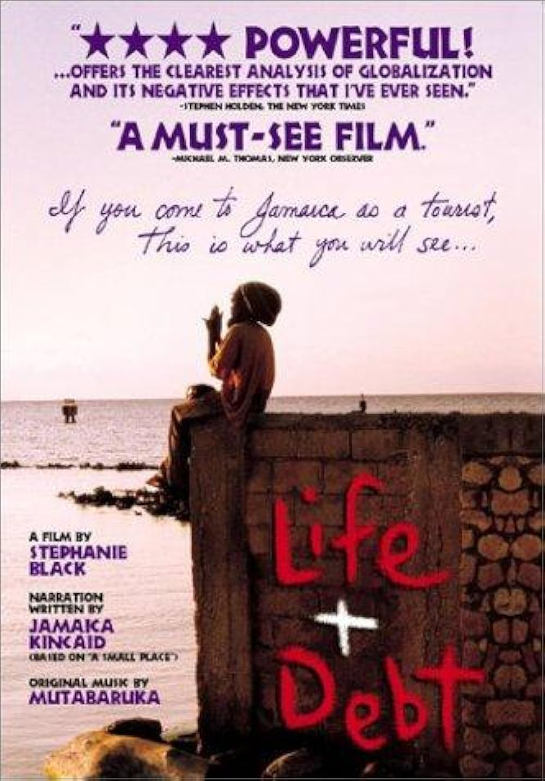

Slide 16


Slide 17
“The hotels are building along the coastlines. Slowly but surely they are coming, like a dark sea. Little Bay, which used to be two towns over from River Bank, was the first to go. Just five years ago the people of Little Bay left in droves, forced out of their homes and into the streets. [. . .] In the past, developers would wait for landslides and other natural disasters to do their dirty work. But when tourism became the bread and butter for the island’s economy, the developers and the government alike became ravenous, indifferent. In retaliation, people stole concrete blocks and cement and zinc from the new developments to rebuild homes in other places, but their pilfering brought soldiers with rifles and tear gas. The developers won the fight, and the people scattered like roaches. [. . .] It was as though their own land had turned on them—swallowed up their homes and livestock and produce and spat out the remains.” (120)

Slide 18
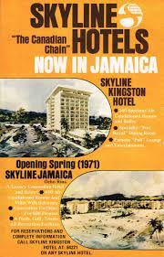
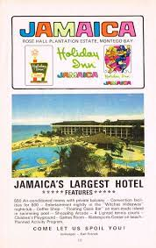
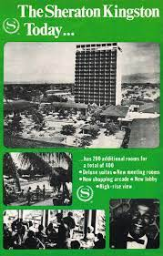

Slide 19
Ian Gregory Strachan in Paradise and Plantation
Like sugar, coffee, or banana production, tourism is an “export industry”, in as much as the Caribbean “product” is marketed and sold to consumers in the North Atlantic. (8)
In a number of crucial ways, tourism has grown out of and sustains the plantation economy. The plantations laid the economic, political, cultural and social groundwork that has enabled tourism to function so effectively in the Caribbean. As an institution of colonization, the plantation established a political and economic dependency on the metropolitan centres that tourism merely extends.

Slide 20
“While tourism sustains large proportions of the working sector of the Caribbean, economic benefit for working people is limited. Foreign and transnationally connected Caribbean business elites dominate the industry, and the majority of the large tourist resorts and facilities are owned and controlled by transnational corporations. The development of the all-inclusive tourist package in which flights, airport transfers, hotel accommodations, meals, drinks, entertainment, sports facilities, excursions, etc., are fully paid in advance, usually in the country of origin, means that few expenditures within such packages are made in the host country and a large proportion of the income generated from tourism remains outside the Caribbean. In addition, around 70 percent of foreign exchange that is eventually earned in the Caribbean from tourism by the state and local businesses pays for imported goods and services. In some countries this “leakage” can be as high as 90 percent.” (Kamala Kempadoo, Sexing the Caribbean, p. 116)

Slide 21


Slide 22
Tourism and Water:
Tourism places huge strains on water resources in the Caribbean (both in terms of usage and pollution)
“Hundreds of thousands of Caribbean nationals do not have piped water, but tourists expect unlimited supplies: with their post-beach showers and baths, they are estimated to use six times as much water as residents. Yet many parts of the Caribbean have water supply problems [. . .]” (Polly Pattullo, Last Resorts, 41).
“She decides to take a shower [. . .]. The water feels good in the heat. [. . .] Margot busies herself with lathering.
“Look like is you g’wan drain di entire island of di likkle wata we ’ave lef’!” (77)
“Also, can you please remind the guests not to leave towels that they only used once for laundry. Remind them that we’re in a drought and our goal is to conserve water” (155).

Slide 23
“Like the rest of this beautiful island, the bitter taste of slavery is in the earth itself, drawn up by the tress into their leaves, a rot in the seed of their fruit. A bile in people’s minds. Now tourism is the trade, the new crop. But it still brings people who have to be served…” Oonya Kempadoo, Tide Running, (107-108)
“But in our tourist brochures the Caribbean is a blue pool into which the republic dangles the extended foot of Florida as inflated rubber islands bob and drinks with umbrellas float towards her on a raft. This is how the islands from shame of necessity sell themselves; this is the seasonal erosion of their identity, that high-pitched repetition of the same images of service that cannot distinguish one island from the other, with a future of polluted marinas, land deals negotiated by ministers, and all of this conducted to the music of Happy Hour and the rictus of a smile.”
Derek Walcott, “The Antilles: Fragments of Epic Memory” in What the Twilight Says (Faber, 1998) p.81

Slide 24
She smiles at him—it’s a slow, easy smile; her first real one all day. Her job entails a conscious movement of the jaw, a curve of the mouth to reveal teeth, all teeth—a distraction from the eyes, which never hold the same enthusiasm, but are practiced all the same to maintain eye contact with guests. “It’s a wonderful day at Palm Star Resort, how may I help you?” “Good morning, sir.” “Yes, ma’am, let me get that for you.” “No, sir, we don’t offer a direct shuttle to Kingston, but there’s one to Ocho Rios.” “May I help you with anything else, ma’am?” “Your shuttle is outside waiting on you, sir.” “You have a good day, now. I’m here if you need anything. No problem.” (12)

Slide 25
Kempadoo:
“Territories that once served as sex havens for the colonial elite are today frequented by sex tourists, and several of the island economies now depend upon the region’s racialized [and] sexualized image” (1)
“Sexual services in the tourism industry are today a part of a range of informal services that are solidly integrated in the tourism industry. Sex tourism is thus a part of the informal package that is indirectly offered to the visitor, and sustains not only many women’s households and lifestyles, but also those of men. Predominantly young women either explicitly or implicitly solicit men’s attention at hotel bars, nightclubs attached to resorts, or on the beach.” (Sexing the Caribbean, 118)

Slide 26
Mimi Sheller: The “production of indebtedness also leads directly to the unequal sexual economies that it turns out are common [. . .] in tourism zones [. . .]. The more general offshoring of sex tourism to island locations and the sexual exploitation of poverty [. . .] is another manifestation of debt, twisted into purchase of bodies.”
("Caribbean futures in the offshore Anthropocene: Debt, disaster, and duration." Environment and Planning D: Society and Space 36.6 (2018): 971-986).

Slide 27
One day a tall, dark-haired man walked into Delores’s stall. He was wearing sunglasses, like most tourists. He had a presence about him, an air Delores associated with important people—white people. [. . .] The man pulled out a wad of cash and began to count it in front of Delores. Delores watched him count six hundred-dollar bills. She had never seen so much money in her life. The crispness of the bills and the scent of newness, which Delores thought was what wealth must smell like—the possibility of moving her family out of River Bank, affording her daughter’s school fee, books, and uniforms, buying a telephone and a landline for her to call people whenever she liked instead of waiting to use the neighbour’s phone—all these possibilities were too much to swallow all at once. “Sah—but she—she’s only fourteen.” “I’m staying right down there.” He gestured to the large cruise ship, which was in plain sight. “I’ll have her back before dinner.” (201-202)

Slide 28
Édouard Glissant: “Our landscape is its own monument: its meaning can only be traced on the underside. It is all history.” (Caribbean Discourse, p. 11)
“The bulldozers appear overnight. they stand in place like resting mammoths, their blades like curved tusks. It’s as though they landed from the sky or were washed ashore. One by one they begin to knock down trees in the cove and along the river. They also take a chunk of the hill, cutting down the trees that cradle the limestone, which they chip away. Their big engines grind two-thousand-year-old tree trunks—trees the ancestors once hid behind, crouching in search of freedom.” (289)

Slide 29
“Where Benjamin observed that "not even the past will be safe" from the conquerors, we may now add that the future is not safe either, and that it is compared to that leveling of the land speculators and builder-investors, whose bulldozers destroy all the site-specific properties of a terrain in order to clear it and make it fungible for any kind of future investment, so that one can build on it whatever the market demands. This is the future prepared by the elimination of historicity, its neutralization by way of progress and technological evolution: it is the future of globalization, in which nothing remains in its particularity, and everything is now fair game for profits and the introduction of the wage-labor system.” (Jameson, Archaeologies of the Future, p. 228)

Slide 30
Lucí Cavallero and Verónica Gago, A Feminist Reading of Debt:
“Financial terror, then, is a structure of obedience that operates over the day-to-day and time to come and forces us to take on the costs of structural adjustment in an individual and private way. But additionally it normalizes the fact that our lives are only sustainable through debt, in a type of financialization of daily life” (14)
Debt, like the wage, is “a mechanism for the extraction of life time and labour time” (18)
However, whereas “the wage functions by exploiting labour that has already taken place,” debt “exploits a time to come” (18)
Debt as a “machine of capture” that lays claim to future labour (and life) time (18).

Slide 31
“Now that she’s inside, outside seems like a foreign country. There’s no concept of time and place. The date—though currently June 1, 1994—is still August 7, 1988, according to the water-stained calendar hanging on a wall. Inside this house, Hurricane Gilbert has not yet come and devastated the island, flooding out some residents of River Bank. Inside this house, Edward Seaga is still Prime Minister of Jamaica, a yellowing picture of him pasted next to the calendar. Inside this house, a fisherman name Asafa still brings home lobster for his family.” (225)

Slide 32
Audre Lorde, “Uses of the Erotic”:
“There are many kinds of power, used and unused, acknowledged or otherwise. The erotic is a resource within each of us that lies in a deeply female and spiritual plane, firmly rooted in the power of our unexpressed or unrecognized feeling. In order to perpetuate itself, every oppression must corrupt or distort those various sources of power within the culture of the oppressed that can provide energy for change.”
“The principal horror of any system which deﬁnes the good in terms of proﬁt rather than in terms of human need, or which deﬁnes human need to the exclusion of the psychic and emotional components of that need – the principal horror of such a system, is that it robs our work of its erotic value, its erotic power and life appeal.”

Slide 33
Janelle Rodriques:
“Margot’s choice of financial gain (by means of sexual exploitation) over spiritual fulfilment stifles the erotic in the name of the pornographic and thus stunts her selfhood. This stunted selfhood, in turn, allegorizes the deleterious effects—on what could be a Caribbean personal and social selfhood—of not only industrial tourism but also nationalized adherence to restrictive norms for women’s behaviour—interrelated processes of oppression that are brought to bear on Margot’s queer, impoverished, marginalized person.”
"Women Loving Women in the Erotic-Pornographic Binary: Sex and Intimacy via Audre Lorde in Nicole Dennis-Benn's Here Comes the Sun." Journal of West Indian Literature 29.2 (2021): 62.

Slide 34
Rodriques: “Here Comes the Sun dramatizes and laments the frustration of erotic potential in the face of the totalizing machine of the post-/colonial, neoliberal tourism economy. It portrays the tragic impossibility of two women living and experiencing love in a colonized space and place—not least in colonized bodies. Margot and Verdene’s efforts to love each other are interrupted by and subjugated to a masculinist imperialism that demands that they value their exploitation by men—and their money—over their relationships with each other, and that they value themselves by their potential as sexualized objects rather than as erotic beings. Tragedy is perhaps a fitting ending for [this] novel” (71).

